Slide 1
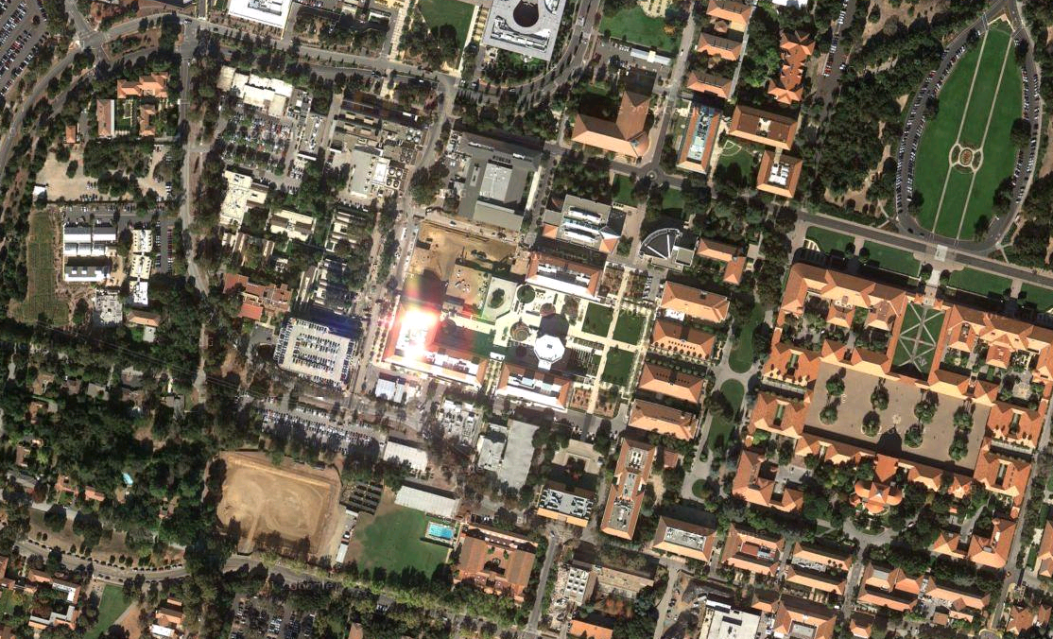
Parking
Cypress North
P&A 1st floor
P&A Basement
Parking
PS 2

Slide 2
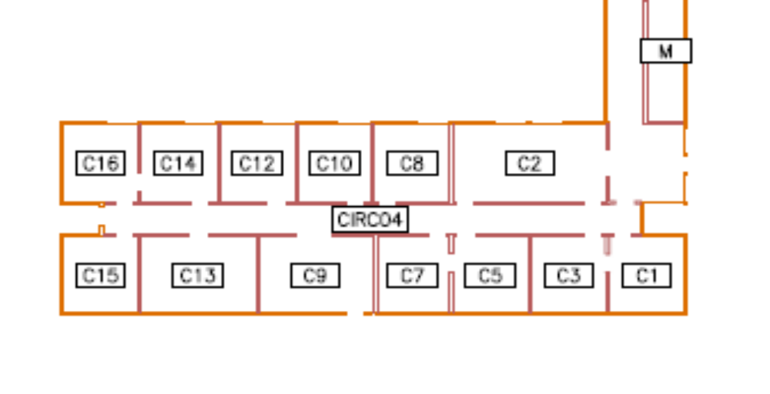

11 offices
1 conf room
1 Library, 1 entry/common area
11’9”
11’7”
11’2”
11’?”
CN conf room
12’4”
11’9”
Visiting
Scholars
Wei Liu &
Sasha K.
Yang
Liu
Haruko
Makitani
Junwei
Zhao
Ruizhu
Chen
23’?”
11’9”
11’9”
11’7”
11’6”
11’?”
11’?”
11’?”
11’?”
CNmid
Printer
Etc.
visitor
12’6”
Small Conf/
library
Todd
Hoeksema
Visiting
Scholar
Gang Li
Xudong
Sun
Monica
Bobra
Leif S. &
Rock Bush
Visiting
Scholar
Rui Wang
Feb 2017-
Cypress North - annotations added.

Slide 3
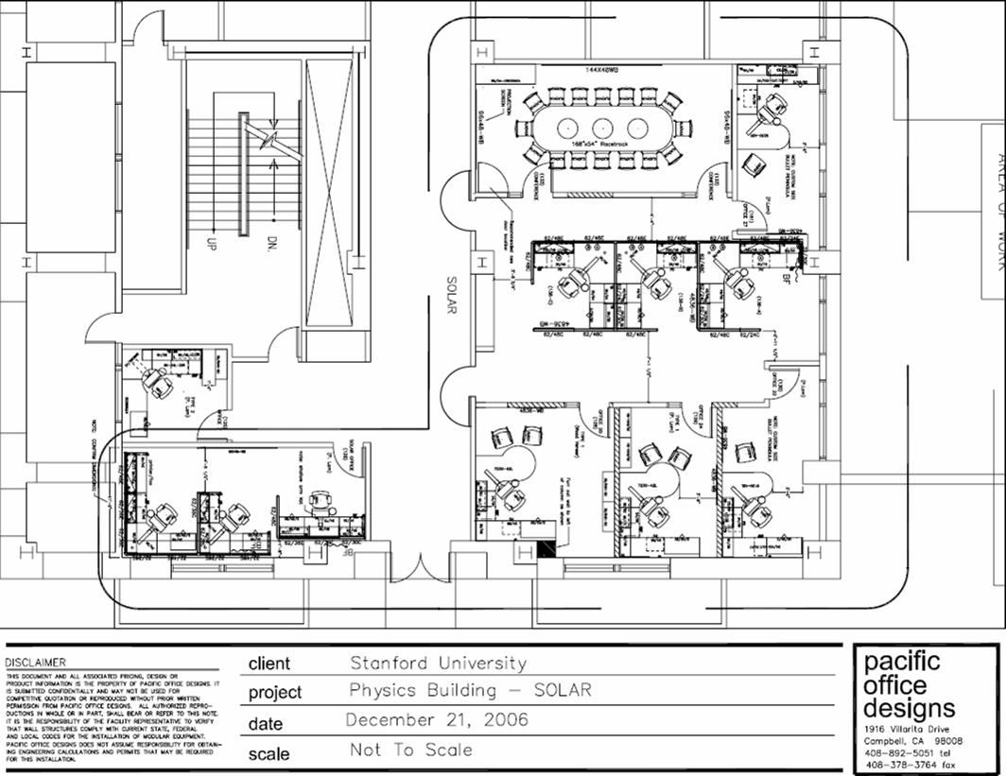
Physics & Astrophysics, HEPL/KIPAC
9’8” X
6’7”
Conf & visitors
Keh-Cheng
Chu
8’0” X
12’10”
A6-1
A6-2
PAconf
Aimee
Norton
7’6”
X17’0”
PA133
9 offices with
1 across hall and
2 in cubicles
1 conf & visitor room
PA132
PA134
Tim
Larson
7’9”
X12’0”
PAc1, PAc2
Charles
Baldner
Art
Amezcua
PA131a,b
Hao
Thai
PA125
PA129
Alipa
PA127
PA128
6’11” X
11’5”
PA130
PA126
9’2” X
14’8”
13’10”
X13’8”
8’10”
X14’8”
10’8” X 23’7”
Phil
Scherrer
Jeneen
Sommers
Rick
Bogart

Slide 4
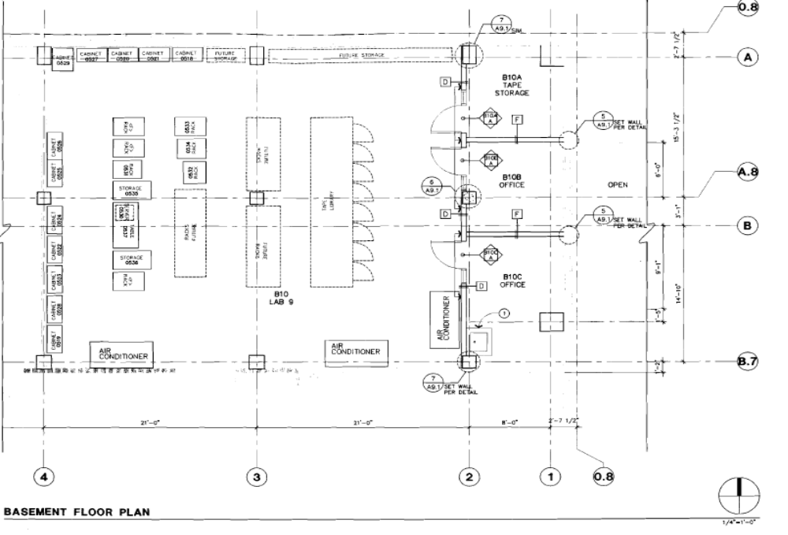
Solar Computer Room, Phys & Astro basement B10

