Slide 1
Detection of Dynamo Waves inside the Sun
Alexander Kosovichev (New Jersey Institute of Technology)
Valery Pipin (Institute for Solar-Terrestrial Physics)
Contact: alexander.g.kosovichev@njit.edu, phone: 408-239-7984
Project materials: http://sun.stanford.edu/~sasha/AAS2019

Slide 2
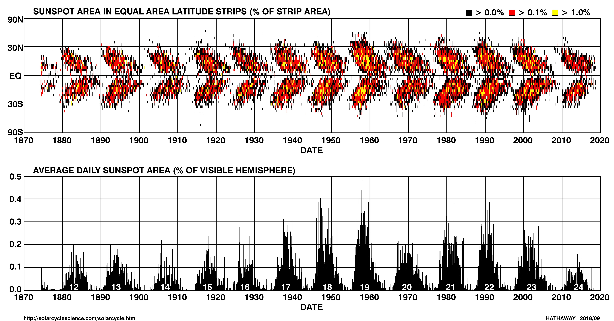
Sunspot cycles
The 11-year sunspot cycles form the ‘butterfly’ diagram: at the beginning of each cycle sunspots emerge at mid latitudes, and then the sunspot formation zone migrates towards the equator.
In 1955, Eugene Parker postulated that the butterfly diagram is caused by dynamo waves. Dynamo is a process of magnetic field generation inside the Sun. Magnetic field is generated in the deep interior and transported to the surface in the form of dynamo waves. Our results provide first observational evidence of such waves.

Slide 3
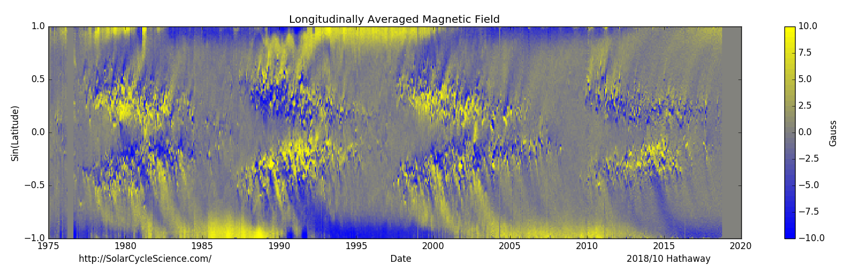
Solar magnetic cycles
Our analysis explains why, and provides a new way to predict solar cycles.
Previously, it was found that the strength of polar magnetic field measured at a solar minimum predicts the next solar maximum.
Cycle 23
Cycle 24

Slide 4
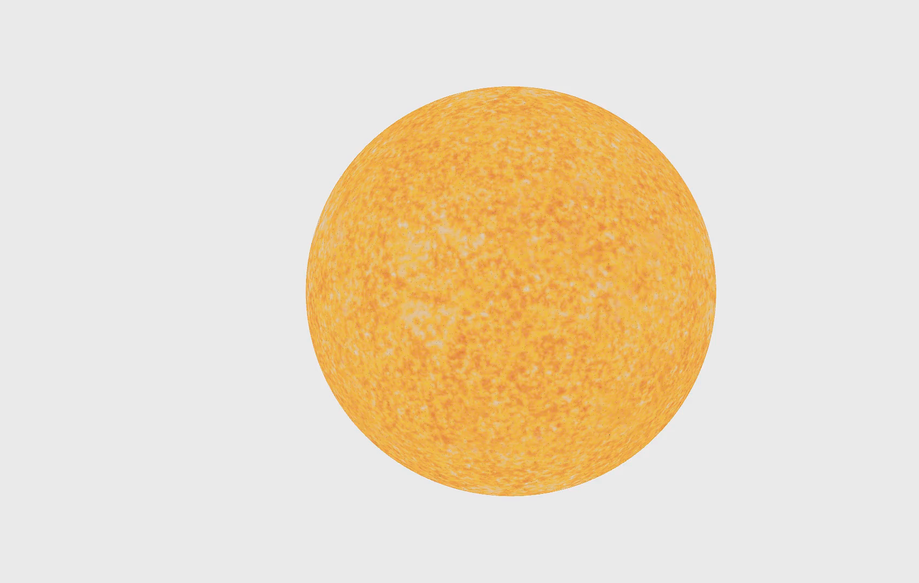
OUR results
By tracking migration of subsurface stream jets (called “torsional oscillations”) in the solar interior we reveal patterns of dynamo waves that control the sunspot cycles.
The helioseismology analysis of the Sun’s torsional oscillations for 22 years allowed us to pin down the location where the solar cycles originate: at the bottom of the solar convection zone, 120,000 miles below the surface, and about 60 degrees latitude.
Measurements of zonal acceleration.

Slide 5
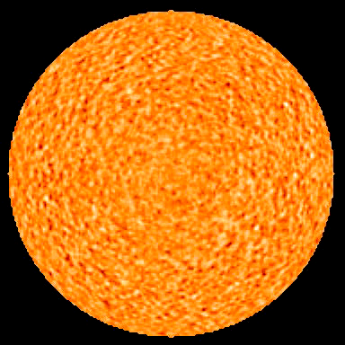
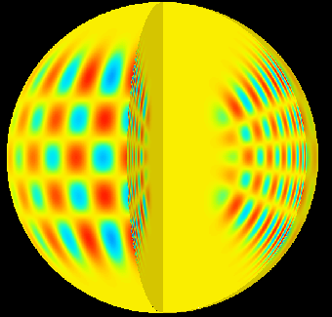
Studying the Interior of the Sun with Sound Waves
By measuring resonant frequencies of the Sun we infer the interior structures and flows.
Solar oscillations observed by SoHO
Resonant mode of solar oscillations

Slide 6
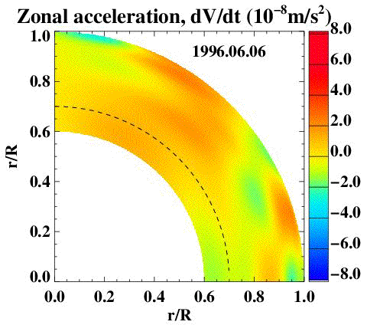
Patterns of Dynamo waves
Measurements of the zonal acceleration revealed zones of deceleration of torsional oscillations, caused by internal magnetic fields (blue regions in the movie).
The flow deceleration originates at the base of the solar convection zone, 120,000 miles beneath the solar surface, at about 60 degrees latitude.
This is the primary seat of the solar dynamo.

Slide 7
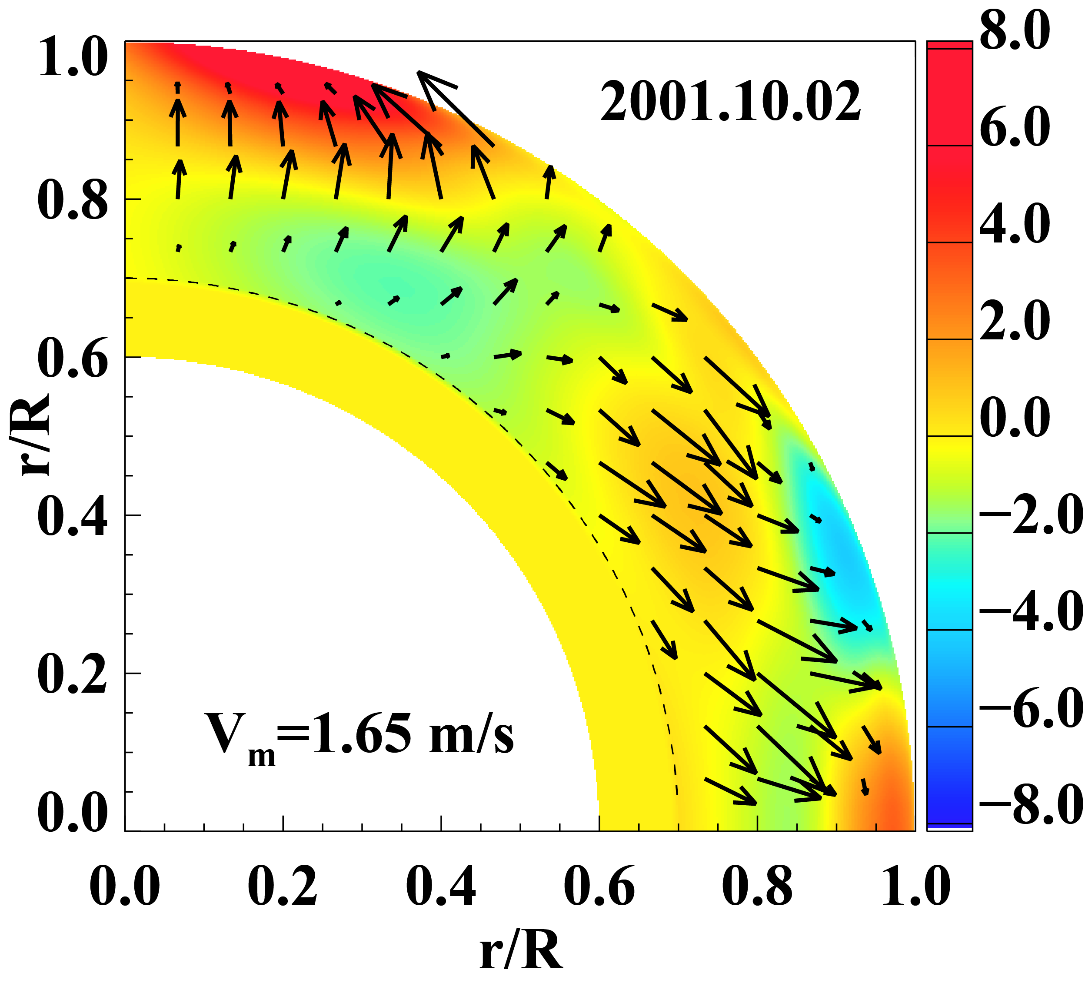
Migration of dynamo waves
The dynamo waves originate at the base of the convection zone (in the “solar tachocline”) and migrate towards the poles and the equator with a speed of 2-4 miles per hour.
The waves reach quickly, in 1-2 years, the polar regions, but it takes them about 10 years to get to the surface at low latitudes and form sunspots. This explains why the polar magnetic field predicts the next sunspot maximum.
Start of Cycle 24 in the interior
Cycle 23 at the surface

Slide 8
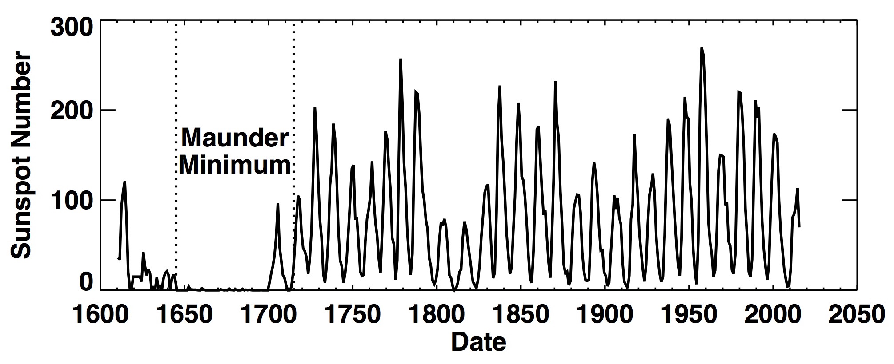
Sunspot cycles
The number of sunspots changes with 11-year period.
What process inside the Sun controls the strength of the cycles?
How can we predict future sunspot maxima?
Dalton
Minimum
Modern
Minimum?

Slide 9
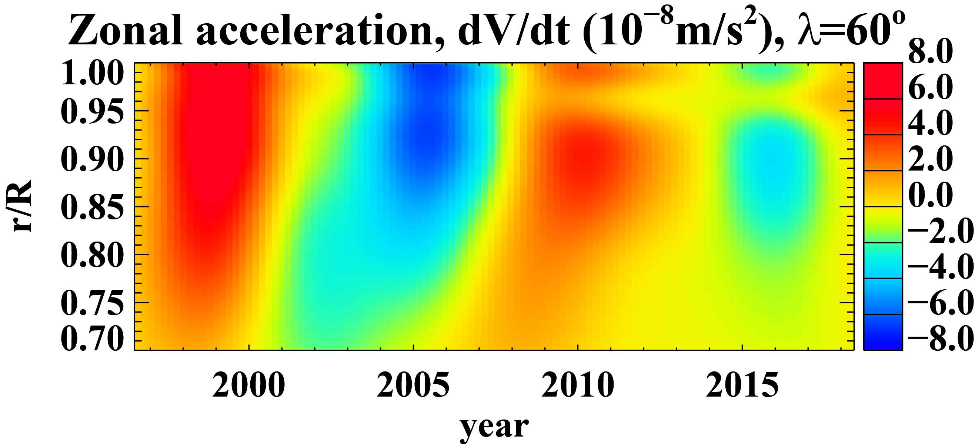
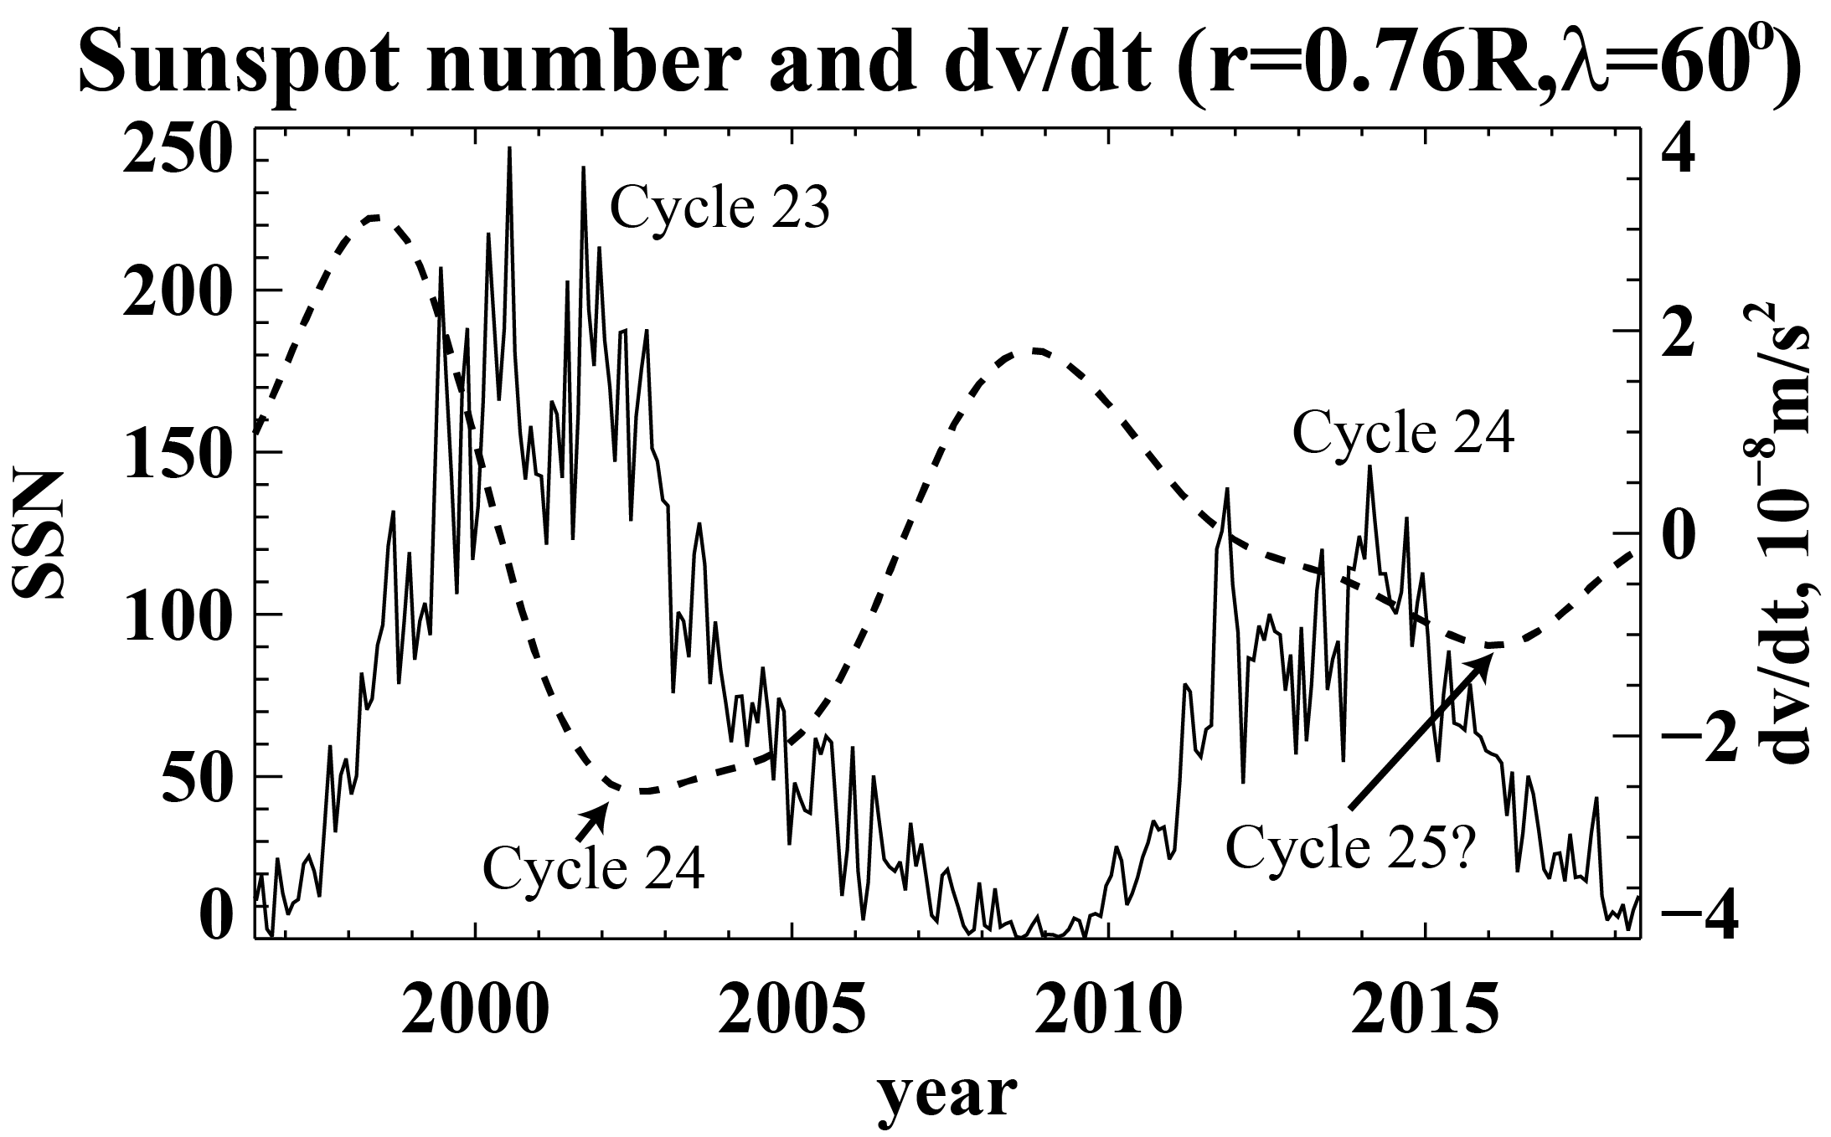
next solar cycle
In the solar interior we already see the signal associated with the next sunspot cycle (Cycle 25).
It appears that it will be even weaker than the current cycle, indicating on continuing long-term decrease of solar activity.
Cycle 24
Cycle 25
Publication: Dynamo Wave Patterns Inside the Sun Revealed by Torsional Oscillations
Authors: Alexander G. Kosovichev, Valery V. Pipin, Astrophys. J. Letters, v.871, L20, 2019

Slide 10

Thank you! to our sponsor

Slide 11
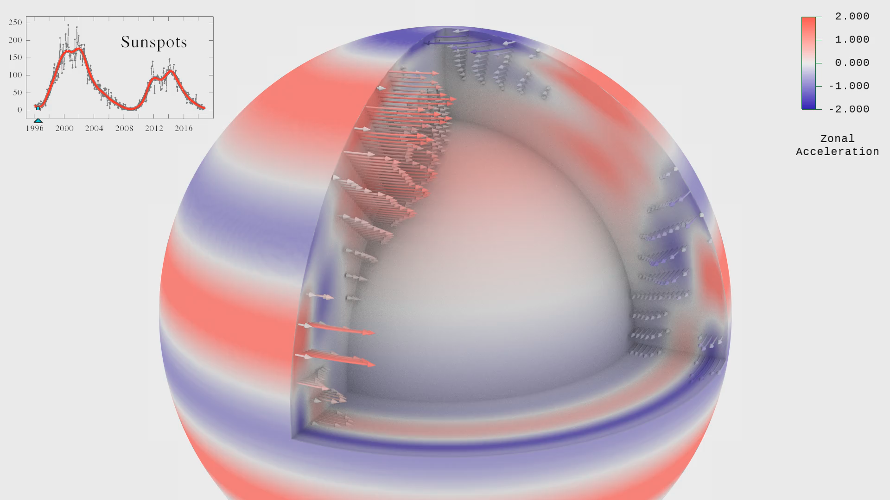
Helioseismic measurements
The helioseismic measurement are performed using data from two NASA space missions: Solar and Heliospheric Observatory (1996-2010) and Solar Dynamics Observatory (2010-current).
It will be important to continue monitoring of the evolution of subsurface flows on the Sun.
Visualization by Tim Sandstrom
(NASA Ames Research Center)

Slide 12
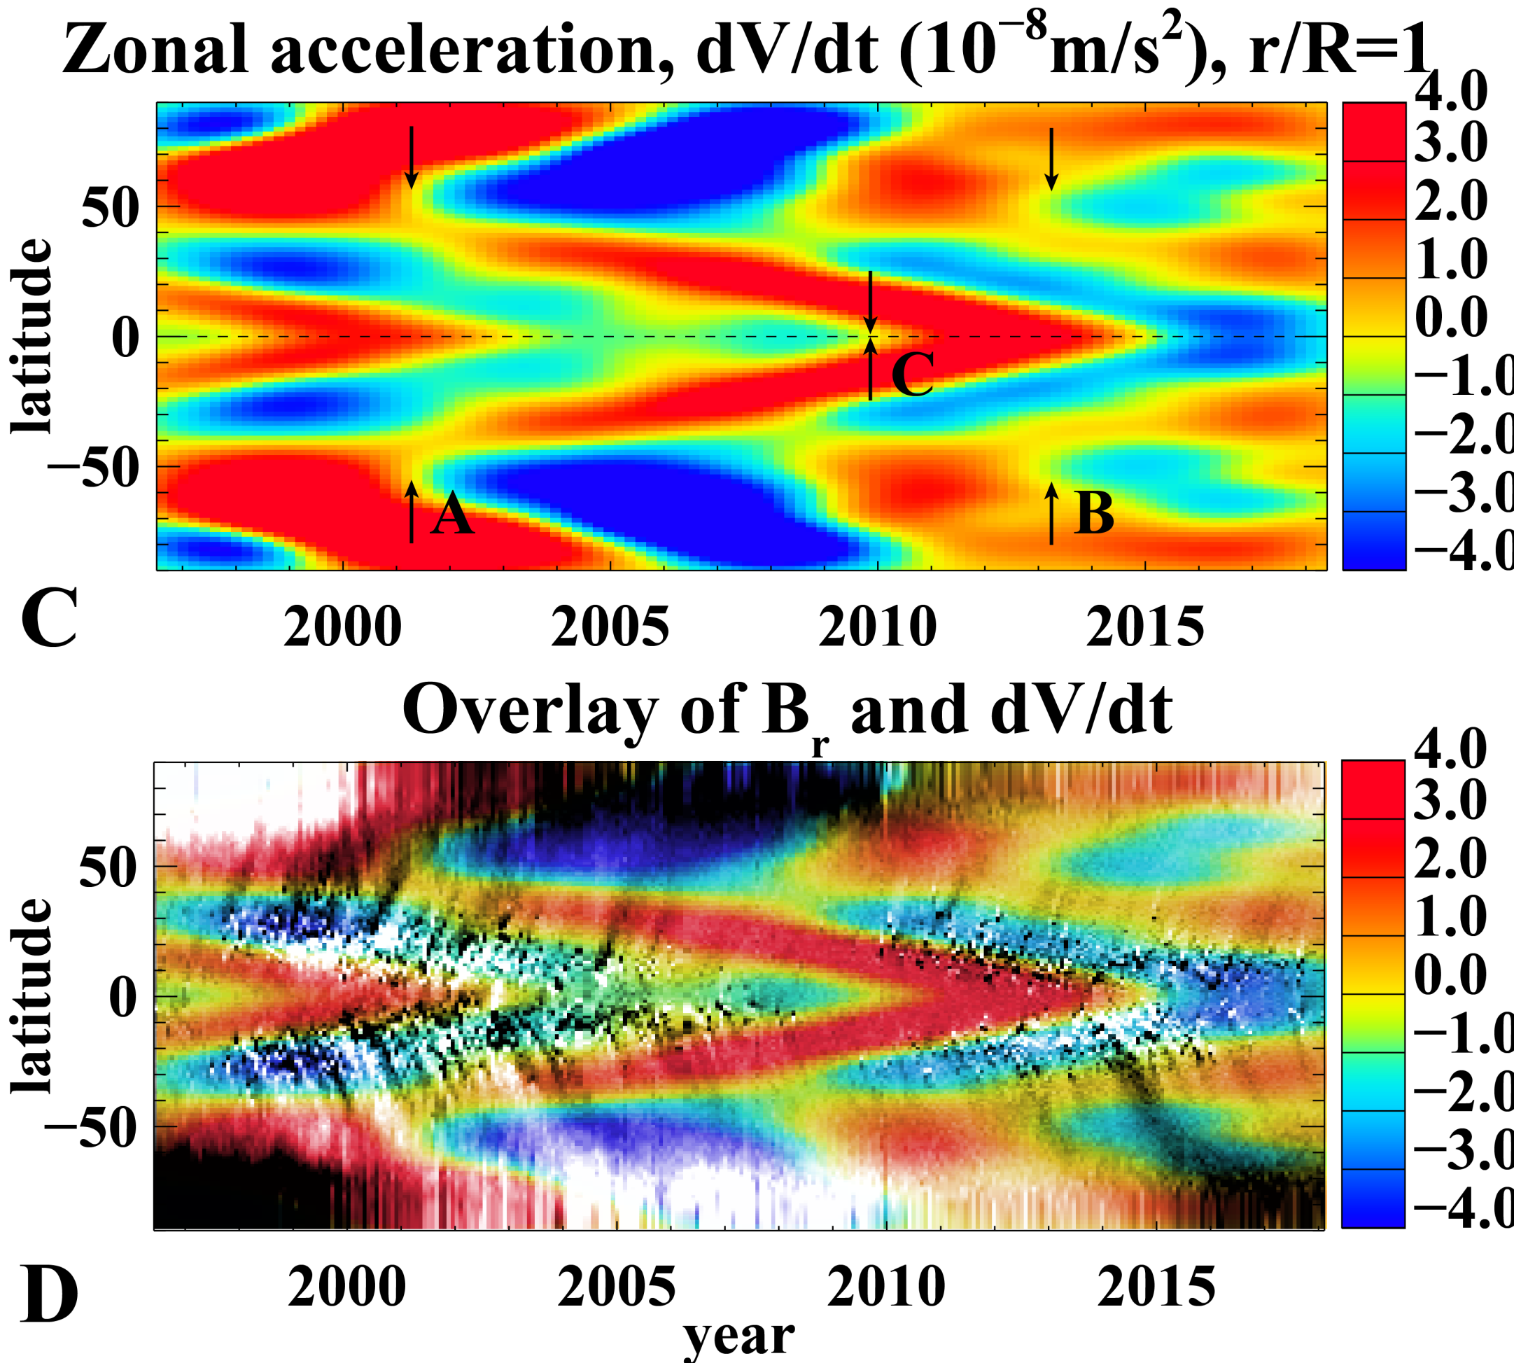
New approach: zonal acceleration
The zonal flow acceleration calculated after applying Gaussian spatial and temporal filters to smooth noise and small-scale variations and reveal large-scale patterns
Overlay of the zonal acceleration (color image) and the radial magnetic field (gray-scale) reveals that the regions of magnetic field emergence at mid and low latitudes coincide with the zones of flow deceleration.

