Slide 1
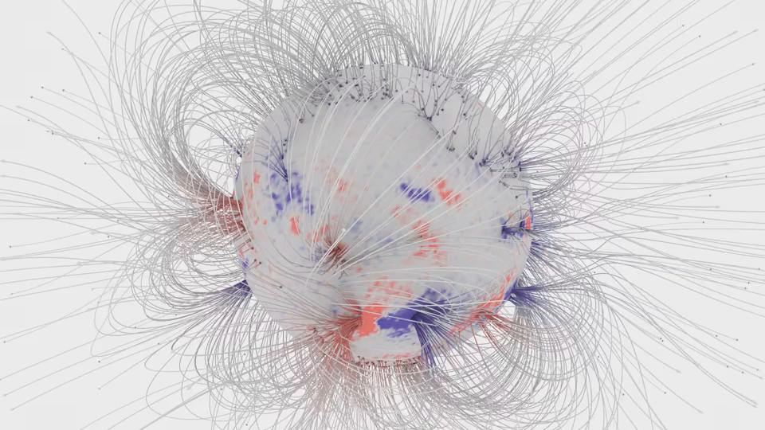
SH14B-01: Helioseismic Evidence for Dynamo Waves Inside the Sun
Alexander Kosovichev (New Jersey Institute of Technology)

Slide 2
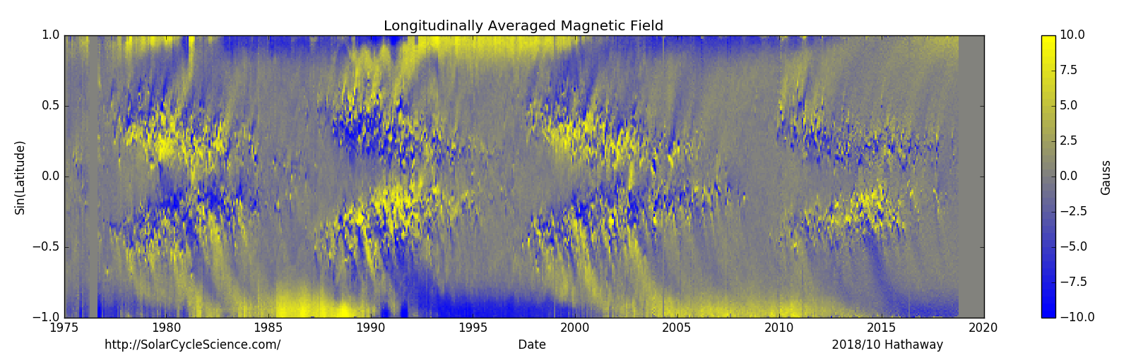
Solar magnetic cycles
Previously, it was found that the strength of polar magnetic field
measured at a solar minimum predicts the next solar maximum.
Our analysis explains why.
Cycle 23
Cycle 24

Slide 3
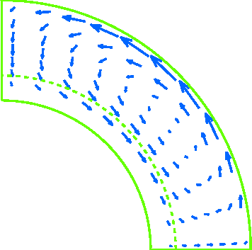
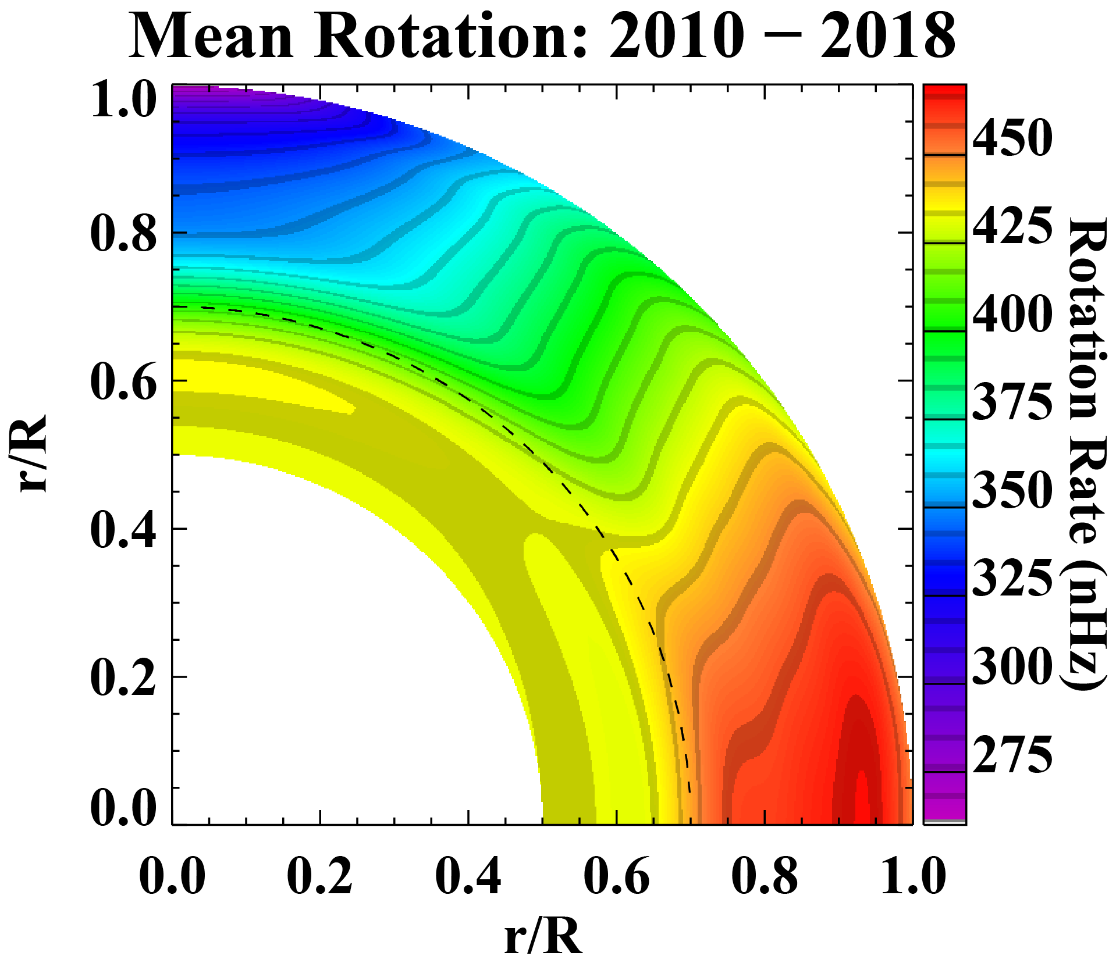
Two paradigms in solar dynamo
Flux-transport theory
Dynamo-wave theory
The dynamo process is controlled by meridional circulation.
Toroidal magnetic field is generated and stored in the tachocline region. Meridional flow in the tachocline produces the butterfly diagram.
The butterfly diagram is produced by dynamo waves.
Theoretical argument: “Dynamo waves propagate along isorotation surfaces” (Parker, 1955; Yoshimura, 1975).
Tachocline
Because of the subsurface shear layer the dynamo wave can propagate towards the equator
(Brandenburg 2005; Pipin & Kosovichev, 2011).
Meridional
circulation
0.6R
0.7R

Slide 4
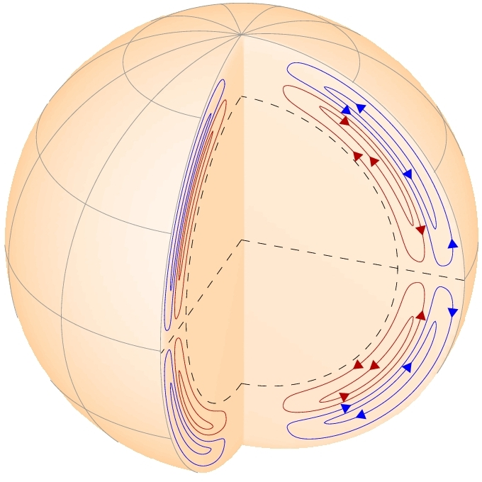
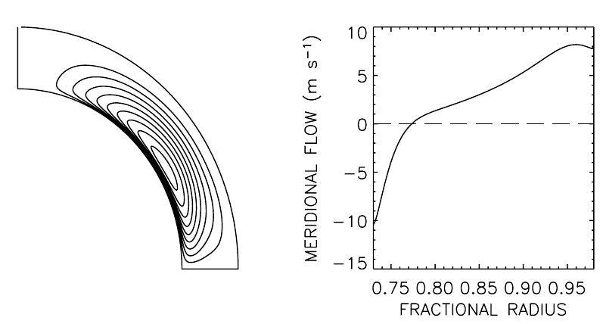
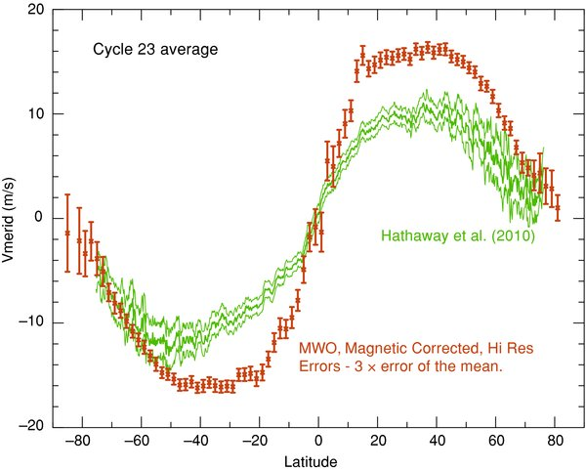
Helioseismology measurements of large-scale flows in the solar interior
Meridional Circulation
old beliefs: return flow is at the bottom of the convection zone
New findings: return flow is shallow
Mitra-Kraev & Thompson (2007)
Zhao et al. (2013)
Schad et al.(2013)
Kholikov et al (2014)
Rajaguru & Antia (2015)
Boning et al (2017)
Helioseismology measurements reveal a multi-cell structure of the meridional circulation, and rule out the flux-transport theory.

Slide 5
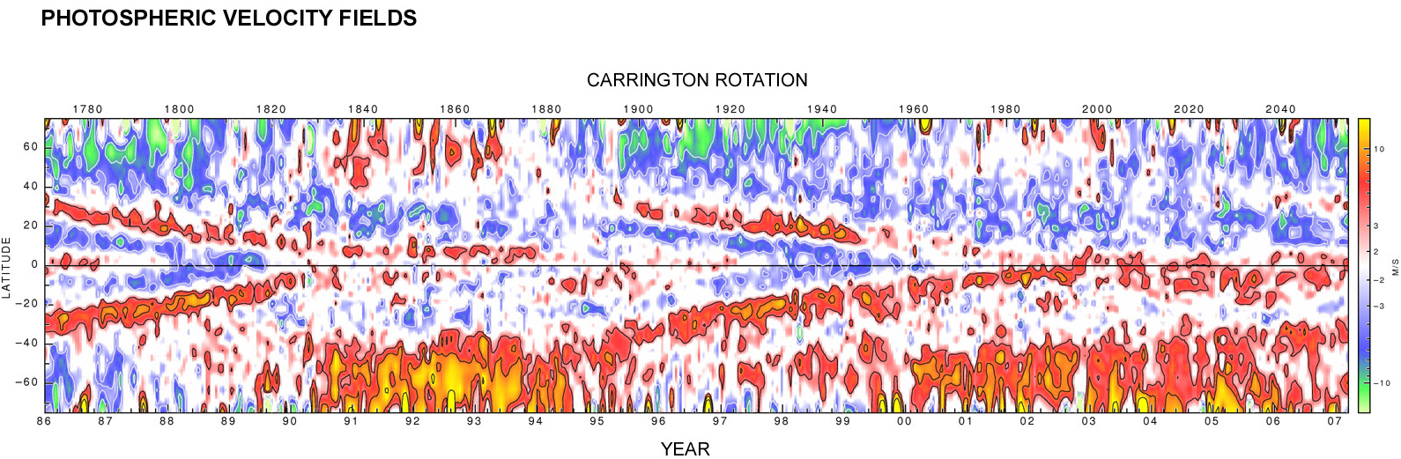
Variations of the differential rotation (“torsional oscillations”) provide insight in the dynamo mechanism
Extended solar cycle 23
1989
2008
Courtesy of Roger Ulrich (http://obs.astro.ucla.edu/torsional.html)
Torsional Oscillations were discovered by Carnegie astronomers Robert Howard and Barry LaBonte using 150-Foot solar telescope data in 1980.

Slide 6
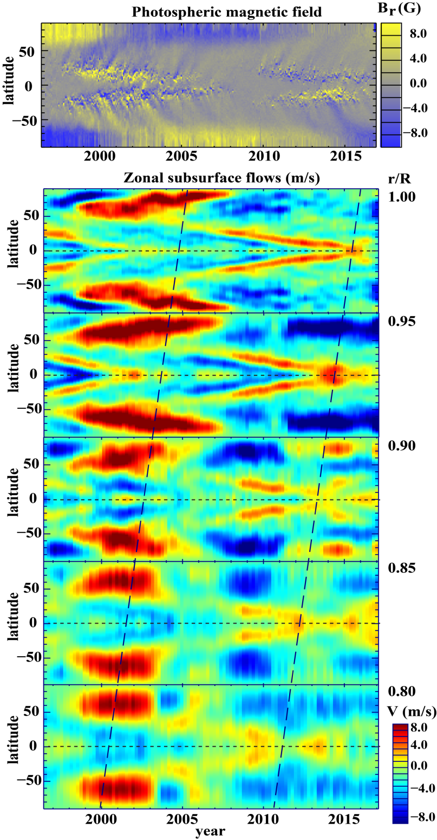
Torsional oscillations at different depth are measured by helioseismology
Comparison of the magnetic butterfly diagram with the corresponding maps of the zonal flows (torsional oscillations) at five different depth in the convection zone during Cycles 23 and 24.
Inclined dashed lines illustrate an apparent migration of the flow pattern with radius. They are drawn through the points where the accelerated equatorial branch crosses the equator (around the solar maxima).
The polar branch (red structure at high latitudes) that was very prominent at the surface in Cycle 23 is missing in Cycle 24. However, it is detected beneath the surface at 0.9R (Howe et al, 2018).

Slide 7
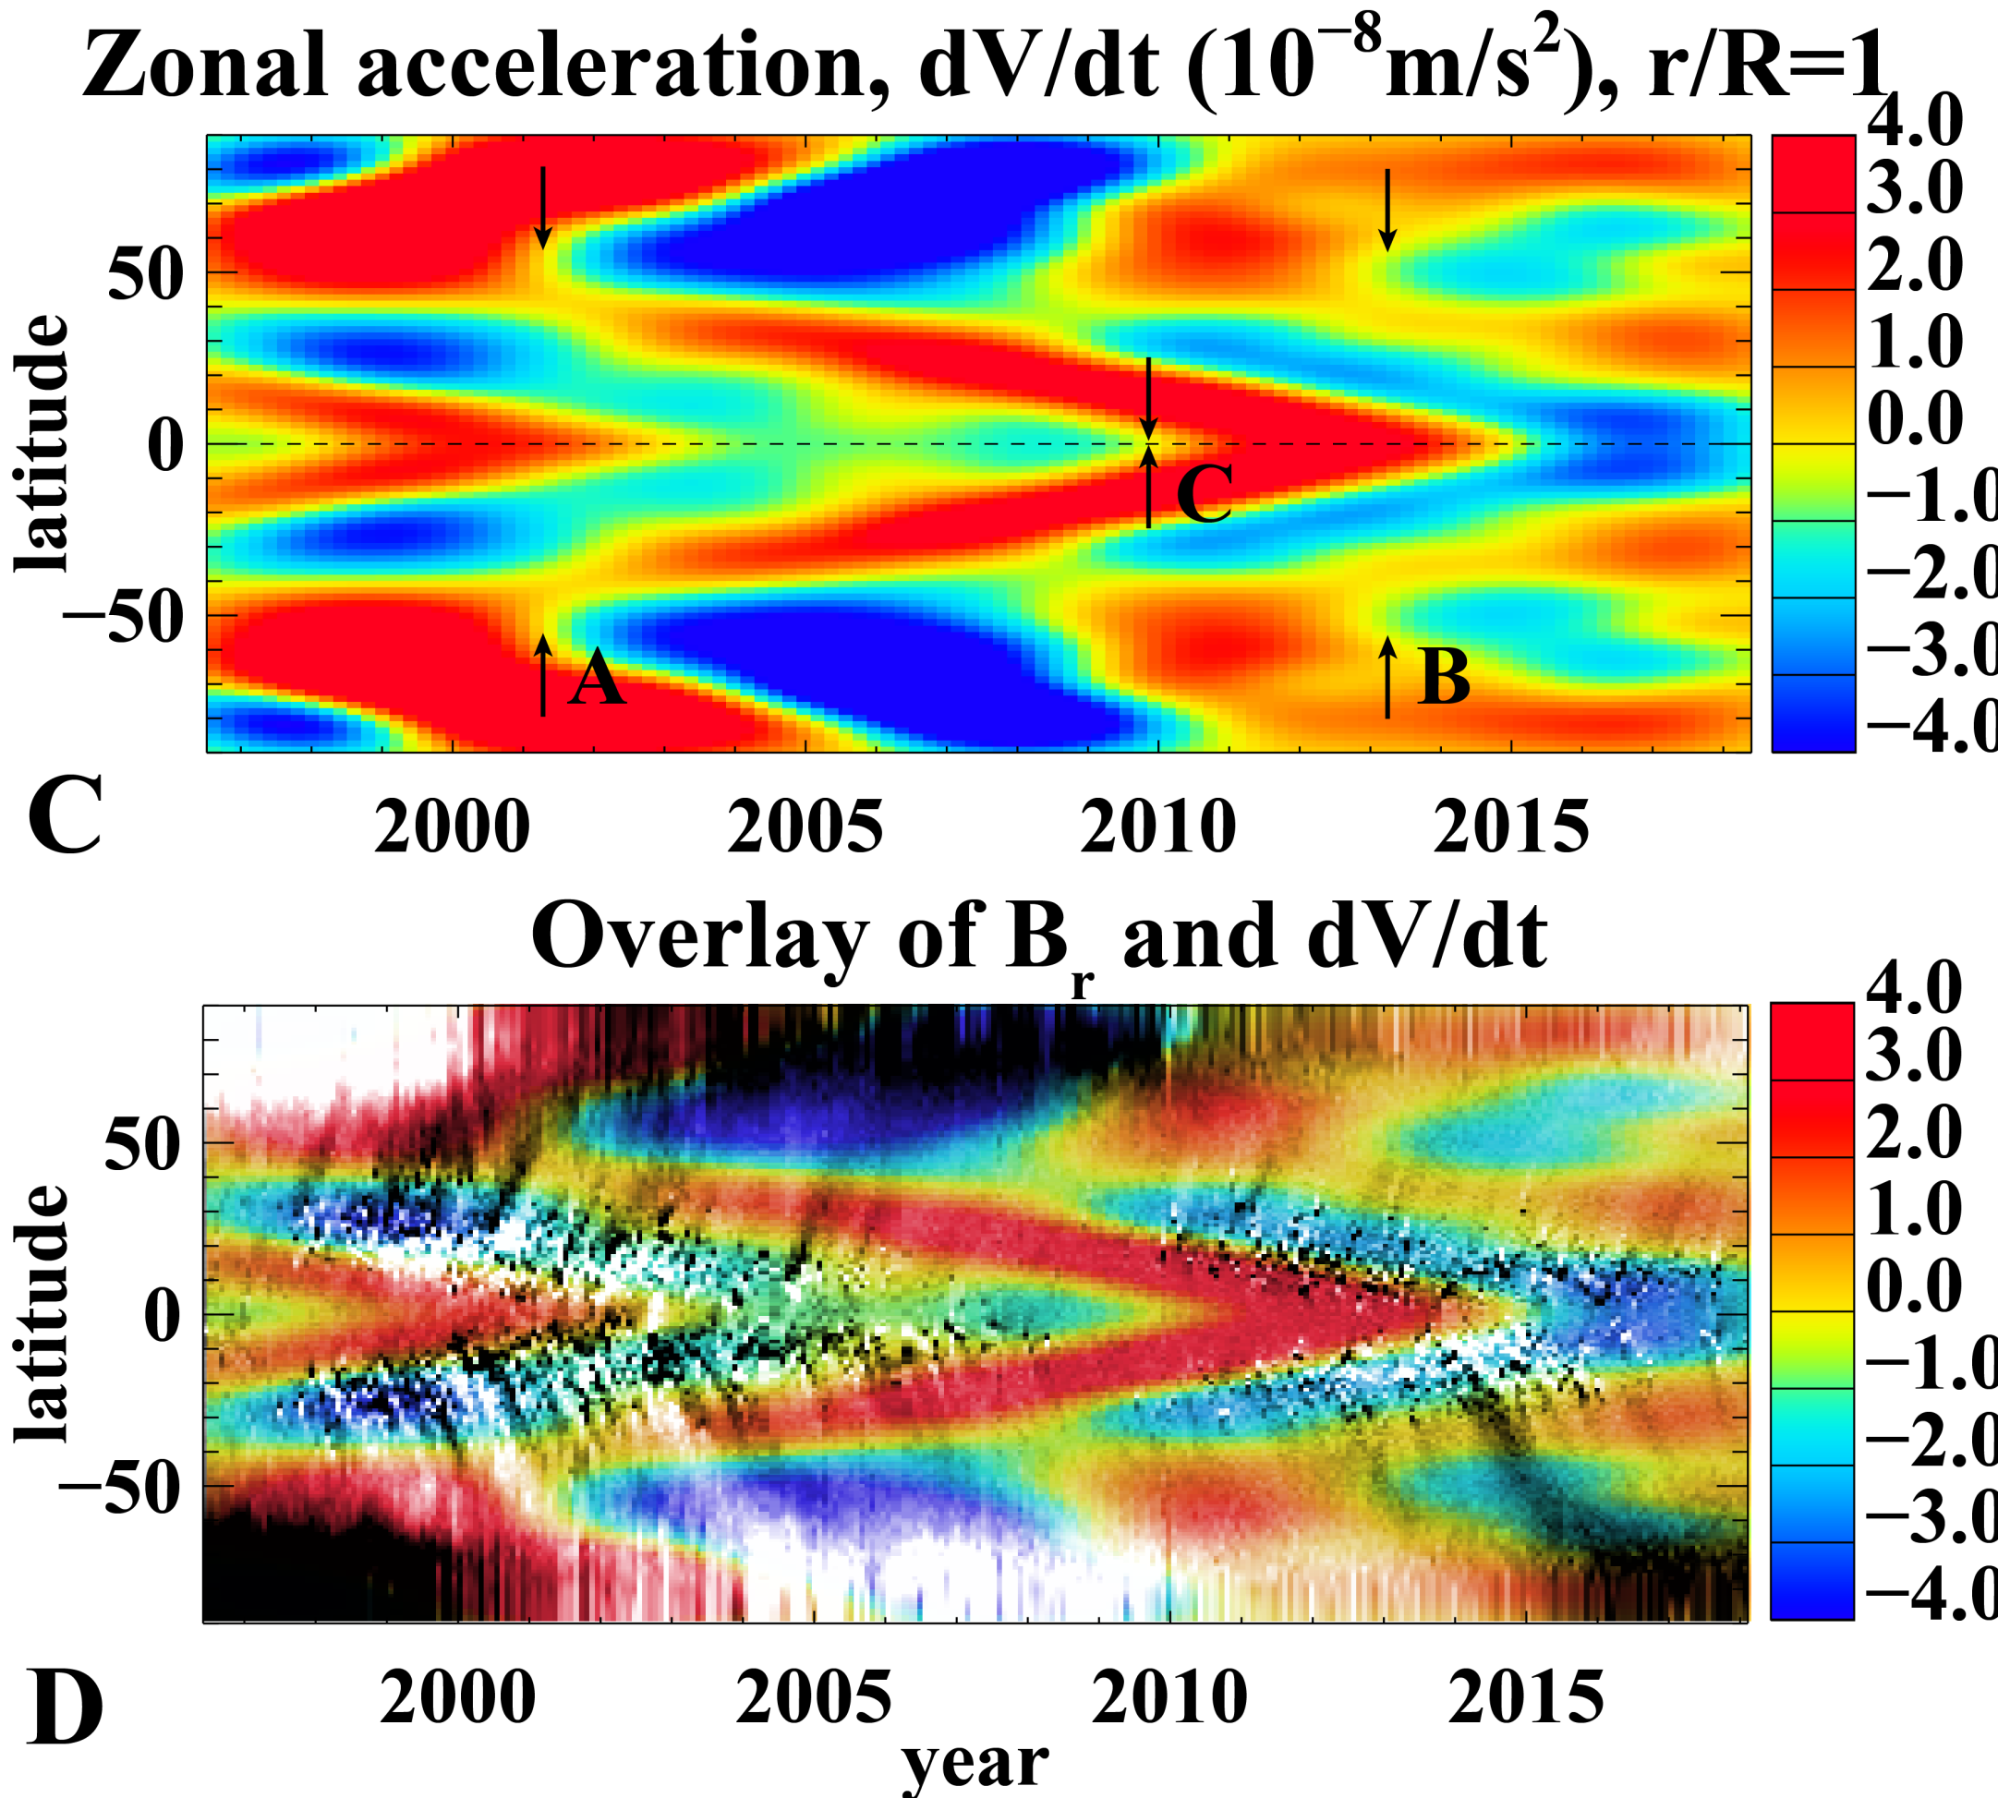
New approach: zonal acceleration
The zonal flow acceleration calculated after applying Gaussian spatial and temporal filters to smooth noise and small-scale variations and reveal large-scale patterns
Overlay of the zonal acceleration (color image) and the radial magnetic field (gray-scale) reveals that the regions of magnetic field emergence at mid and low latitudes coincide with the zones of flow deceleration.

Slide 8
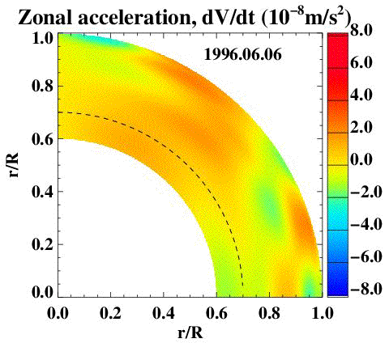
Patterns of Dynamo waves
Measurements of the zonal acceleration revealed zones of deceleration, caused by internal magnetic fields (blue areas in the movie).
The flow deceleration originates at the base of the solar convection zone,
200 Mm beneath the solar surface, at about 60 degrees latitude.
This is the primary seat of the solar dynamo.

Slide 9
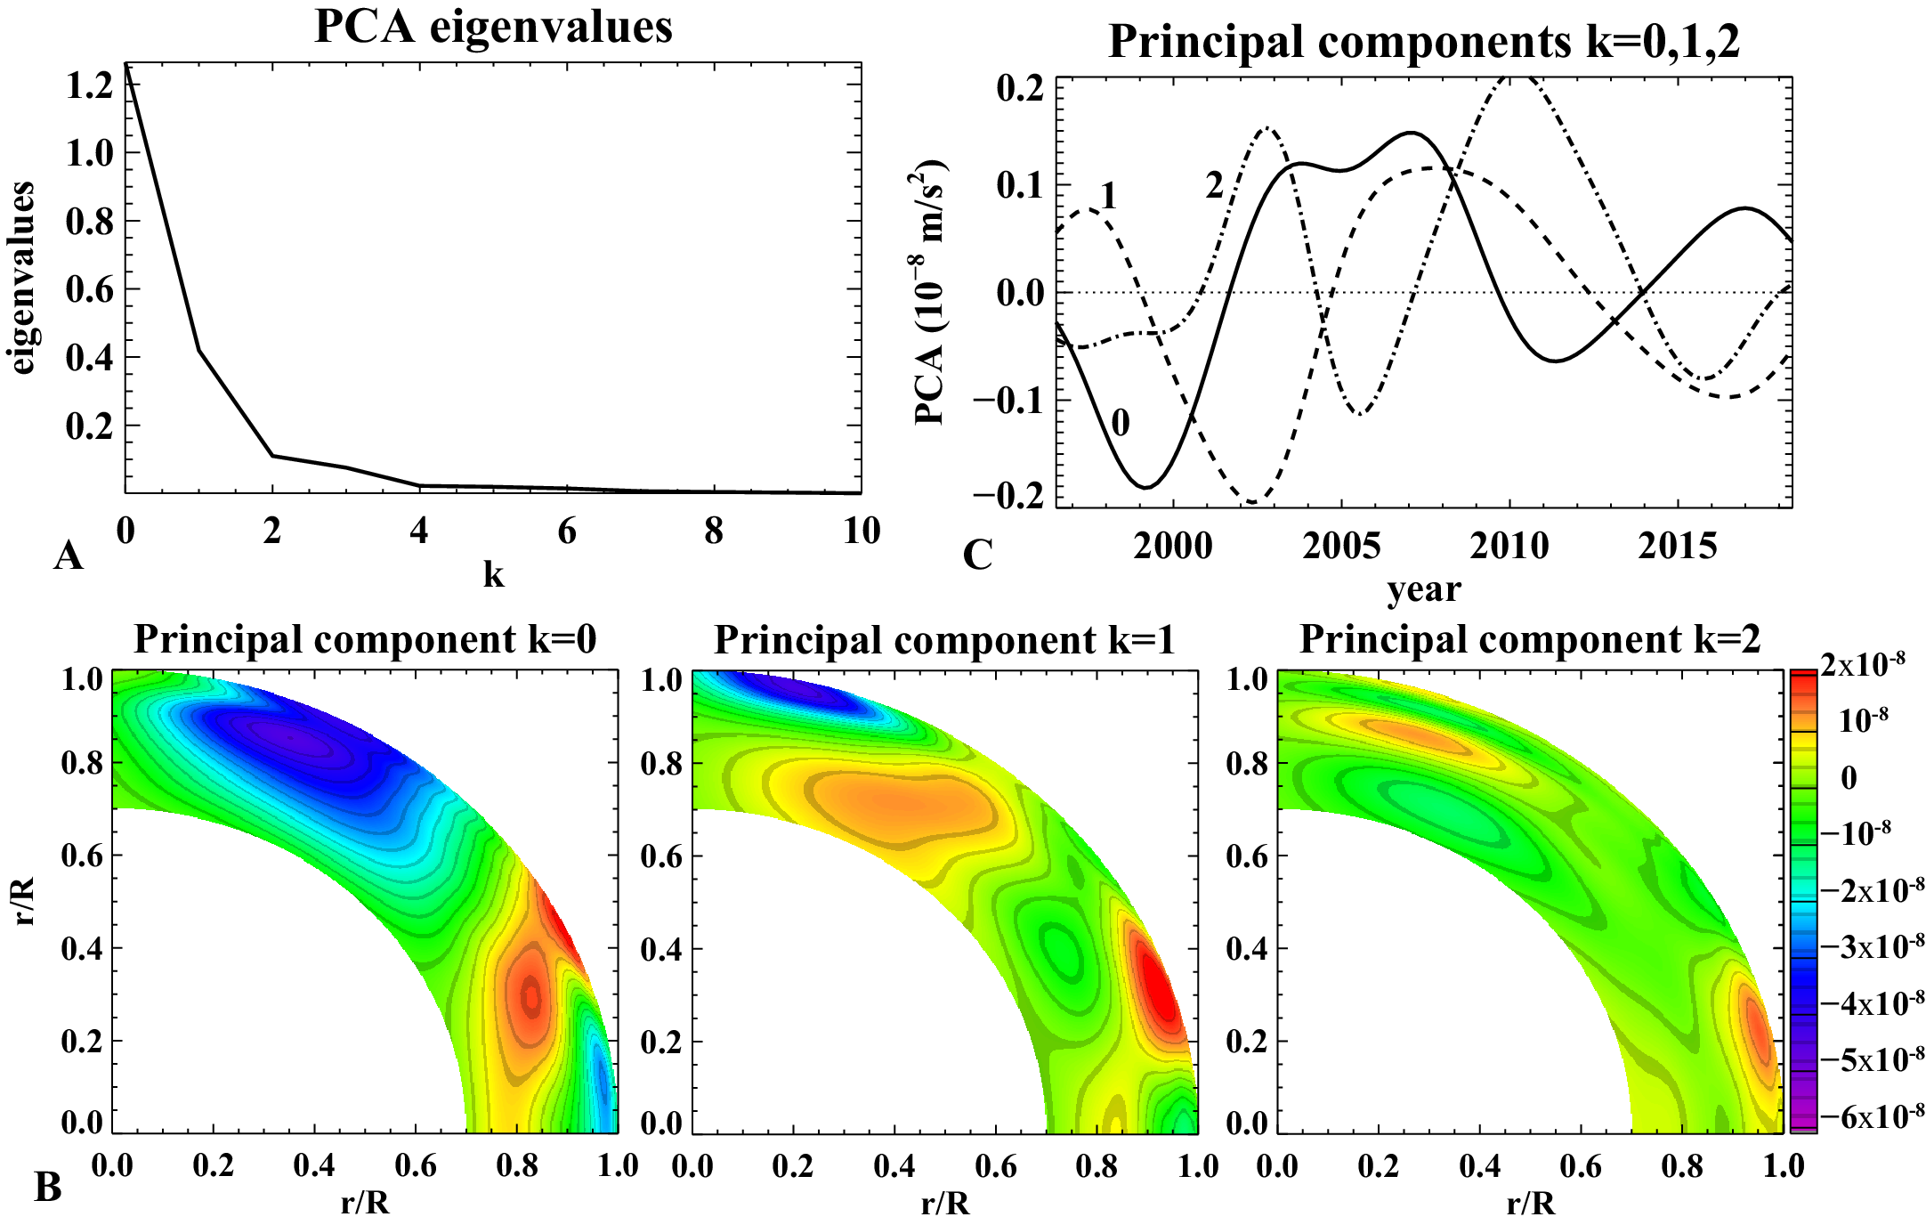
Principal component analysis (PCA)
PCA converts observational data into a set of linearly uncorrelated orthogonal components called principal components, which are ordered so that the first few retain most of the variation present in the original data

Slide 10
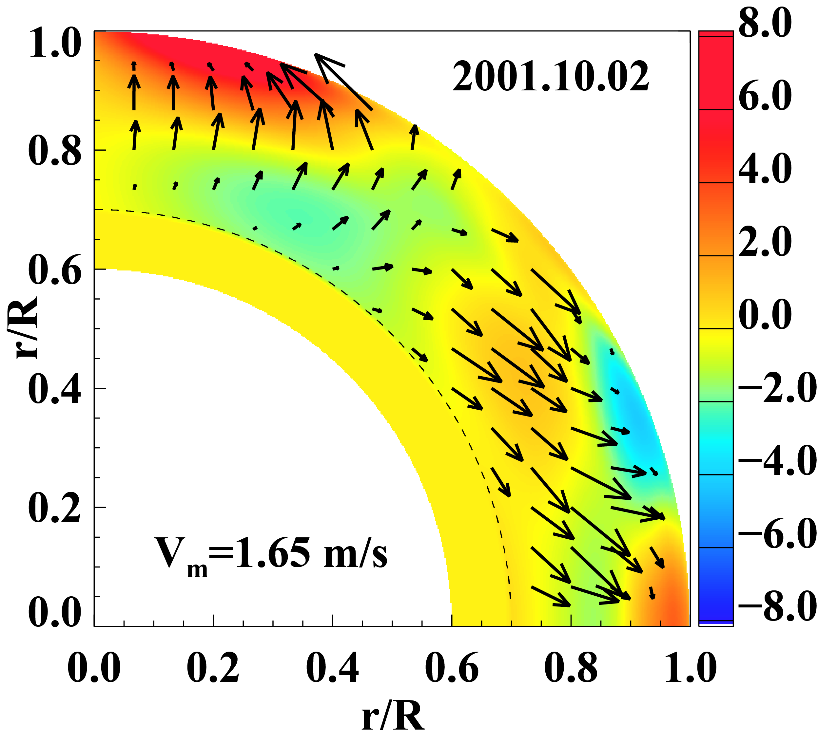
Migration of dynamo waves
The dynamo waves originate at the base of the convection zone (in the “solar tachocline”) and migrate towards the poles and the equator with a speed of 1-2 m/s.
It reaches the surface near the poles in 1-2 years, but it takes about 10 years to reach the surface at low latitudes where it forms sunspots.
This explains why the polar magnetic field predicts the next sunspot maximum.
Local correlation tracking
Start of Cycle 24 in the interior
Cycle 23 at the surface

Slide 11
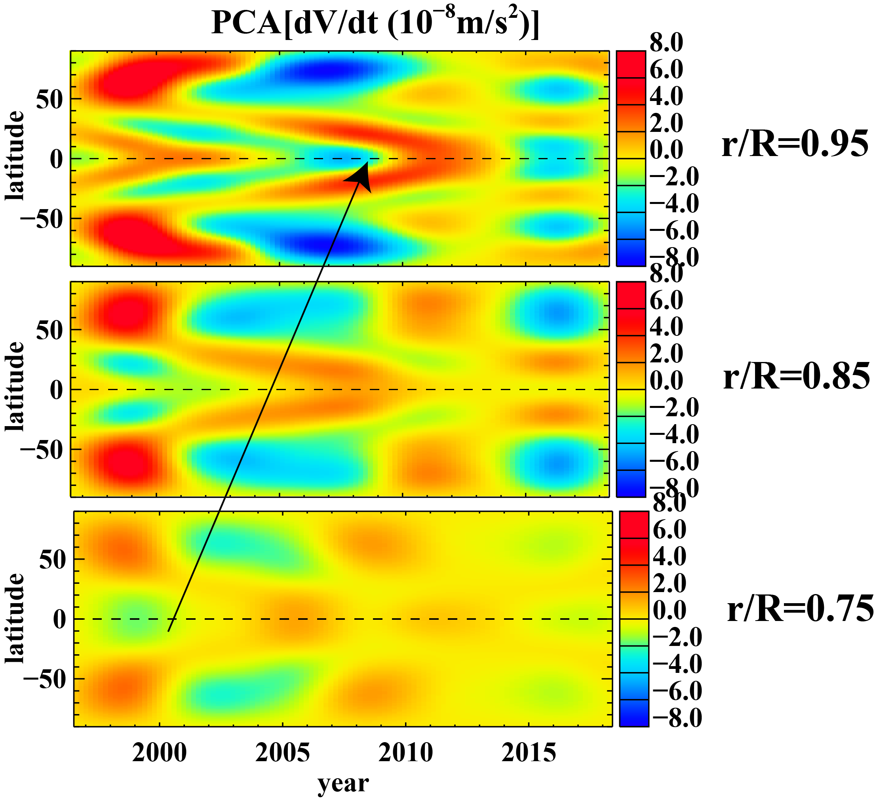
Tracking the zonal acceleration through the convection zone
Cycle 23

Slide 12
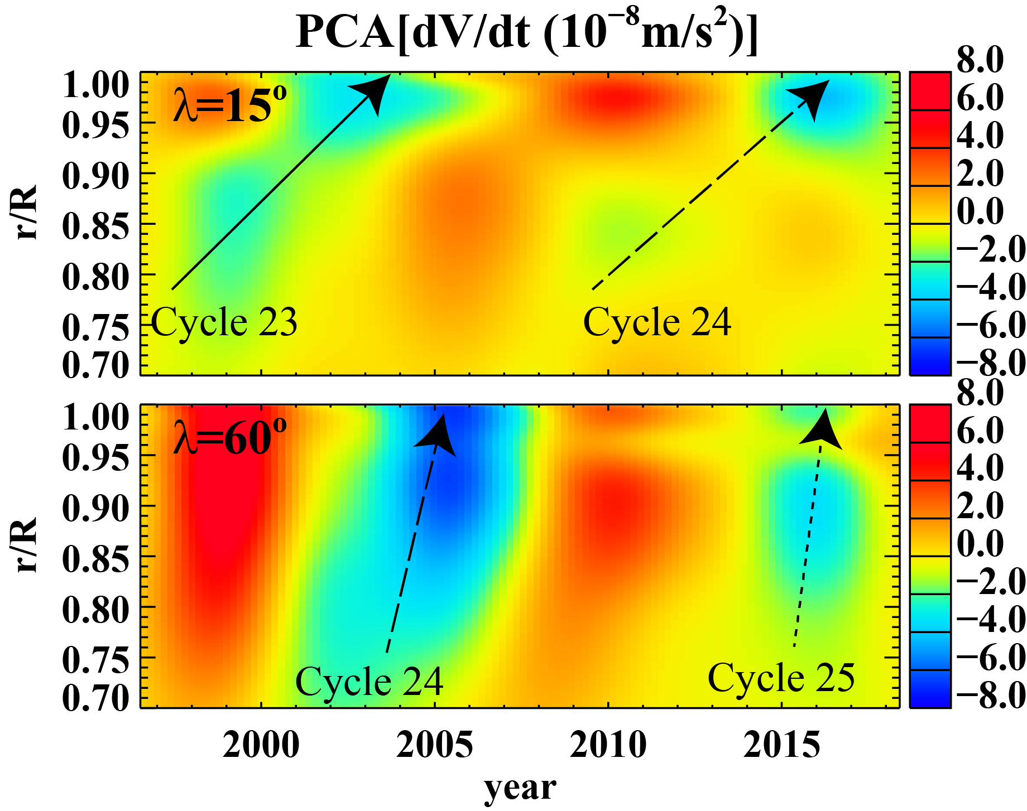
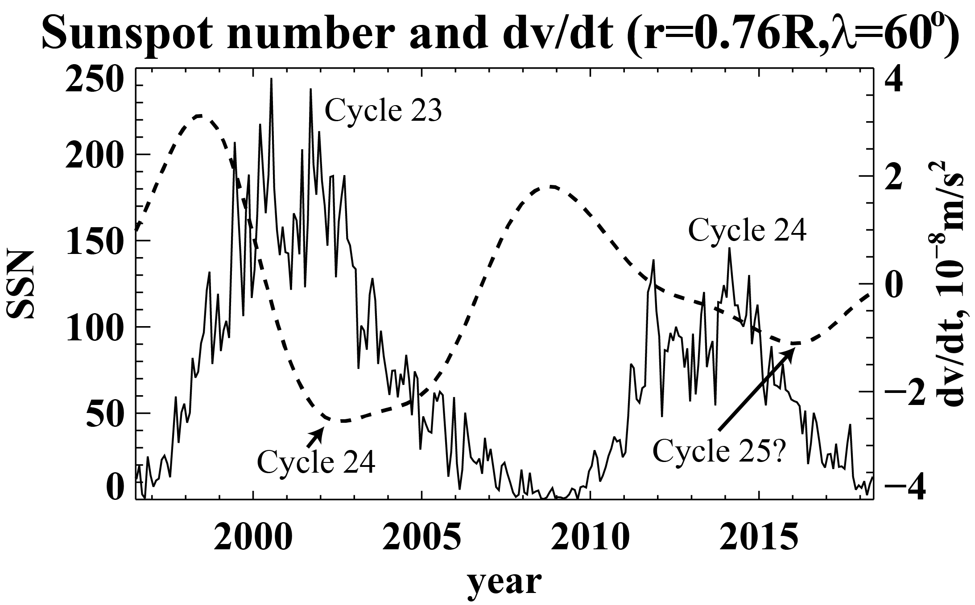
next solar cycle
In the solar interior we already see the signal associated with the next sunspot cycle (Cycle 25).
It appears that it will be even weaker than the current cycle, indicating on continuing long-term decrease of solar activity.

Slide 13
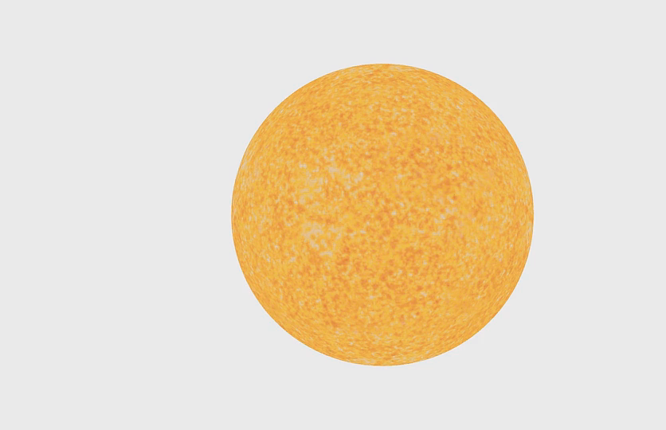
Main results
By tracking migration of stream jets (called “torsional oscillations”) in the solar interior we reveal patterns of dynamo waves that control the sunspot cycles.
The helioseismology measurements of the Sun’s torsional oscillations for 22 years allow us to pin down the location where the solar cycles originate: the tachocline, 60 degrees latitude.
It appears that Cycle 25 will be even weaker than the current cycle.
Visualization by Tim Sandstrom
(NASA Ames Research Center)
Publication: Dynamo Wave Patterns Inside the Sun Revealed by Torsional Oscillations
Authors: Alexander G. Kosovichev, Valery V. Pipin arXiv:1809.10776 , 2018

Slide 14


