Slide 1
PHYS780: Solar and Solar-Terrestrial Physics
Time: 1:00 pm - 2:25 pm, Monday, Tuesday
Place: GITC, room 1403
Instructor: Alexander Kosovichev
  e-mail: alexander.g.kosovichev@njit.edu
  Phone: 408-239-6874
  Office: Cullimore 105F
  Office hours: by appointment
  URL: http://sun.stanford.edu/~sasha/PHYS780/SOLAR_PHYSICS
  NJIT Webex: https://njit.webex.com/join/sasha
Grades: homework (40%), class quizzes (20%), final presentation/essay (40%)

Slide 2
Lecture Plan
September 4, Tuesday. Introduction. Course overview. "Big problems of heliophysics": solar neutrinos, rotation, dynamo, magnetic energy release, coronal heating, solar wind.
September 10 Monday. The Sun as a star. General properties, place in the Hertzsprung-Russell diagram. Distance, mass, radius, luminosity, composition, age, evolution, spectral energy distribution.
September 11, Tuesday. Tools for solar observations I. Solar telescopes. Resolution, MTF, seeing. High resolution telescopes. Spectrographs.
September 17, Monday. Tools for solar observations II. Measurements of the line shift. Zeeman effect. Magnetic fields and polarimetry.
September 18, Tuesday. Tools for solar observations III. Solar space missions: SOHO, TRACE, STEREO, Hinode, RHESSI, SDO, IRIS. Neutrino telescopes. Quiz #1
September 24, Monday. Internal structure I. Stellar Scaling Laws. Standard model. Evolution. Nuclear reactions. Equation of state. Radiative transfer.

Slide 3
September 25, Tuesday. Internal structure II. Stability. Convective energy transfer. Non-standard models. Solar neutrinos, neutrino transitions, MSW effect.
October 1, Monday. Solar oscillations. Observations. Excitation mechanisms.
October 2, Tuesday. Theory of solar oscillations. Theory of p-, g-, and r-modes.
October 9, Monday. Principles of helioseismology I. Global helioseismology. Asymptotic inversion. Variational principle, perturbation theory. Inversions, sound speed and rotation inferences.
October 10, Tuesday. Principles of Helioseismology II. Local-area helioseismology. Ring-diagrams, acoustic imaging, time-distance tomography. Far-side imaging. Meridional circulation. Emerging magnetic flux. Active region dynamics.
October 15, Monday. Convection. Granulation, supergranulation, giant cells. Blue shift, models. Energy balance. Superadiabatic layer. Rotational and magnetic effects. Numerical simulations. Quiz #2

Slide 4
October 16, Tuesday. Differential rotation. Observations. Heliographic coordinates. Oblateness, quadrupole moment, test of the general relativity. Rotational history. Models of differential rotation.
October 22, Monday. Solar MHD. MHD equations, Alfven and magneto-acoustic waves. Instabilities. Shocks.
October 23, Tuesday. The Solar Cycle. Global magnetism. "Magnetic carpet".
October 29, Monday. Dynamo theory. Mean-field electrodynamics, dynamo models, 3D MHD simulations. Quiz #3
October 30, Tuesday. Magnetic energy release. Reconnection. Particle acceleration. Observations. Theories of reconnection, current sheets, MHD and plasma instabilities. Acceleration mechanisms.
November 5, Monday. Solar atmosphere. The structure of the solar atmosphere, photosphere, chromosphere, corona. Transition region. Chromospheric network, filaments, prominences, spicules.
November 6, Tuesday. Sunspots. Active regions. Flux tubes. Observations. Static models. Flows, Evershed effect. Formation and decay of sunspots. Theories of emerging flux tubes, magnetic buoyancy.

Slide 5
November 12, Monday. Flares. Observations. Radiation, radio-, X-, and gamma-rays. Energetic particles. Thin- and thick-target models, evaporation, heat conduction. Radiative and MHD shocks. Moreton waves, "sunquakes".
November 13, Tuesday. Corona. CME. Observations, eclipses. White light corona, Thompson scattering. Coronal heating, heat conduction. Large-scale structure, change with the solar cycle. Coronal mass ejections, shocks. Quiz #4
November 19, Monday. Solar wind. Observations. Expansion, Parker’s model, high- and low-speed wind. Composition, first-ionization potential effect. Sector structure, current sheet.
November 26, Monday. Magnetosphere. Interaction of solar wind with the Earth's magnetosphere and planets. Geomagnetic effects.
November 27, Tuesday. Ionosphere. Auroras, substorms. Space weather.
December 3, Monday. Presentations
December 4, Tuesday. Presentations
December 10, Monday. Presentations

Slide 6
Textbooks
Stix, M. 2002, “The Sun: An Introduction”, (Berlin: Springer)
“Introduction to Space Physics”, ed. M.G. Kivelson & C.T. Russell, Cambridge Univ. Press, 1995
Recommended books
Priest, E.R. 2014, Magnetohydrodynamics of the Sun (Cambridge Univ. Press)
Aschwanden, M. J., 2006, Physics of the Solar Corona (Springer)
Zirin, H. 1988, Astrophysics of the Sun (Cambridge Univ. Press)
Cox, A.N., Lingston, W.C., Matthews, M.S., 1991, Solar Interior and Atmosphere (Tucson, University of Arizona)
Bahcall J.N. 1989, Neutrino Astrophysics (Cambridge Univ. Press)
Foukal, P. 1990, Solar Astrophysics (New York: Wiley)
Golub, L., and Pasachoff, J.M. 1997, The Solar Corona (Cambridge Univ. Press)
Sturrock, P. (ed.) 1986, Physics of the Sun, (Kluwer).

Slide 7
Presentations (essays)
Presentation (essay) topics can be on your research related to the course, or chosen from my list. Your suggestions are welcome.
Requirements for 20 min presentations:
  Present observational facts
  Explain the basic physical processes
  Briefly review the current state of research
  Answer questions
For each topic I will provide references and initial material.

Slide 8
Essay Topics.
Solar diameter, oblateness and gravitational quadrupole moment
Solar neutrino problem.
Predictions of the solar cycle.
Spectrum of solar oscillations
Helioseismic inverse problem for structure.
Helioseismic inverse problem for rotation
Excitation of solar oscillations.
Solar convection and turbulence.
Mechanism of differential rotation.
Solar tachocline.
Magnetic reconnection.
MHD shocks and Moreton waves.
Dynamo models.
Acceleration mechanisms in solar flares.
Sunquakes
Coronal mass ejections.
Mechanisms of coronal heating.
Coronal seismology.
Acceleration of solar wind.
Waves in magnetosphere

Slide 9
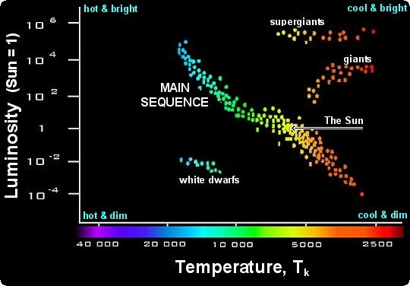
The Sun as a star.
Hertzsprung-Russell (HR) Diagram
General properties.
Place in the HR diagram.
Distance, mass, radius, luminosity, composition, age, evolution, spectral energy distribution.
Irradiance spectrum
Seismic radius
Solar-type stars

Slide 10
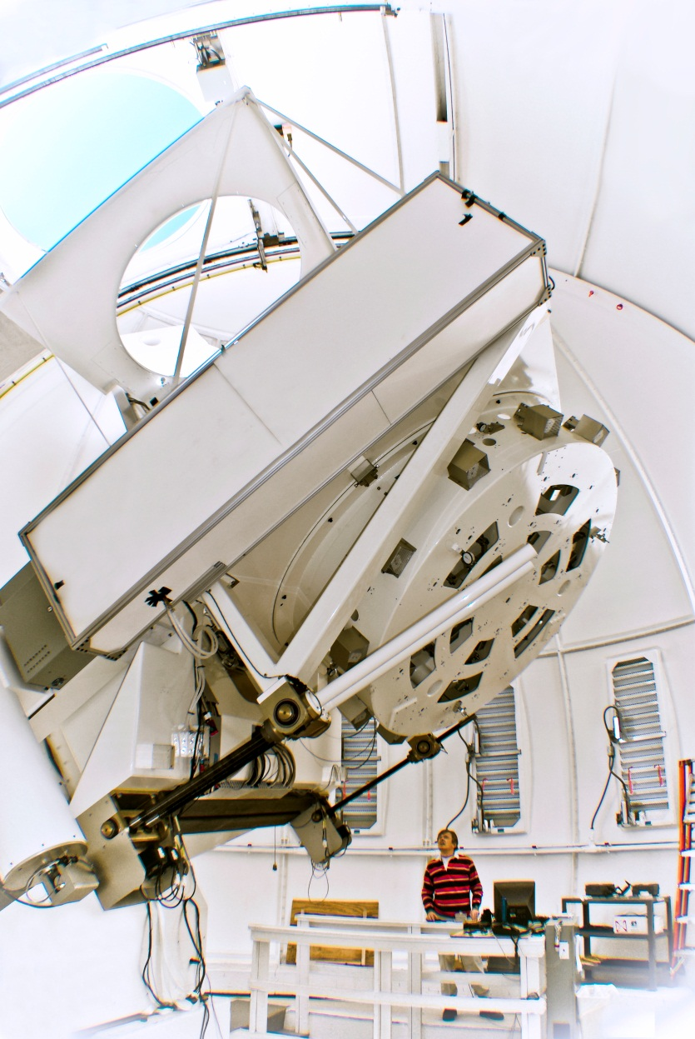
Tools for solar observations I.
1.6m Solar Telescope at BBSO
Solar telescopes
Resolution, MTF (Modulation Transfer Function), seeing.
High resolution telescopes.
Spectrographs.

Slide 11
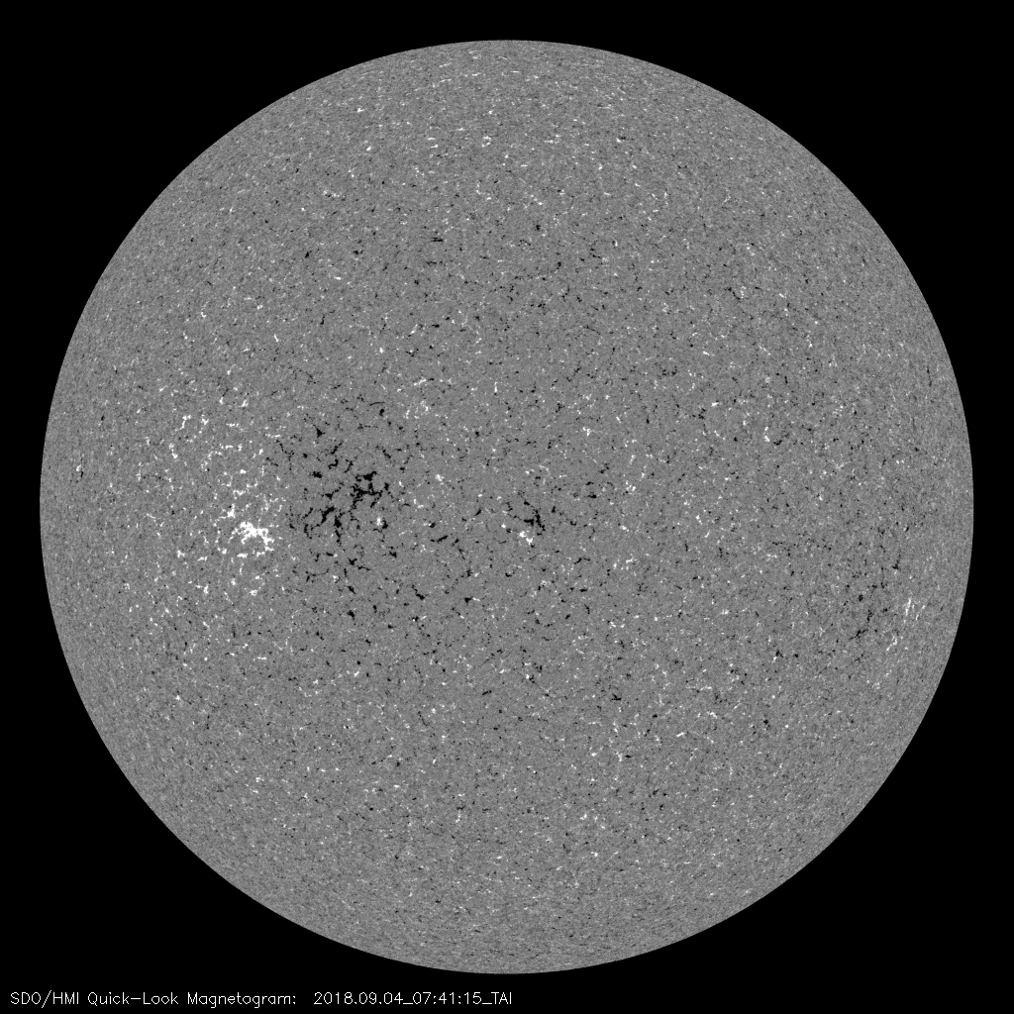
Tools for solar observations II.
Spectroscopy
Measurements of the line shift.
Zeeman effect.
Magnetic fields and polarimetry.

Slide 12
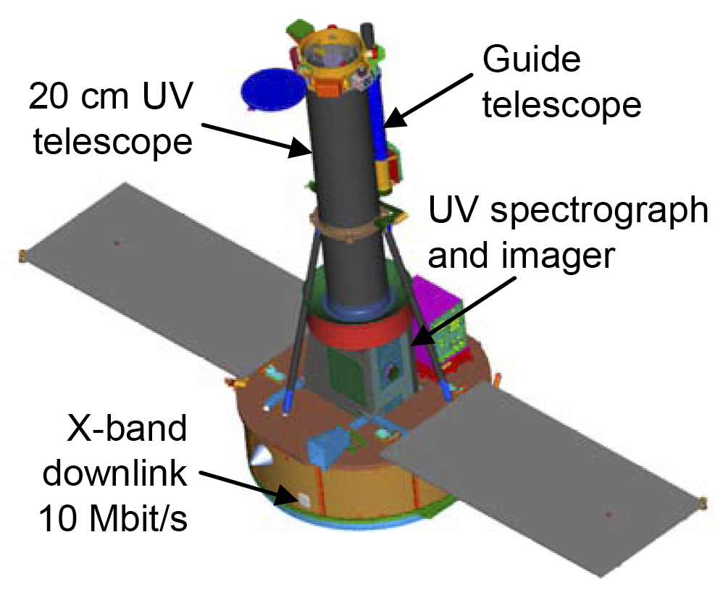
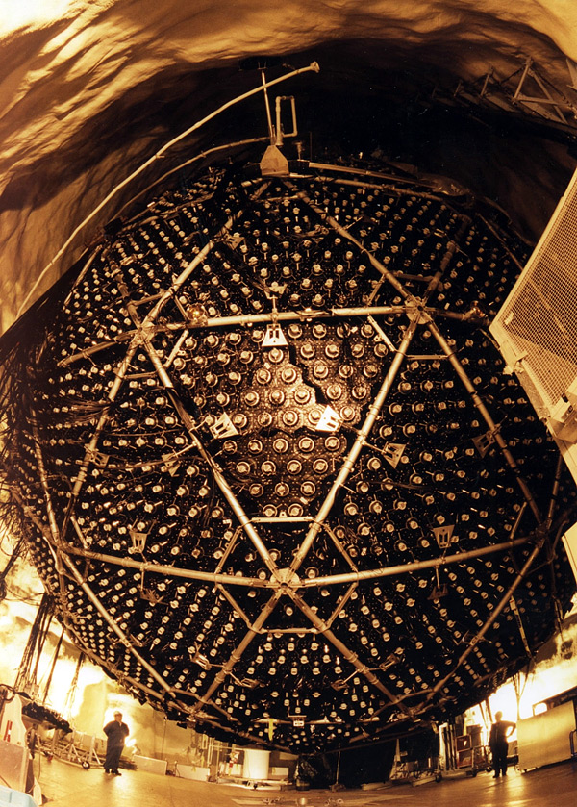
Tools for solar observations III.
Solar space missions: SOHO, TRACE, STEREO, Hinode, RHESSI, SDO, IRIS.
Neutrino telescopes.
Interface Region Imaging Spectrograph (IRIS) explorer
Sudbury Neutrino Observatory
detects solar neutrinos through their interactions with a large tank of heavy water.

Slide 13
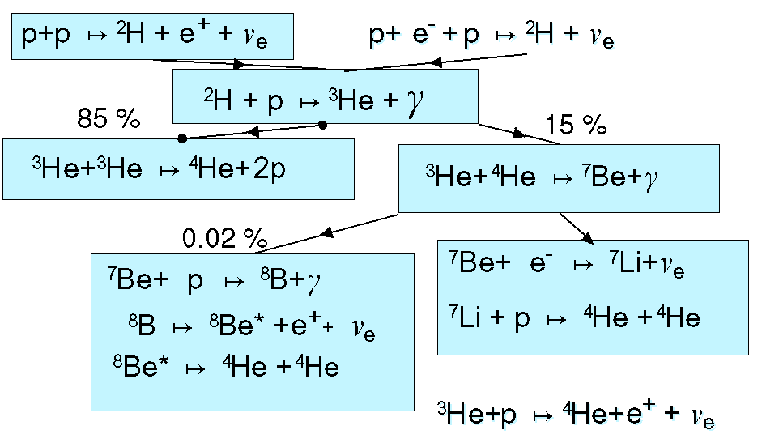
Internal structure I.
Stellar Scaling Laws. Standard model. Evolution. Nuclear reactions. Equation of state. Radiative transfer.

Slide 14
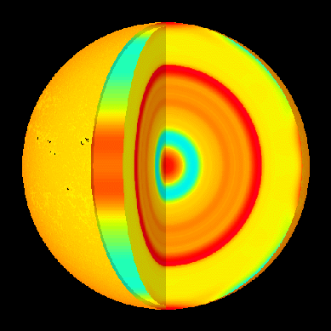
Internal structure II.
Variations of the sound speed detected by helioseismology
Convective instability.
Convective energy transfer.
Non-standard solar models.
Solar neutrinos, neutrino transitions, MSW effect.

Slide 15
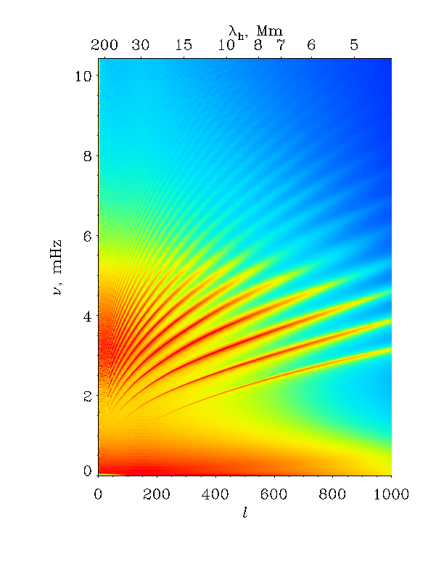
Solar oscillations.
Observations.
Theory of p-, g-, and r-modes.
Excitation mechanisms.
Oscillations of solar-type stars.
Oscillation power spectrum from
Solar and Heliospheric Observatory

Slide 16
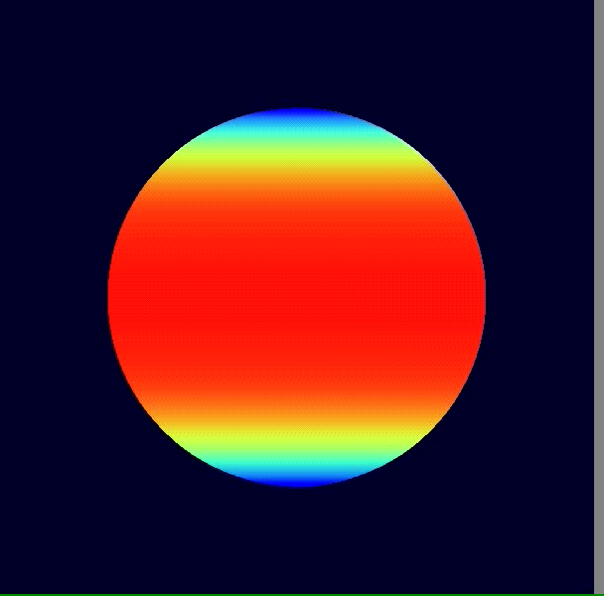
Principles of Helioseismology I.
Variational principle
Perturbation theory.
Inversions, sound speed and rotation inferences.

Slide 17
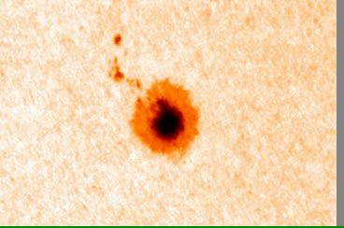
Principles of Helioseismology II.
Local-area helioseismology
Ring-diagrams
Acoustic imaging
Time-distance tomography.
Subsurface structure of sunspot

Slide 18
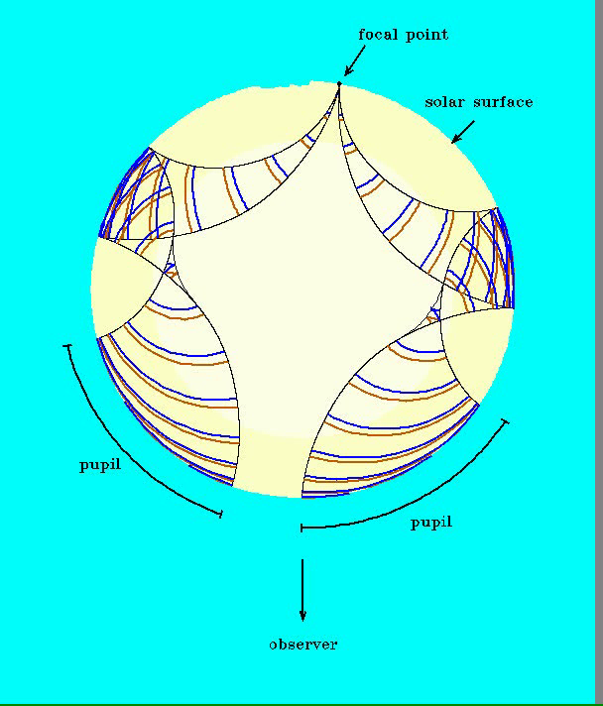
Subsurface structure and dynamics.
Current helioseismology results.
Far-side imaging.
Meridional circulation.
Emerging magnetic flux.
Active region dynamics.
Illustration of far-side imaging of active regions

Slide 19
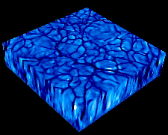
Convection.
Granulation, supergranulation, giant cells.
Convective blue shift.
Energy balance.
Superadiabatic layer.
Rotational and magnetic effects.
Numerical simulations.
3D numerical simulations of solar
granulation

Slide 20
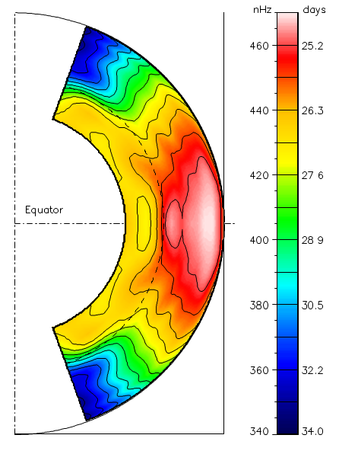
Differential rotation.
Rotation rate inside the Sun
determined by helioseismology
Observations.
Heliographic coordinates.
Oblateness, quadrupole moment, test of the general relativity.
Rotational history.
Models of differential rotation.
Rotation of solar-type stars.

Slide 21
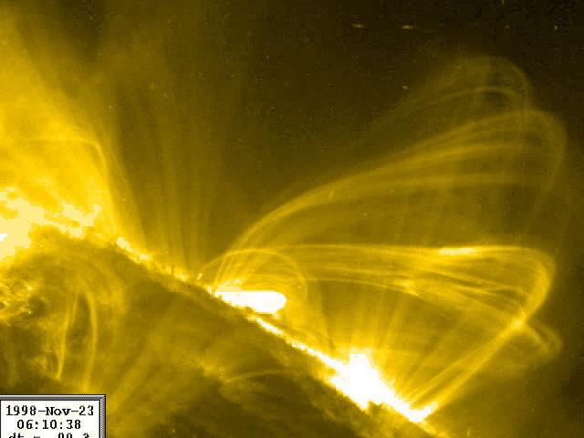
Solar MHD.
Excitation of MHD waves by solar flare
MHD (magneto-hydrodynamics) equations
Alfven and magneto-acoustic waves.
Instabilities.
Shocks.

Slide 22
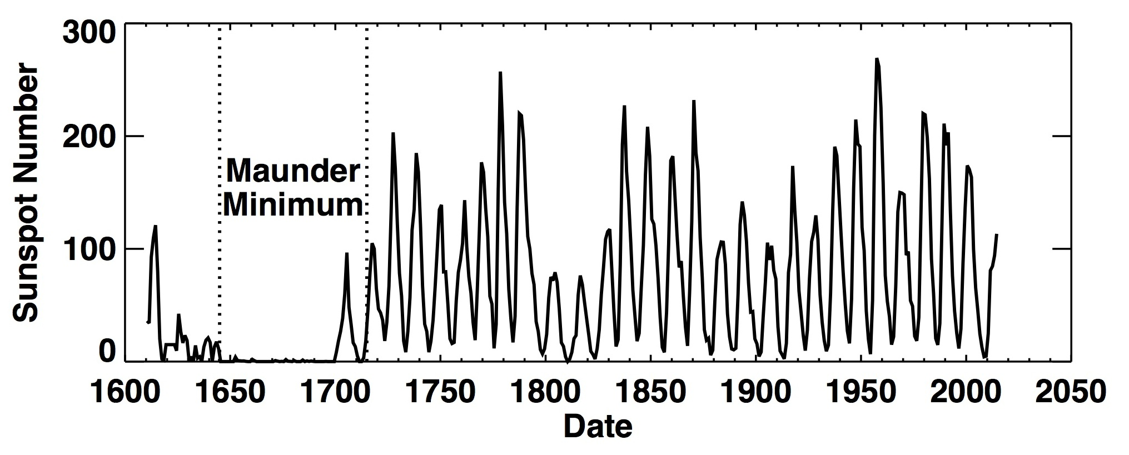
The Solar Cycle
Global magnetism. "Magnetic carpet".
Sunspot cycles for the whole history of solar observations

Slide 23
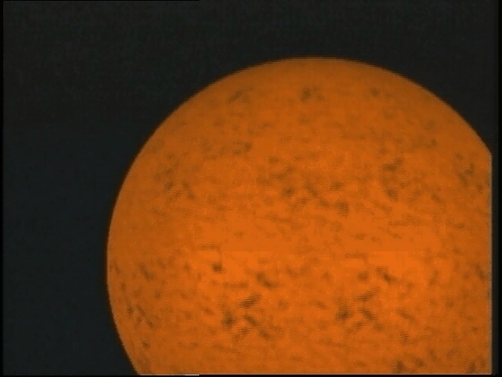
Dynamo theory.
Mean-field electrodynamics.
Alpha- and Omega-effects.
Dynamo models.
3D MHD simulations.
Animation of the solar dynamo

Slide 24
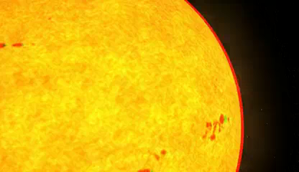
Magnetic energy release.
Magnetic reconnection.
Particle acceleration.
Observational evidence.
Theories of reconnection, current sheets, MHD and plasma instabilities.
Acceleration mechanisms.
Animation of magnetic reconnection
in the magnetosphere initiated by coronal
mass ejection

Slide 25
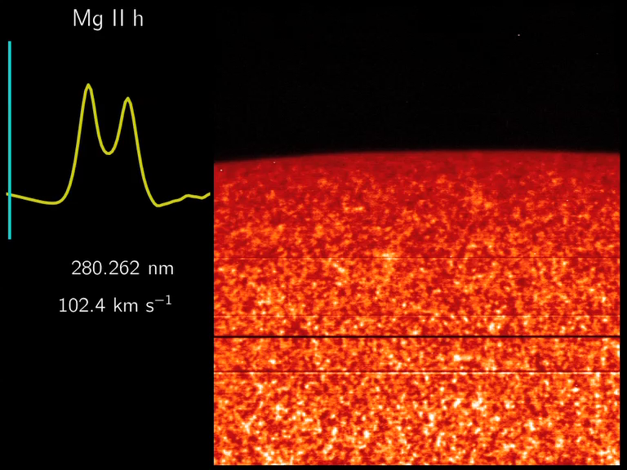
Solar atmosphere.
The structure of the solar atmosphere.
Photosphere, chromosphere, corona.
Chromosphere-corona transition region.
Chromospheric network, filaments, prominences, spicules.
Spectroscopic observations of the chromosphere
and transition regions from IRIS (T=15,000 K)

Slide 26
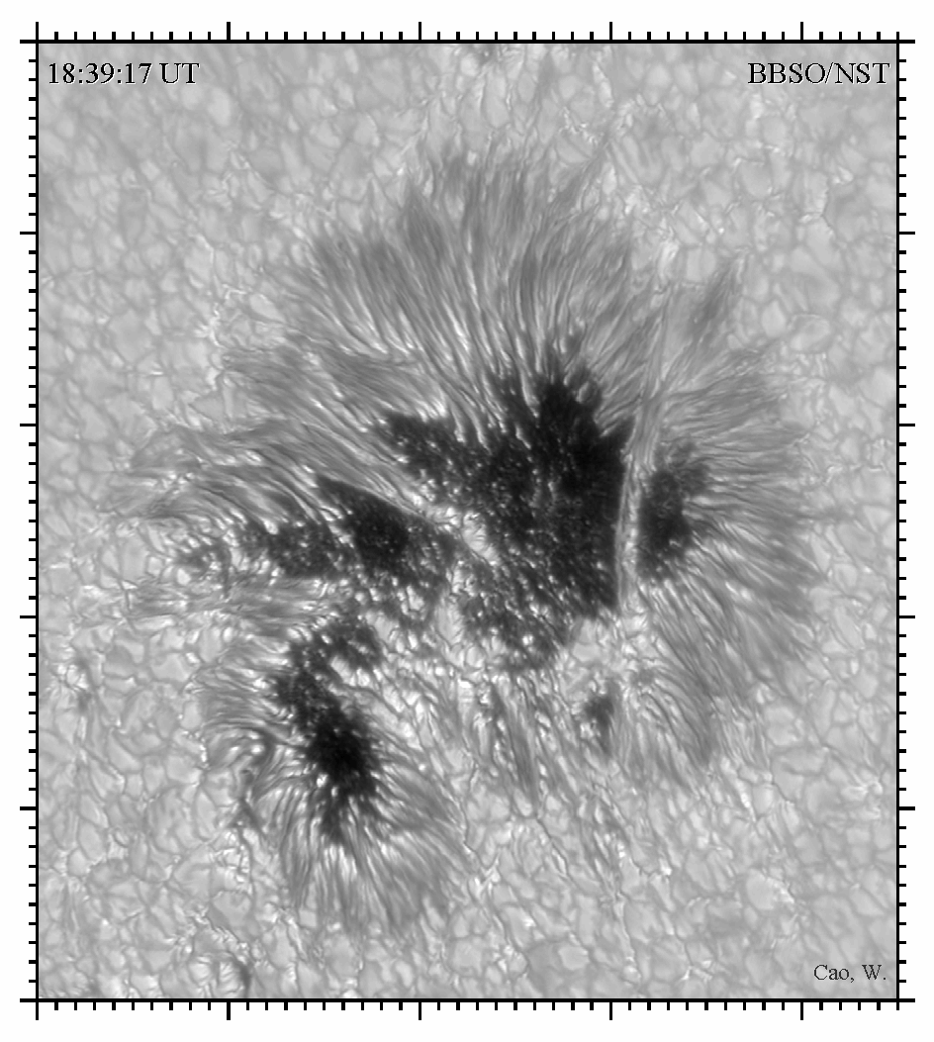
Sunspots.
Active regions and sunspots.
Magnetic flux tubes. Observations. Static models.
Sunspot flows, Evershed effect.
Formation and decay of sunspots.
Theories of emerging flux tubes, magnetic buoyancy.
High-resolution observations of a sunspot
from BBSO

Slide 27
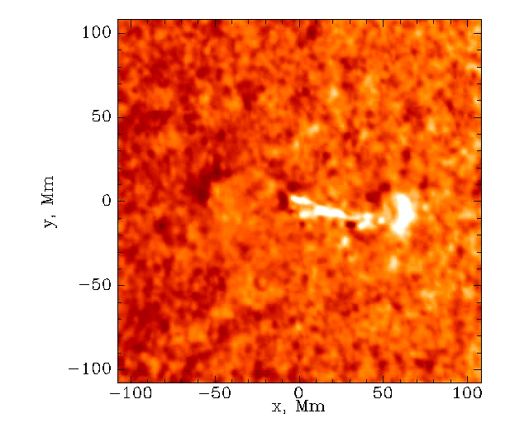
Flares.
Observations.
Radiation, radio-, X-, and gamma-rays.
Energetic particles.
Thin- and thick-target models, chromospheric evaporation, heat conduction.
Radiative and MHD shocks. Moreton waves, "sunquakes".
Sunquakes – helioseismic waves
excited by solar flares

Slide 28
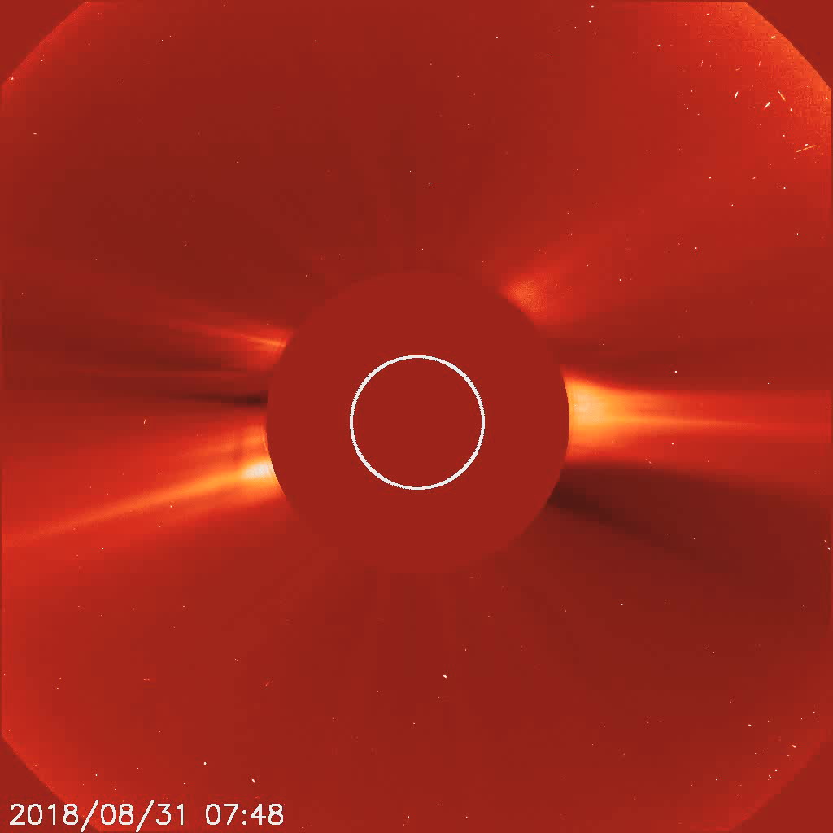
Corona.
Coronal Mass Ejections (CME).
Observations, eclipses.
White light corona, Thompson scattering.
Coronal heating, heat conduction.
Large-scale structure, change with the solar cycle. Coronal mass ejections, shocks.

Slide 29
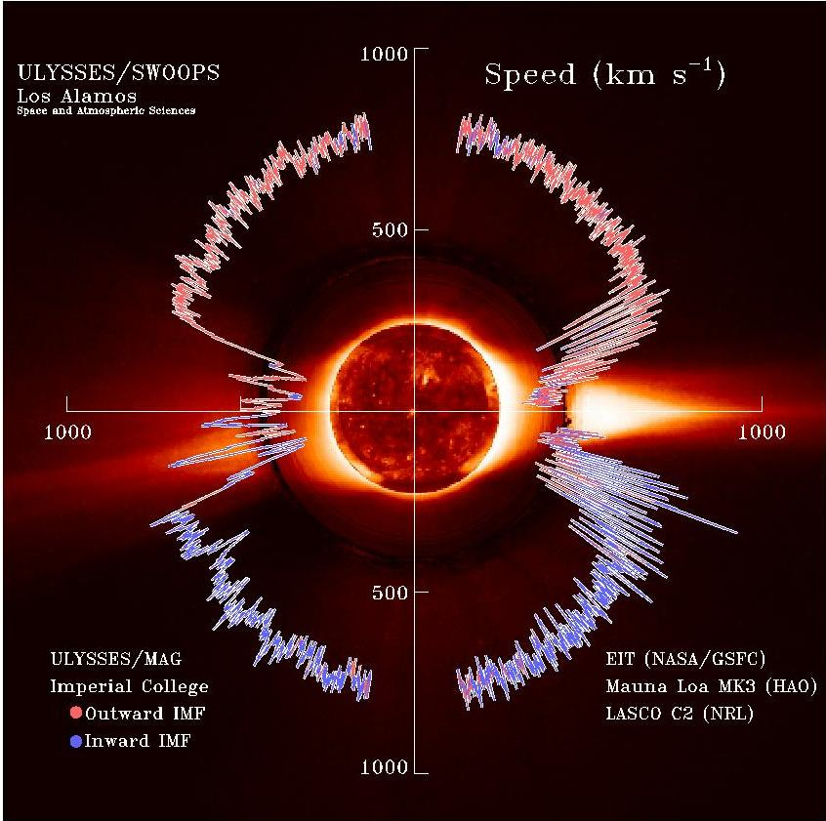
Solar wind.
Observations.
Coronal expansion.
Parker’s model
High- and low-speed wind.
Composition, first-ionization potential effect.
Sector structure, current sheet.
Observations of the solar wind speed from Ulysses spacecraft

Slide 30
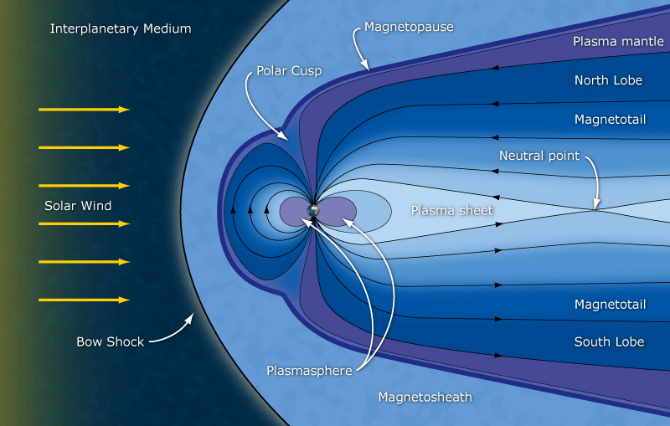
Magnetosphere.
Schematic structure of the magnetosphere
Interaction of solar wind with the Earth's magnetosphere and planets.
Geomagnetic effects.

Slide 31
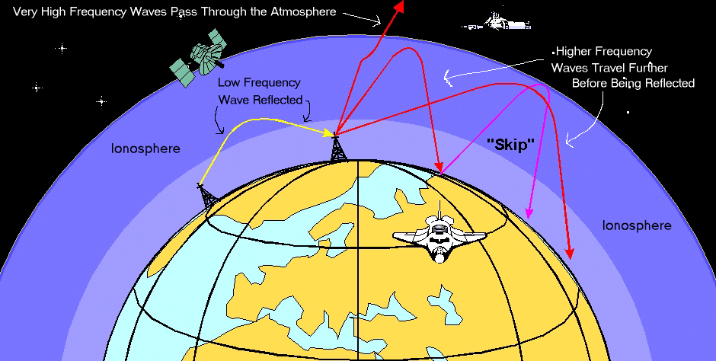
Ionosphere.
Auroras, substorms. Space weather.
Propagation of radiowaves in the ionosphere

Slide 32
“Big” problems in solar physics
Solar neutrino problem
Solar cycle and dynamo
Magnetic energy storage and release
Particle acceleration
Coronal heating
Source of solar wind

Slide 33
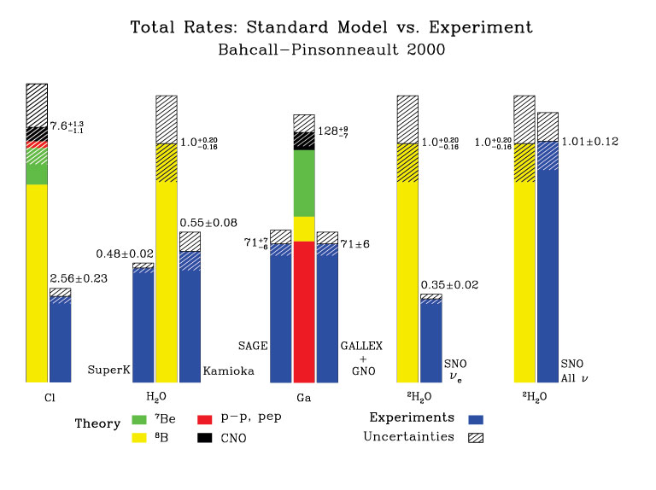
Solar Neutrino Problem

Slide 34
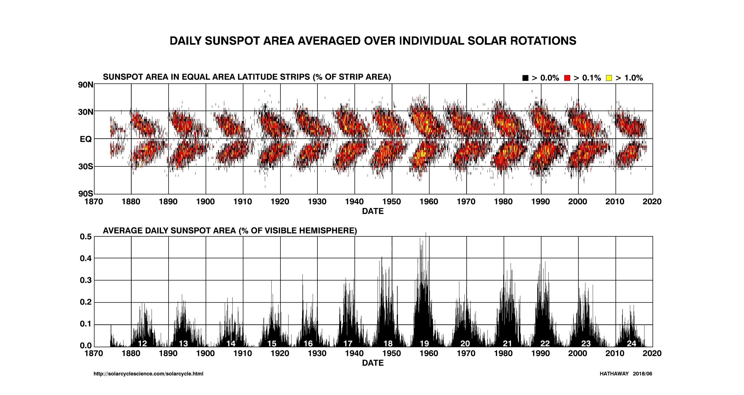
Solar cycle and dynamo

Slide 35
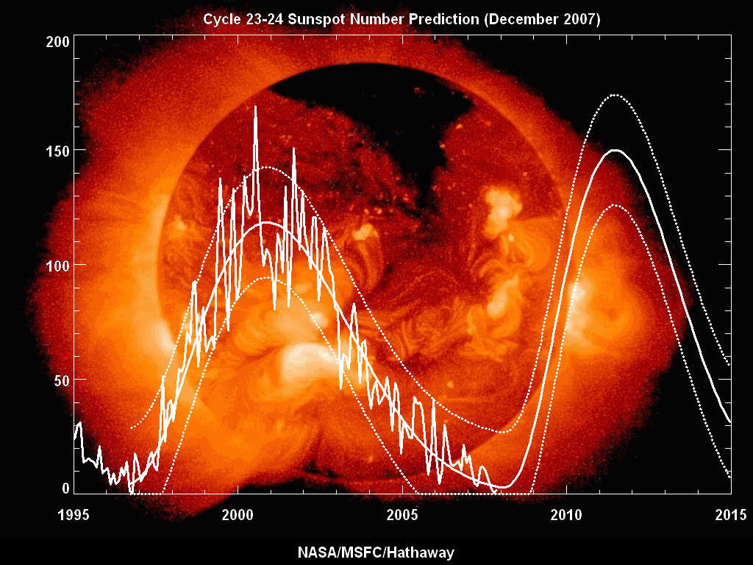

Slide 36
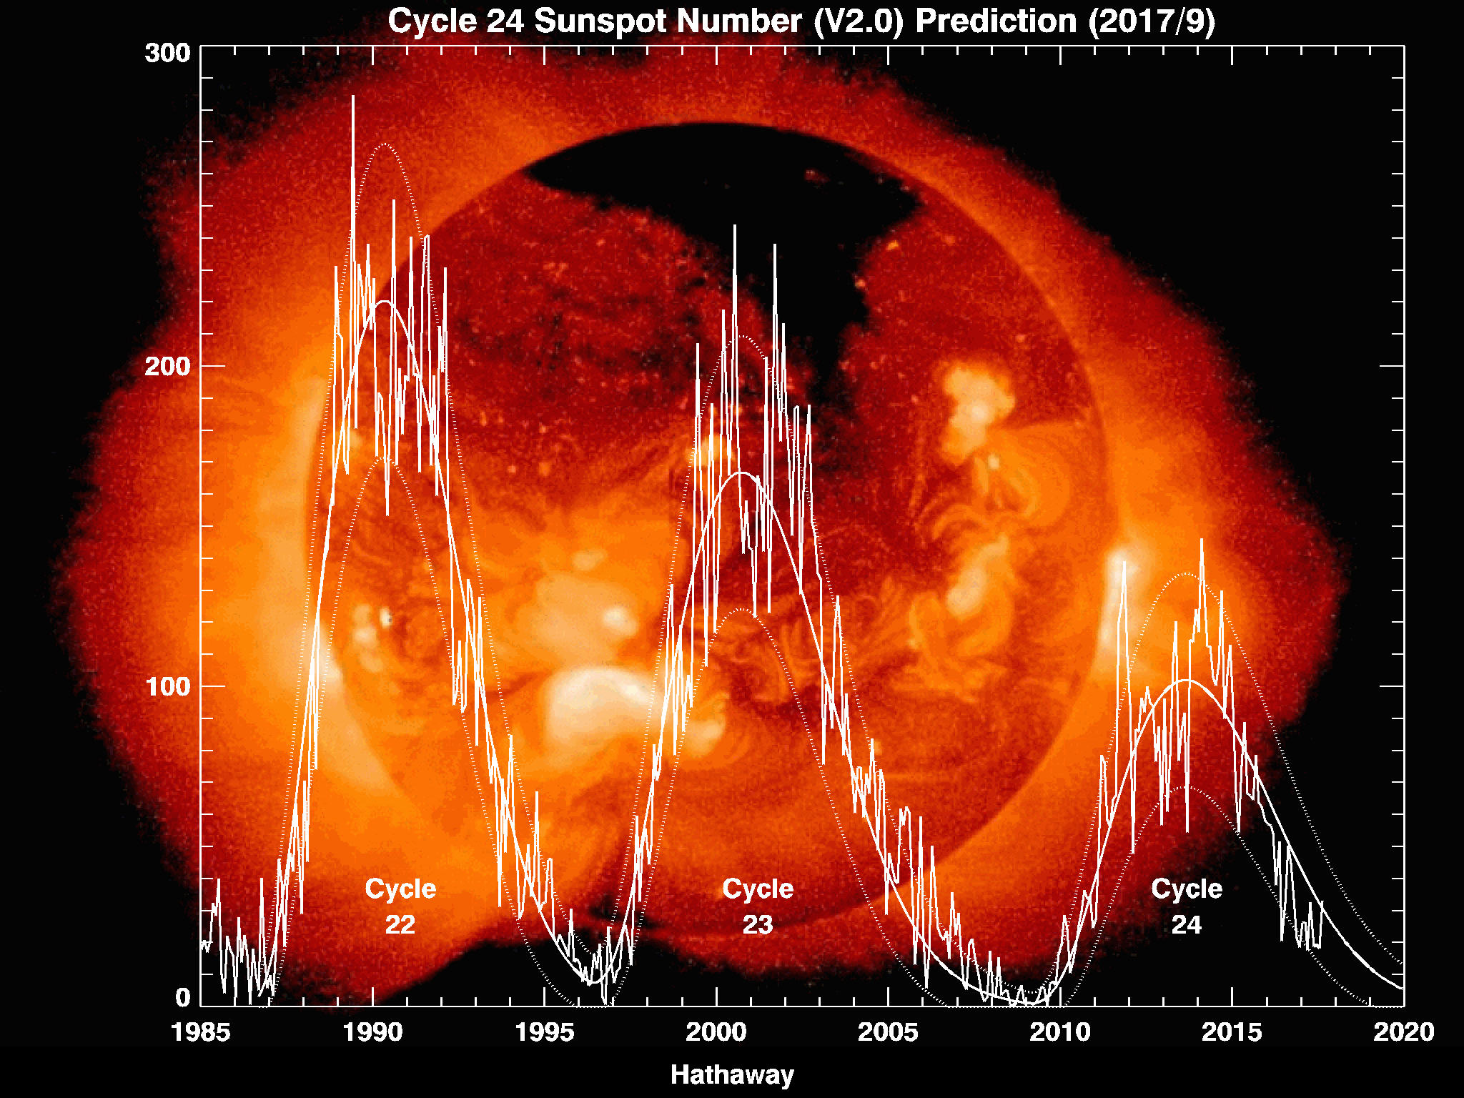

Slide 37
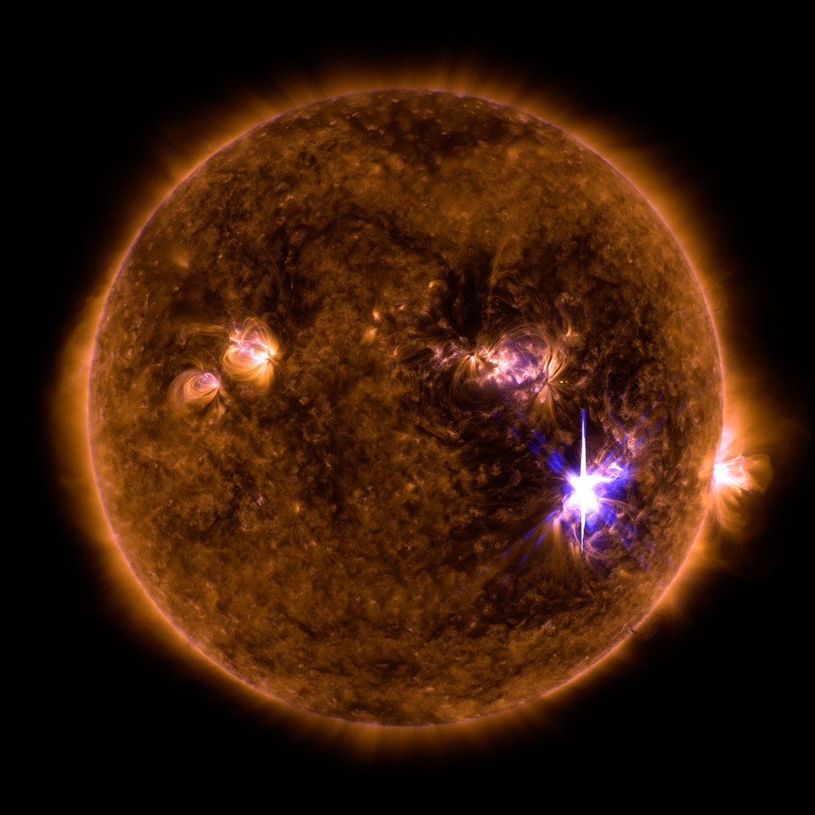
Magnetic energy storage and release
Sept 6, 2017

Slide 38
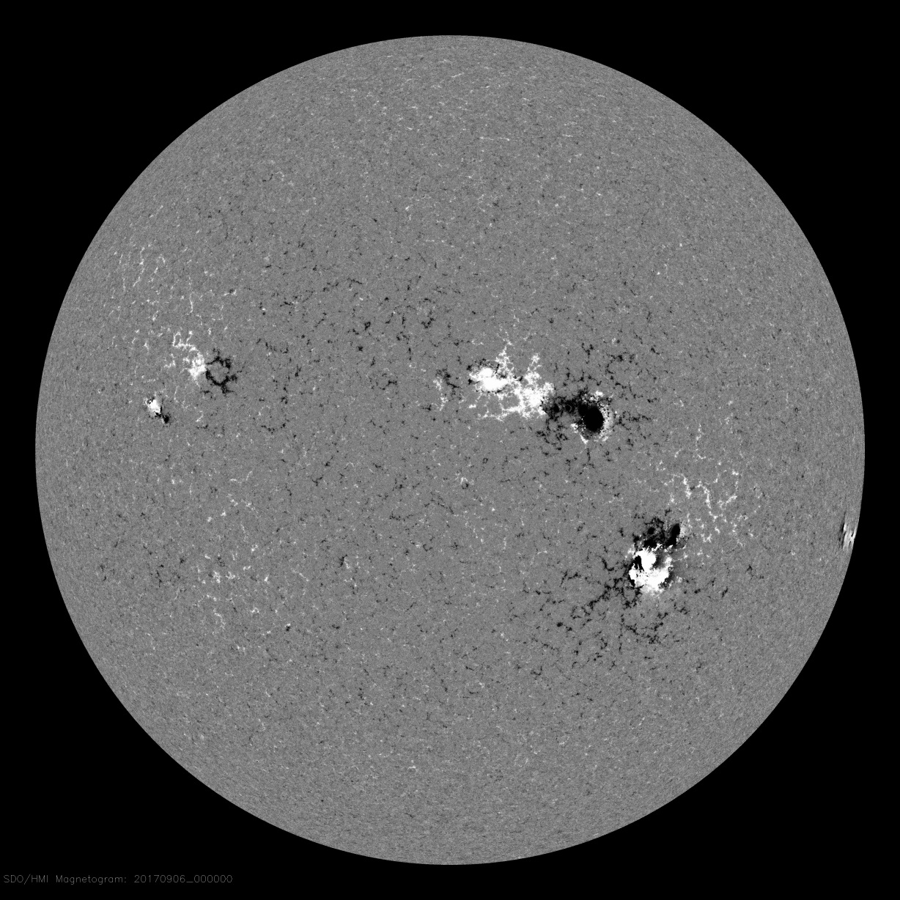
Magnetic energy storage and release

Slide 39
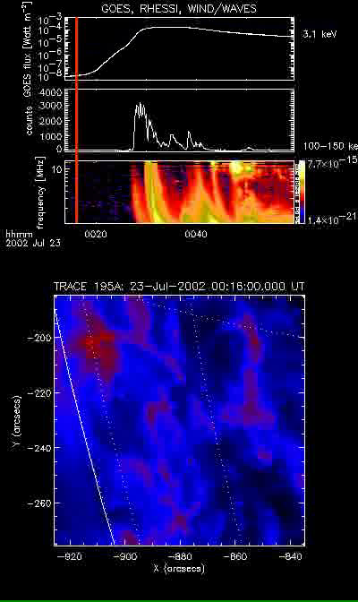
Particle acceleration
RHESSI observations of
July 23, 2002, flare
00:20-00:40 UT (RED: 12-20 keV,
BLUE: 100-150 keV)

Slide 40
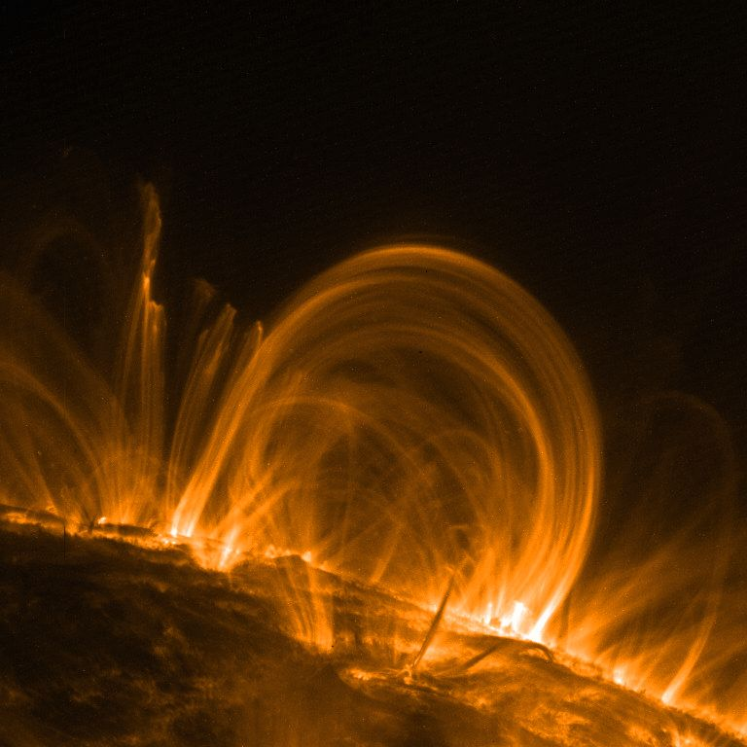
Coronal heating

Slide 41
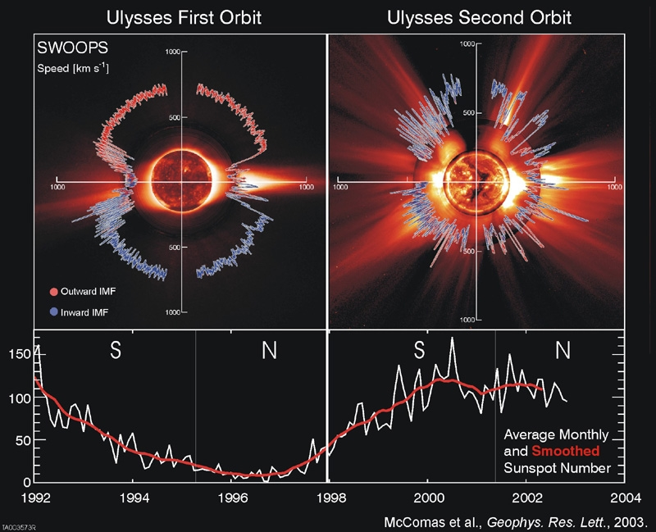
Source of solar wind

Slide 42
