Slide 1
11. Principles of helioseismology:
Local helioseismology

Slide 2
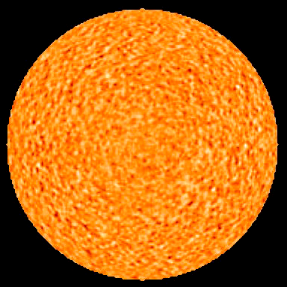
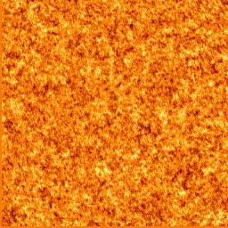
Randomly excited solar oscillations

Slide 3
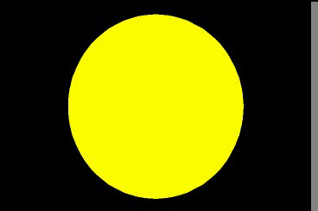
The idea of helioseismology
Measure travel times τ or resonant frequencies ω of acoustic waves and infer the internal properties, e.g. c_{s}(r) - sound speed

Slide 4
Two principal approaches
Global Helioseismology – measure global oscillation modes from the oscillation power spectra obtained by applying the spherical harmonic transform to the full-disk oscillation data
Local Helioseismology - measure variations of oscillation frequencies in local areas by applying the Fourier transform to the oscillations in these area, or by measuring the travel times of phase shifts in local areas.

Slide 5
Methods of local-area helioseismology:
Method | Observable | Inferences
Ring-diagram analysis (Gough, Hill, November, Toomre, 1981) | Local variations of oscillation frequencies | Large-scale sound speed perturbations and horizontal flows
Time-distance helioseismology (Duvall et al. 1993) | Phase and group travel times of acoustic and surface gravity waves | 3D sound speed, density and flows
Acoustic Imaging (Chou, LaBonte, et al. 1990) | Phase and amplitude variations | 3D sound speed and flows
Acoustic Holography (Lindsey & Braun, 1990) | Phase and amplitude variations | Phase variations and amplitude maps

Slide 6
Input Data
Dopplergrams-
observational requirements:
long duration (>4 hours)
high-resolution (0.5 arcsec per pixel)
high-cadence (45-sec cadence)
stability
SDO high-resolution Dopplergrams

Slide 7
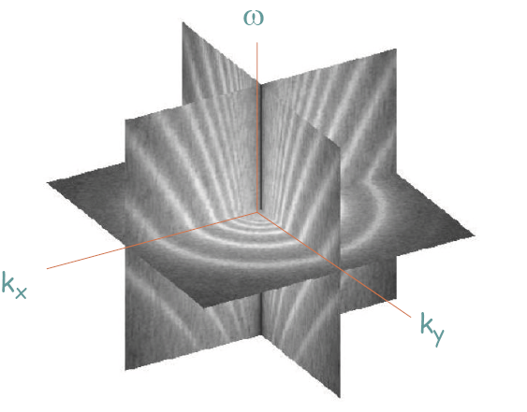

Slide 8
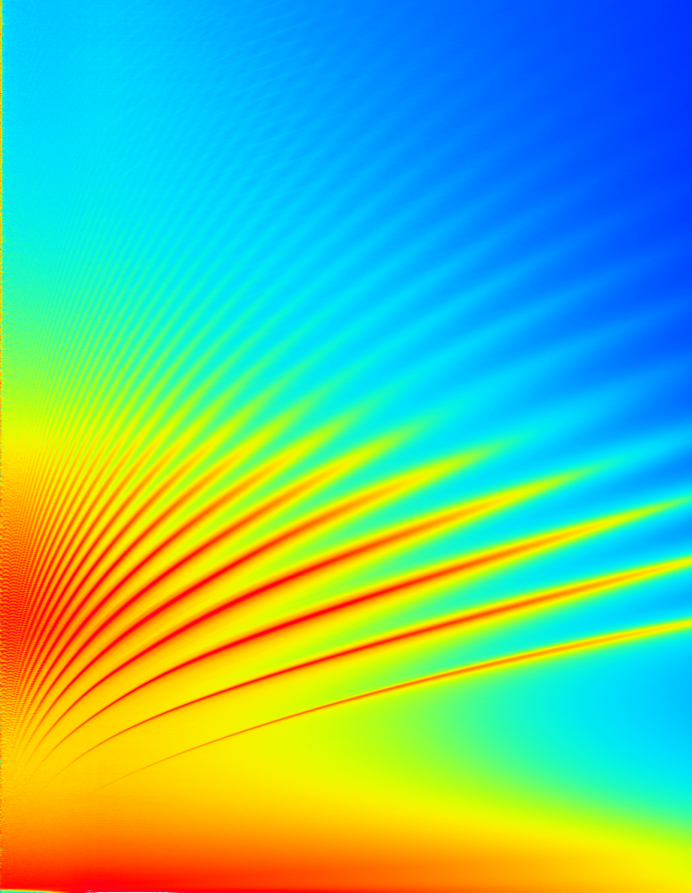
Compare with the global oscillation power spectrum
Spectrum of global oscillations of the sphere
Spectrum of oscillations in a local area

Slide 9
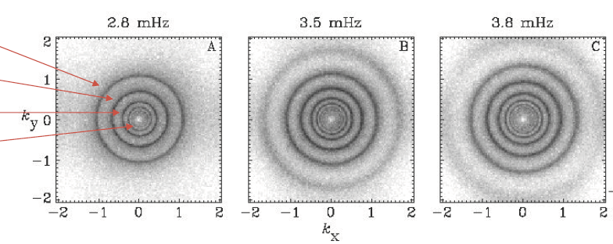
Cuts of the local power spectra at constant frequencies produce rings
f-mode
p₁- mode
p₂- mode
p₃- mode

Slide 10
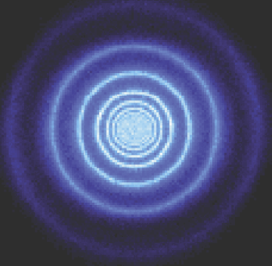
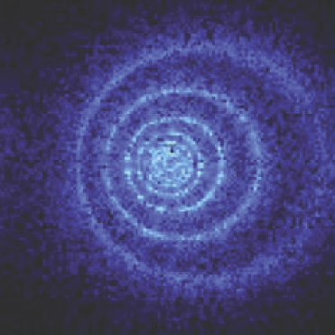
Flows cause displacement of rings (Doppler shift of solar waves)
(ω-k_{x}U)²=ω_{c}²+c²k²
Frequency shift caused by flow with velocity U along x-axis.
By measuring the shift for various modes one can determine the
depth dependence of U.

Slide 11
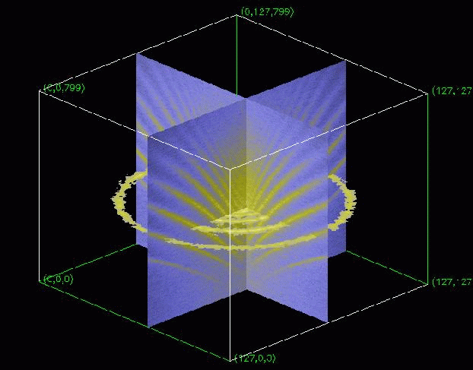
Ring-Diagram Analysis
The ring-diagram method is based on inversion of the local dispersion relation (3D power spectrum) for acoustic waves.
Perturbation to the local variation in frequency of the component of the wave pattern whose local horizontal wave number is k is given by
is the horizontal component of flow
velocity, and are
perturbations to the local sound speed
and adiabatic exponent; B(z), F(z), and G(z) are the sensitivity functions that are similar to the global helioseismology Using this equation one can infer the horizontal flow velocity and sound-speed perturbations averaged over some areas (15ºx15º) as a function of depth z.
Local 3D power spectrum of acoustic waves as a function of horizontal wave numbers
k_{x}, k_{y} (horizontal axes) and
frequency ω (vertical axis).

Slide 12
Time-distance helioseismology
Measures travel times of acoustic or surface gravity waves propagating between different surface points through the interior. The travel times τ depend on conditions, flow velocity U and sound speed variations c along the ray path Γ.
In practice, travel-time variations are measured:
ω/k is the wave phase speed

Slide 13
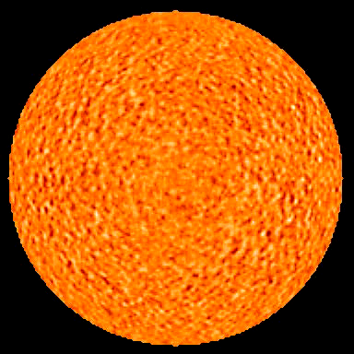
Time-distance diagnostics
Using the time-distance diagram one can measure the travel time of acoustic waves for various distances, and then infer the sound speed along the wave paths.
Can we measure the travel times by using the stochastic wave field continuously generated by the turbulent convection?

Slide 14

Time-distance helioseismology
A remarkable discovery was made by Tom Duvall in 1993 that the travel times of the solar waves can be measured by using a cross-covariance function of the stochastic wave field:
Integration time
o
r
C
(
¿
¢
)
;
Time Distance
Oscillation signal (Doppler velocity, intensity
etc) at two points on the Sun’s surface

Slide 15
Time-distance measurements
Travel times are determined from the cross-covariance function:
Cross-covariance function for a particular distance (30 degrees in this case) represents a series of wave packets.

Slide 16
Simple interpretation of time-distance measurements
The cross-covariance function collects coherent signals for solar waves excited at a given point and traveling to another point
The cross-covariance signal corresponds to a strong point source (similar to the flare signal) – Claerbout’s conjecture
The cross-covariance signal corresponds to a wave packet of waves in a finite frequency range. The solar oscillations have periods around 5 min. Thus, we see the 5-min periodicity in the wave packet.
The cross-covariance function can be used for measuring group and phase travel times.
Direct waves
Second-bounce
waves
We measure the group and phase travel times from these diagrams.

Slide 17
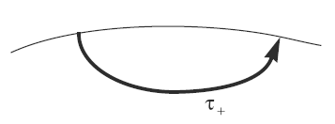
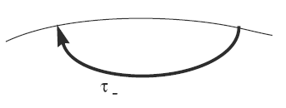
Time-distance inferences of the sound speed and flow velocity
Measures travel times of acoustic or surface gravity waves propagating between different surface points through the interior. The travel times depend on conditions, flow velocity and sound speed along the ray path:
The sound speed and flow velocity signals are separated by measuring
the travel times for waves propagating in the opposite directions along
the same ray paths and calculating the mean travel times and the differences:

Slide 18
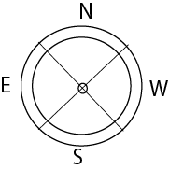
Vector velocity measurement scheme
is a travel time difference
averaged over the
full annulus.

Slide 19
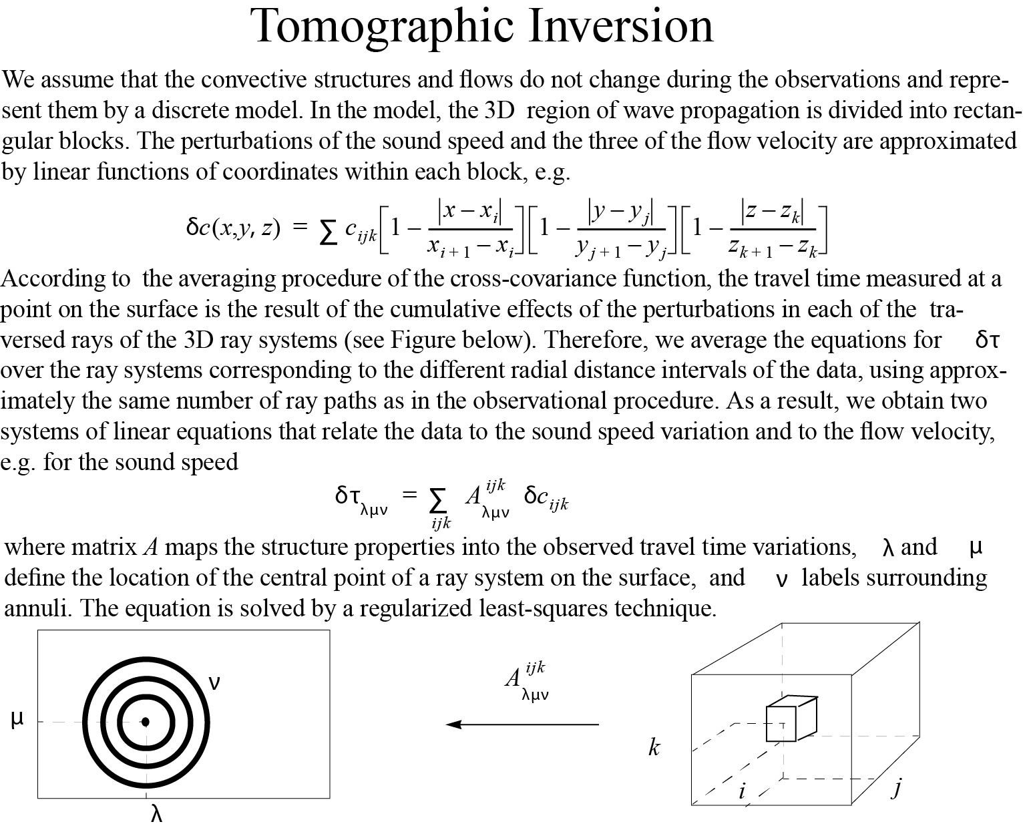
Surface travel times
measured at location
(μ,λ) for distance ν
Subsurface
perturbation
at grid point
(i,j,k)

Slide 20
Deep- and surface-focusing observing schemes
Surface focusing
Deep focusing

Slide 21
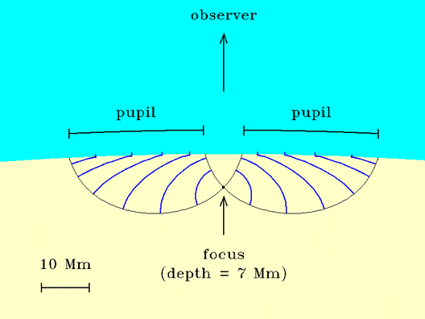
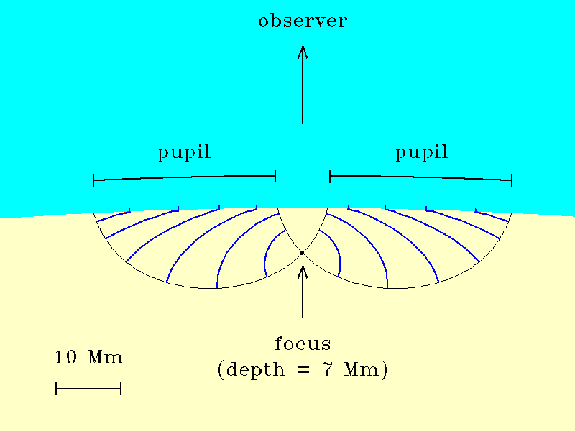
Helioseismic holography
The idea of helioseismic holography is to reconstruct the acoustic wave field at particular locations beneath the surface by using measurements on the surface and a theoretical Green’s functions for the wave propagation from point sources.
The ingression and egression estimate of the wave field at some point in the solar interior assuming that the observed wave field resulted entirely from waves diverging from that point (for the egression) or waves converging towards that point (for the ingression). Egression propagates signals back in time.
H₋ = ingression
H₊ = egression
(z = depth, r = horizontal position of the focal point, ψ= surface amplitude, G±= Greens’ functions)
The ingression and egression power is sensitive to sources, sinks at focus.
(Lindsey & Braun, 1990)

Slide 22
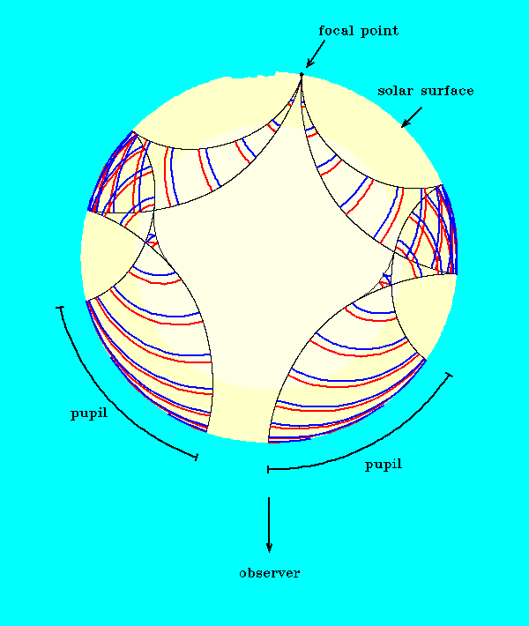
Far-side imaging with helioseismic holography
Helioseismic holography is used to obtain images of solar active region on the far-side of the Sun by placing the focal point on the far-side surface.
The analysis on calculations of the phase shift (or equivalent travel time) between the ingression and egression signals.
1. egression, ingression:
2. correlation:
3. correlation phase:
4. travel-time perturbation:
Lindsey & Braun 2000, Science 287, 1799

Slide 23
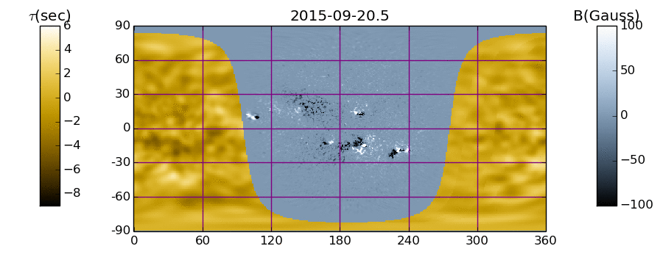
Daily far-side imaging data are used for space-weather forecasts because most solar storms are produced by active regions
GONG MDI
Composite Map of Far and Near Solar Hemispheres. Line-of-sight magnetic field in the Sun's near hemisphere is rendered in blue-gray, in Gauss. Seismic map of the Sun's far hemisphere is rendered in yellow. The far-side seismic image maps a phase shift between solar acoustic noise with periods of about five minutes embarking into the solar interior from the Sun's near hemisphere and its echos from respective locations in the far hemisphere. This phase shift is expressed here as a travel-time perturbation in seconds.
http://jsoc.stanford.edu/data/farside/

Slide 24
Results of time-distance helioseismology

Slide 25
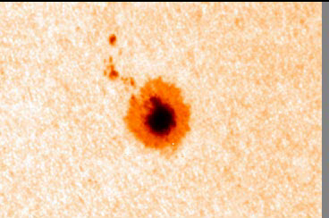
Sunspot structure and dynamics

Slide 26
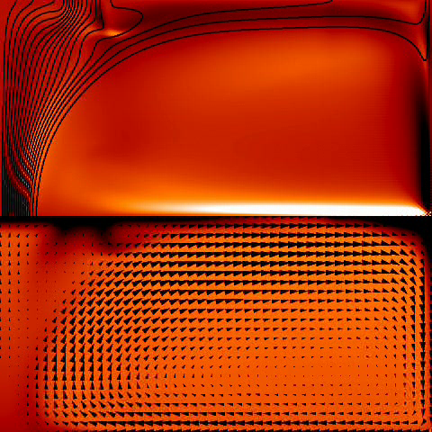
Numerical simulations of sunspot dynamics (N.Hurlburt)

Slide 27
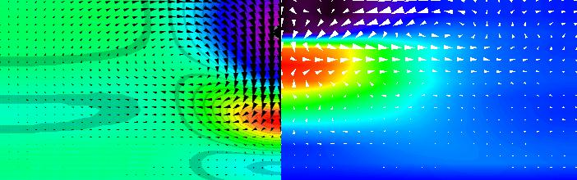
Numerical model of sunspot vs observations
Model
Hurlburt and Rucklidge(2000)
Observations

Slide 29
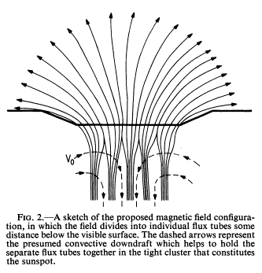
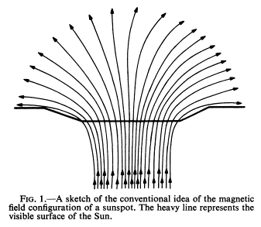
Parker’s model of sunspots
Monolithic model
Cluster Model
Helioseismology provides strong evidence for the cluster model.

Slide 30
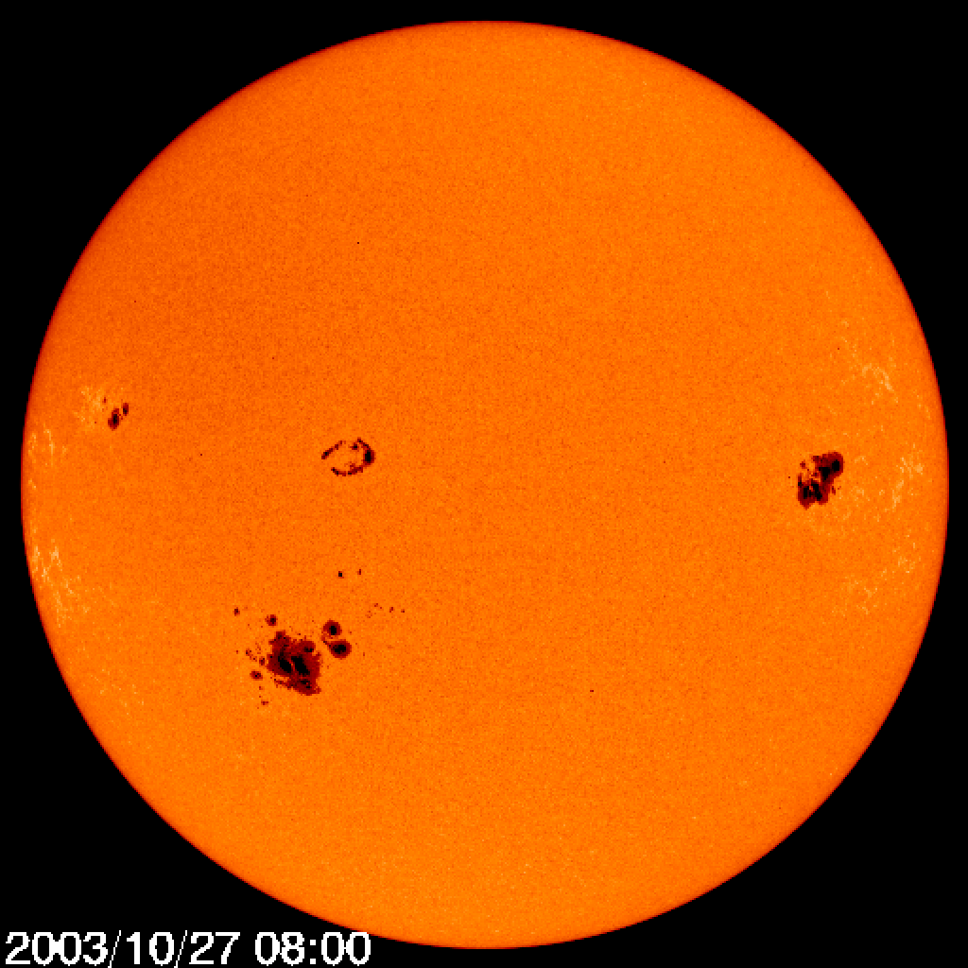
Subphotospheric imaging of active regions
AR 10488
AR 10484
AR 10486

Slide 31
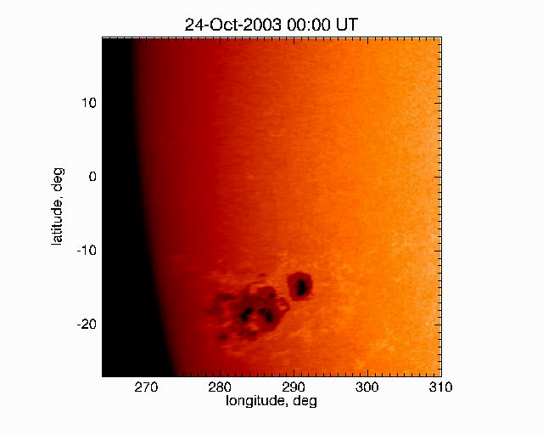
Evolution of AR 10486-488: October 24 – November 2, 2003

Slide 32
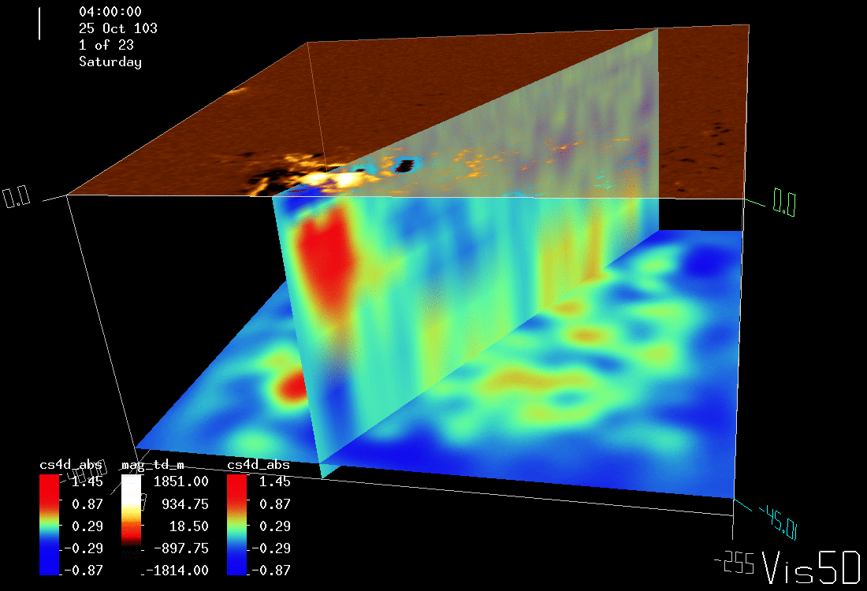
Sound-speed map and magnetogram of AR 10486 on October 25, 2003, 4:00 UT
(depth of the lower panel: 45 Mm)
AR 10486

Slide 33
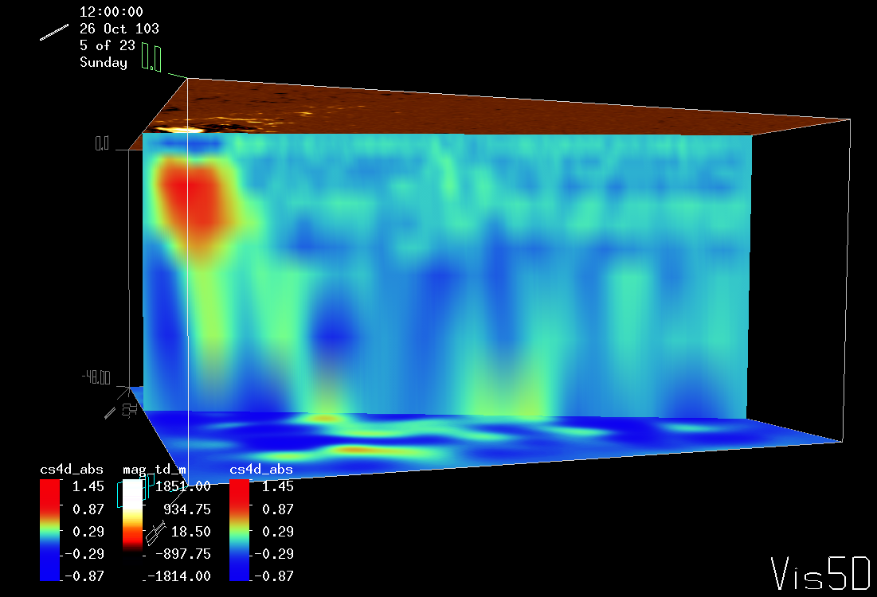
Sound-speed map and magnetogram of AR 10486 on October 26, 2003, 12:00 UT
AR 10488 is emerging
AR 10486
AR 10488

Slide 34
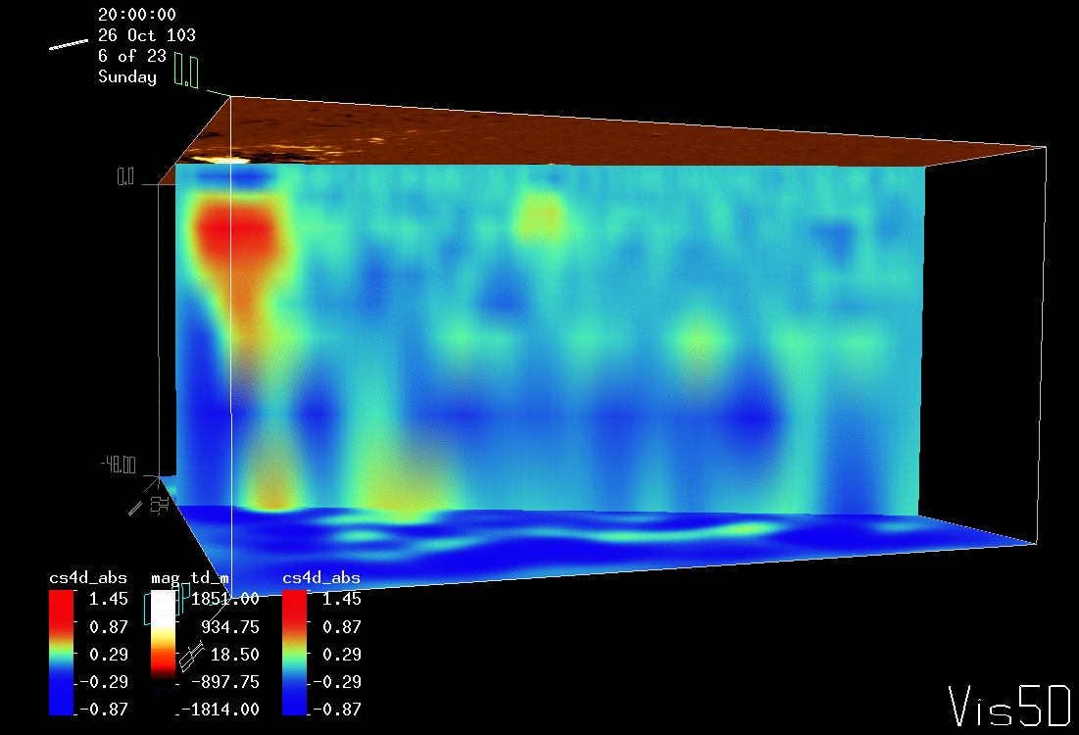
Emergence of AR 10488, October 26, 2003, 20:00 UT
AR 10488

Slide 35
Emergence of AR 10488, October 26, 2003, 20:00 UT
AR 10488

Slide 36
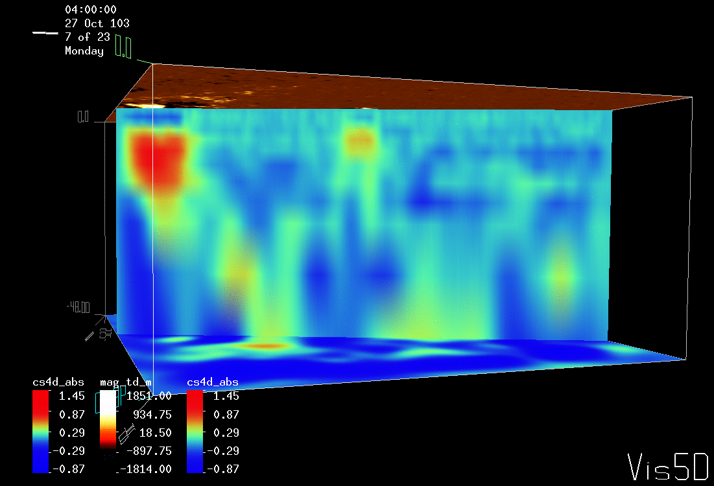
Emergence of AR 10488, October 27, 2003, 4:00 UT
AR 10488

Slide 37
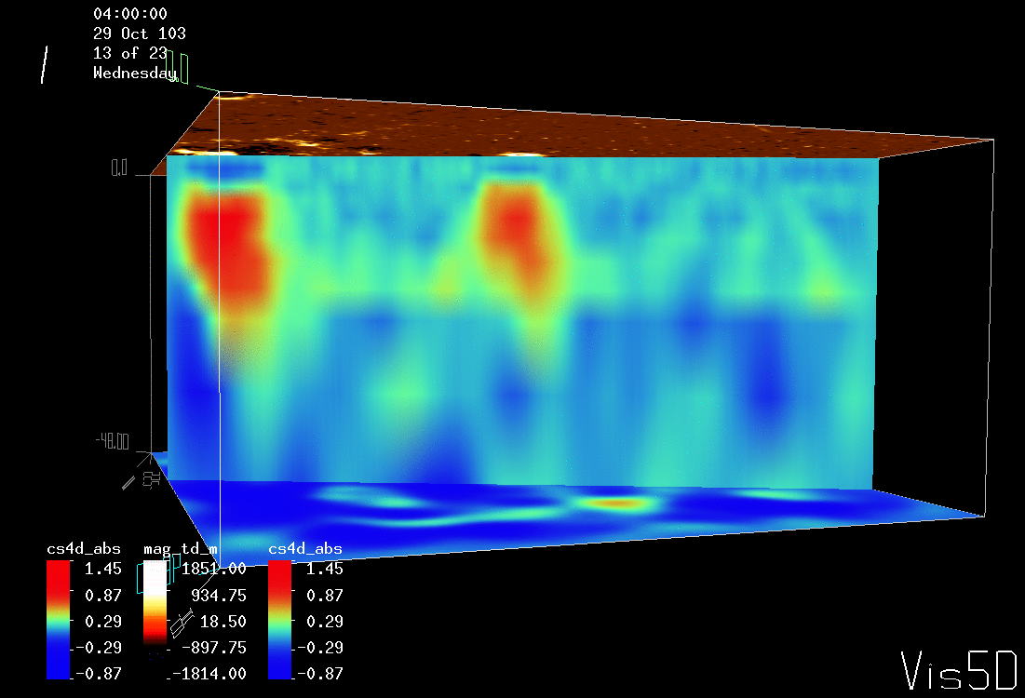
Growth and formation of sunspots of AR 10488, October 29, 2003, 4:00 UT
AR 10488

Slide 38
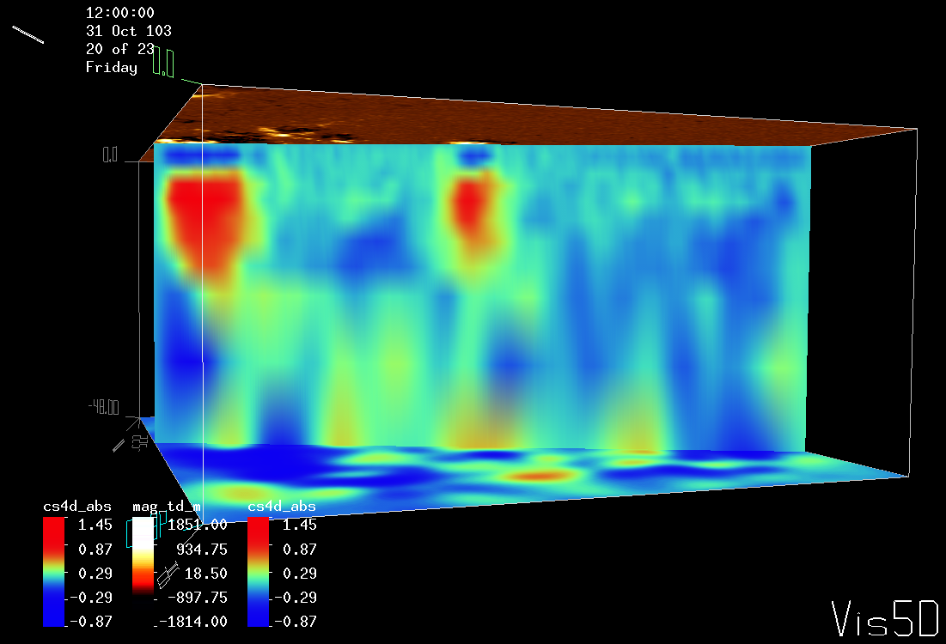
Growth and formation of sunspots of AR 10488, October 31, 2003, 12:00 UT
AR 10488

Slide 39
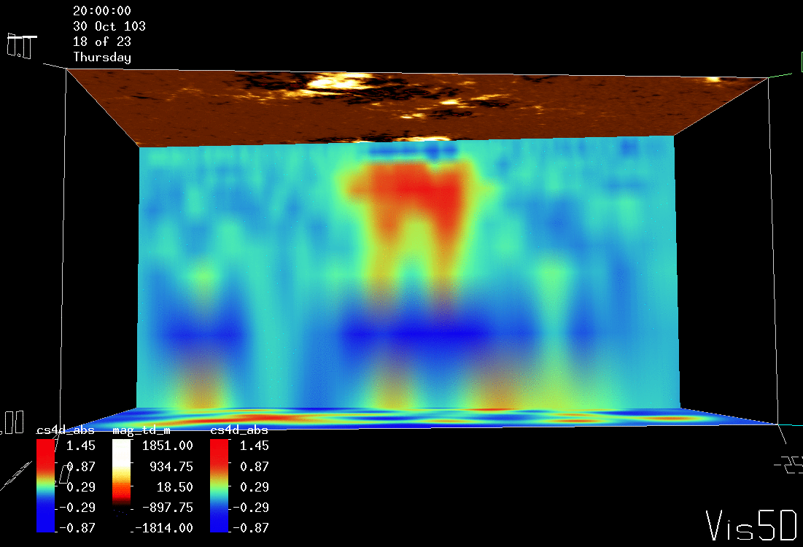
Cut in East-West direction through both magnetic polarities, showing a loop-like structure
beneath AR 10488, October 30, 2003, 20:00 UT
AR 10488

Slide 40
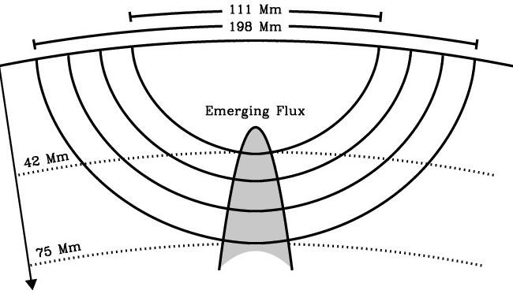
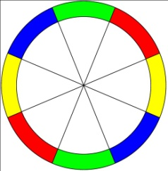
New helioseismology method of detection of emerging magnetic flux inside the Sun
Deep-focus Time-Distance Helioseismology: solar oscillation signal is filtered to select acoustic waves traveling to depth 40-70 Mm (right), averaged over arcs (left), and cross-correlated for opposite arcs. Travel-time perturbations are measured by fitting Gabor wavelet. This method has been tested with 3 different instruments (MDI, HMI, GONG) for many quiet and emerging flux regions.
Ilonidis, Zhao, Kosovichev, 2011

Slide 41

Active region NOAA 1158, February 2011
Detection of emerging active regions in the deep interior – 60-70 Mm below the visible surface, 24-hours before the flux appears on the surface.

Slide 42
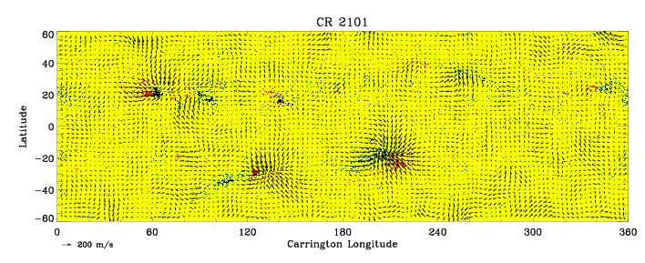
Synoptic subsurface flow maps from helioseismology analysis of Solar Dynamics Observatory data
Large-scale converging flows with a speed of ~50 m/s affect the mean meridional flow (reduce its speed at high latitudes).

Slide 43
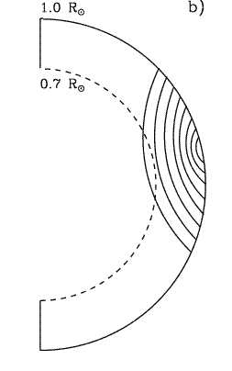
Measurements of deep meridional flows from SDO
We used HMI full-disk Doppler observations, starting from May 1, 2010 through April 30, 2012, a total of 2 years’ observations.
Full-disk data are firstly binned down to 1024x1024 pixels. Running difference data are used for analysis.
Deep-focusing time-distance helioseismology measurement is used.
Fitting for acoustic travel times is done for each Carrington rotation. Then, fitted travel times are averaged over this 2-year period for the final results.

Slide 44
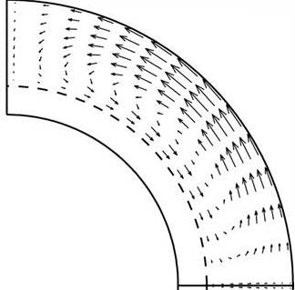
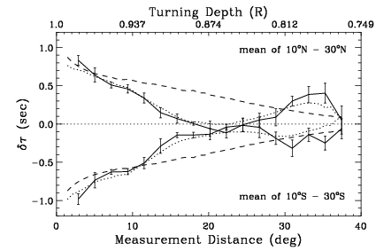
The helioseismology data do not support a single circulation cell needed for flux-transport dynamo
Travel-time measurements
Inversion result
Zhao et al, 2013

Slide 45
Double-Cell Meridional Circulation from Helioseismology
The upper circulation cell extends from surface to about 0.83R (depending on latitude) , with the flow direction starting to change to equator-ward at about 0.93R (50Mm). Meridional flows switch to pole-ward again below 0.83R. The pole-ward flow near surface is an order of 15 m/s. The equator-ward flow below is an order of 10 m/s. The deeper pole-ward flow is roughly 10m/s.
Zhao et al, 2013

