Slide 1
12. Solar Convection

Slide 2
Solar Convection
Convection Zone
Convective Instability
Convective Energy Transport
Mixing-Length Theory
Convective overshoot
Observation of Solar Convection
  Granulation
  Supergranulation
  Search for giant cells
Numerical Simulations of Solar Convection

Slide 3
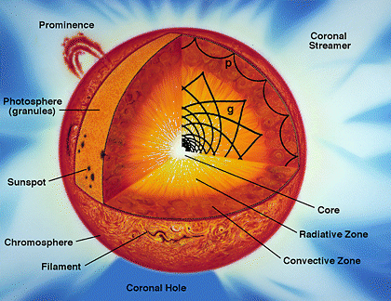

Slide 4
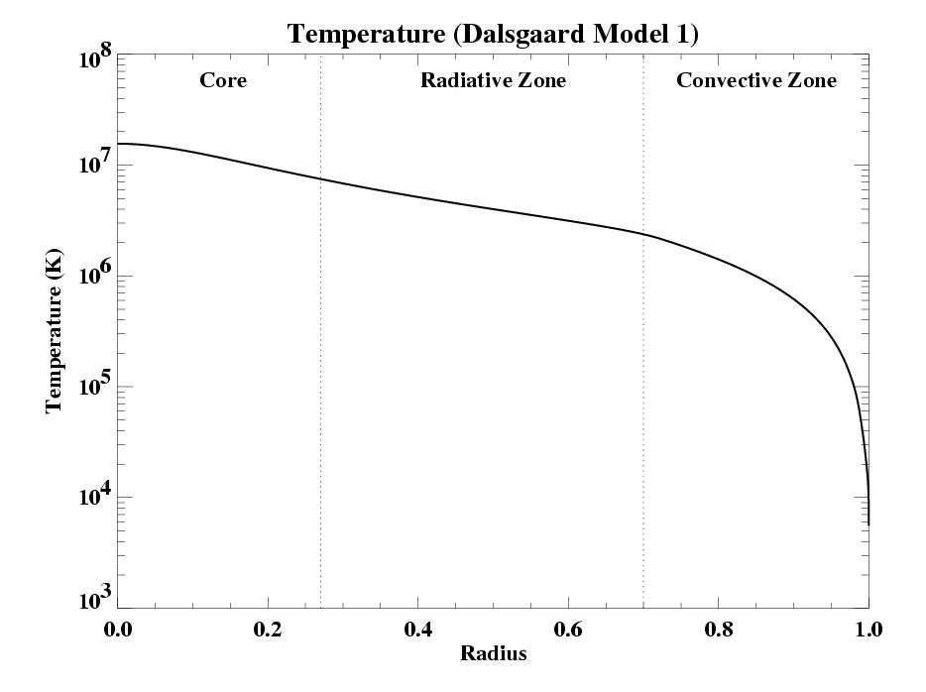
Origin of the solar convection zone

Slide 5
Radiative and convective energy fluxes

Slide 6
Convective instability

Slide 8
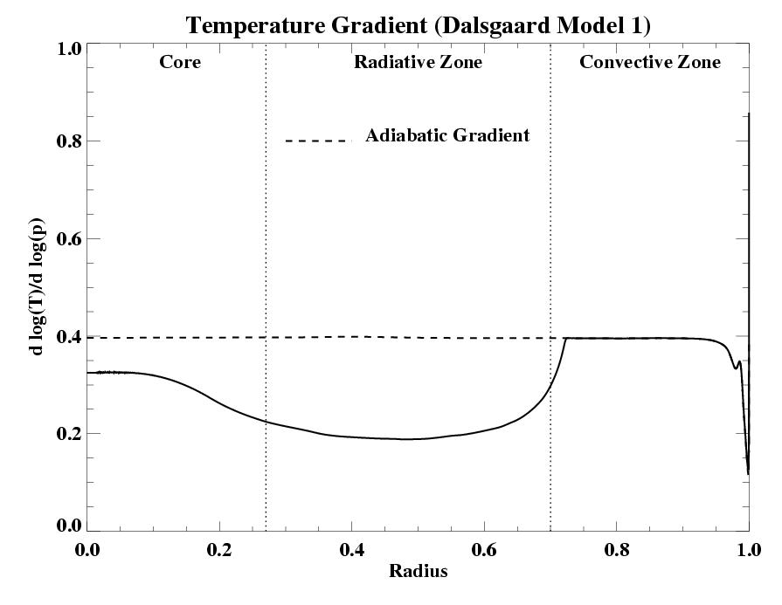
Convective instability in terms of temperature gradients
He⁺⁺
Ionization zones
H⁺

Slide 9
Effect of molecular weight gradients on convective instability
Because of nuclear reactions the solar core has more helium than the rest of the Sun. Thus, the molecular weight decreases with the radius.

Slide 12
Mixing-length parameter

Slide 13
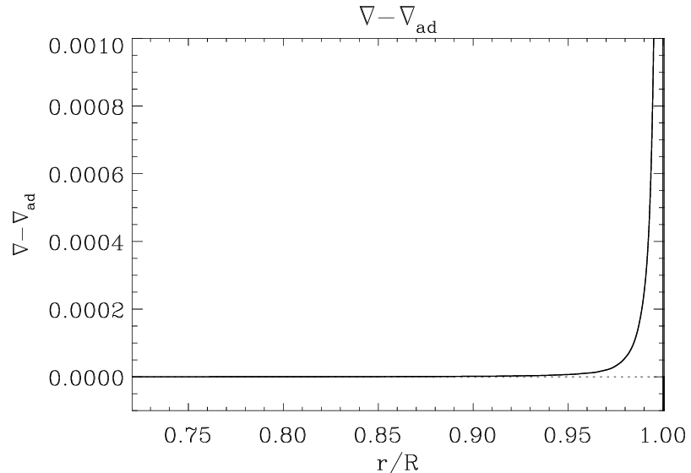
Superadiabatic gradient
Superadiabatic zone

Slide 15
Adiabatic overshoot
Subadiabatic overshoot

Slide 16
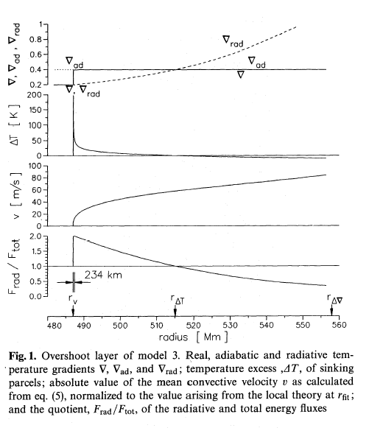
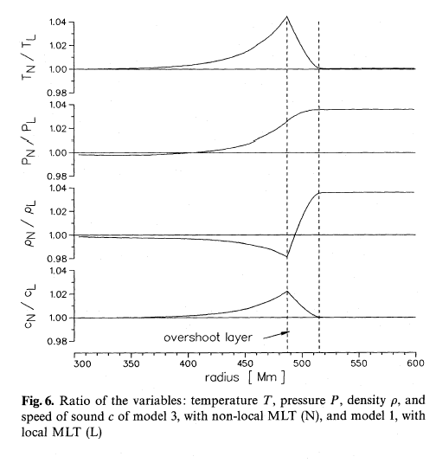
Overshoot model of Stix and Skaley (1991) may explain the sound-speed bump (in )at the base of the convection zone found by helioseismology
Sound-speed peak

Slide 19
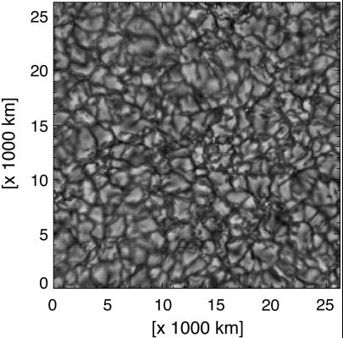

Slide 20
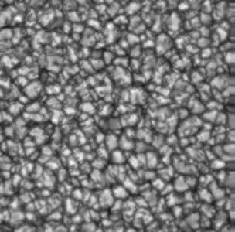
Movie of solar granulation observed with adaptive optics

Slide 21
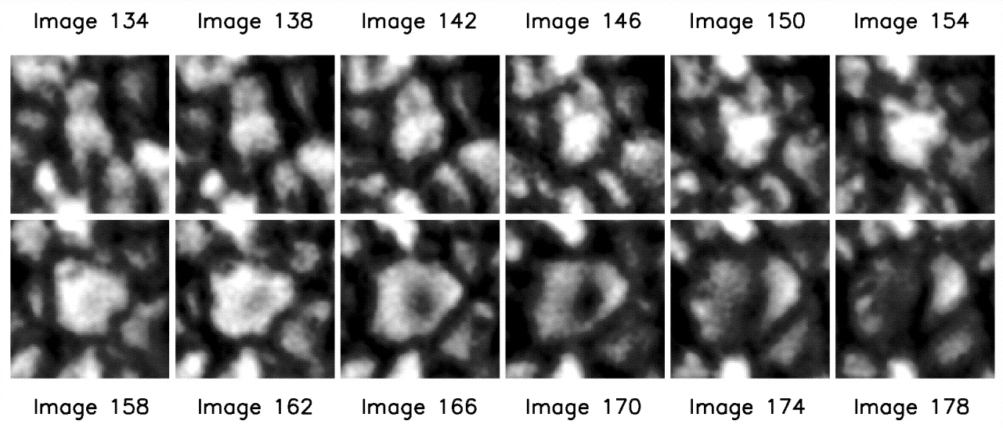

Slide 22
Flow field in exploding granules

Slide 23
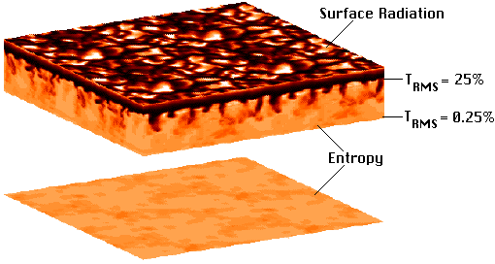

Slide 24
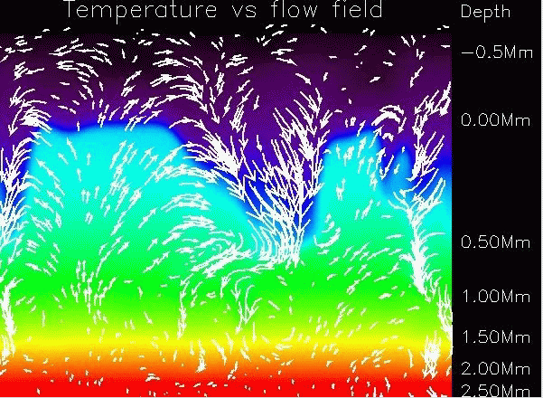

Slide 25
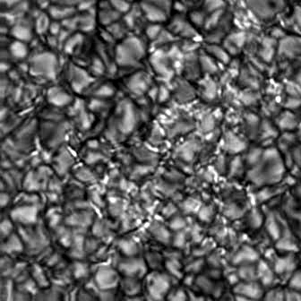
Concentrations of magnetic flux tubes (B~1 kG) in the intergranular lanes

Slide 26
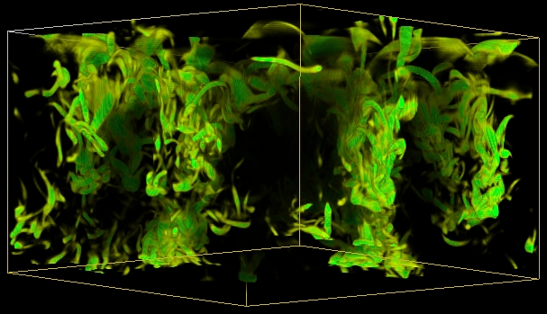
Numerical simulations reveal flow vorticity in the convection downdrafts in the intergranular lanes

Slide 27
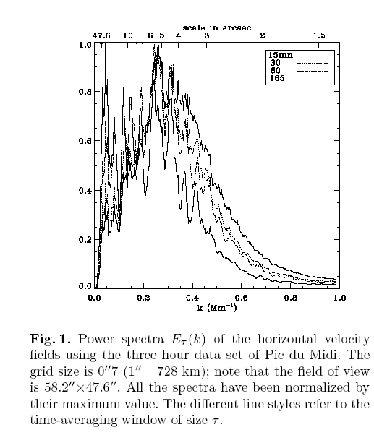
Spectral properties of solar convection
1 arcsec = 720 km
Granulation size ~ 3,000-4,000 km
Mesogranulation size ~ 7,000-8,000 km
Supergranulation size ~ 30,000-40,000 km
granulation
supergranulation
mesogranulation

Slide 28
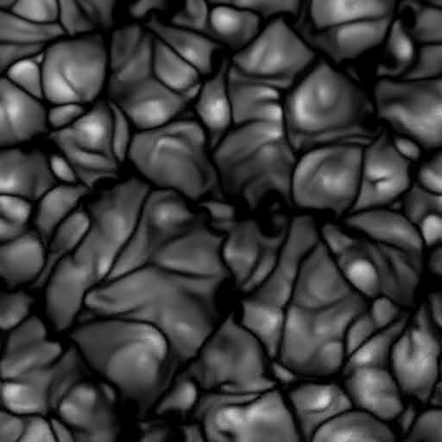
Mesogranulation – clustering of granules – no clear observational picture
Numerical simulation by Cattaneo et al

Slide 29
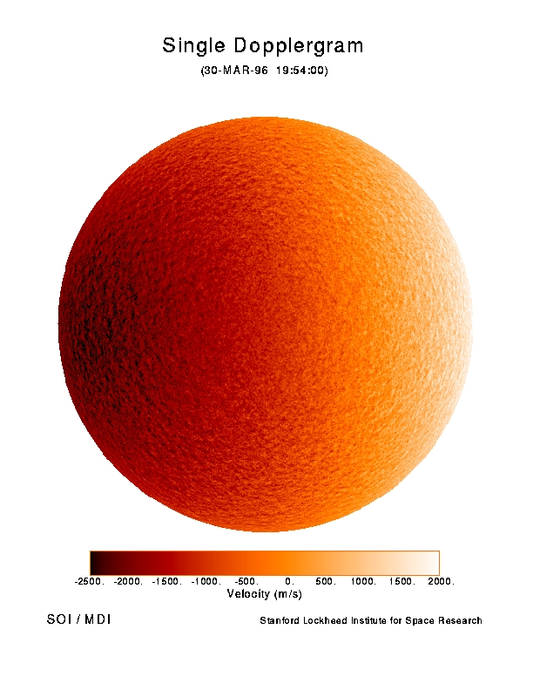
The rotation speed of the solar surface is 2km/s.

Slide 30
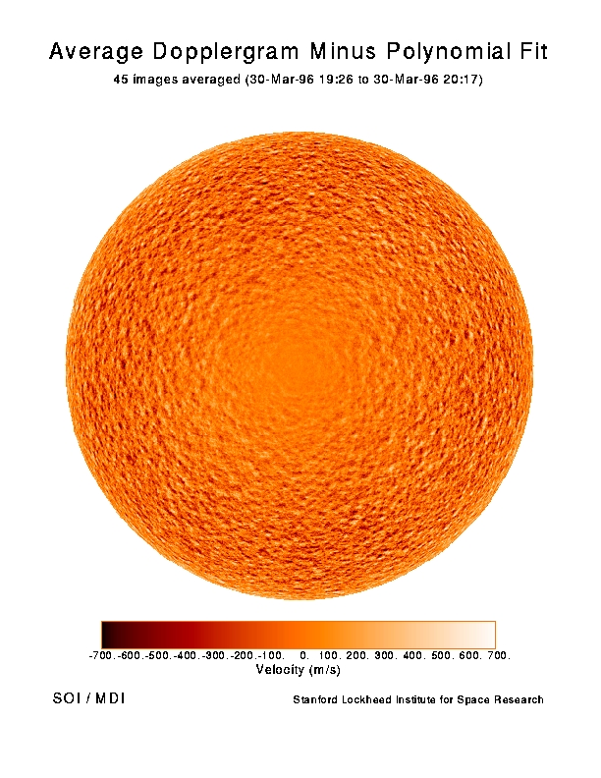

Slide 31
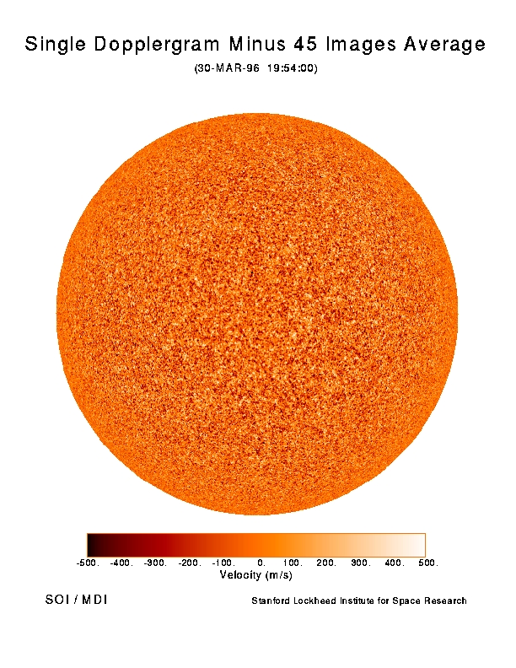

Slide 32
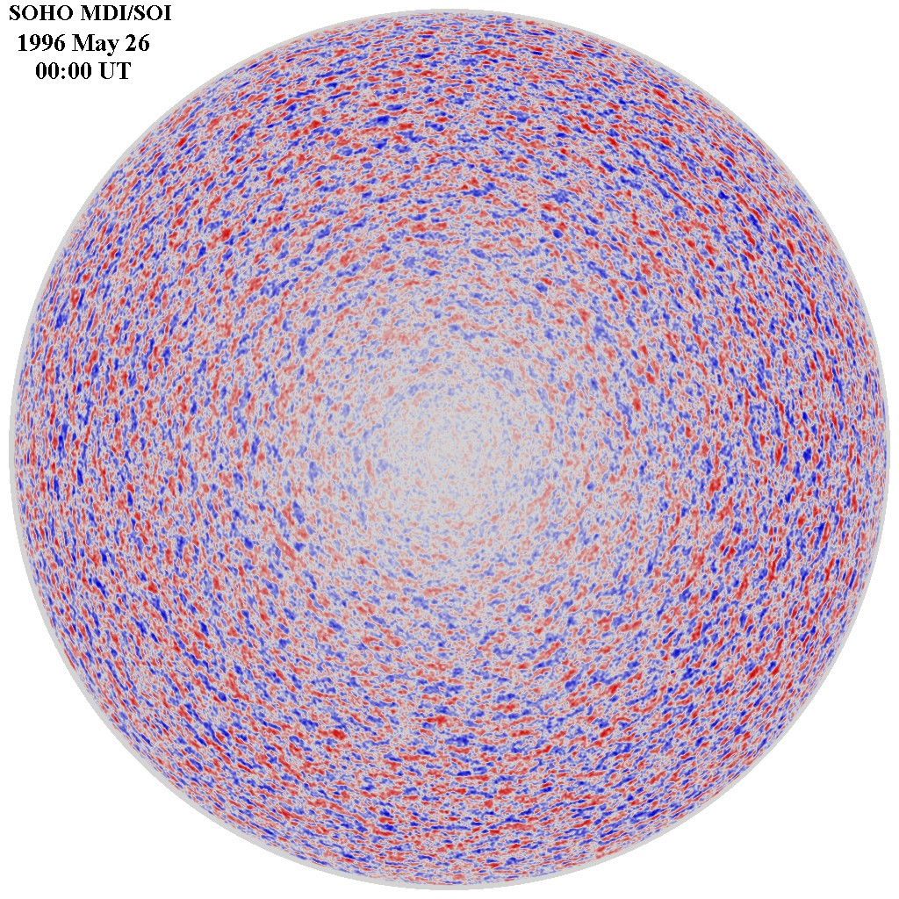
Supergranulation
Doppler shift
observations

Slide 33
Measurement of supergranulation flows by time-distance helioseismology

Slide 34
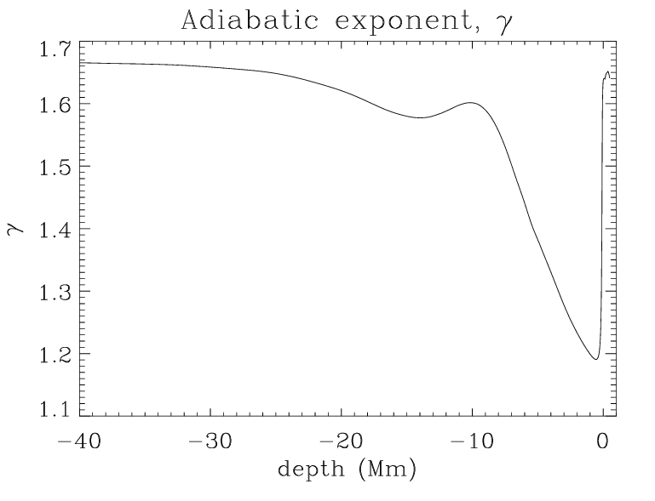
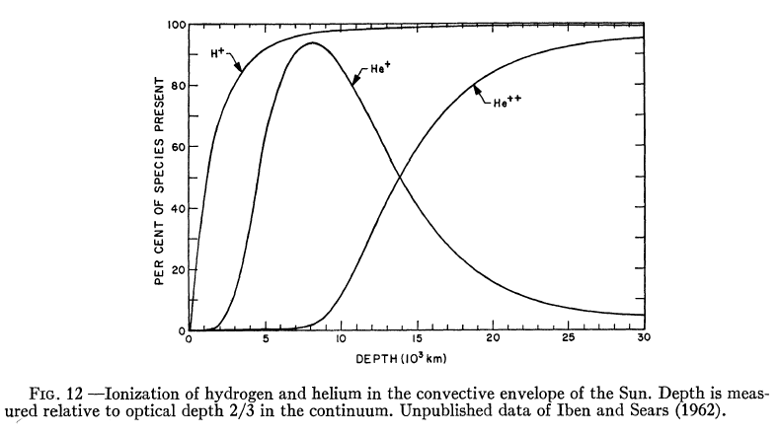
Origin of supergranulation
Origin of supergranulation – increased convective instability in the He II ionization zone (second ionization of helium), located 15 Mm below the photosphere (Simon & Leighton, 1963), due to the decreasing adiabatic exponent γ < 5/3.
He⁺⁺
He⁺, H⁺

Slide 35
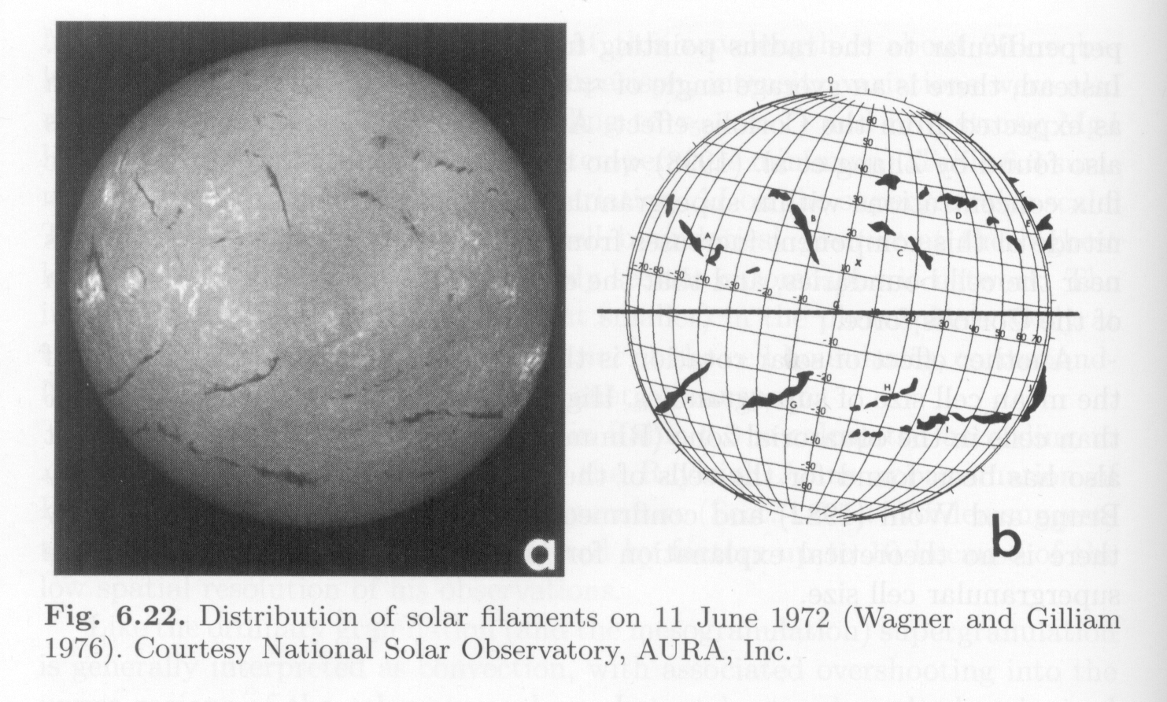
Search for giant cells

Slide 36
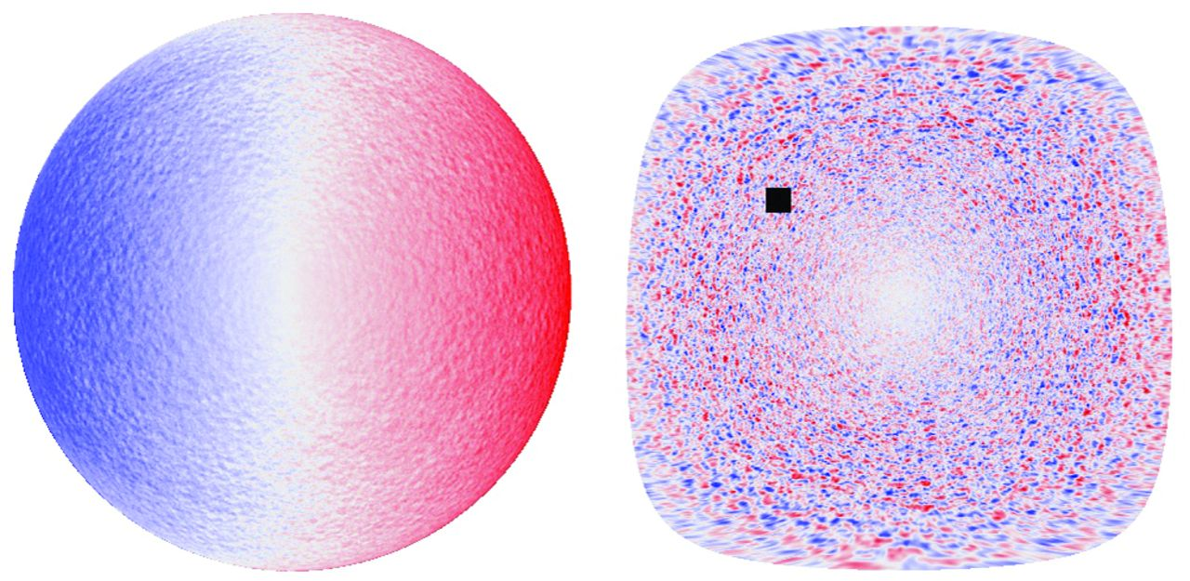
Science 6 December 2013:
Vol. 342 no. 6163 pp. 1217-1219
Giant Convection Cells Found on the Sun
David H. Hathaway, Lisa Upton, Owen Colegrove
They found evidence for giant cellular flows that persist for months by tracking the motions of supergranules.

Slide 37
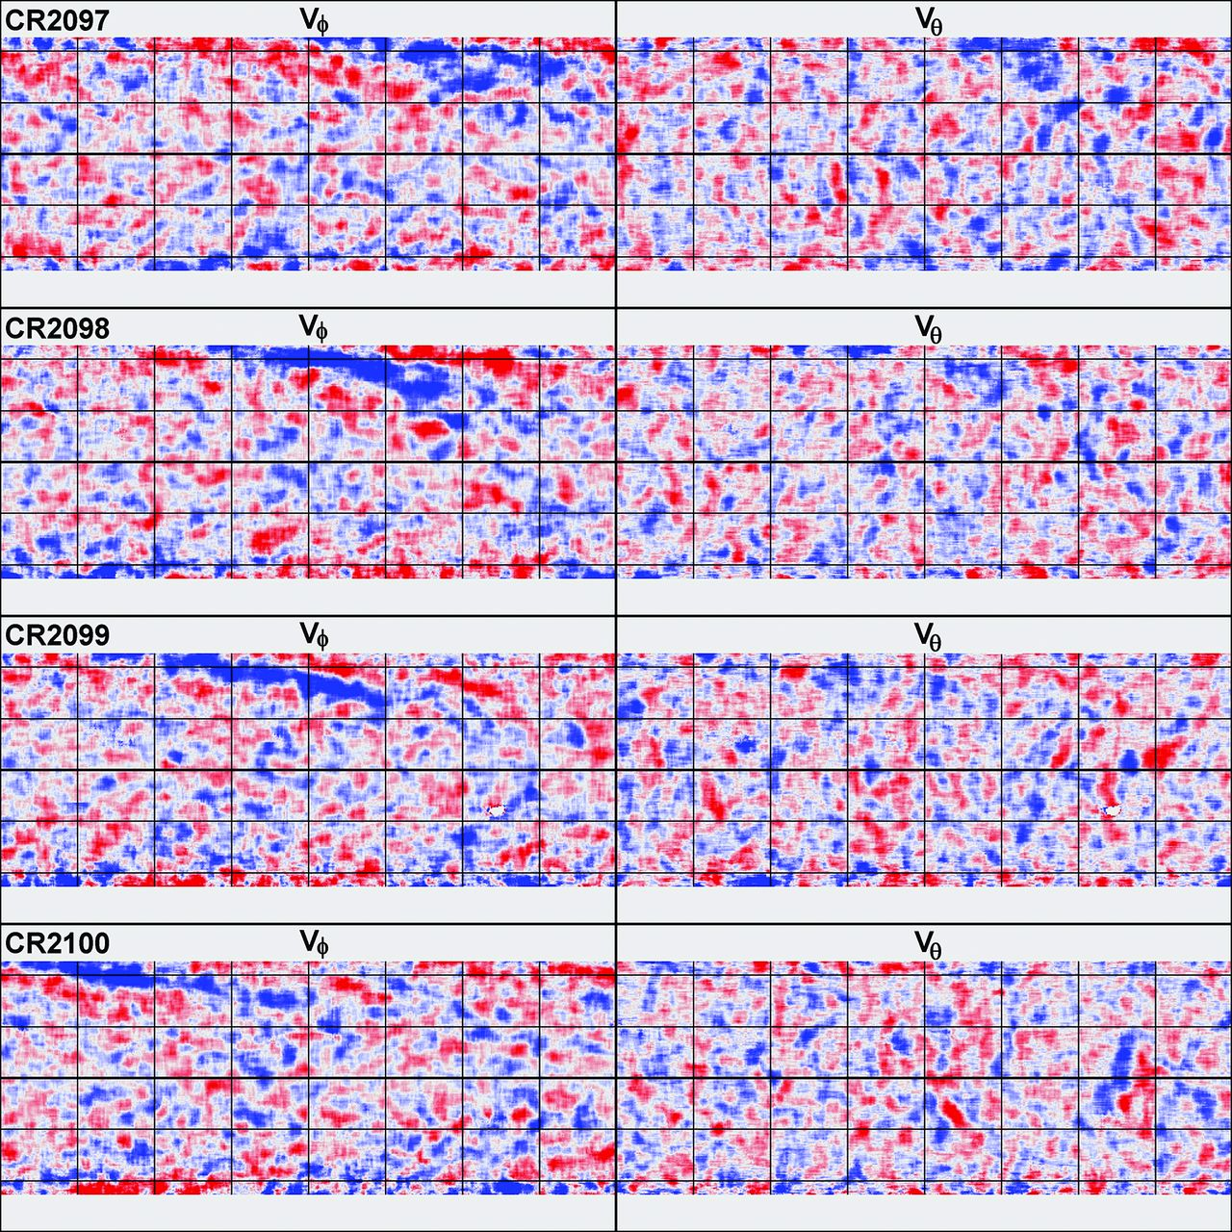
Evidence for Giant Convection Cells
latitude
longitude
A sequence of supergranule flow velocity maps shows persistent large-scale patterns.

Slide 38
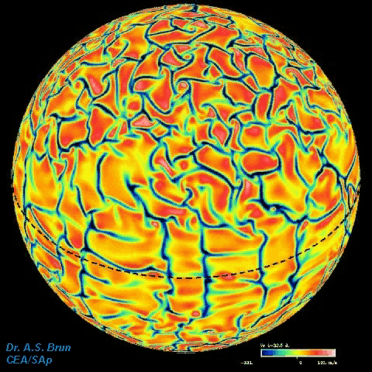
Numerical simulations of convection in a rotating sphere have not explained the multi-scale structure of solar convection but reproduced the differential rotation

