Slide 1
14. Solar MHD

Slide 2
Solar MHD
Particle Motion in Electric Field
Magnetic Effects
Ohm’s Law
MHD Equations
Magnetic Field Diffusion
Frozen Magnetic Flux Approximation
Magnetic Forces
MHD Waves
Magnetohydrodynamics movie: https://www.youtube.com/watch?v=QArcTylNooQ

Slide 3
Examples of MHD dynamics
Sunspots
Flares
Coronal mass ejections
Oscillations and waves

Slide 4
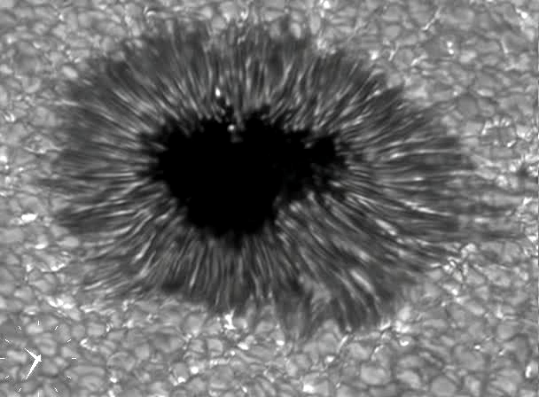
Sunspots
Size: 10-20 Mm, Lifetime: 1 Month

Slide 5
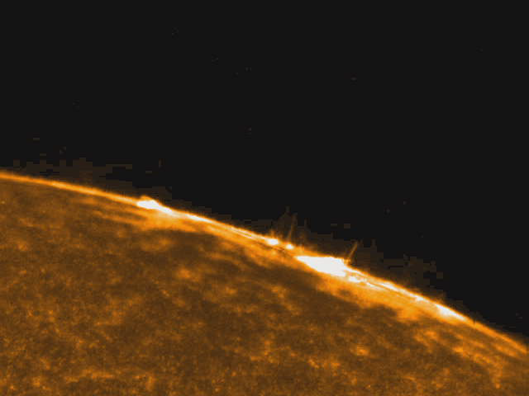
Flares
Size: 10-100 Mm, lifetime: 100-1000 sec

Slide 6
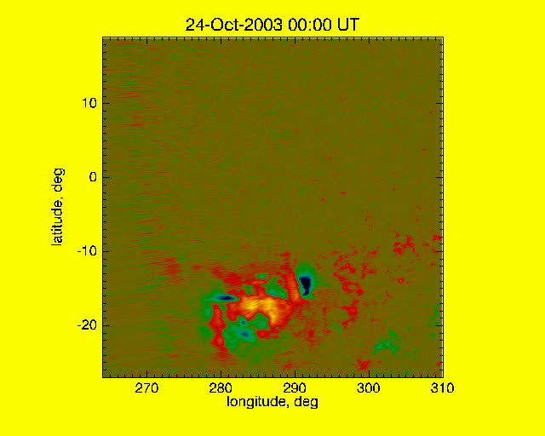
Magnetic field of Active Region 10486 (October 2003)

Slide 7
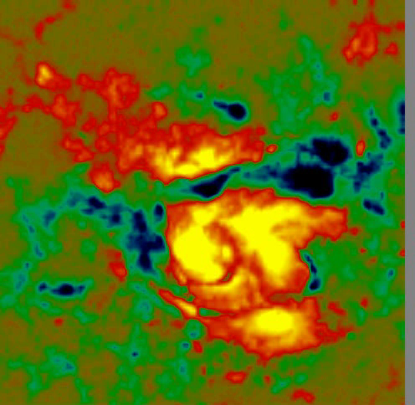
Magnetic field changes in X10 flare, Oct. 29, 2003, 20:37 UT

Slide 8
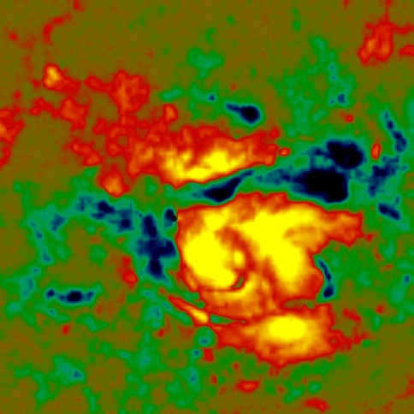
20:28 UT
Flare energy release is associated with magnetic neutral lines

Slide 9
20:28 UT

Slide 10
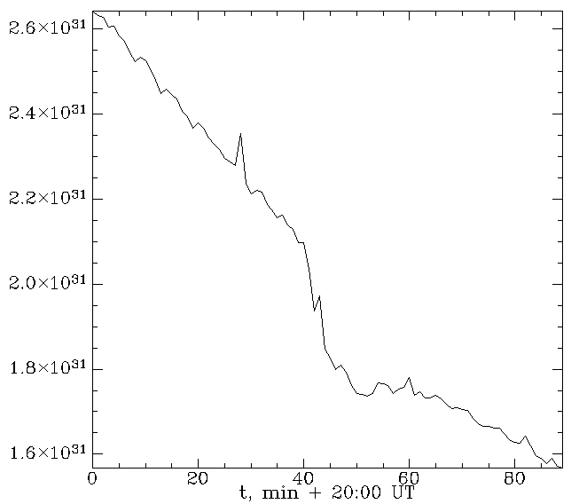
Change of the magnetic energy during the flare
DE, erg/cm

Slide 11
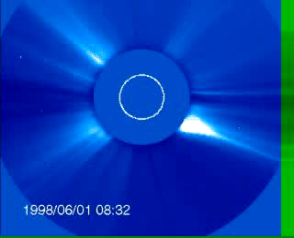
Coronal mass ejections (CME)
Size: 100 Mm, eruption time: 1000 sec

Slide 12
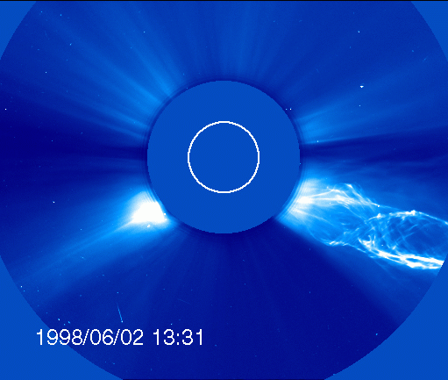
Coronal mass ejections show twisted magnetic structures

Slide 13
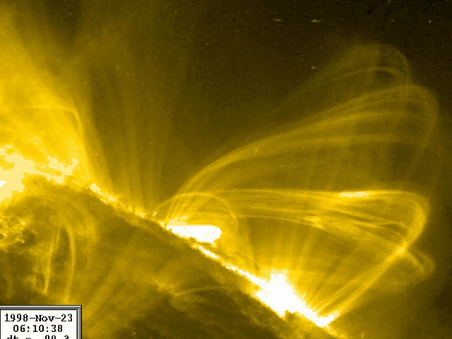
Coronal loop oscillations represent various types of MHD waves
Size: 100 Mm, period: 300 sec

Slide 16
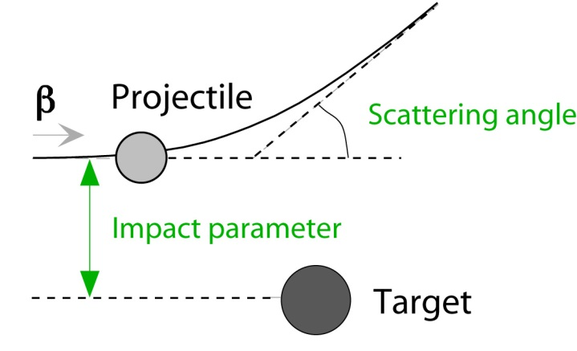
e
d
Ze

Slide 19
Run-away electrons may contribute to coronal heating

Slide 20
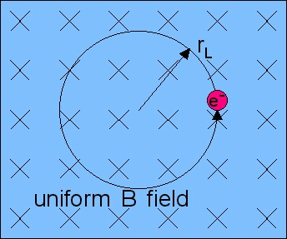

Slide 24
MHD approximation
neglect displacement current because MHD processes are slow compared to the speed of light
neglect separation of electric charges of electrons and ions – plasma quasi-neutrality

Slide 29
advection of magnetic field
magnetic field diffusion

Slide 33
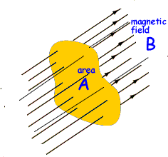

Slide 35
B₀
θ
k
wave vector

Slide 37
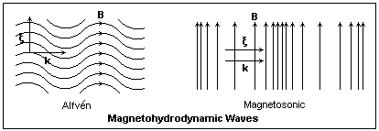
Illustration of Alfven and magnetosonic (fast MHD) waves
(fast MHD waves)
Alfven waves are incompressible. They transfer vorticity along the field lines. Plasma oscillates across the initial field lines.
The fast MHD waves mostly travel across the magnetic field lines with a speed higher the speed of sound and the Alfven speed.
The slow MHD waves mostly travel along the field line with a speed slower than the sound speed.

Slide 38
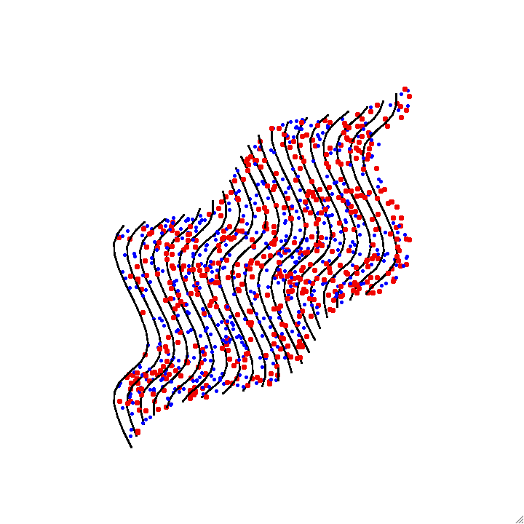
Animation of Alfven wave – magnetic field lines are frozen in plasma

Slide 39
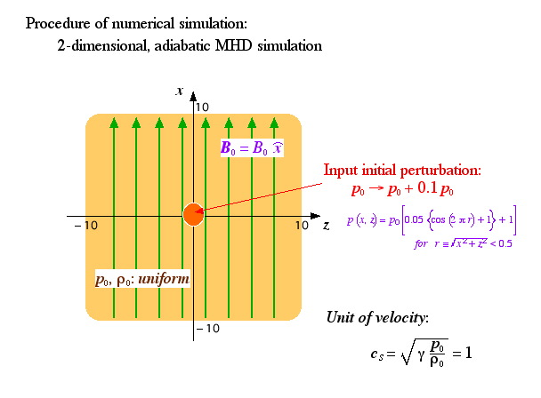
Illustration of the wave propagation and energy transport from a localized pressure perturbation (T. Magara)

Slide 40
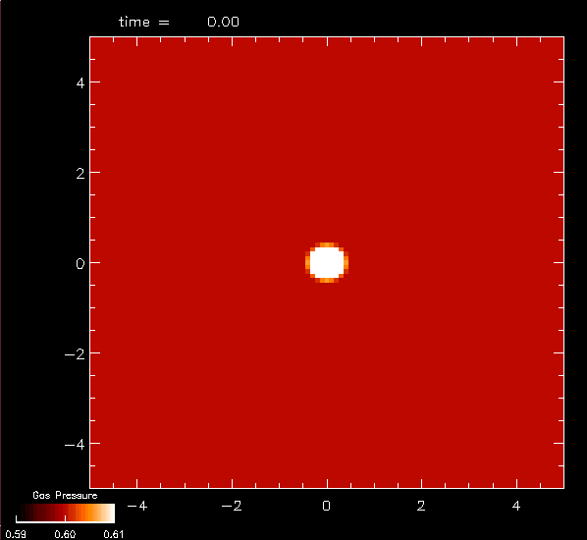
Sound wave (B₀=0)
Without magnetic field the solution represents an isotropic sound wave.
Pressure perturbation

Slide 41
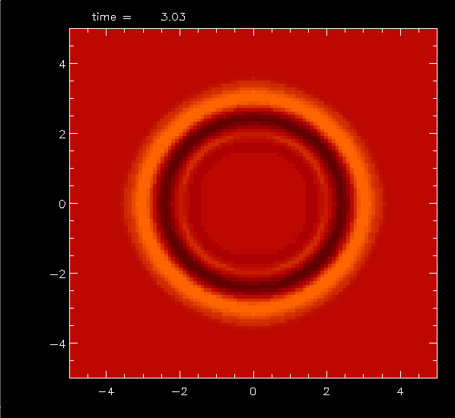
Sound wave (B₀=0)
Without magnetic field the solution represents an isotropic sound wave.
Pressure perturbation

Slide 42
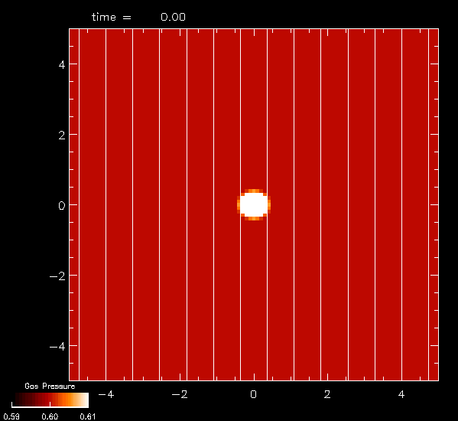
Weak magnetic field (c_{S}>v_{A})
In the case of weak field:
the solution is a superposition of fast MHD waves (most pronounced across the field lines) and slow wave (mostly along the field lines) .
This is the case of “high plasma beta”:
B₀
Pressure perturbation

Slide 43
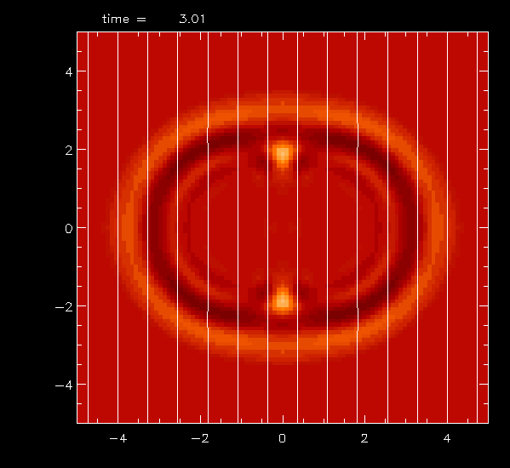
Weak magnetic field (c_{S}>v_{A})
In the case of weak field:
the solution is a superposition of fast MHD waves (most pronounced across the field lines) and slow wave (mostly along the field lines) .
This is the case of “high plasma beta”:
B₀
Pressure perturbation

Slide 44
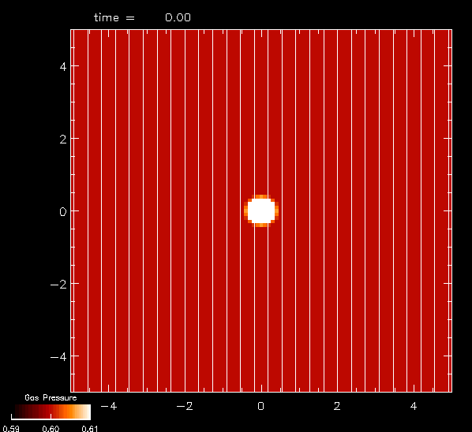
Strong magnetic field (v_{A}>c_{S})
In this case (“low plasma beta”) most of the energy is transported by
the slow MHD waves along the magnetic field lines.
B₀
Pressure perturbation

Slide 45
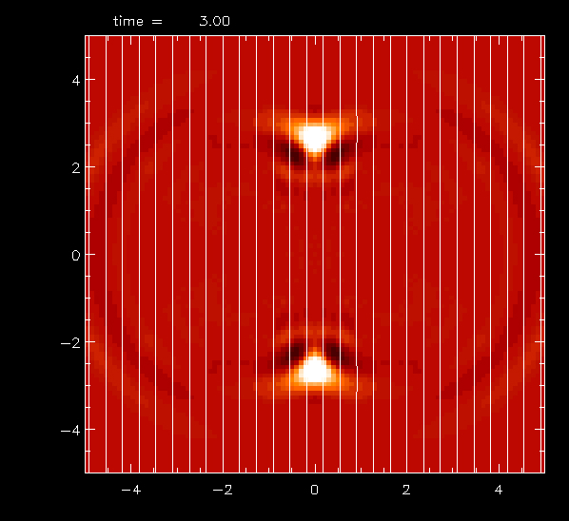
Strong magnetic field (v_{A}>c_{S})
In this case (“low plasma beta”) most of the energy is transported by
the slow MHD waves along the magnetic field lines.
B₀
Pressure perturbation

Slide 46
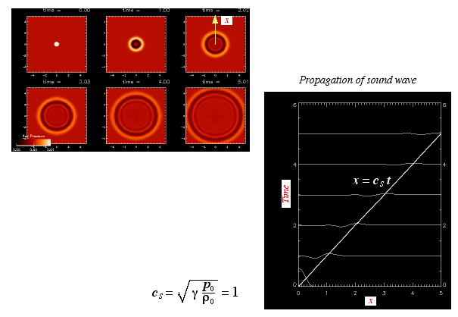
Propagation of pure acoustic wave
Time-distance diagram

Slide 47
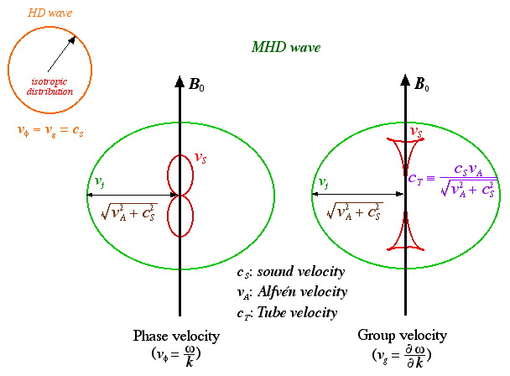
Explanation of MHD waves in terms of phase diagrams
(Friedrich’s diagrams)
(strong field case)
ω/k
v_{A}
c_{S}
We plot the phase velocity, u=ω/k
(or v_{φ}), in the polar coordinates (|u|,θ), where θ is the angle between B₀ and wave vector k.

Slide 48
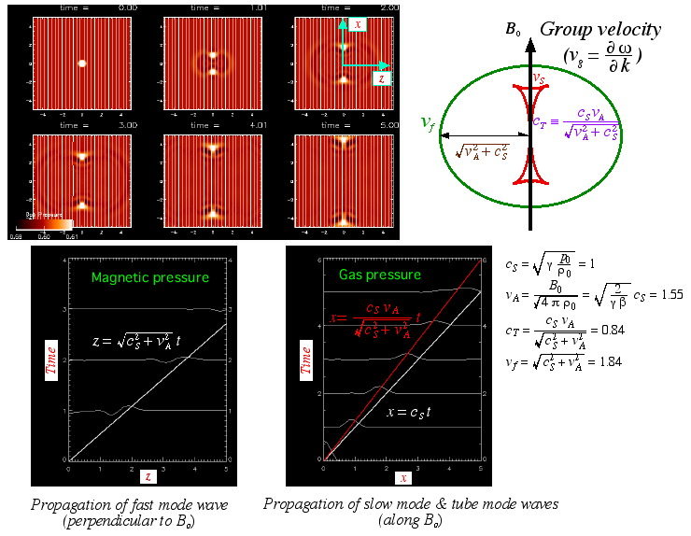
Propagation of MHD waves: case v_{A}>c_{S}
Strong magnetic field transports wave energy preferentially along the magnetic field.

Slide 49
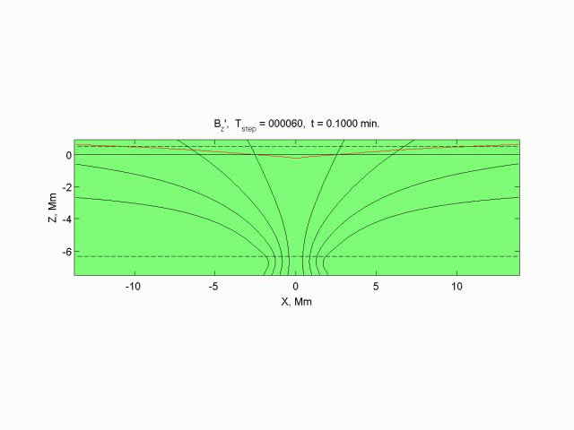
Numerical simulation of MHD wave propagation
through a sunspot (K.Parchevsky)
Fast MHD waves travels across the magnetic field lines; slow MHD waves travels along the field lines into the deeper layers.

