Slide 1
15. Solar MHD II.

Slide 2
Solar MHD
Particle Motion in Electric Field
Magnetic Effects
Ohm’s Law
MHD Equations
Magnetic Field Diffusion
Frozen Magnetic Flux Approximation
Magnetic Forces
MHD Waves
Magnetohydrodynamics movie: https://www.youtube.com/watch?v=QArcTylNooQ

Slide 3
MHD approximation
neglect displacement current because MHD processes are slow compared to the speed of light
neglect separation of electric charges of electrons and ions – plasma quasi-neutrality

Slide 6
advection of magnetic field
magnetic field diffusion

Slide 10
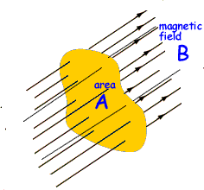

Slide 13
B₀
θ
k
wave vector

Slide 14
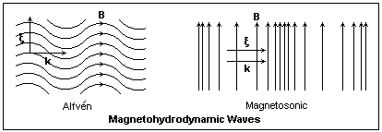

Slide 16
Illustration of Alfven and magnetosonic (fast MHD) waves
(fast MHD waves)
The Alfven waves are incompressible. They transfer vorticity along the field lines. Plasma oscillates across the initial field lines.
The fast MHD waves mostly travel across the magnetic field lines with a speed higher the speed of sound and the Alfven speed.
The slow MHD waves mostly travel along the field line with a speed slower than the sound speed.
In plasma of variable density (solar atmosphere) the waves can transform from one type to another.

Slide 17
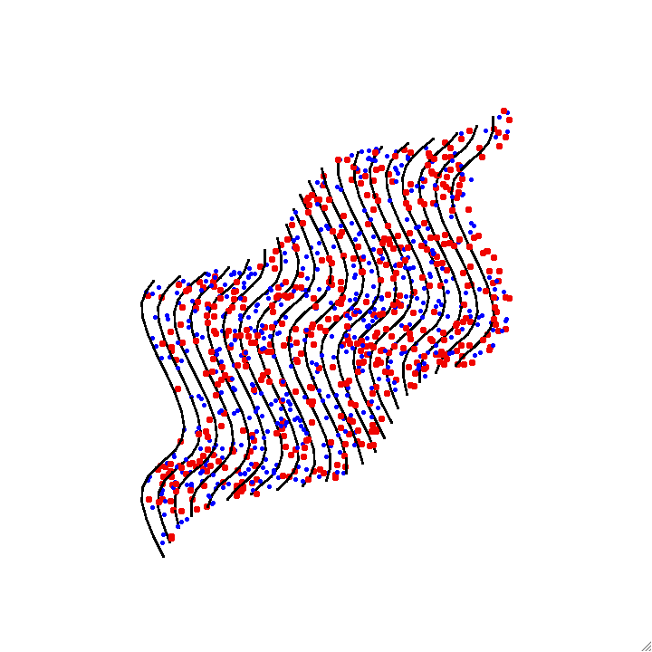
Animation of Alfven wave – magnetic field lines are frozen in plasma

Slide 18
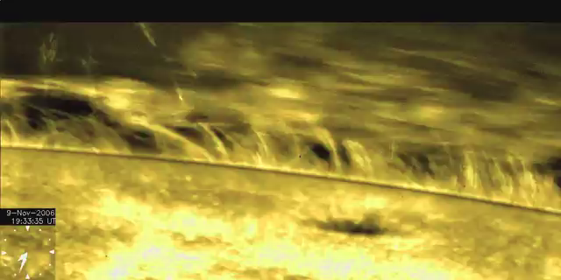
Hinode observations of Alfven waves in the solar corona

Slide 19
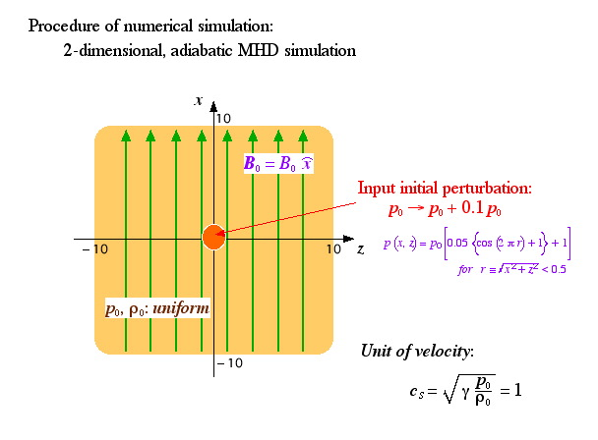
Illustration of the wave propagation and energy transport from a localized pressure perturbation (T. Magara)

Slide 20
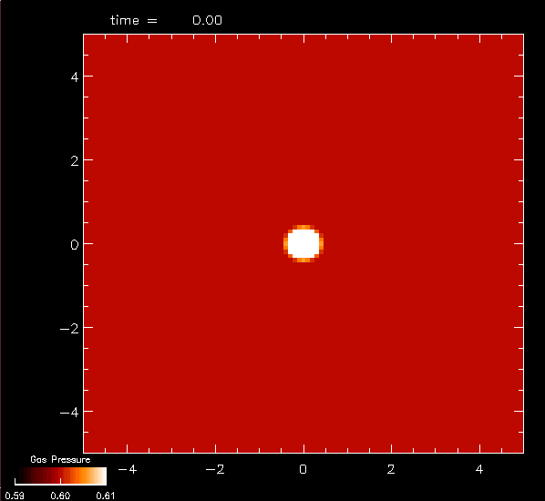
Sound wave (B₀=0)
Without magnetic field the solution represents an isotropic sound wave.
Pressure perturbation

Slide 21
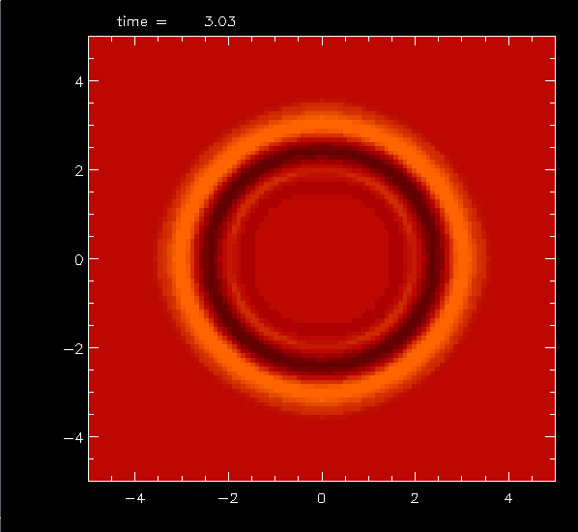
Sound wave (B₀=0)
Without magnetic field the solution represents an isotropic sound wave.
Pressure perturbation

Slide 22
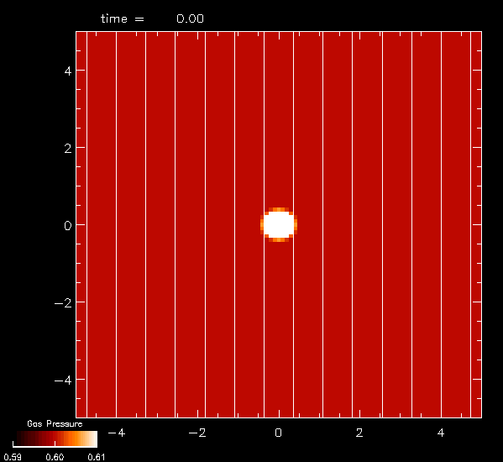
Weak magnetic field (c_{S}>v_{A})
In the case of weak field:
the solution is a superposition of fast MHD waves (most pronounced across the field lines) and slow wave (mostly along the field lines) .
This is the case of “high plasma beta”:
B₀
Pressure perturbation

Slide 23
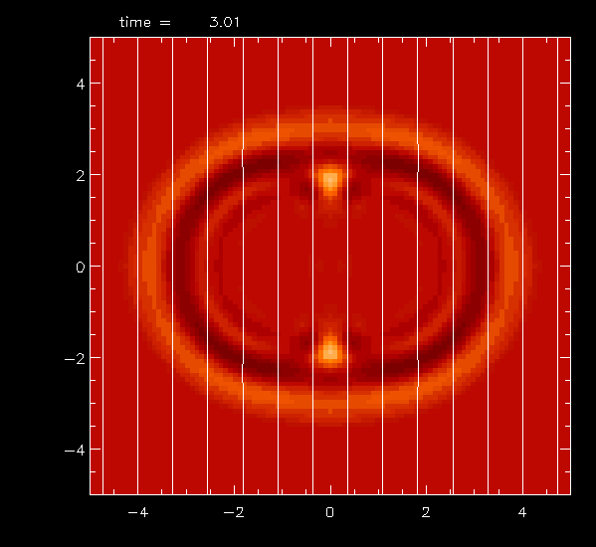
Weak magnetic field (c_{S}>v_{A})
In the case of weak field:
the solution is a superposition of fast MHD waves (most pronounced across the field lines) and slow wave (mostly along the field lines) .
This is the case of “high plasma beta”:
B₀
Pressure perturbation

Slide 24
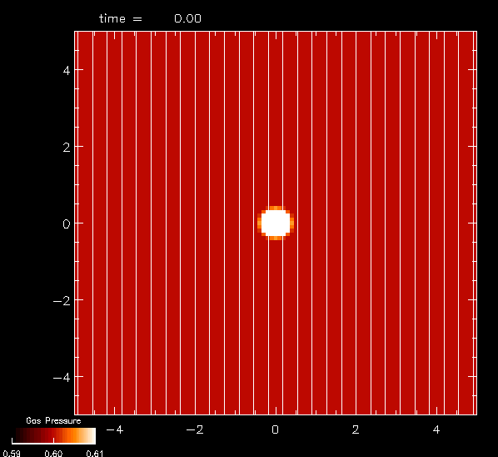
Strong magnetic field (v_{A}>c_{S})
In this case (“low plasma beta”) most of the energy is transported by
the slow MHD waves along the magnetic field lines.
B₀
Pressure perturbation

Slide 25
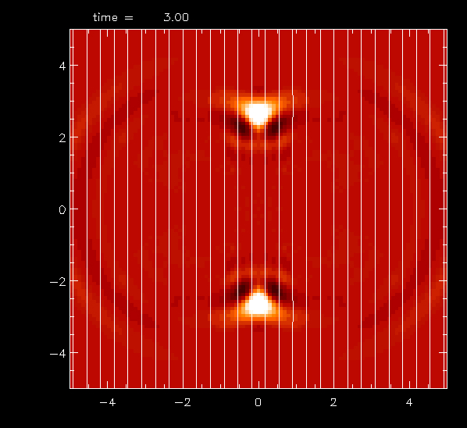
Strong magnetic field (v_{A}>c_{S})
In this case (“low plasma beta”) most of the energy is transported by
the slow MHD waves along the magnetic field lines.
B₀
Pressure perturbation

Slide 26
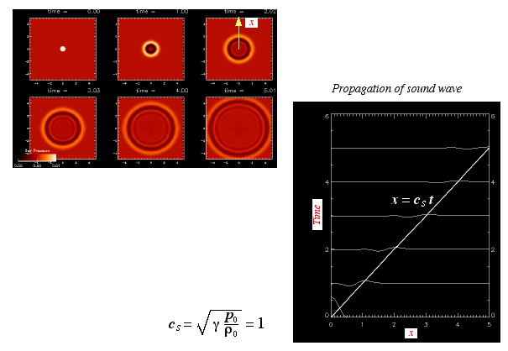
Propagation of pure acoustic wave
Time-distance diagram

Slide 27
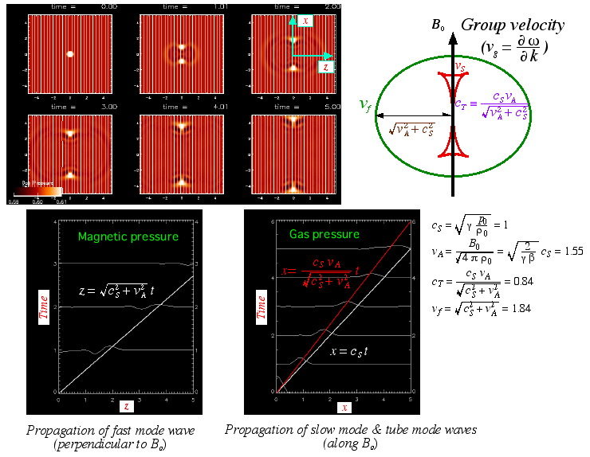
Propagation of MHD waves: case v_{A}>c_{S}
Strong magnetic field transports wave energy preferentially along the magnetic field.

Slide 28
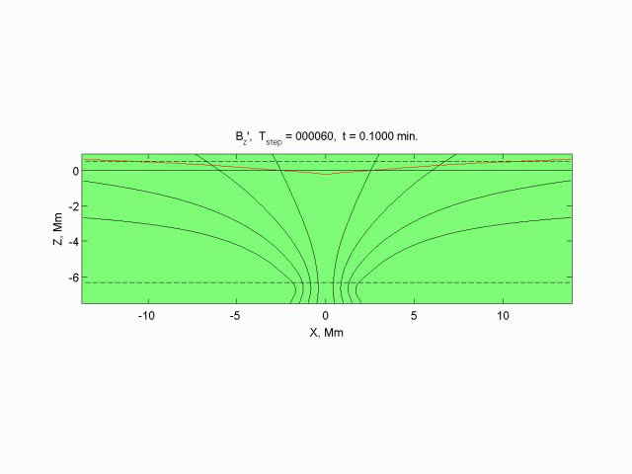
Numerical simulation of MHD wave propagation
through a sunspot (K.Parchevsky)
Fast MHD waves travels across the magnetic field lines; slow MHD waves travels along the field lines into the deeper layers.

