Slide 1
16. Solar Cycle and Dynamo Theory

Slide 2
Solar Dynamo

Slide 3
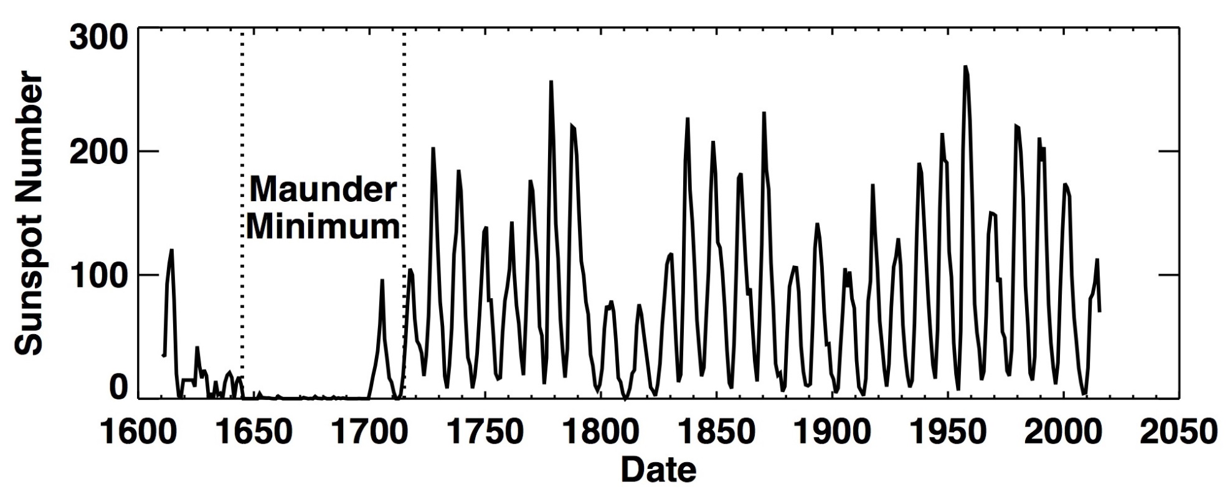
Dalton
Minimum

Slide 4
Sunspot numbers
There are two official sunspot numbers in common use. The first, the daily "Boulder Sunspot Number," is computed by the NOAA Space Environment Center using a formula devised by Rudolph Wolf in 1848: R=k (10g+s), where R is the sunspot number; g is the number of sunspot groups on the solar disk; s is the total number of individual spots in all the groups; and k is a variable scaling factor (usually <1) that accounts for observing conditions and the type of telescope (binoculars, space telescopes, etc.). Scientists combine data from lots of observatories -- each with its own k factor -- to arrive at a daily value.
The Boulder number (reported daily on SpaceWeather.com) is usually about 25% higher than the second official index, the "International Sunspot Number," published daily by the Sunspot Index Data Center in Belgium. Both the Boulder and the International numbers are calculated from the same basic formula, but they incorporate data from different observatories.
As a rule of thumb, if you divide either of the official sunspot numbers by 15, you'll get the approximate number of individual sunspots visible on the solar disk if you look at the Sun by projecting its image on a paper plate with a small telescope.

Slide 5
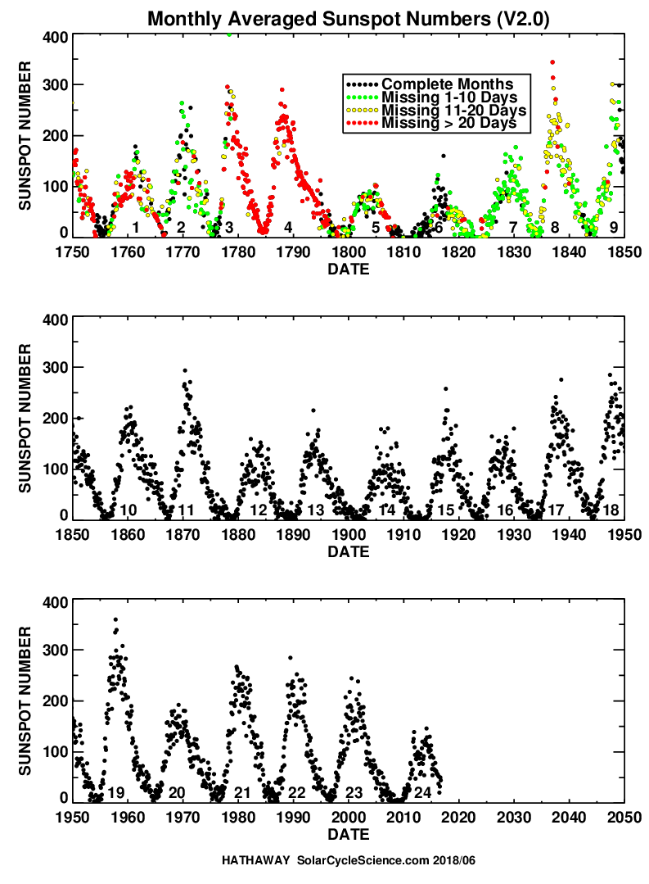
Numbering of solar cycles starts from 1755.
The current cycle is number 24.
Waldmeier’s effects:
1) stronger cycles have shorter rise time;
2) weaker cycles are longer.

Slide 6
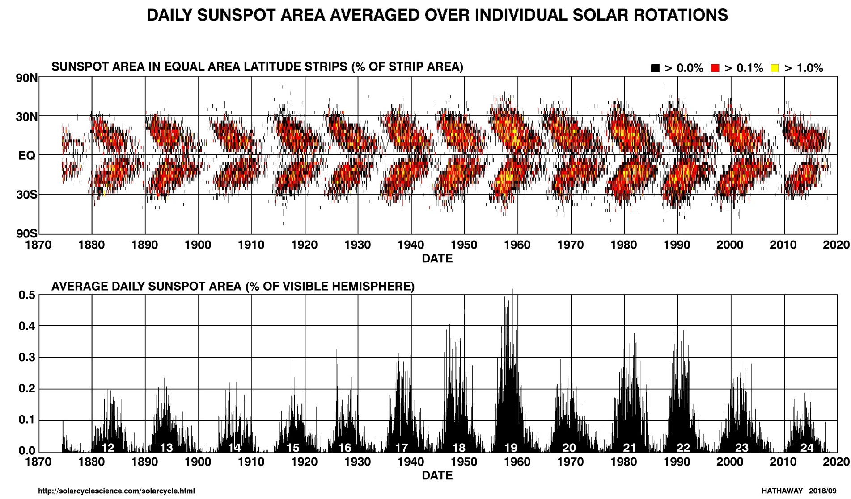
The butterfly diagram

Slide 7
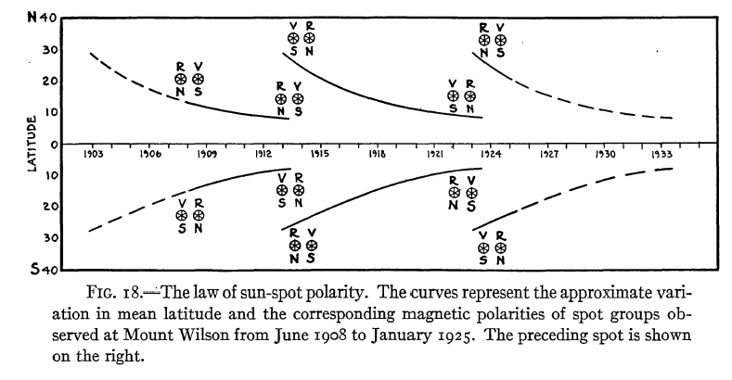
Hale’s Polarity Law

Slide 8
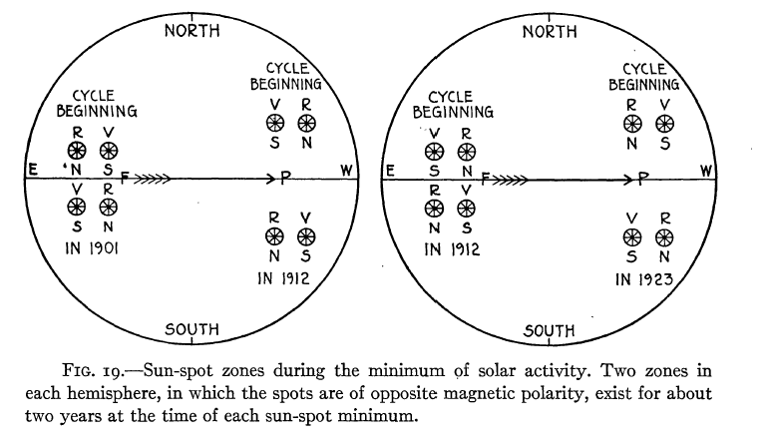
During solar minima two consecutive cycles may overlap

Slide 9
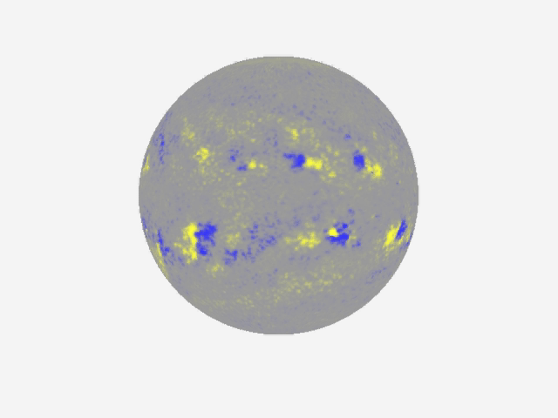
Evolution of the Sun's magnetic field over 30-years
(D. Hathaway)

Slide 10
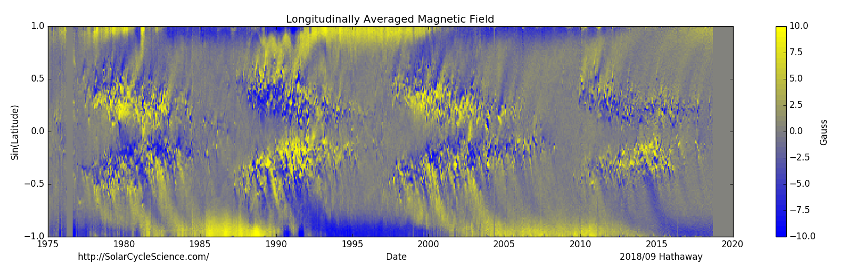

Slide 11
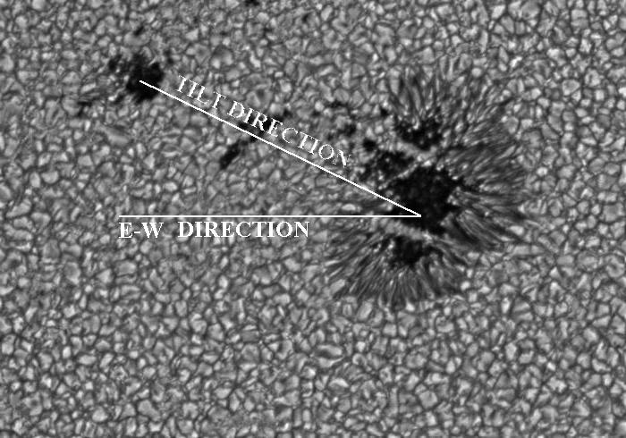
Joy’s law: the leading spot is closer to equator than the following one

Slide 12
A successful model for the solar dynamo must explain several observations:
The 11-year period of the sunspot cycle,
The equator-ward drift of the active latitude as seen in the butterfly diagram
The Hale’s polarity law and the 22-year magnetic cycle,
The Joy’s law for the observed tilt of sunspot groups
The reversal of the polar magnetic fields near the time of cycle maximum as seen in the magnetic butterfly diagram.
The Waldmeier’s effect for the inverse relationship between the cycle amplitude and the rise time.

Slide 13
extra term due correlated turbulent fluctuations

Slide 16
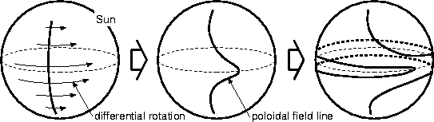
Poloidal field
Toroidal field

Slide 17
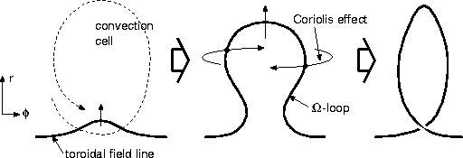
The origin of the α-effect
Toroidal field
Poloidal field

Slide 18
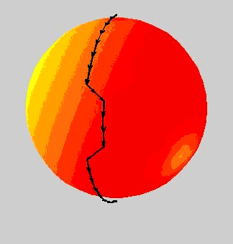
Illustration of the Ω-effect
Generation of toroidal field by shearing a pre-existing poloidal field by differential rotation
(Ω-effect )

Slide 19
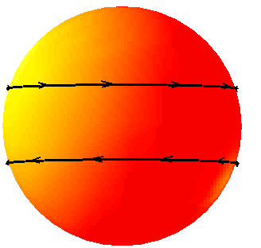
Illustration of the α-effect
(ii) Re-generation of poloidal field by lifting and twisting a toroidal flux tube by helical turbulence
(α-effect)
Proposed by Parker (1955)
Mathematically formulated by Steenbeck, Krause & Radler (1969)

Slide 21
Solution of the mean-field dynamo equation (Parker, 1955)

Slide 22
Solution of the mean-field dynamo equation (Parker, 1955)

Slide 23
Solution of the mean-field dynamo equation (Parker, 1955)
wave term
growth/decay

Slide 24
Solution of the mean-field dynamo equation (Parker, 1955)

Slide 25
Difficulties of the Parker-Yoshimura’s model
The equator-ward propagation of the dynamo wave is governed by Parker-Yoshimura sign rule; that is α dΩ/dr < 0 in the Northern hemisphere. This can explain the magnetic butterfly diagram. The sign of α is determined by the Coriolis force: α > 0 in the Northern hemisphere. Therefore, in 1960’s and 70’s, it was believed that the solar rotation rate rotation increases inward throughout the convection zone.
But, in 90’s, helioseismic analysis inferred that in the bulk of the convection zone the rotation rate decreases with depth.
The radial gradient is strong at or below the base of the convection zone in the tachocline, and it is also decreasing inward at the sunspot latitudes (0-30 degrees).
This means that the Parker’s dynamo model could not explain the sunspot cycles. Therefore, it was suggested that the dynamo operates in the tachocline, and that the butterfly diagram is due to magnetic flux transport by the meridional circulation – “flux-transport dynamo model”.
tachocline

Slide 26
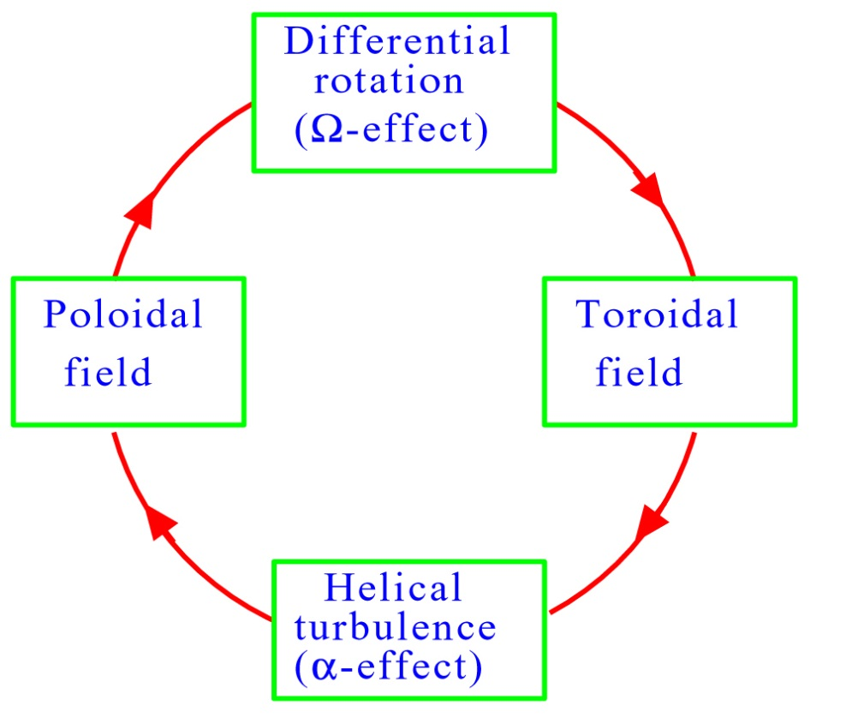
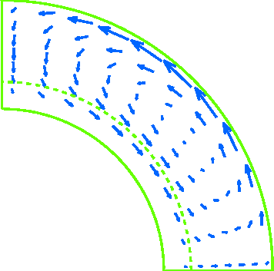
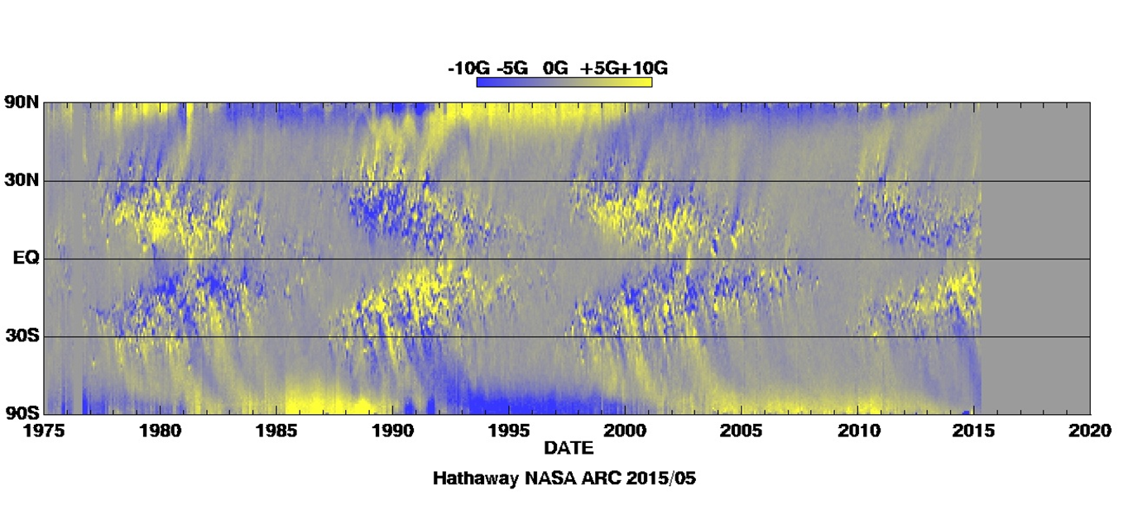
⇒ FLUX-TRANSPORT DYNAMO
What is a Flux-transport Dynamo?
“Conveyor belt” of the magnetic flux transport.
Pole
+
Meridional
circulation
0.6R
0.7R
1R
Equator
The butterfly diagram is explained by the flux transport at the bottom of the convection zone.
The polar field reversals are explained by the surface flux transport.
(Courtesy of M.Dikpati)

Slide 27
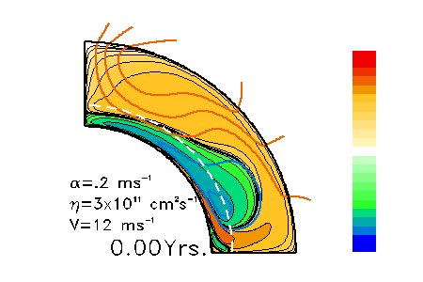
Evolution of Magnetic Fields
In a Babcock-Leighton Flux-Transport Dynamo
(Courtesy of M.Dikpati)

Slide 28
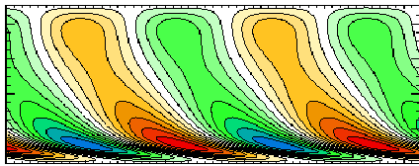
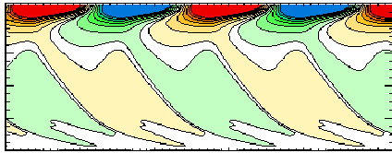
Time-latitude Diagrams Produced from the
Babcock-Leighton Flux-transport Dynamo Solution
Toroidal Field at r = 0.7R
Equatorward migrating sunspot belts
Pole
Latitude (degree)
Poleward drifting
large-scale radial fields
Equator
Correct phase relation
between these two fields
0 10 20 30 40 50
t (yr)
Surface Radial Field
Pole
Dynamo cycle period ( T )
primarily governed by
meridional flow speed
Latitude (degree)
T
=
56
.
8
υ
−
0
.
89
s
−
0
.
13
η
0
.
22
,
Equator
m
0
T
0 10 20 30 40 50
υ
→
max.
flow
speed
m
t (yr)
s
→
surface
poloidal
source
0
Dikpati & Charbonneau, 1999, ApJ, 518, 508
η
→
turbulent
diffusivit
y
T
(Courtesy of M.Dikpati)

Slide 29
Conclusions of the flux-transport dynamo model
Large-scale solar dynamo mechanism involves 3 basic processes;
(i) Ω-effect,
(ii) α-effect,
(iii) flux-transport by meridional circulation
Mean meridional flow sets the solar clock
Sun is likely to have both Babcock-Leighton type
and tachocline α-effect.
(Courtesy of M.Dikpati)

Slide 30
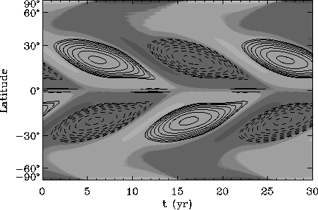
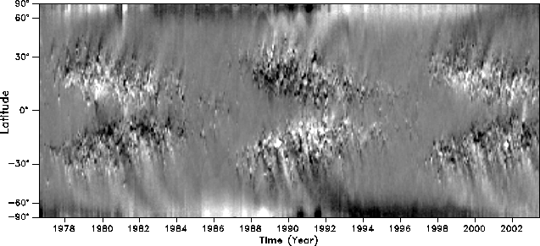
Validity test of calibration:
Time-latitude diagram to match with observation
Model output
Contours: toroidal fields at CZ base
Gray-shades: surface radial fields
Observed NSO map of longitude-averaged photospheric fields
(Courtesy of M.Dikpati)

Slide 31
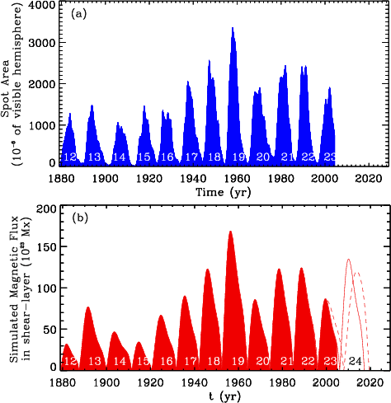
Solar-cycle prediction
The calibrated flux-transport dynamo model predicted that Solar Cycle 24 will be much stronger than Cycle 23.
Solid curve shows the prediction for constant meridional circulation speed; the dashed curve is the prediction in the case of varying circulation speed.
(Courtesy of M.Dikpati)

Slide 32
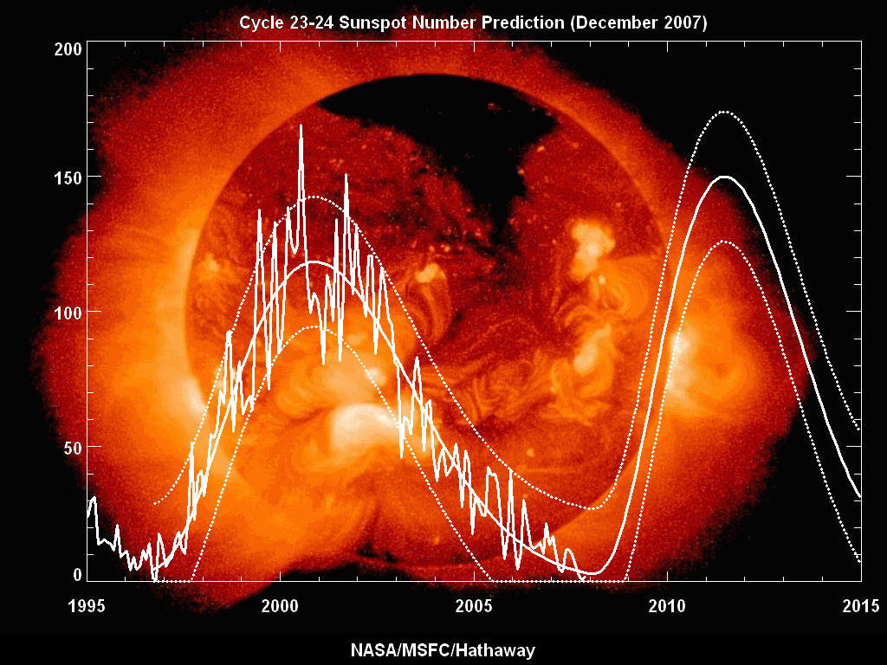

Slide 33
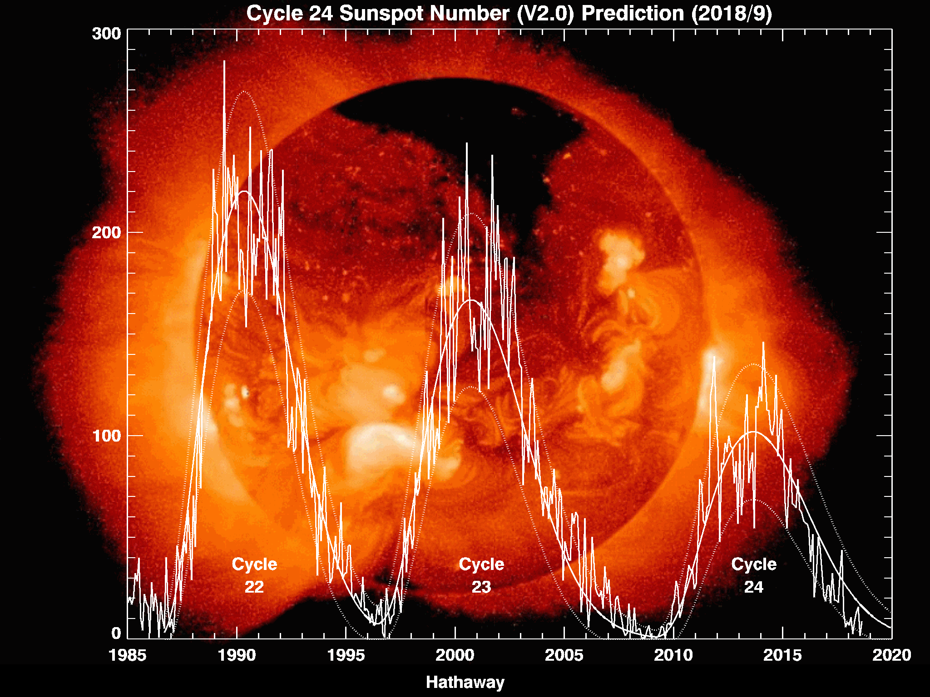
The model prediction failed. Cycle 24 is very weak.

Slide 34
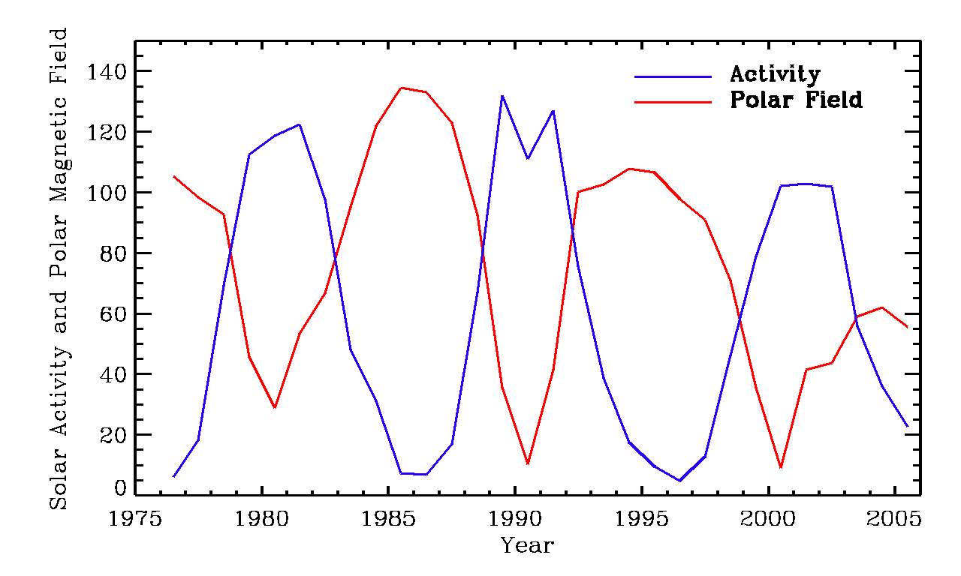
Solar cycle precursors:
polar magnetic field strength

Slide 35
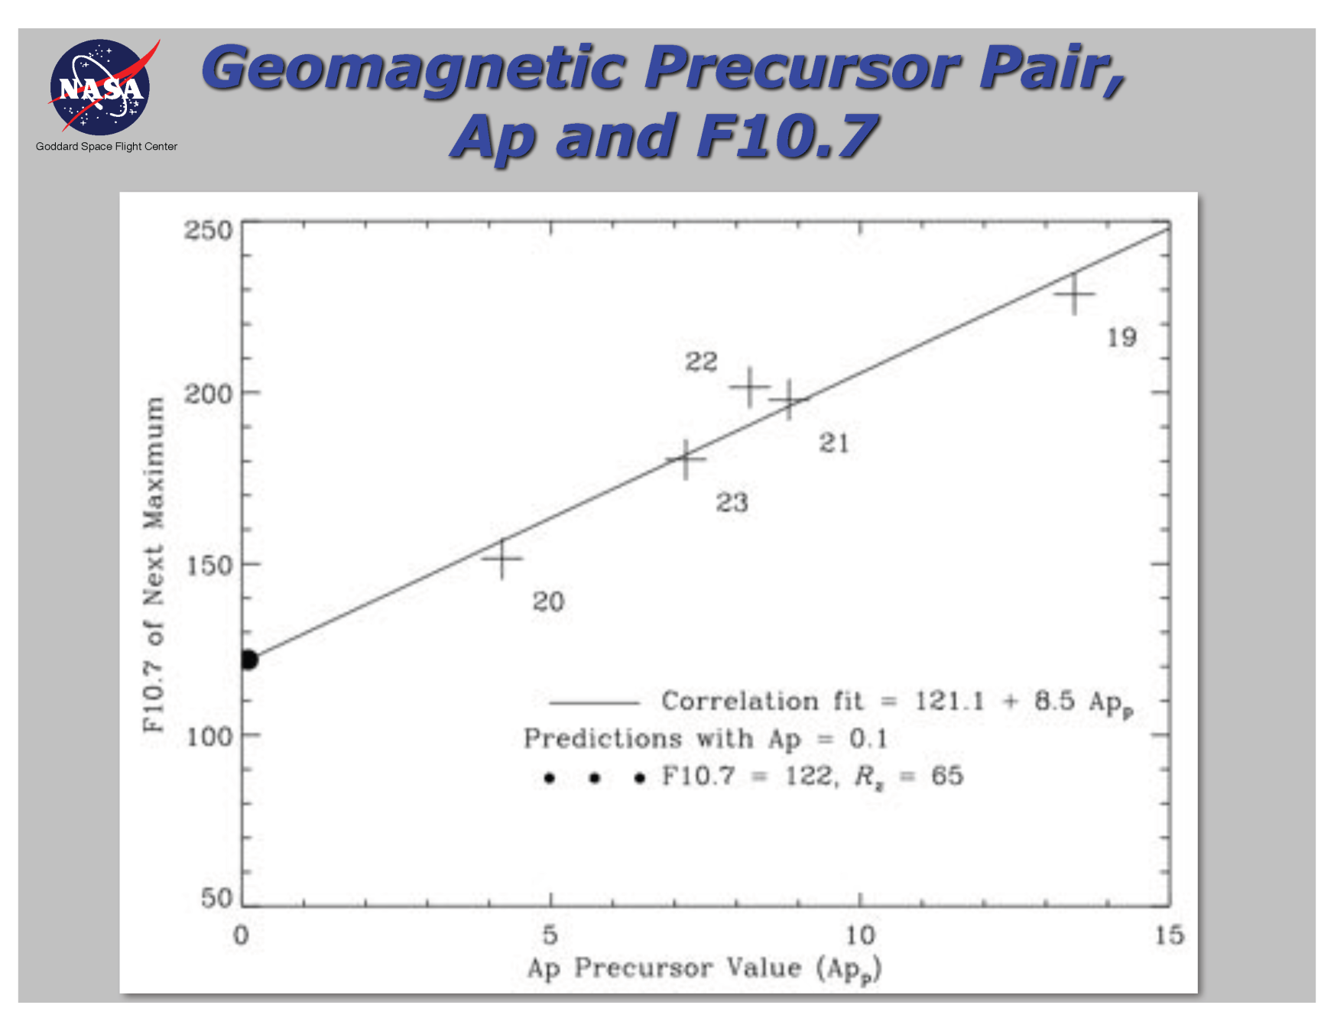
Solar cycle precursors: geomagnetic Ap index

Slide 36
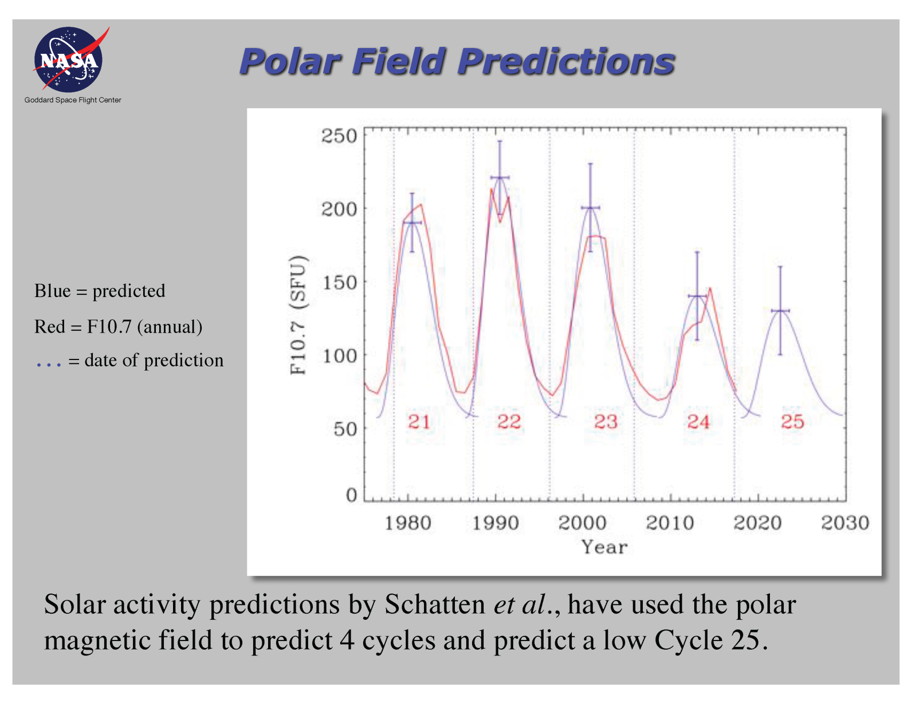
Solar cycle precursors:
polar magnetic field strength

Slide 37
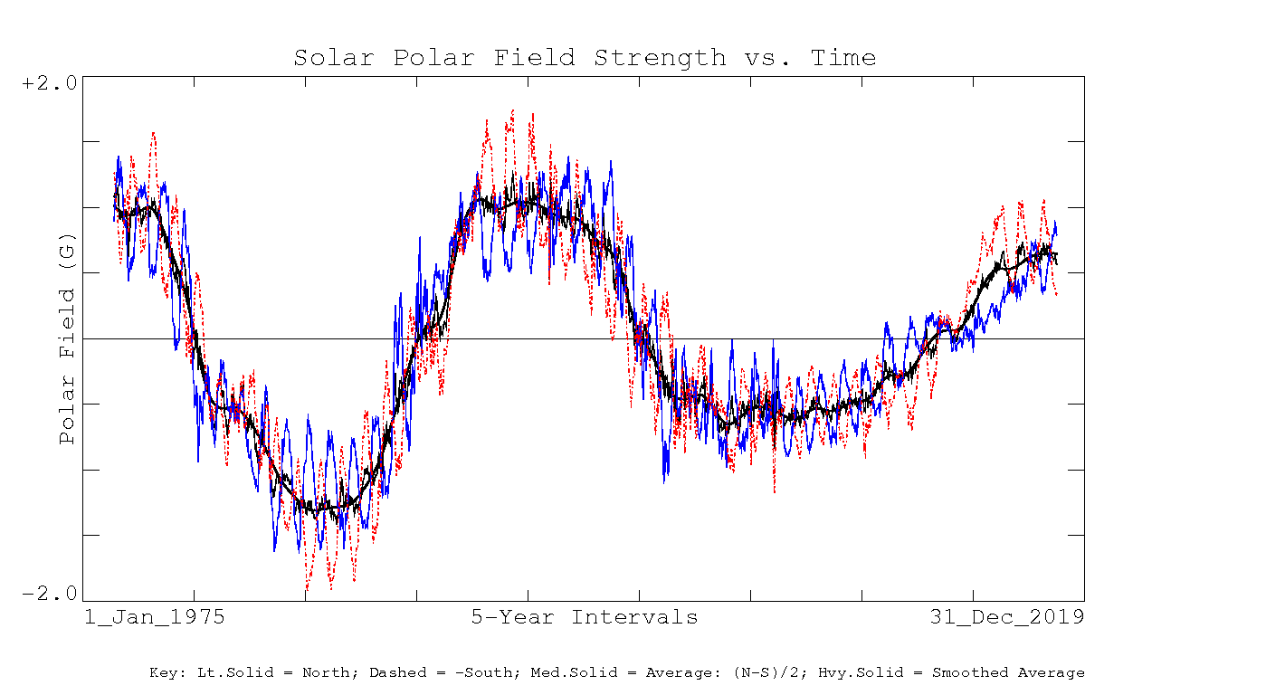
Measurements of the polar magnetic field at Wilcox Solar Observatory
The max value will predict the next solar maximum

Slide 38
Difficulties
A Babcock-Leighton dynamo is not self-excited; won’t revive after Maunder minima
Can there be other poloidal sources to revive the solar dynamo?
2. Furthermore, N & S hemispheres are coupled by an antisymmetric magnetic field about the equator, as inferred from Hale’s polarity rule

Slide 39
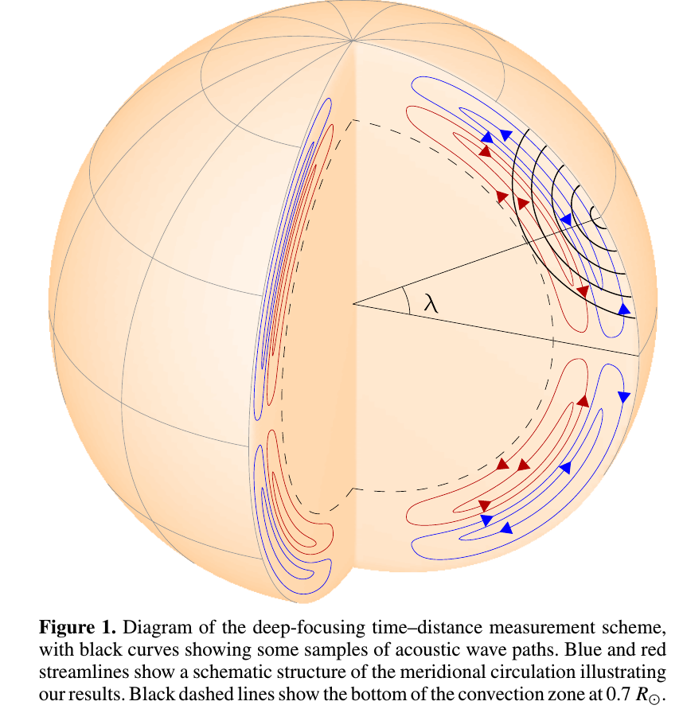
New ideas in the solar dynamo theories
The discovery of the double-cell meridional circulation is another difficulty of the flux-transport model.
New idea: the solar dynamo works in the whole convection zone, but the butterfly diagram is formed by the Parker-Yoshimura mechanism in the near-surface shear layer (Brandenburg, 2005).
Zhao et al, 2013

Slide 40
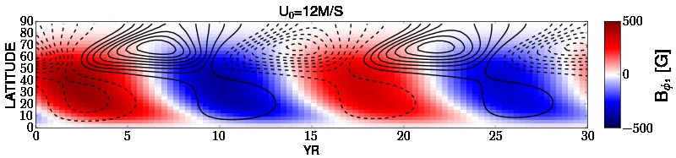
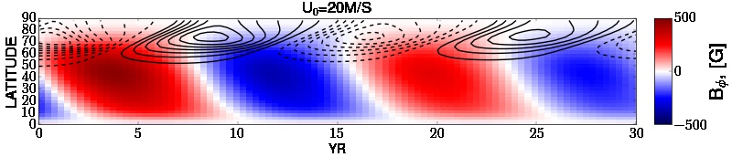
Magnetic butterfly diagram for the distributed dynamo models with the double-cell meridional circulation
(colors - toroidal magnetic field, contours – radial field)
r=0.82R
The butterfly diagram can be explained by the dynamo wave in the near-surface rotational shear layer (Pipin & Kosovichev, 2013)

Slide 41
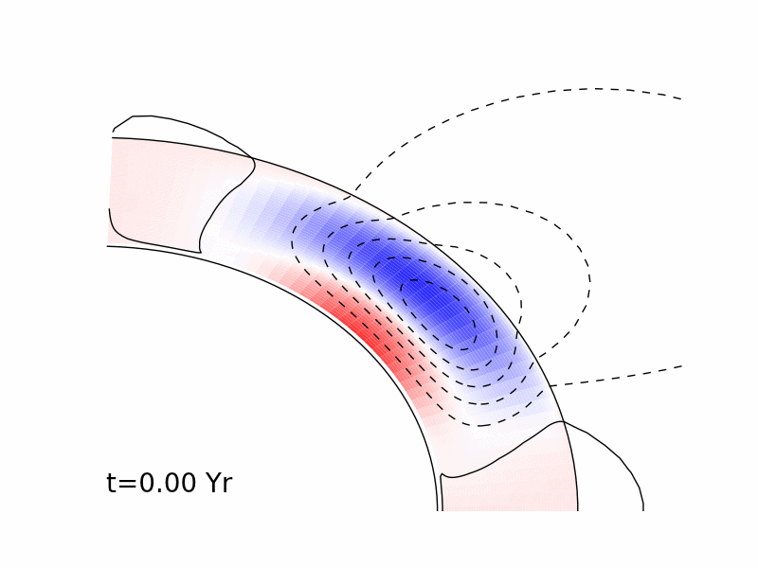
Evolution of magnetic field in the solar interior in the dynamo model with the field migration in the near-surface rotational shear layer
(V. Pipin 2013)

Slide 42
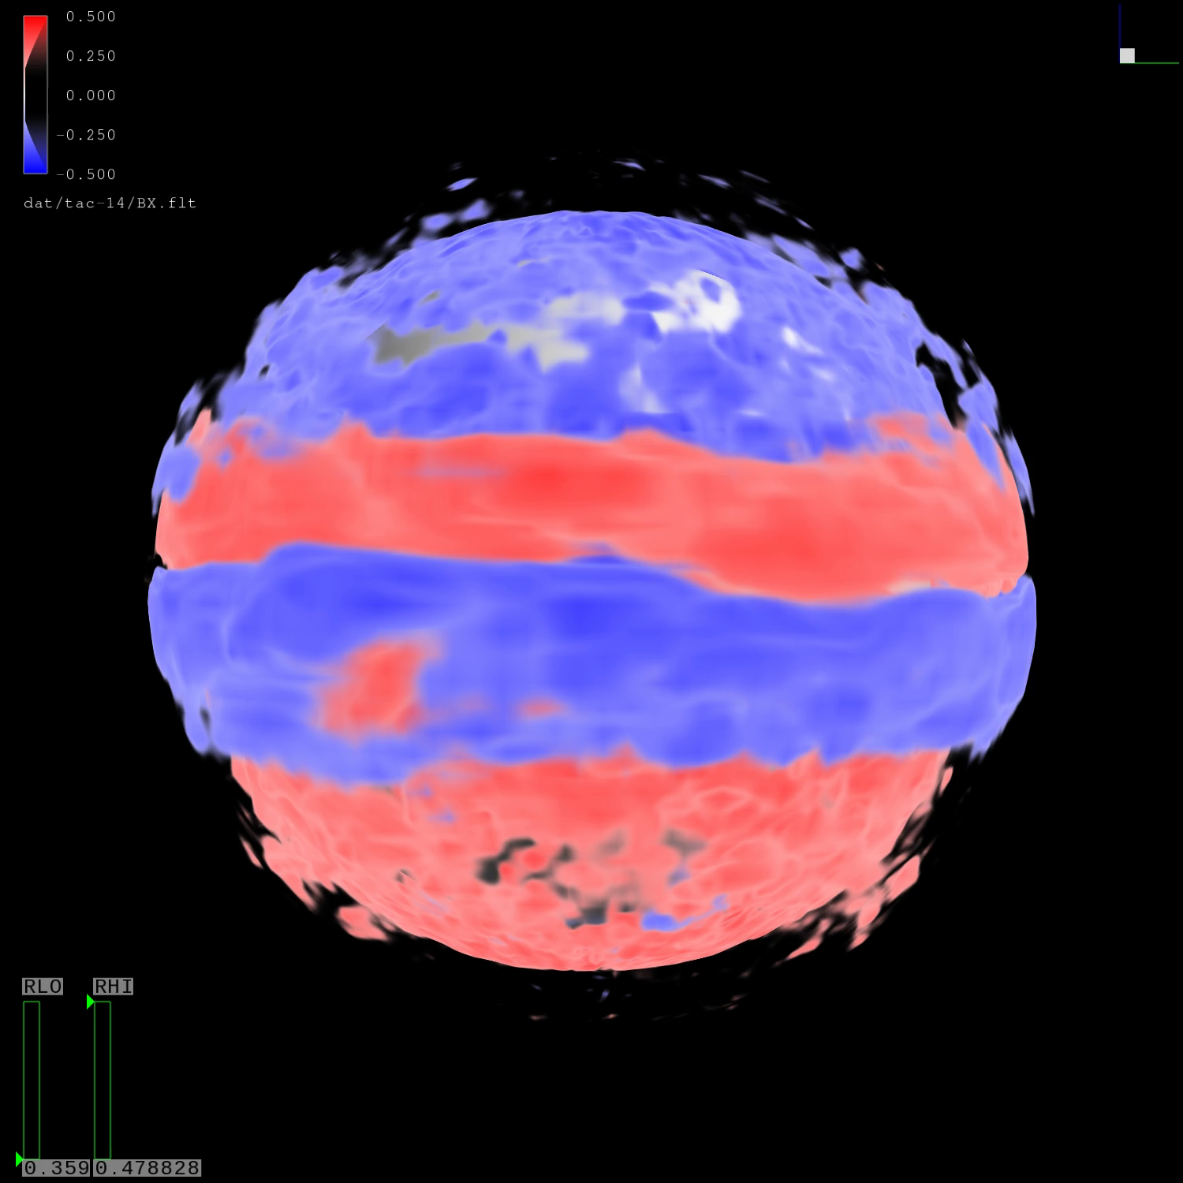
Future development of the dynamo theory: understanding of the turbulence physics, differential rotation and the alpha-effect from 3D numerical MHD simulations
Evolution of the toroidal magnetic field in the convection zone (A.Stejko)

