Slide 1
17. Magnetic Energy Release

Slide 2
Magnetic Energy Release
Solar Energetic Phenomena
Energy Equation
Two Types of Magnetic Energy Release
Rapid Dissipation: Sweet’s Mechanism
Petschek’s Mechanism
Numerical Models of Magnetic Reconnection
Observations of Magnetic Reconnection

Slide 4
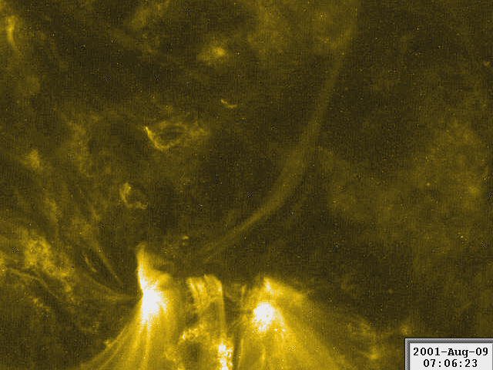
Observations of emerging magnetic flux and magnetic energy release in EUV from TRACE satellite

Slide 10
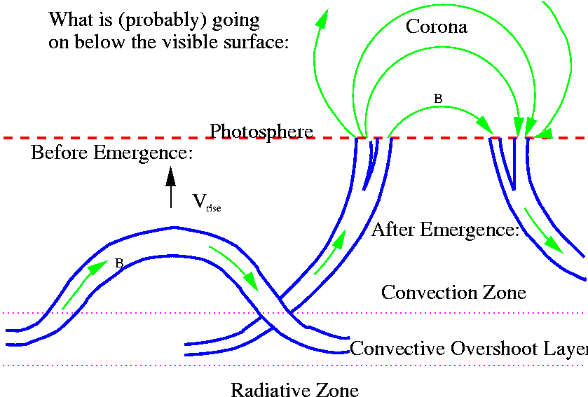
Example: The Poynting Flux and Coronal Heating (B.Welsch)
The magnetic energy balance:
F_{P}
Assume the ideal MHD approximation and integrate this equation over a volume in the atmosphere with the bottom boundary in the photosphere and apply the Gauss theorem:
It was found that the average F_{P} is sufficient to explain coronal heating, with values near (5±1)×10⁷ erg cm⁻² s⁻¹. The energy flux required for coronal heating ~ 10⁷ erg cm⁻²s⁻¹, for chromospheric heating: 2×10⁷ erg cm⁻² s⁻¹ (Welsch, 2015, Publ. Astr.Soc.Jap. 67 (2), 18).

Slide 11
kinetic energy flux
enthalpy flux
Poynting flux

Slide 18
Example: formation of thin current sheets due to winding of magnetic field lines by photospheric motions (Parker)

Slide 19
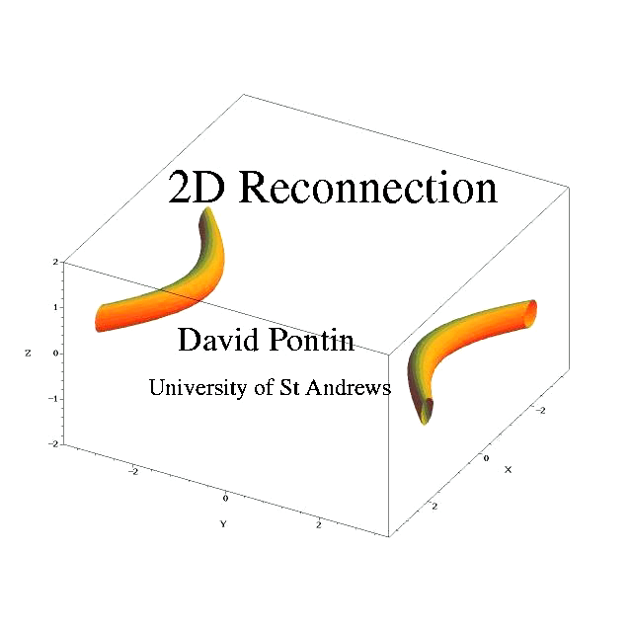

Slide 21
Calculation of the characteristic reconnection time (Parker, 1957)

Slide 24
Physical Interpretation of Petschek's Solution
(Semenov)
temporarily enhanced “anomalous” resistivity
Anomalous resistivity may occur as a result of plasma instabilities in regions of high electric current density when the speed of electrons reaches the speed of plasma waves, or due to small-scale turbulence.
Anomalous resistivity may significantly decrease the dissipation time.
Petschek (quasi-steady
Reconnection regime):

Slide 27
Electric current density

Slide 28
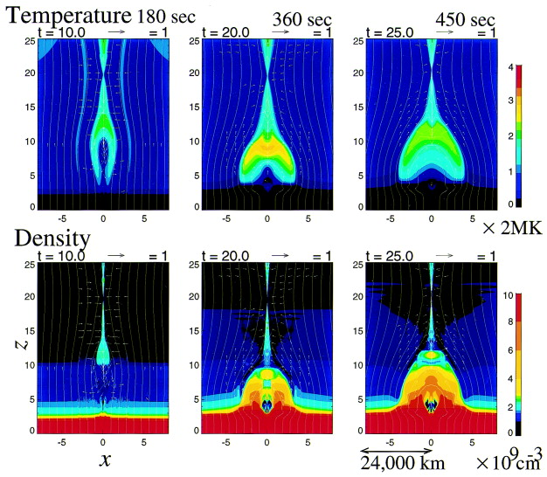
Evolution of plasma temperature and density

Slide 29
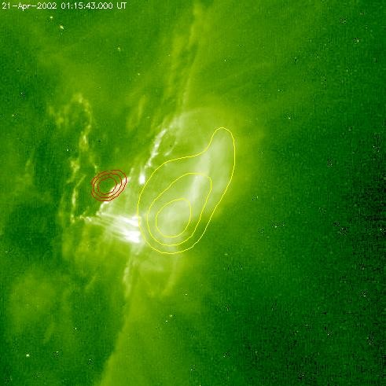
Observational evidence for magnetic reconnection – plasma heating at the top of magnetic loops
Gallagher et al., Solar Phys. 2002

Slide 30

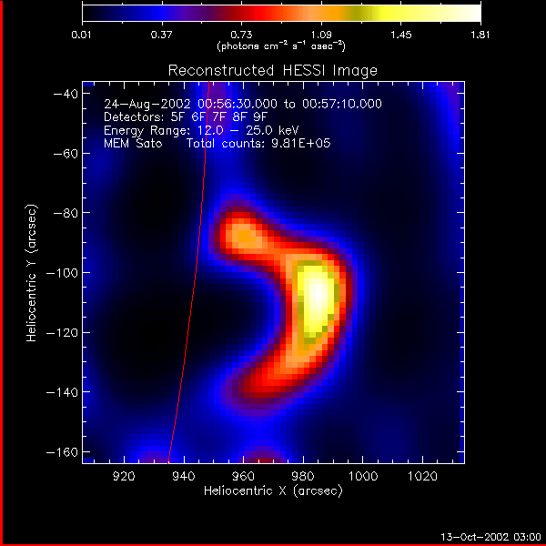
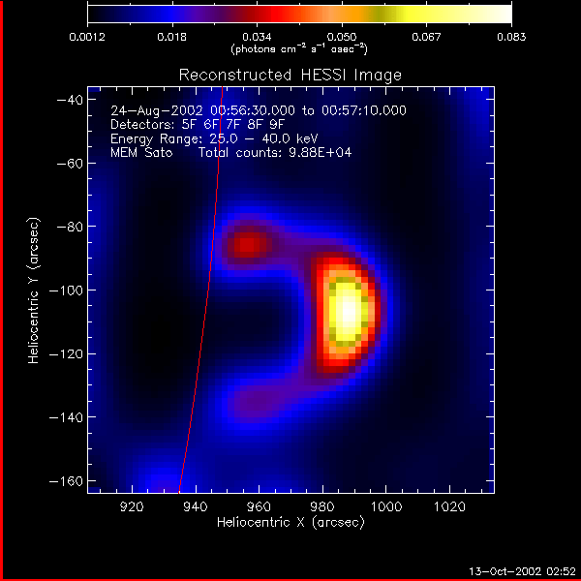
X-ray sources during the 2002/08/24 X3.1 flare
Solar limb
Thermal emission
34MK
43MK
12-18 keV
12 - 25 keV
25 - 40 keV

Slide 32
Geometrical model of magnetic loops
The three-dimensional geometry of the four involved magnetic field lines with circular segments, additionally constrained by the geometric condition that the two pre-reconnection field lines have to intersect each other at the onset of the reconnection process, leading to a 10 parameter model. They fit this 10 parameter model to Yohkoh Soft and Hard X-Ray Telescopes (SXT and HXT) data of 10 solar flares and determine in this way the loop sizes and relative orientation of interacting field lines before and after reconnection.

Slide 33
Fitting the model to X-ray images of magnetic loops

Slide 35
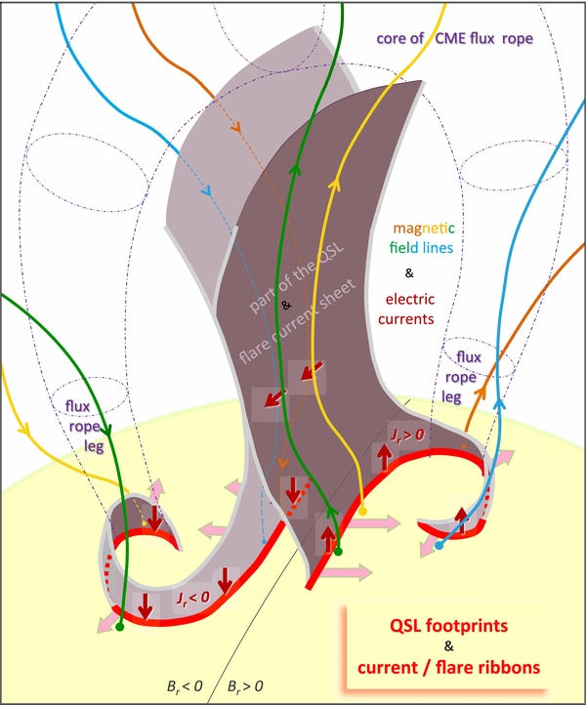
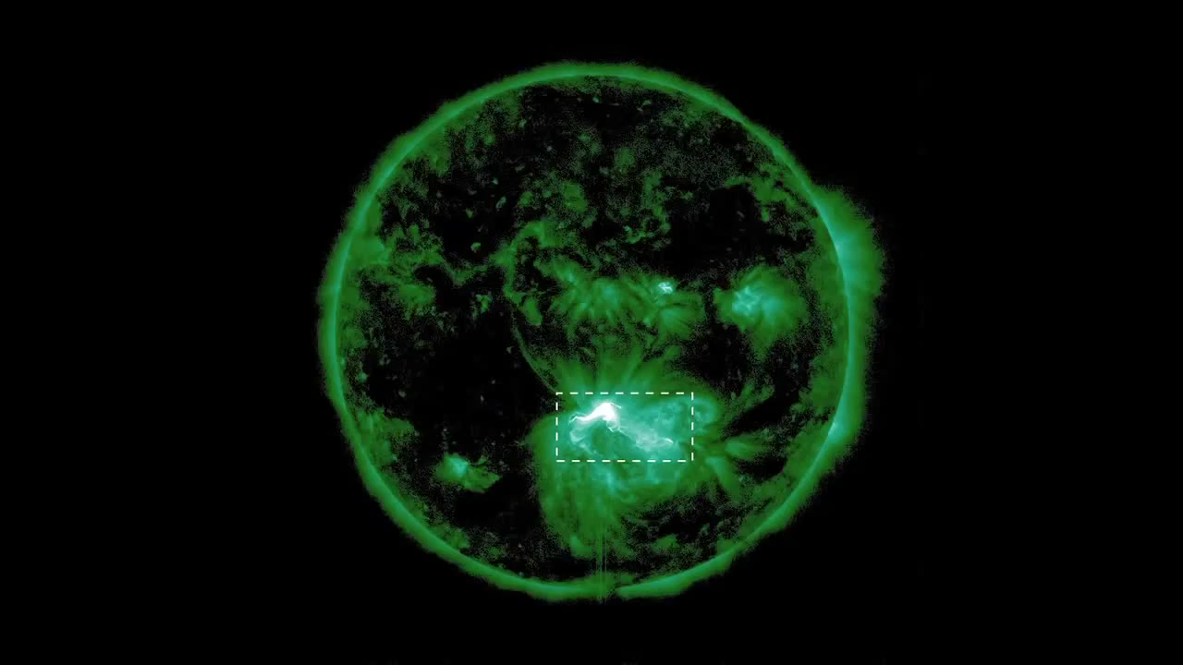
Recent development – models and observations of “slipping” reconnection: the footpoints of reconnecting magnetic lines “slip” along the flare ribbons of a “J-shape” that is formed by a overlying flux rope (Javier, et al, 2014, ApJ, 788:60, 1)

Slide 36
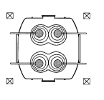
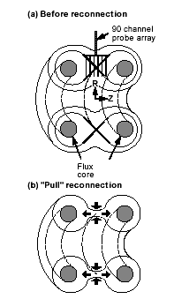
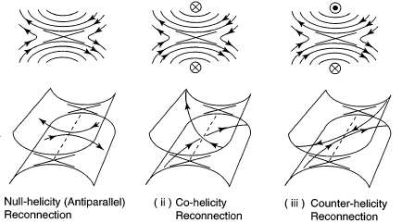
Reconnection experiments - MRX
Magnetic Reconnection eXperiment (Princeton) T_{e} ≈ 50,000 - 300,000 K, n_{e} ≈ 0.1 - 1.5 10²⁰ m⁻³, B ≈ 0.5 kG
Yamada et al, 1997, Ji et al, 2001)...

