Slide 1
18. Solar Atmosphere

Slide 2
Solar Atmosphere
Structure of the Solar Atmosphere
Models of the Solar Atmosphere
Filaments and Prominences
Chromospheric Structures
Spicules

Slide 3
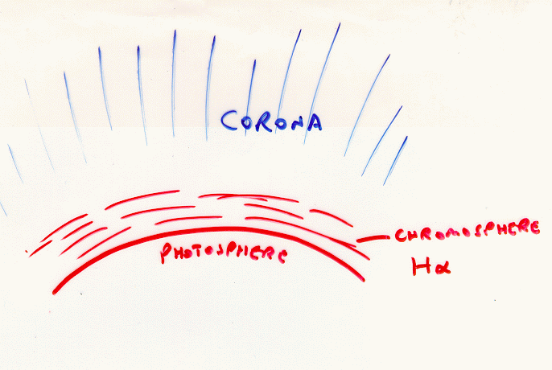

Slide 5
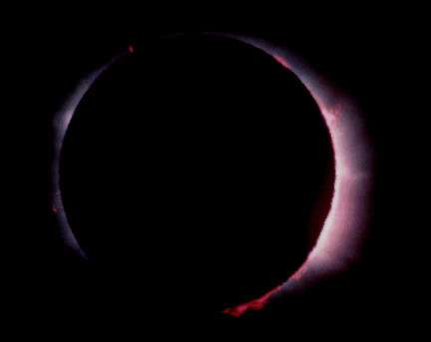

Slide 6
The chromosphere is 2000-3000 km thick. It glows faintly relative to the photosphere and can only be seen easily in a total solar eclipse. When it can be seen it is reddish in color (because of strong Balmer H-alpha emission). This color is the origin of its name (chromos meaning ``color'').
The faint flow of the chromosphere is due to an emission spectrum from hot, low density gases emitting at discrete wavelengths. The discovery of helium noted earlier was from emission lines seen in the chromosphere during an eclipse in 1868. This new element was only found on the Earth in 1895.

Slide 8
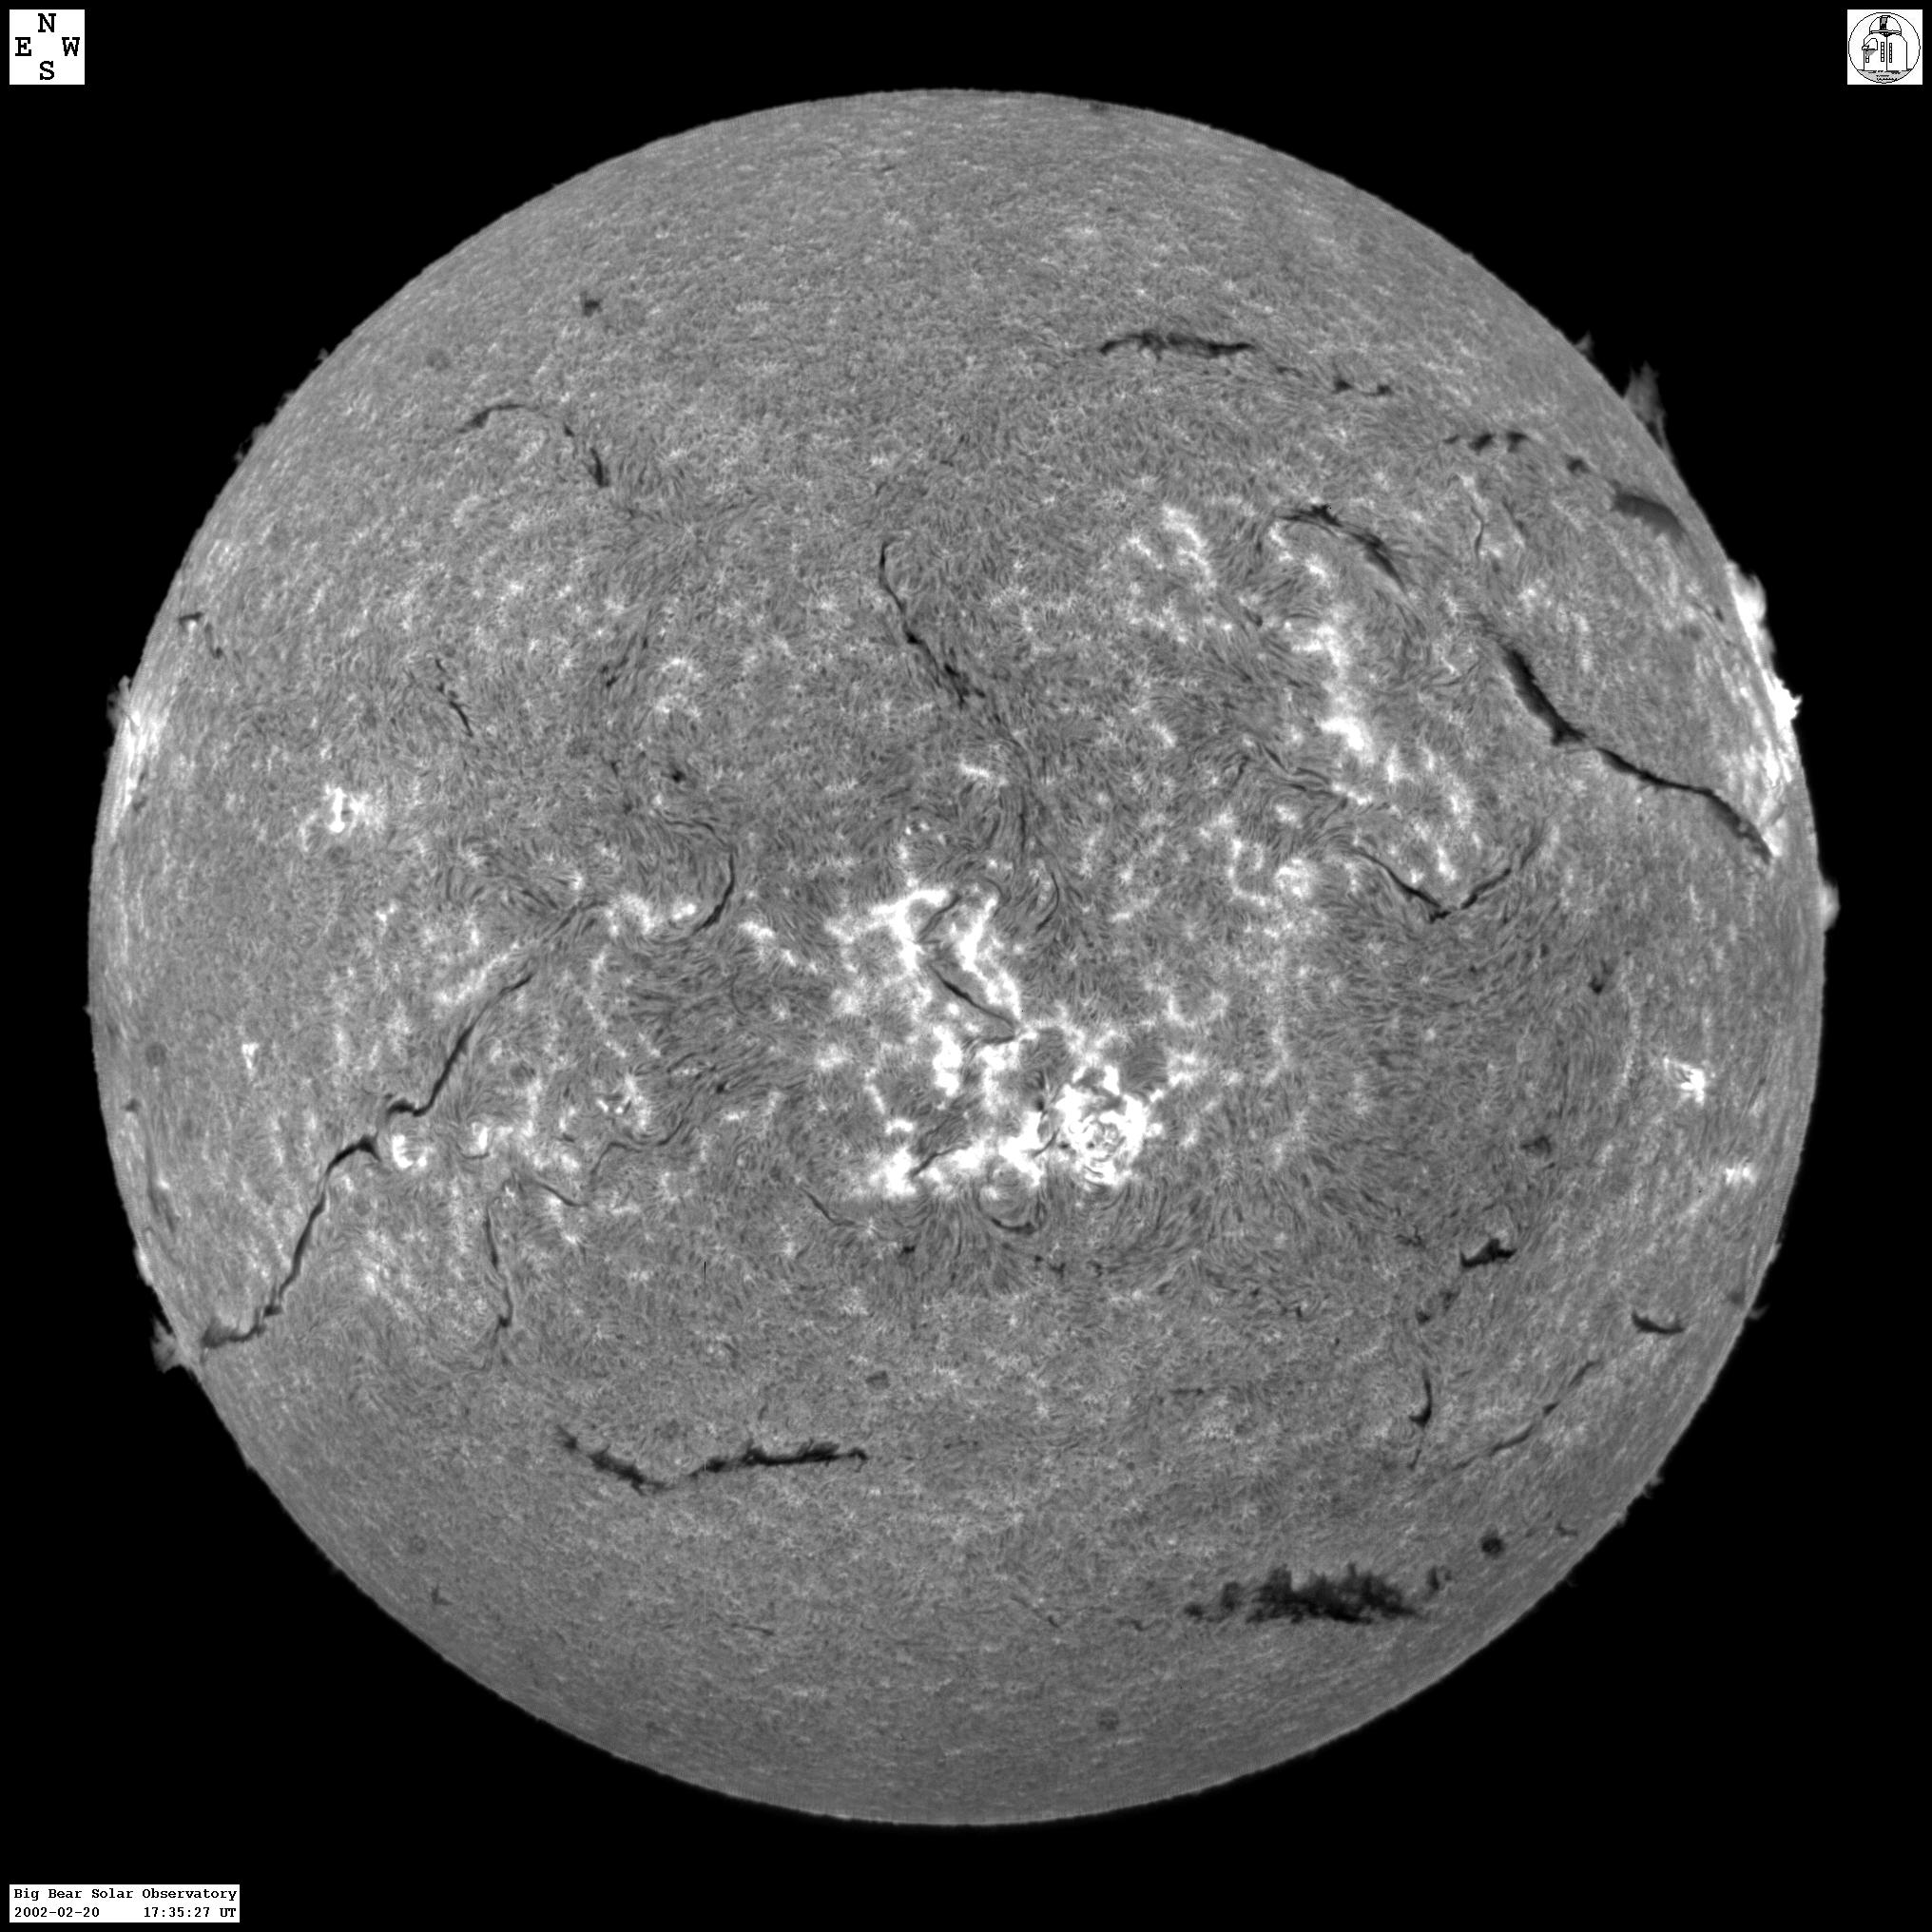

Slide 9
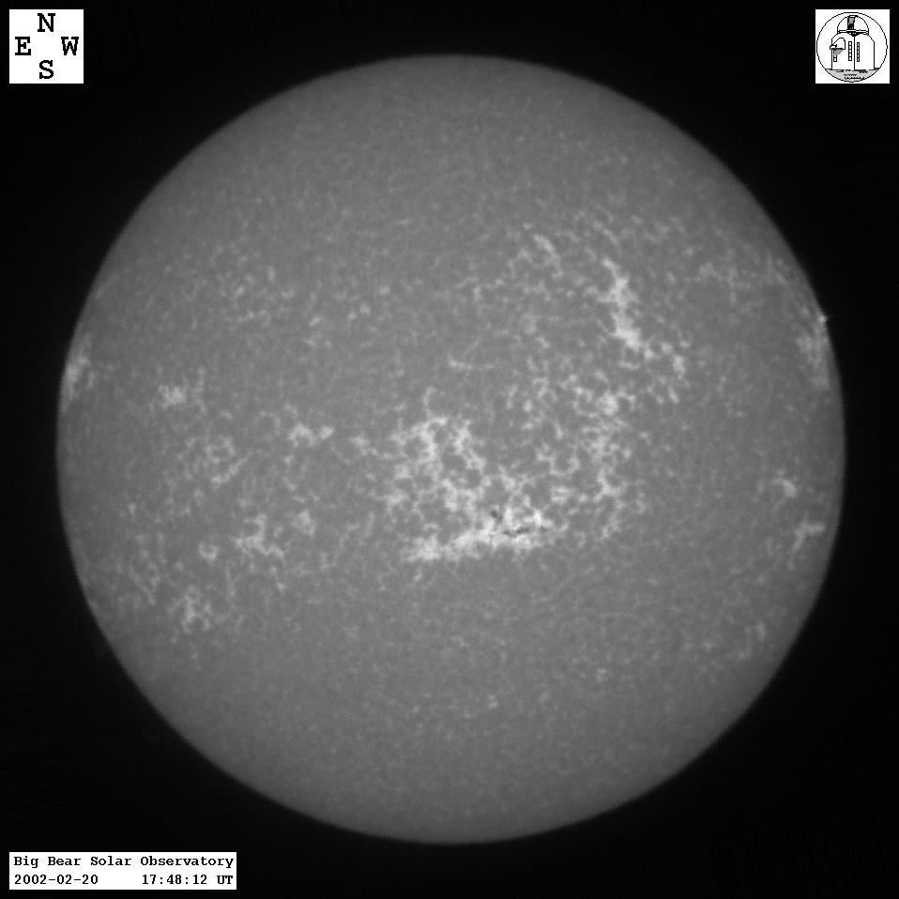

Slide 10
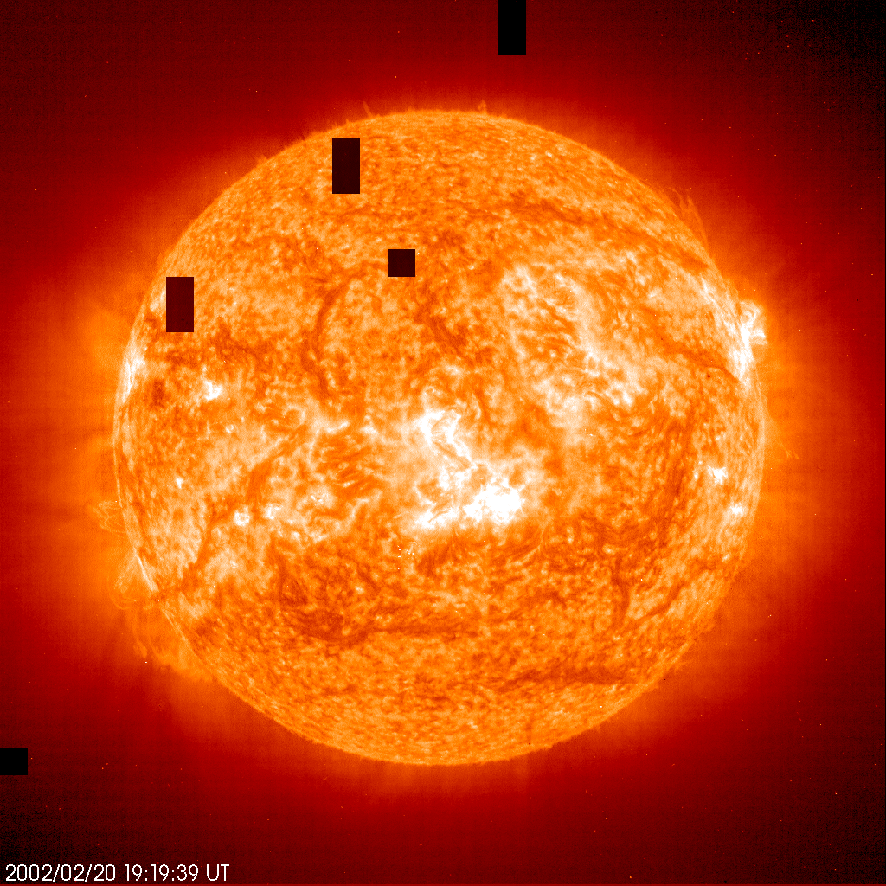

Slide 11
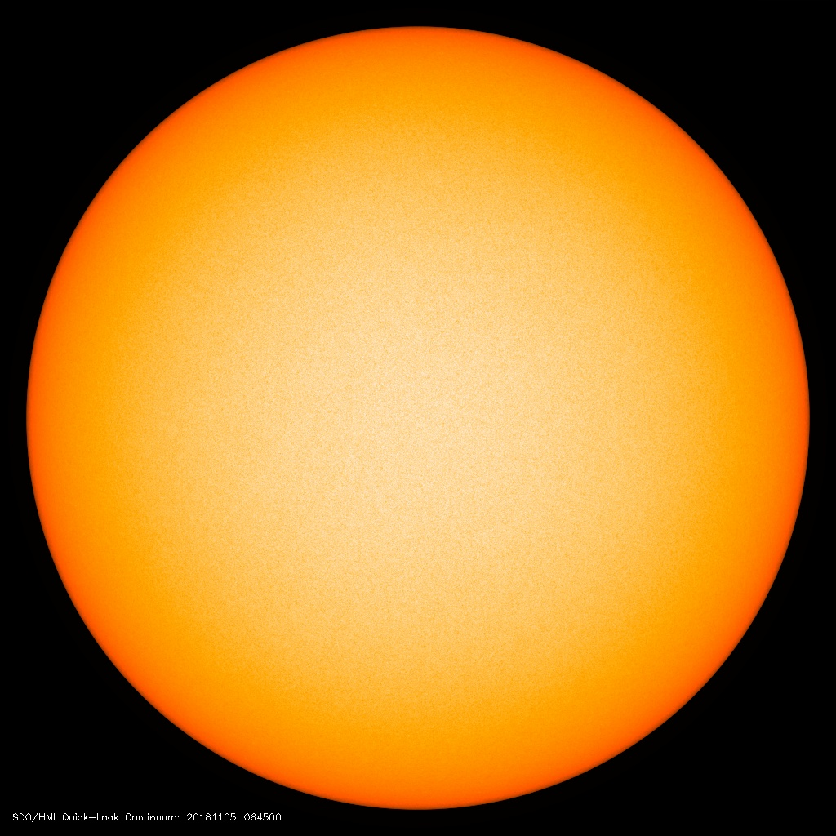
Today’s image from the HMI instrument (Helioseismic and Magnetic Imager) on SDO.
Notice the limb darkening.

Slide 12
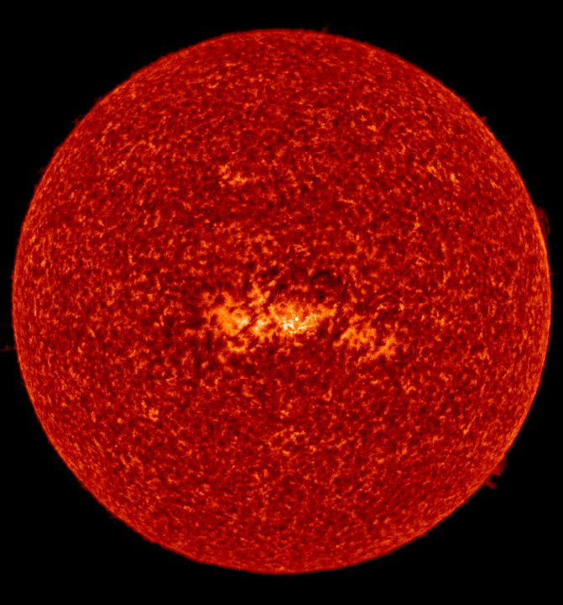
Full disk of the Sun on 12 May 1996, observed by SUMER instrument on SOHO alternating in H I Lyε (937 Å), S VI (933 Å), and S VI (944 Å) blended with Si VIII.
An isolated active region can be seen near the center of the disk. Note the changing length of the plasma structures with the formation temperature of the emission lines and the absence of any significant limb brightening of the H I line, which is emitted from optically thick plasmas.
Notice that the limb is brighter in UV.

Slide 13
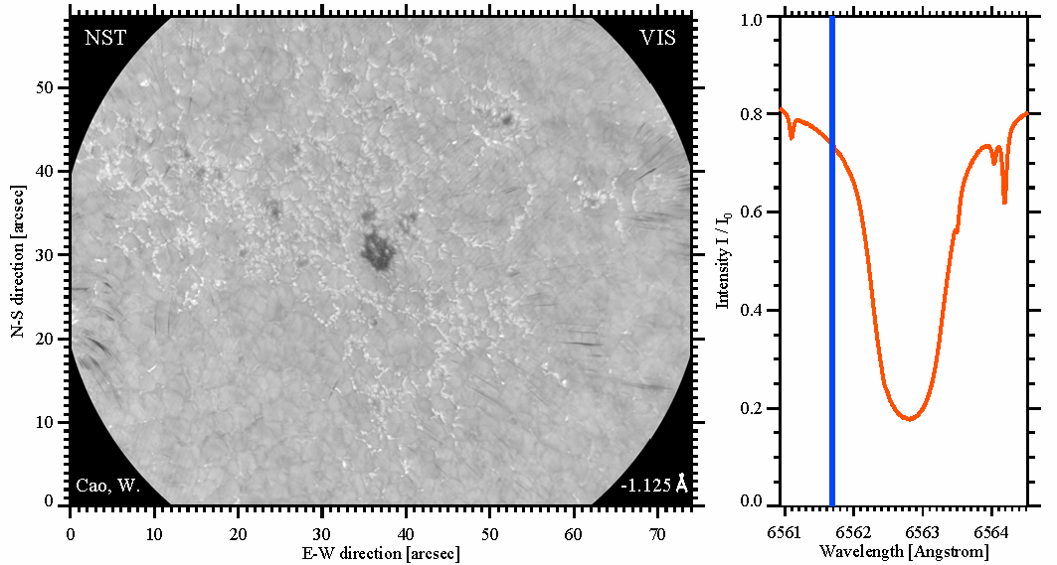
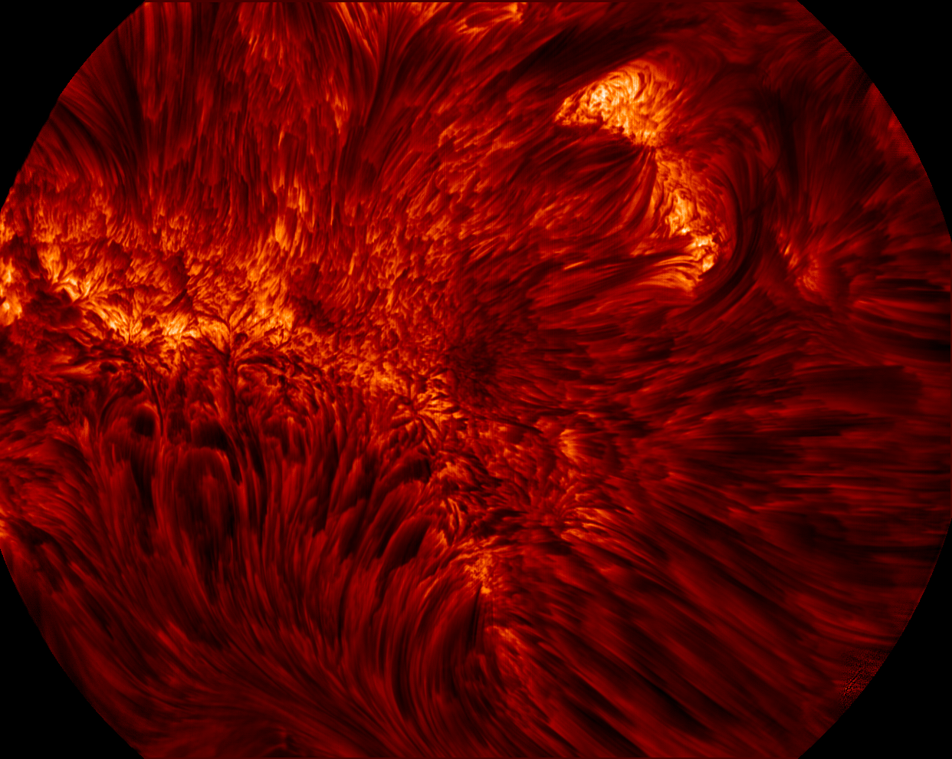
VIS: H-alpha Observations
(Courtesy of W.Cao)
Notes:
13
The 1st light observations of VIS on 22May2013 have revealed quite good image quality.
This image was taken in the line center of Ha line.
And this movie illustrates a spectroscopic scan over the Ha line.

Slide 14
Temperature structure of the solar atmosphere
To determine the temperature structure we need to consider the equation of radiative transfer and identify the sources of radiation absorption and emission.

Slide 15
dI_{ν}
ds
dz
θ
τ_{ν}=0
τ_{ν}
dz
θ

Slide 16
The radiative transfer equation (Eq.1) can be easily solved the integrating factor method.

Slide 20
Negative ions of hydrogen are the main source of photospheric absorption and emission.

Slide 21
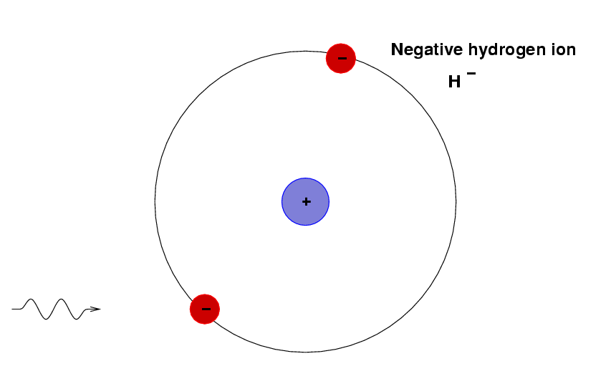
Illustration of the negative hydrogen ion

Slide 22
chromosphere
chromosphere-corona transition region
photosphere
temperature minimum

Slide 23
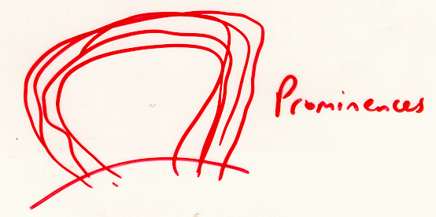

Slide 24
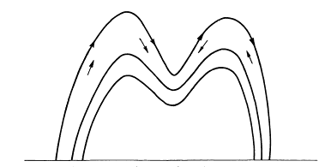
Formation of prominences
radiative
cooling
Siphon flow
driven by pressure
gradient

Slide 25
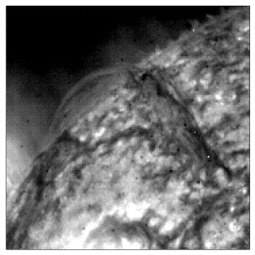

Slide 26
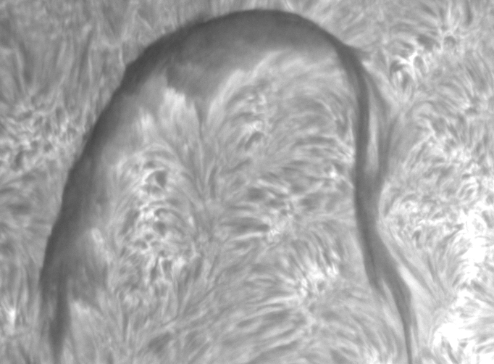
Filament Observations
Obtained at the Swedish Vacuum Solar Telescope, La Palma, using the Lockheed Tunable Filter in Hα (1998, June 21):
filament “barb”
parallel threads
network element
Hα line center
18:15:47 UT

Slide 27
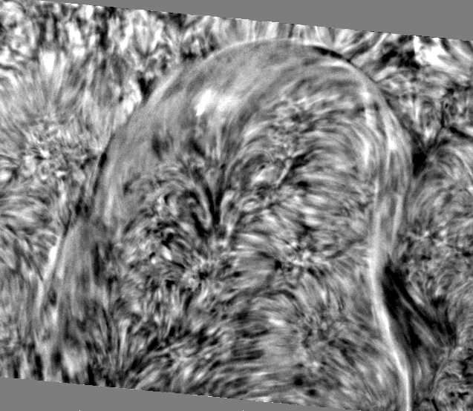
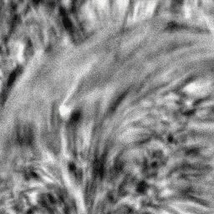
Filament Observations
Dopplergrams based on off-band Hα images (±0.3 Å) show threads within filament:

Slide 28
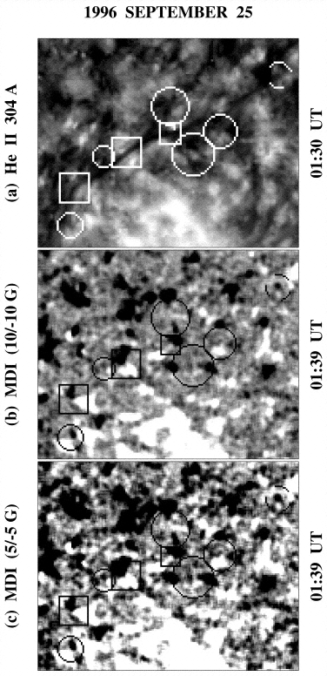

Slide 29
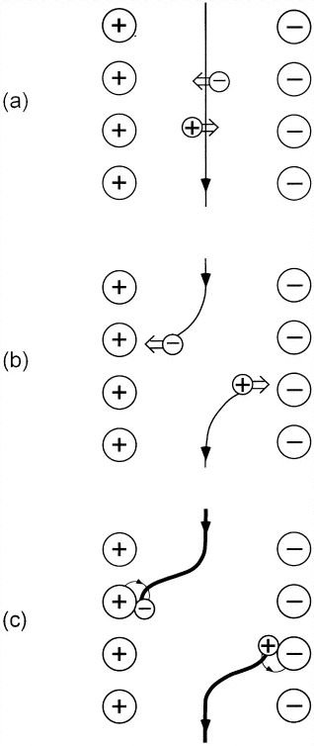

Slide 33
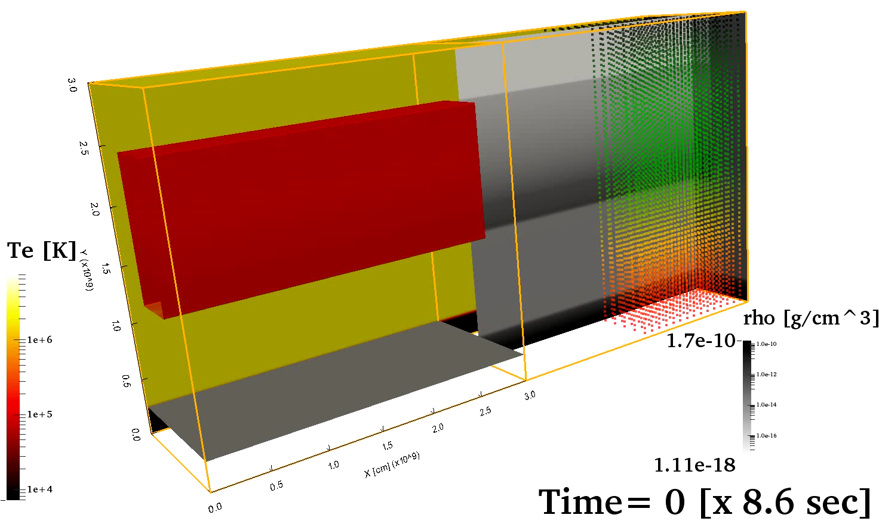
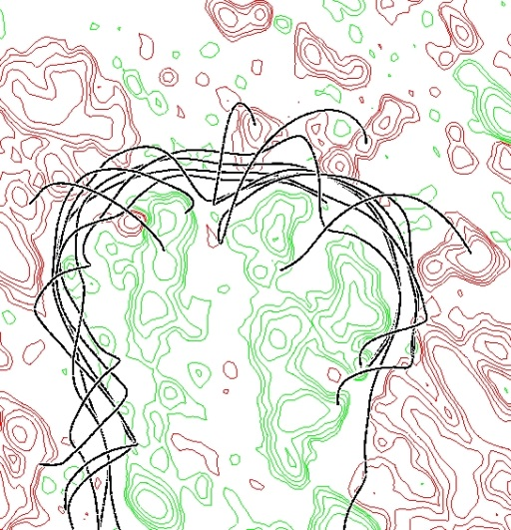
3D modeling of prominences
Observations revealed rich dynamics within prominences, the cool (10000 K), macroscopic (sizes of order 100Mm)
“clouds” in the million degree solar corona. Even quiescent prominences are continuously perturbed by hot, rising
bubbles. Since prominence matter is hundredfold denser than coronal plasma, this bubbling is related to Rayleigh–
Taylor instabilities. The movie shows true macroscopic simulations well into this bubbling phase, adopting an
MHD description from chromospheric layers up to 30Mm height. Our virtual prominences rapidly establish fully
nonlinear (magneto)convective motions where hot bubbles interplay with falling pillars, with dynamical details
including upwelling pillars forming within bubbles. The simulations show impacting Rayleigh–Taylor fingers
reflecting on transition region plasma, ensuring that cool, dense chromospheric material gets mixed with
prominence matter up to very large heights. This offers an explanation for the return mass cycle mystery for
prominence material. Synthetic views at extreme ultraviolet wavelengths show remarkable agreement with
observations, with clear indications of shear-flow induced fragmentations.
(Keppens et al 2015)

Slide 34
Chromosperic Structures

Slide 36
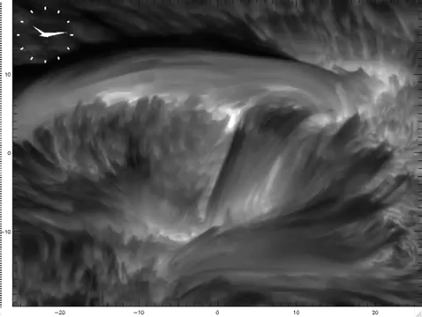
Hα line center imaging from the Swedish Solar Telescope, Courtesy of G. Scharmer, M. Carlsson

Slide 37
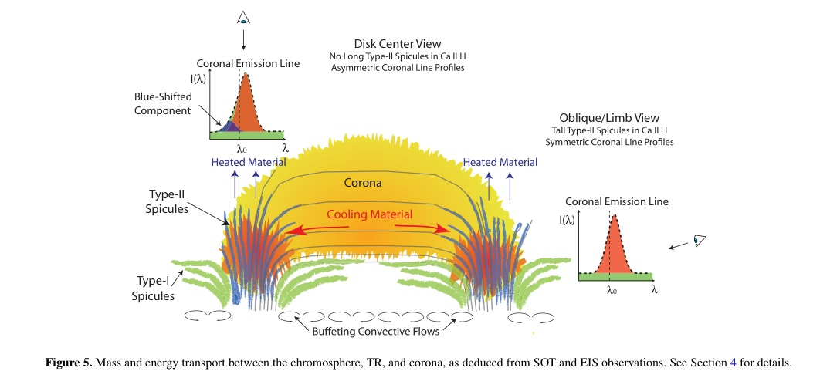
Spicule Dynamics
[ From De Pontieu, McIntosh, Hansteen, & Schrijver, ApJ 701, L1 (2009) ]

Slide 38
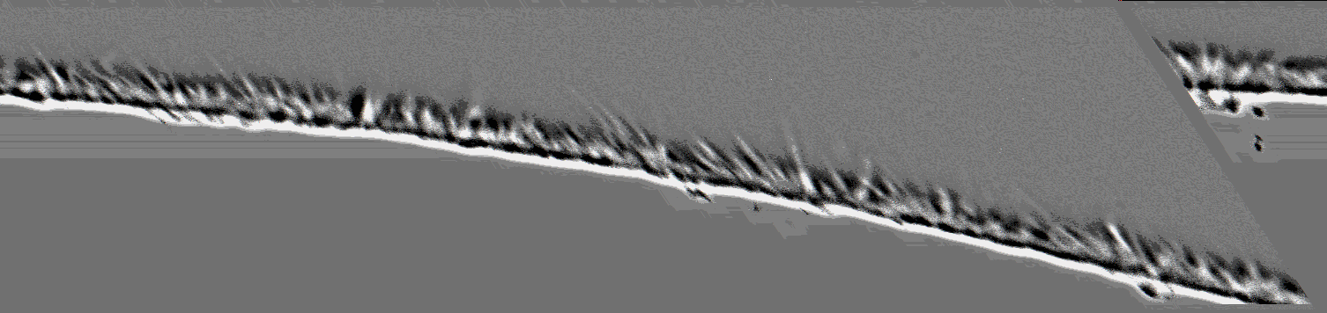
(Zirin & Cameron, 1997)

Slide 40
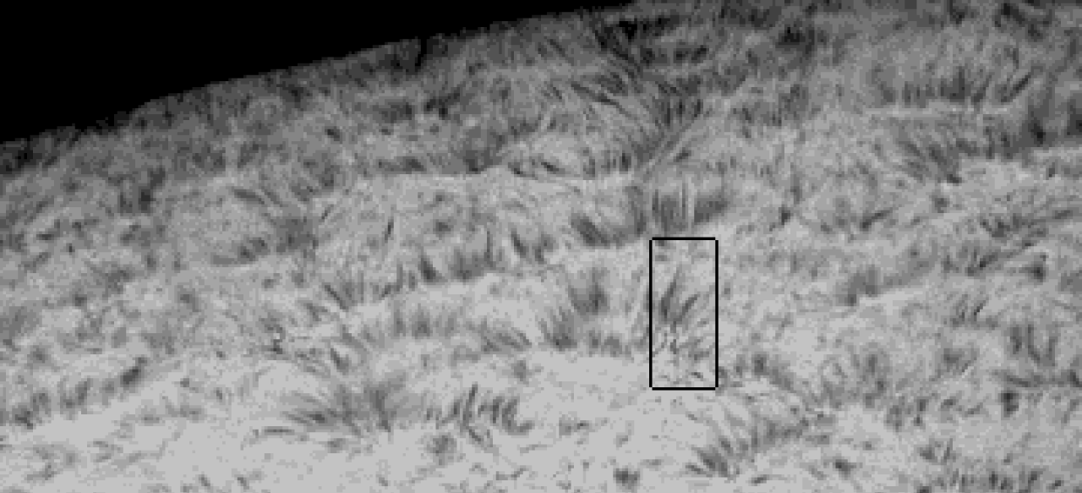

Slide 41
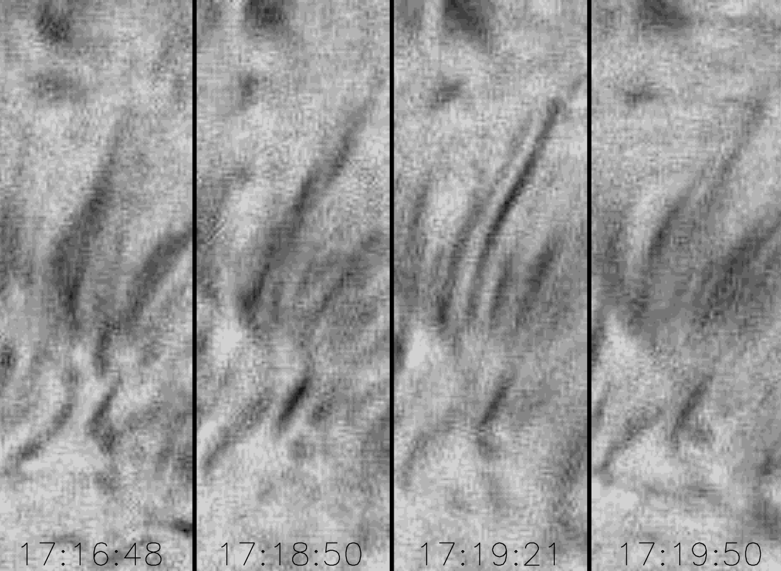

Slide 42

He II 284A

Slide 44
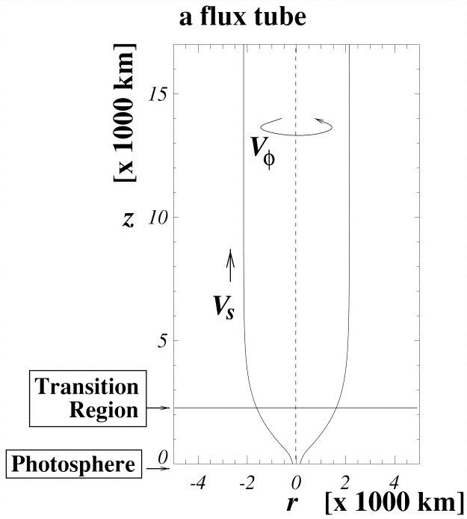

Slide 45
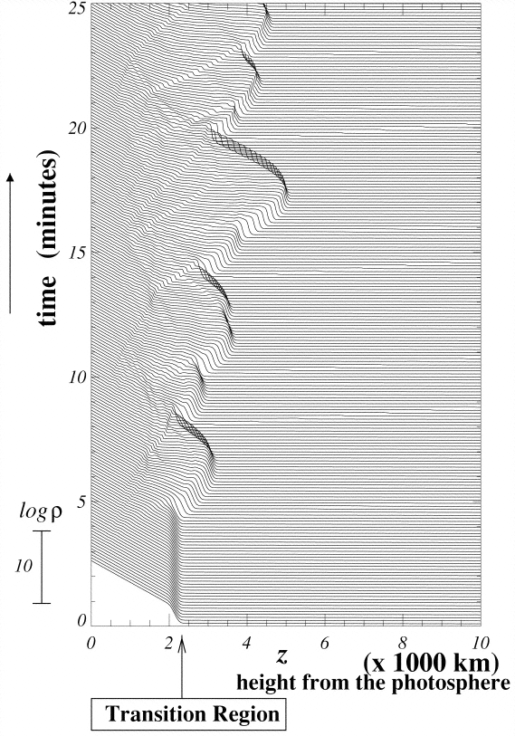

Slide 46
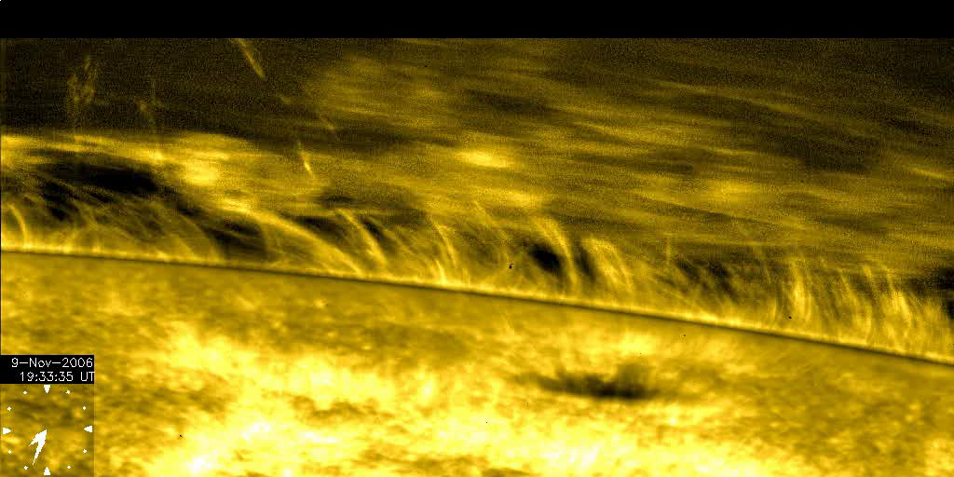
Observation of atmospheric dynamics from Hinode

Slide 47
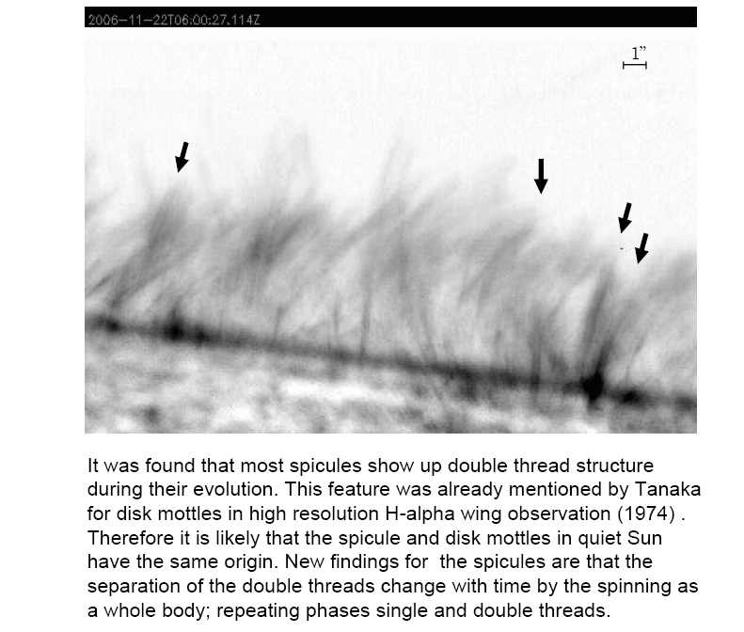

Slide 48
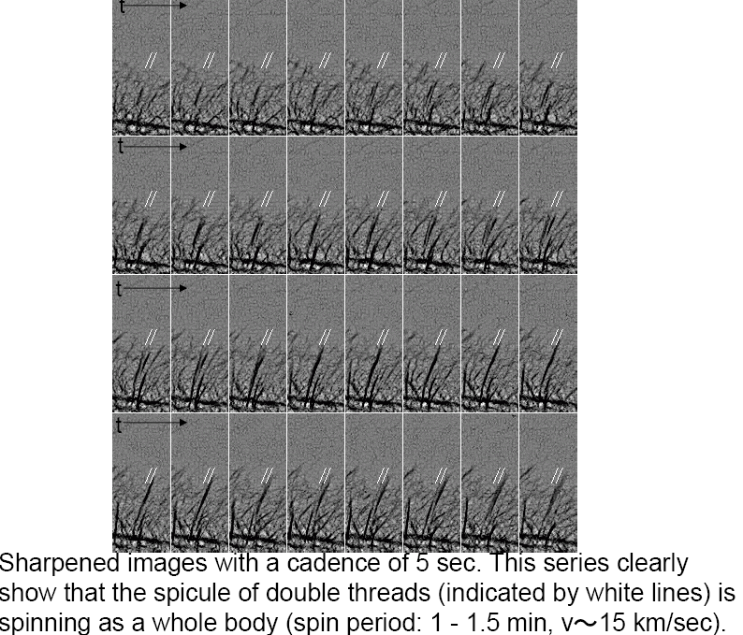

Slide 49
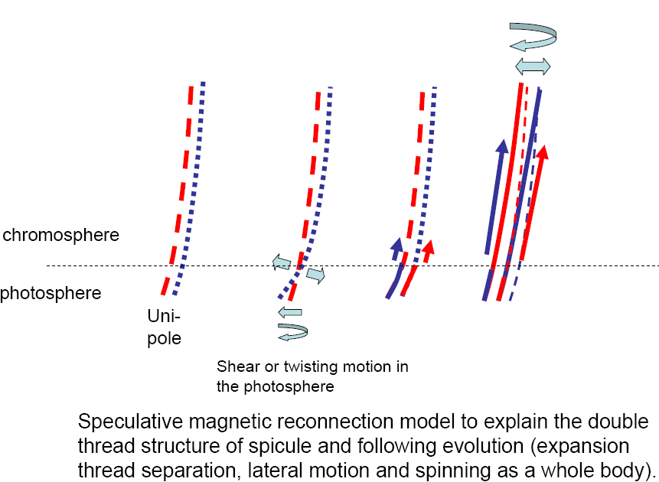

Slide 50
Hinode observations provided evidence of two types of spicules
“Type-I” spicules – material returns to the surface. They are possibly driven by shock waves that form when global oscillations and convective flows leak into the upper atmosphere along magnetic field lines on 3–7 minute timescales.
“Type-II” spicules do not return - “fade out”. They are much more dynamic: they form rapidly (in ∼10s), are very thin (≤200 km wide), have lifetimes of 10–150s (at any one height), and seem to be rapidly heated to (at least) transition region temperatures, sending material through the chromosphere at speeds of order 50–150 km s⁻¹.
The properties of Type II spicules suggest a formation process that is a consequence of magnetic reconnection, typically in the vicinity of magnetic flux concentrations in plage and network.
(De Pontieu et al 2007)

Slide 51
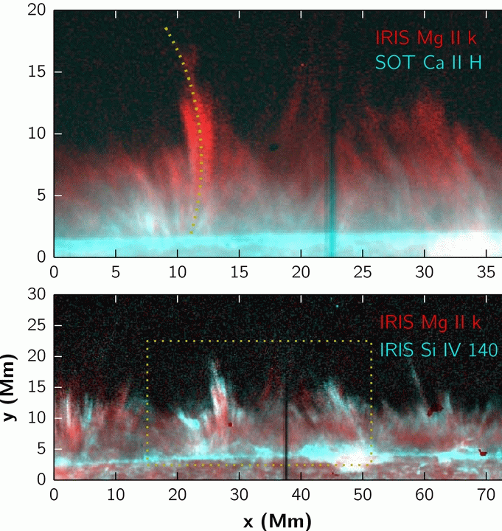
The observations of spicules from IRIS (Interface Region Imaging Spectrograph)
The group behavior of spicules is clearer in the IRIS observations. What is often perceived as one or two spicules in SOT turns out to be a much wider structure in IRIS. With clearly defined multiple strands, these wide bunches of spicules have the same time evolution, and extend to areas with little or no emission in Ca ii. Such group behavior plausibly contributes to the appearance of seemingly co-spatial spicules in lower-resolution observations It is likely that only the cooler strands of such groups become visible in Ca ii. The group behavior, multi-thermal nature, and apparent heating of these spicules indicate that these features are likely not driven in the same way as dynamic fibrils.
(Pereira et al. 2014).

