Slide 1
2. The Sun as a star
General properties, place in the Hertzsprung-Russell diagram. Distance, mass, radius, luminosity, composition, age, evolution, spectral energy distribution.

Slide 2
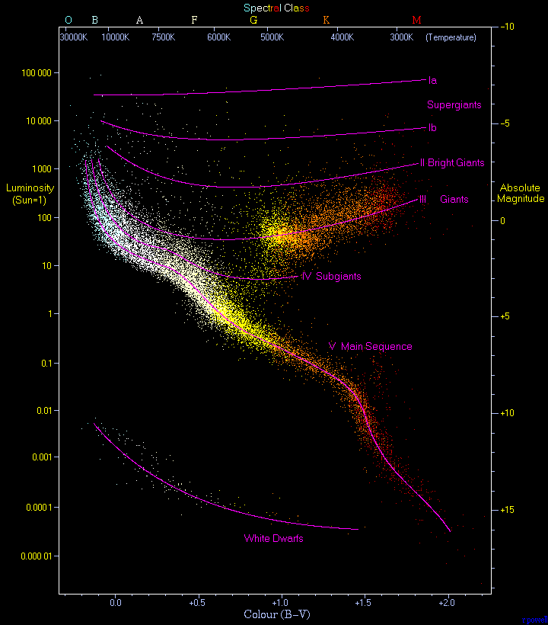
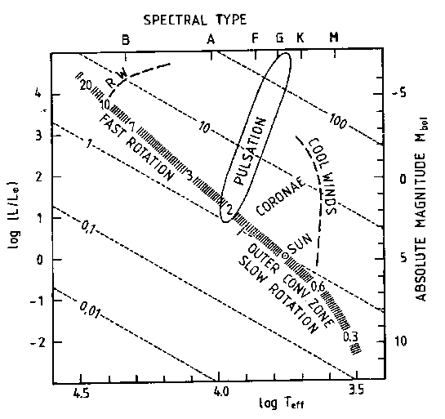
General Properties of the Sun.
Hertzsprung-Russel Diagram.
In 1911-13, Ejnar Hertzsprung and Henry Norris Russell independently developed H-R diagram
  Horizontal axis - spectral type (or, equivalently, color index or surface temperature)
  Vertical axis - absolute magnitude (or luminosity)
Data points define definite regions, suggesting common relationship exists for stars composing region. Each region represents stage in evolution of stars.
The place of a star on the H-R diagram also tells us about its radius, energy generation and transport, periods and growth rates of pulsations, rotation rate, stellar activity, X-ray coronas, etc.
Sun is G2 main-sequence star. Lies roughly in middle of diagram among what are referred to as yellow dwarfs.
Sun
Hertzsprung-Russel Diagram. Numbers in the main-sequence band are stellar masses in units of the solar mass. Dotted lines correspond to constant radius in units of the solar radius.RW - radiatively driven wind.
22,000 stars from Hipparcos catalog

Slide 3
Overall properties

Slide 4
Sun’s age
Radioactive
decay
Does not change
over time
Measured by mass spectrometer

Slide 5
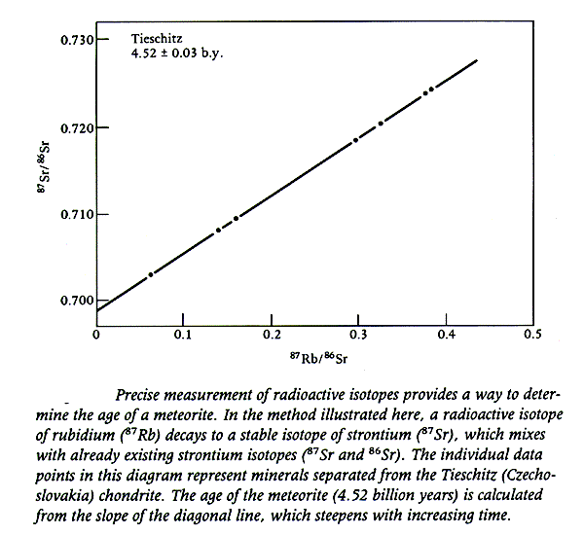
The age is
determined from
the slope

Slide 6
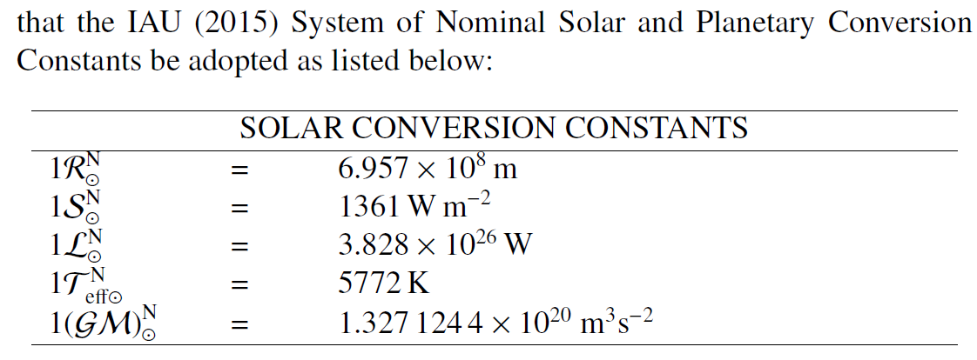
New solar parameters adopted by the International Astronomical Union (2015)

Slide 7
Distance - I

Slide 8
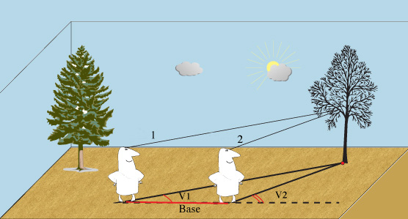
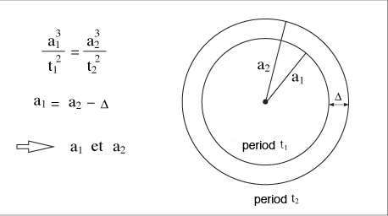
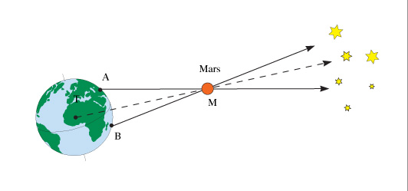
Distance - II
Kepler’s law
Triangulation
Measure the distance between the planets, Δ, the orbital periods, t₁ and t₂, and then calculate their distances to the Sun, a₁ and a₂.

Slide 9
Distance - III
The Sun's angular size varies from 31' 27.7" to 32' 31.9" during the course of a year because the distance changes from 1.471x10¹¹m in January to 1.521x10¹¹ m in July.
1 arcsec varies from 710 km to 734 km.

Slide 10
The Solar Mass

Slide 11
Sun’s rotation axis is inclined by 7.23 degrees to the ecliptic

Slide 12
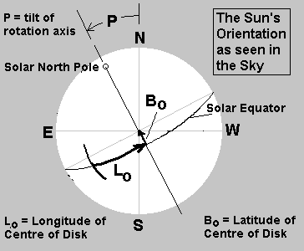
Solar coordinates
P-angle (or P): The position angle between the geocentric north pole and the solar rotational north pole measured eastward from geocentric north. The range in P is +/- 26.31 degrees.
B0: Heliographic latitude of the central point of the solar disk; also called the B-angle. The range of B0 is +/- 7.23 degrees, correcting for the tilt of the ecliptic with respect to the solar equatorial plane.
L0: Heliographic longitude of the central point of the solar disk. The longitude value is determined with reference to a system of fixed longitudes rotating on the Sun at a rate of 13.2 degrees/day (the mean rate of rotation observed from central meridian transits of sunspots). The standard meridian on the Sun is defined to be the meridian that passed through the Sun's equator on 1 January 1854 at 1200 UTC and is calculated for the present day by assuming a uniform sidereal period of rotation of 25.38 days. (Carrington longitude).

Slide 13
The Solar Radius

Slide 14
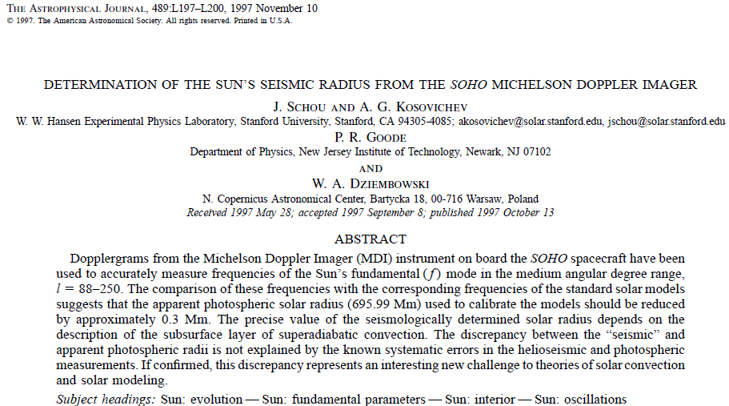
Determination of the seismic radius

Slide 15
Helioseismic estimate of the solar radius

Slide 16
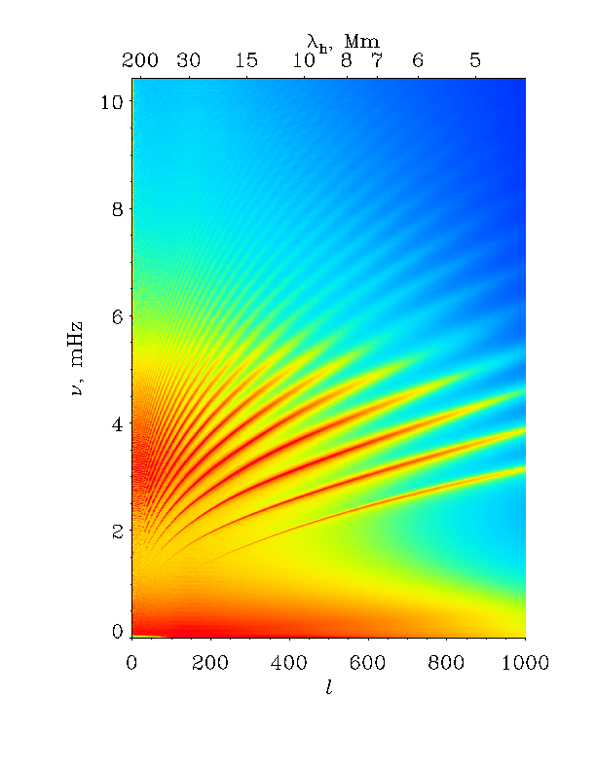
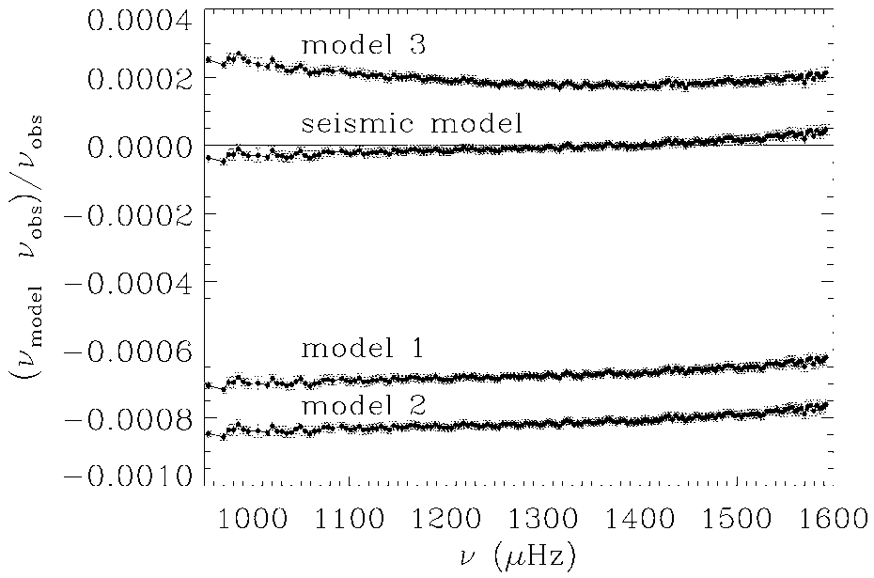
Measurements of f-mode frequencies and comparison with solar models
f-mode

Slide 17
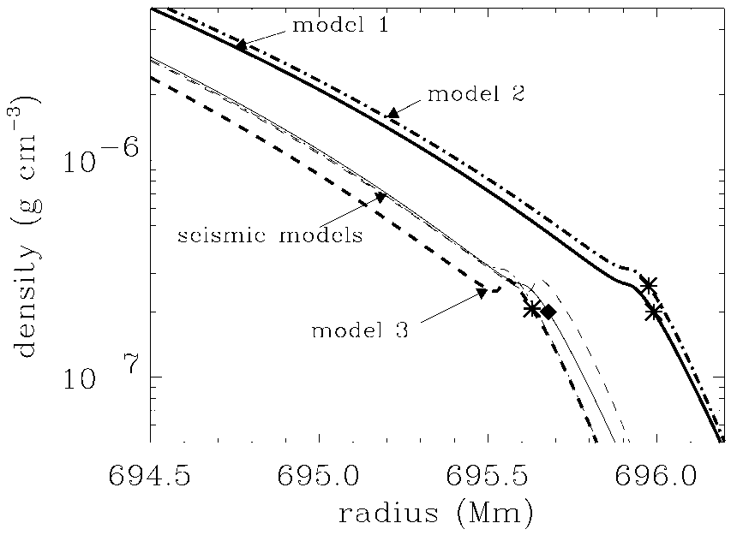
Calibration of solar models to match the helioseismology data
Old standard model
Seismic radius

Slide 18
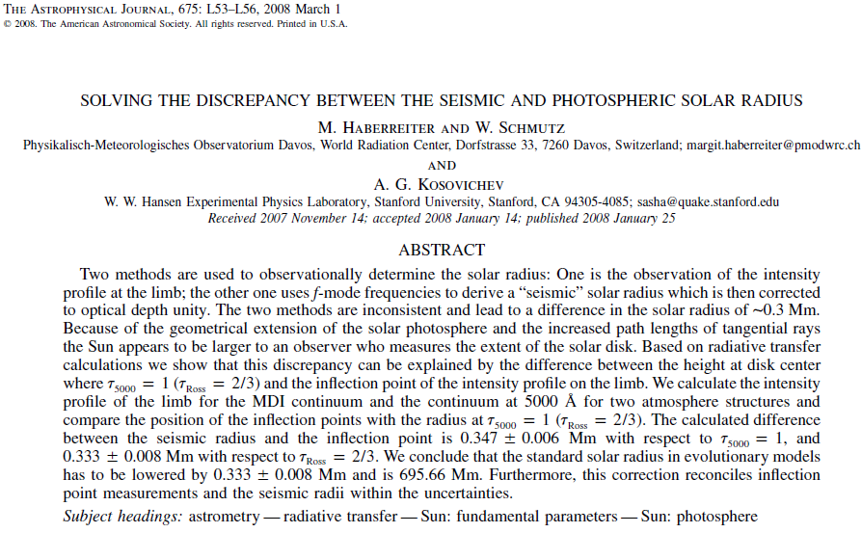

Slide 19
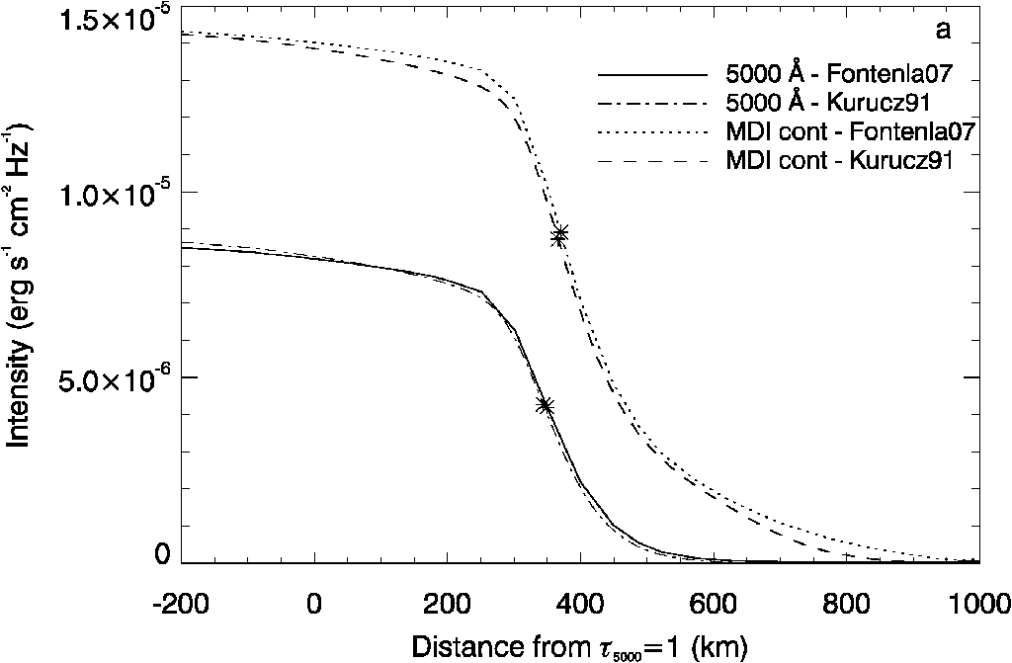
Radiative transfer calculations to determine the precise surface location
At the limb we see higher layers of the solar atmosphere because
of the higher optical depth. The reference wavelength is 5000A.
To observer
atmosphere

Slide 20
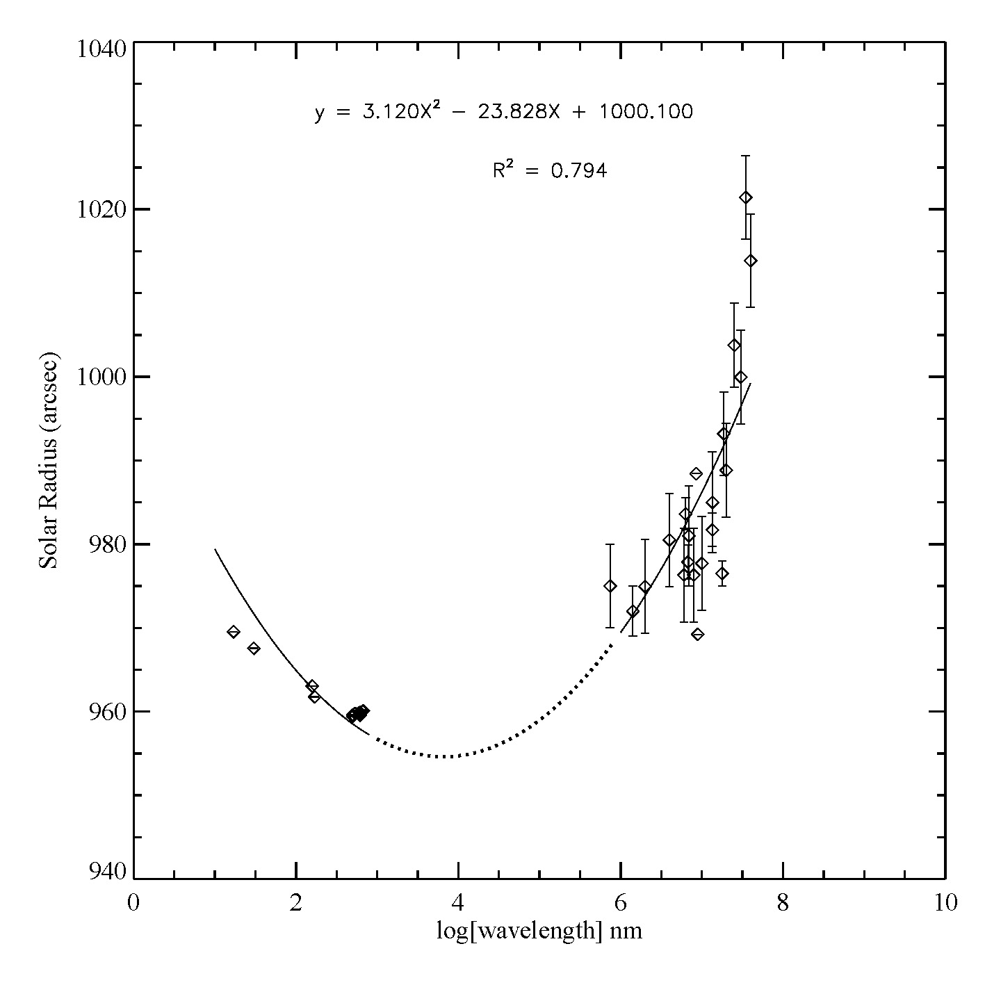
The apparent solar radius depends on wavelength (the standard value is for 5,000A=500nm)
Radio
EUV
V
Rozelot, Kosovichev, Kilcik, 2015

Slide 21
Oblateness

Slide 22
Quadrupole moment

Slide 23
Composition

Slide 24
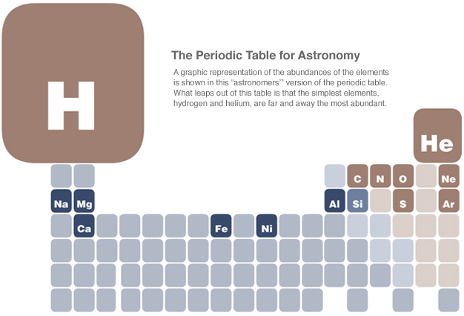
The Periodic Table for Astronomy

Slide 25

Solar composition
Solar (stellar) composition is determined by the fractional percentage of hydrogen, X, helium, Y, and the heavier elements, Z:
X+Y+Z=1
X=m_{H}/M (M is the total mass)
Y=m_{He}/M
Z=1-X-Y
Canonical values:
Logarithmic abundances are defined relatively to the number density of hydrogen:
log ε_{X}=log(N_{X}/N_{H})+12
N_{X} – number density of element X
N_{H} – number density of hydrogen H
Stellar “metallicity” is defined relative to the Sun [Fe/H]:
measured in dex (e.g. if [Fe/H]=-1 the number density is 10 times smaller than on the Sun).
Hydrogen mass fraction
Helium mass fraction
Heavy elements

Slide 26
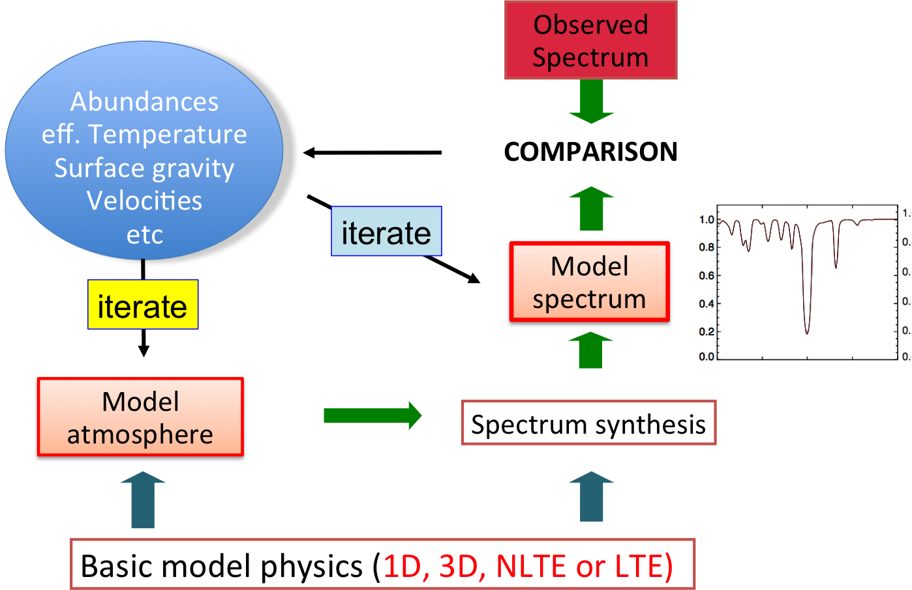
Determination of solar (stellar) abundances
Recent development of 3D models

Slide 27
Temperature & Density Structure of the Solar Atmosphere
10
7
)
10
16
-3
3 million K
n
Corona
1 million K
H
10
6
T
10
14
Temperature (K)
10
5
Transition Region
Total Hydrogen Density (cm
60,000 K
10
12
Chromosphere
4
10
6,000 K
10
10
3
10
8
10
10
2
10
3
10
4
10
5
Height Above Photosphere (km)

Slide 28
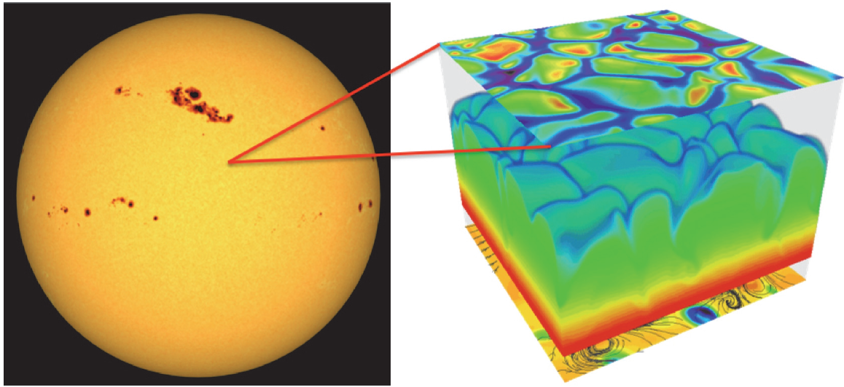
3D realistic simulation of the solar surface take into account all essential physics: stratification, gravity, radiative energy transfer, ionization, detailed chemical composition
Vz
T
Only small surface areas can be simulated
on modern supercomputers

Slide 29
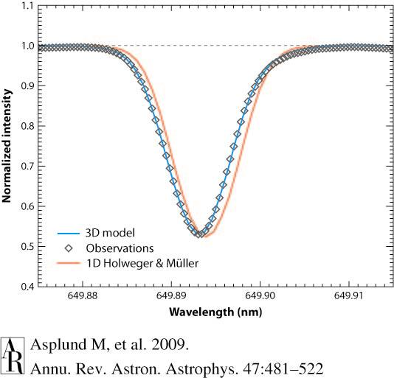
Example of fitting synthetic spectral line of Fe I from1D and 3D models to observations
Much better fit with the 3D model

Slide 30
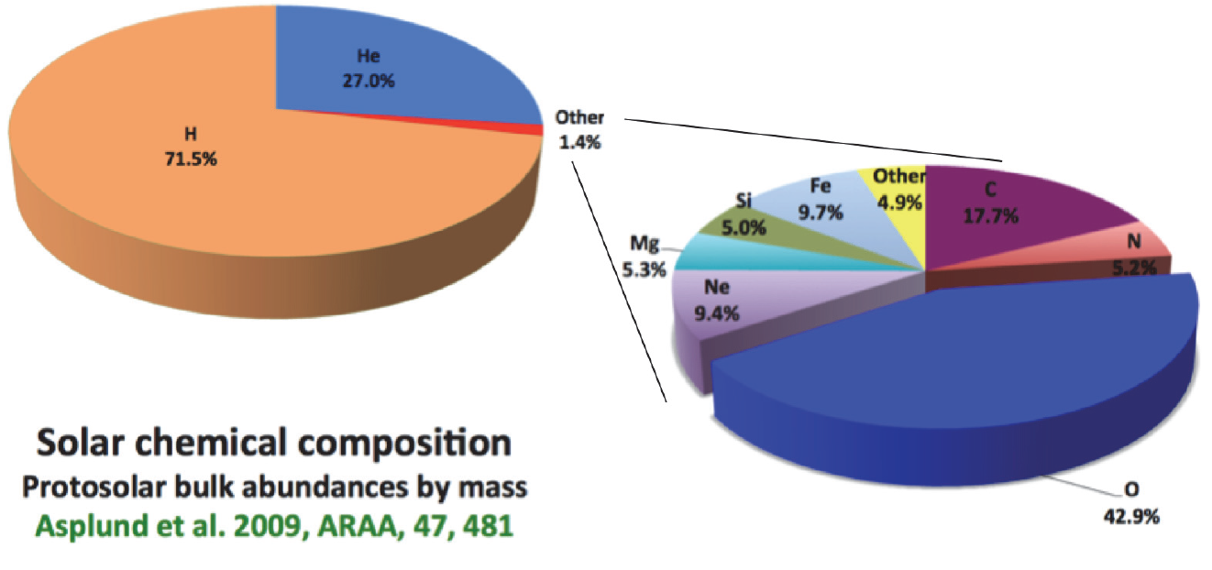
Illustration of the solar abundances (mass fractions)
X
Y
Helium
Hydrogen
Z
Oxygen
The result of the 3D models was a substantially lower abundance
of the heavy elements: Z=0.014 instead of 0.02 found using 1D models.

Slide 31
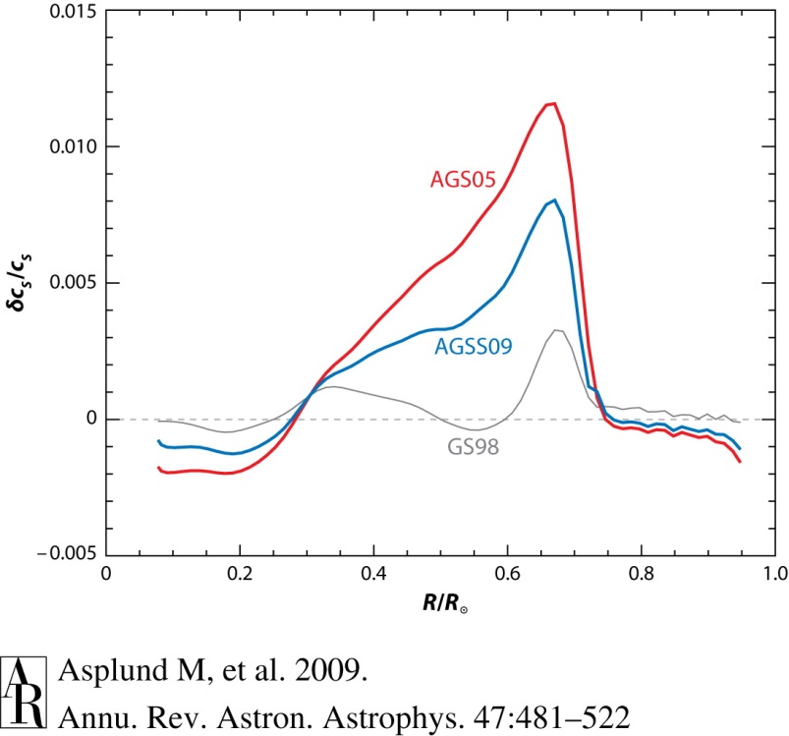
The low Z led to a “crisis” in helioseismology and solar modeling
For a given chemical composition, X, Y, Z, the structure of the Sun is calculated using the Standard Stellar Evolution Theory.
The distribution of the sound speed as a function of radius is determined by helioseismology, and can be compared with the solar model.
For Z=0.02 the solar model is in excellent agreement with helioseismology.
However, for Z=0.014 the disagreement is very large. The source of discrepancy is still unknown.
Asplund, Grevesse & Sauval,2005-9
Z=0.014
Z=0.02
Grevesse & Sauval,1998

Slide 32
Luminosity
Absorption in the Earth’s atmosphere.
The edge of the shaded area marks the height where the radiation is reduced to 1/2 of its original strength.
UV - ultraviolet; V- visible; IR - infrared.

Slide 33
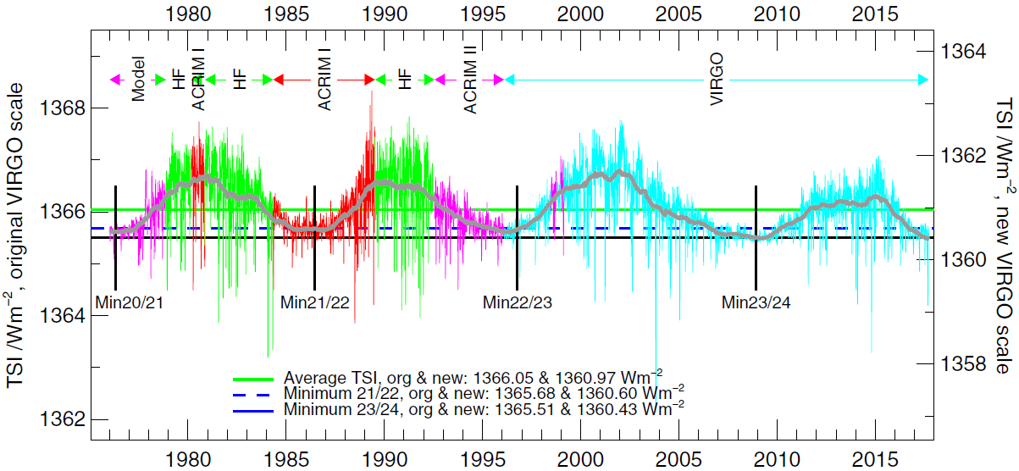
Irradiance variations
The composite total irradiance from 1977 to 2018.
Note the variation with the solar activity cycle of order 0.1%

Slide 34
Faint young Sun paradox
The Standard Stellar Evolution theory shows that the Sun’s luminosity increased by 28% over the Sun’s life of 4.6 billion years.
If the solar energy output was 28% lower then oceans would freeze. But geological records show that this was not the case, and the surface was warm.
Possible solutions:
  Earth’s atmosphere had more greenhouse gases
  Earth produced more internal heat
  The Sun was more massive, and lost mass because of strong solar wind – this is a hot topic of current research in astronomy (“The Sun in Time” project).

Slide 35
Effective temperature of the Sun

Slide 36
Spectral energy distribution

Slide 37
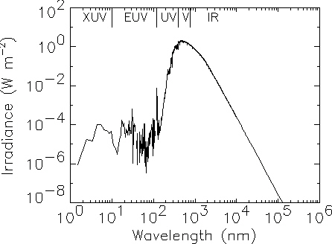
Solar irradiance spectrum
1 Angstrom = 10⁻¹⁰ m = 10⁻⁸ cm = 0.1 nm
1 nm = 10 A

Slide 38
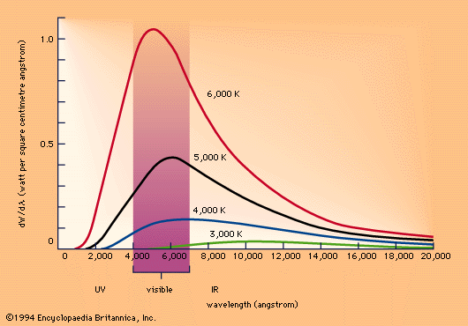
Black body radiation
Black body spectrum depends only on temperature

Slide 39
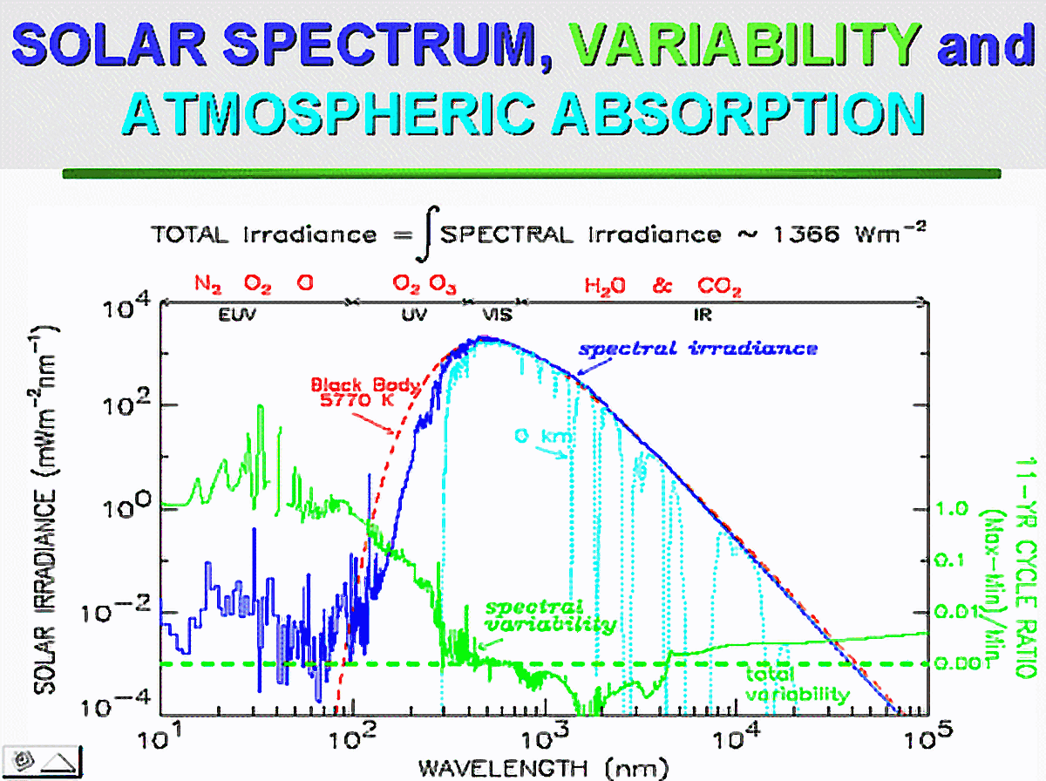

Slide 40
Spectral energy distribution

Slide 41
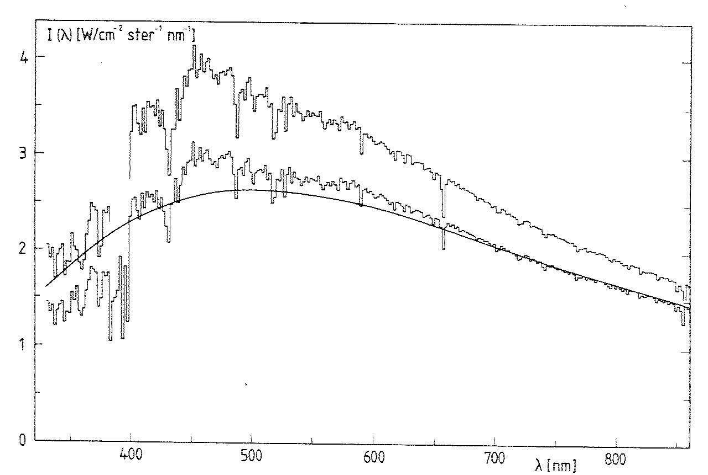
Visible spectrum
H-alpha line
6563 A

Slide 42
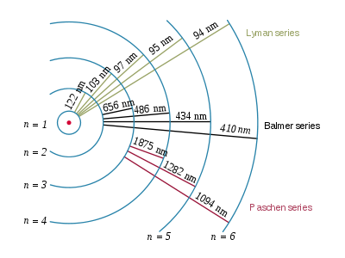
Hydrogen series
Lyα
Hα
Hβ
Hγ

Slide 43
Visible spectrum
Hβ
Hγ
Hα line
6553 A
CaII H&K

Slide 44
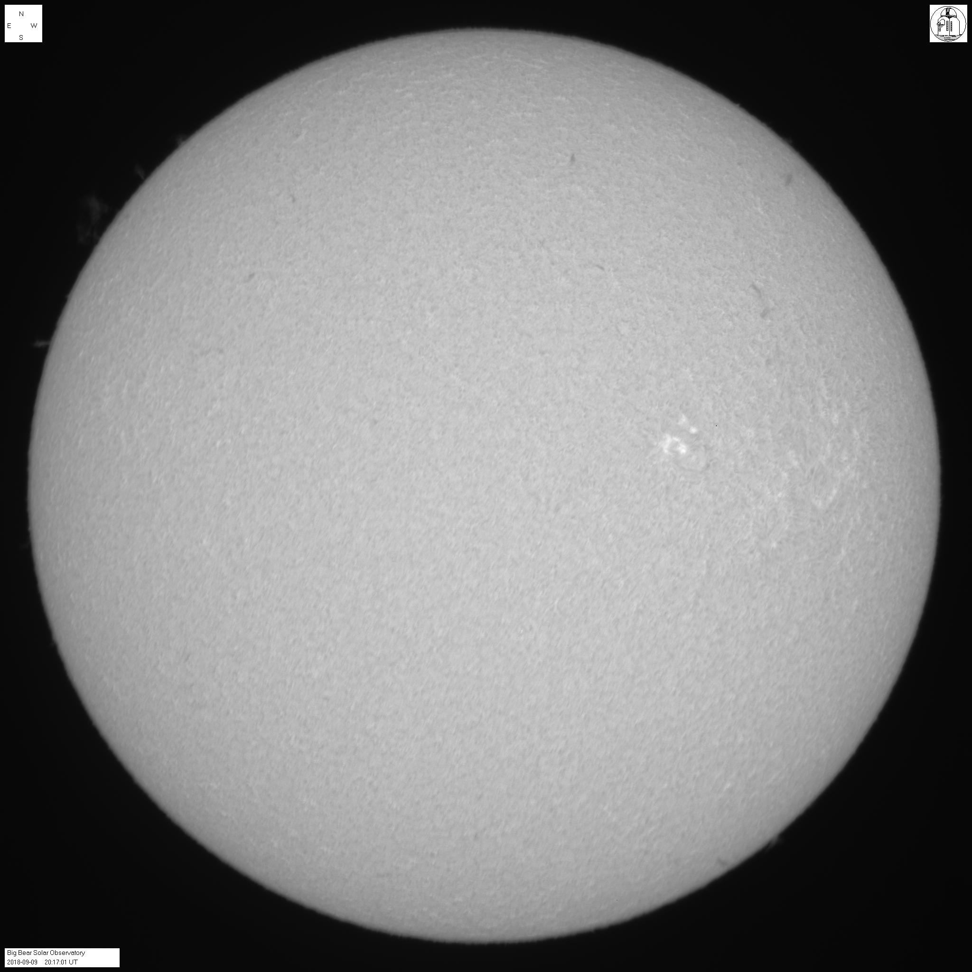
Hα image from BBSO September 9, 2018

Slide 45
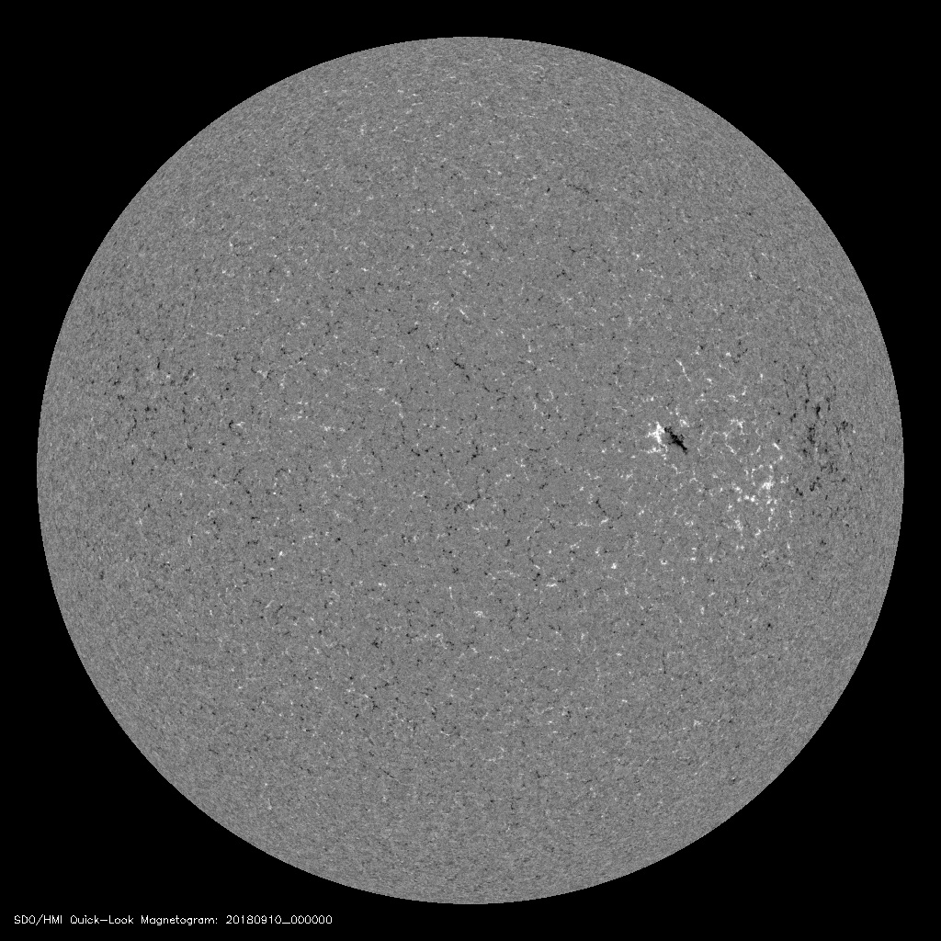
Magneto-gram
SDO/HMI

Slide 46
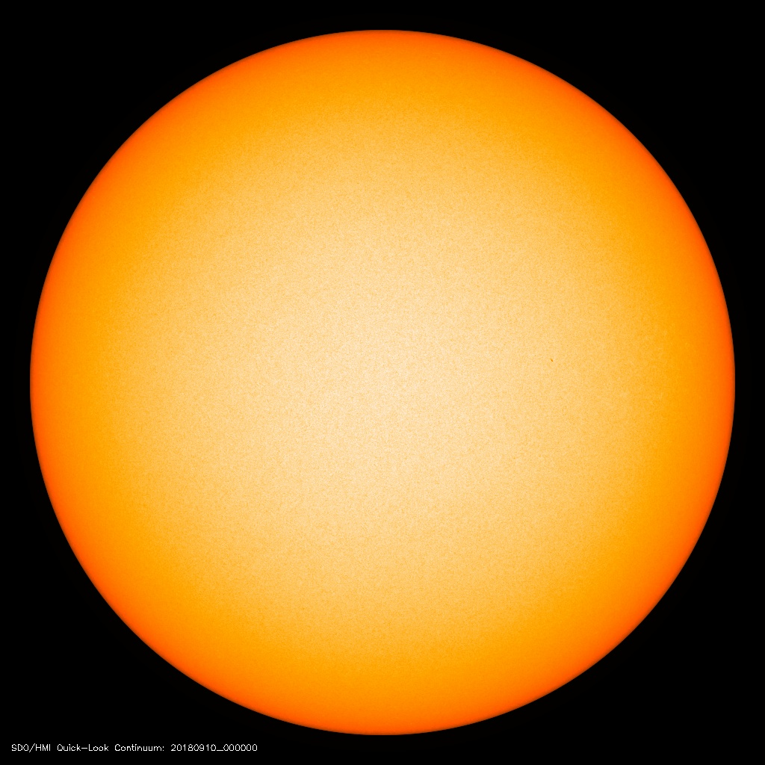
Continuum
Image
SDO/HMI

Slide 47
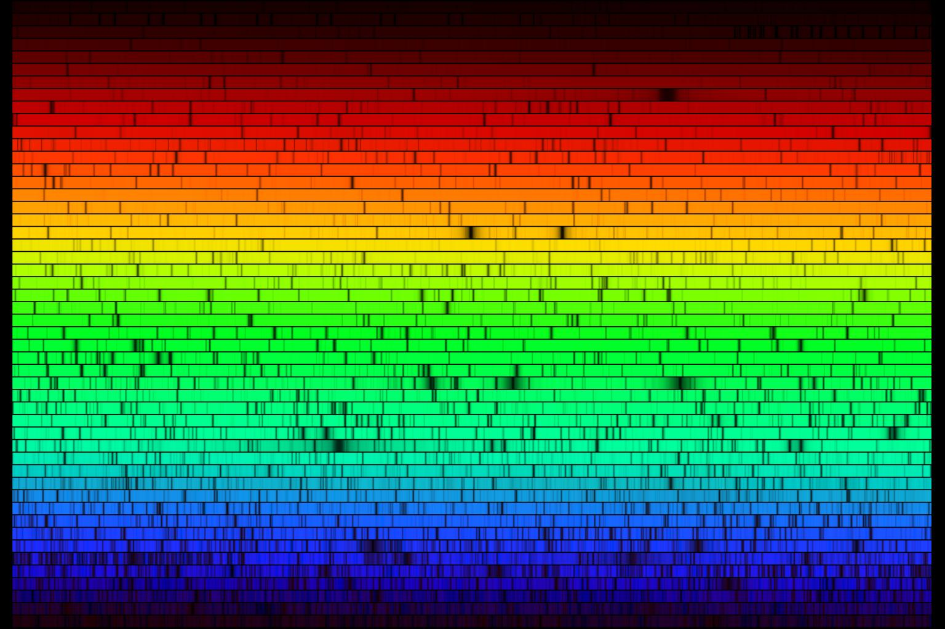
Visible solar spectrum with absorption (Fraunhofer) lines

Slide 48
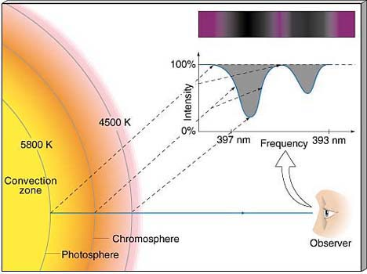
Different parts of Fraunhofer lines are formed in different layers: the line core is formed higher than the line wings

Slide 49
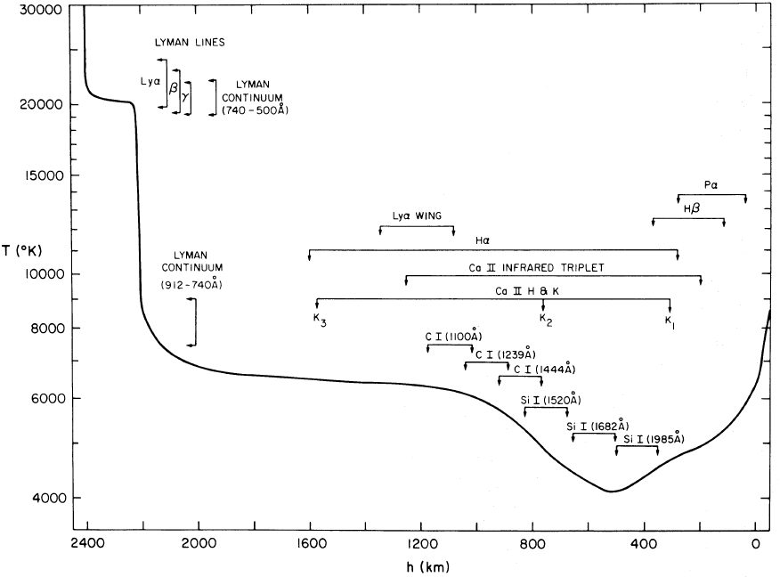
VAL (Vernazza, Avrett, Loeser) model of the solar atmosphere

Slide 50
Color indices

Slide 51
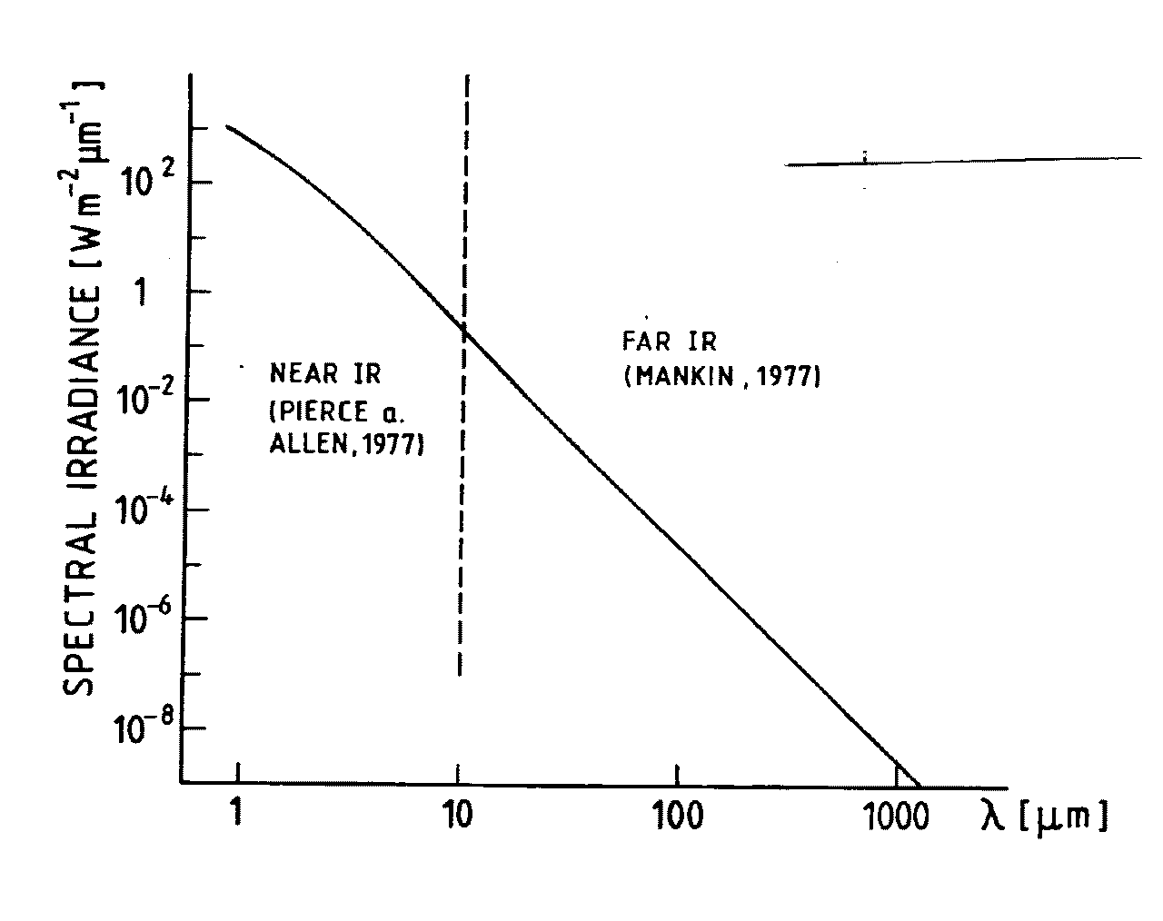
Infrared spectrum
The infrared spectral irradiance.

Slide 52
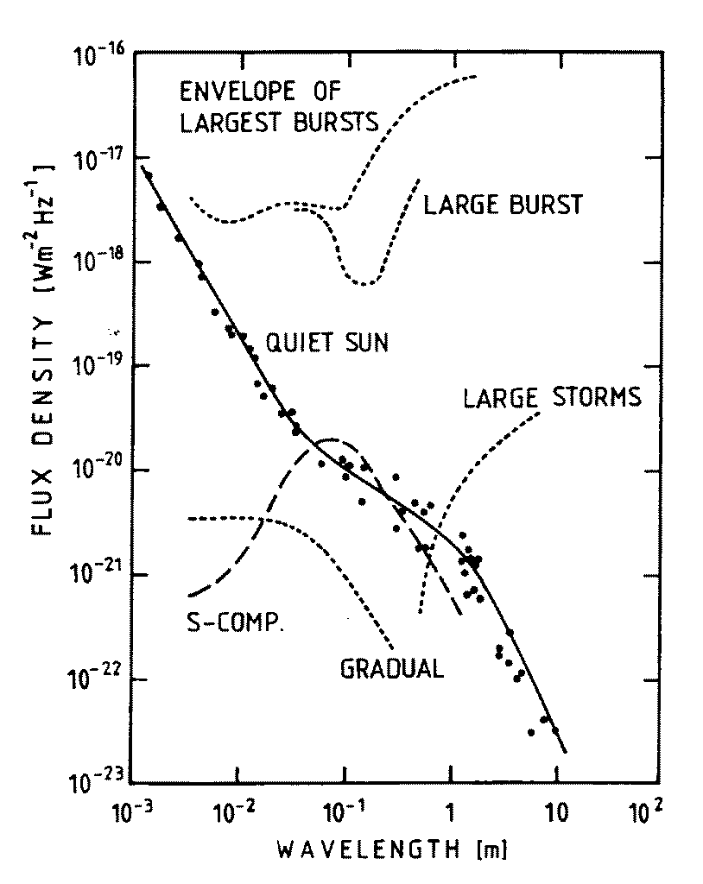
Radio spectrum

Slide 53
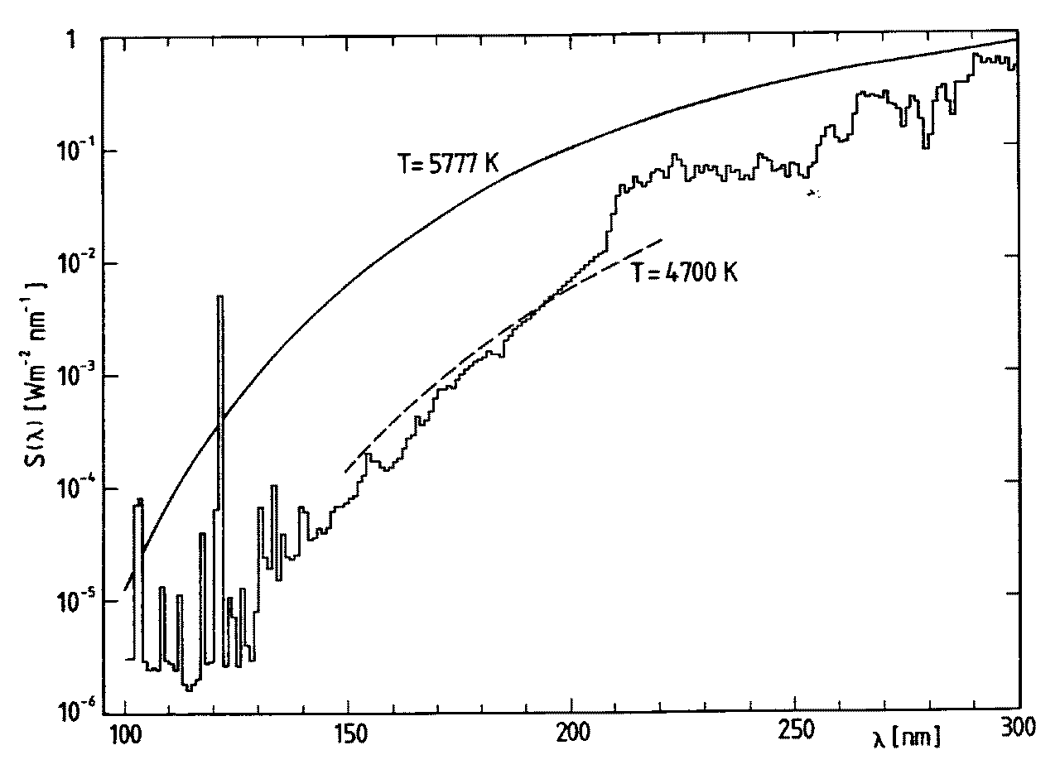
UV spectrum
Lyα

Slide 54
EUV and X-ray spectrum

Slide 55
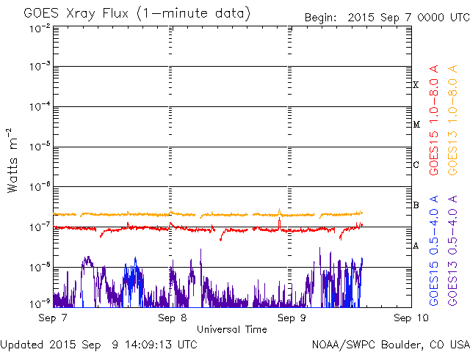
X-ray emission is highly variable
Soft X-ray from GOES satellite (last 2 days)

Slide 56
Real-time solar images
http://jsoc.stanford.edu/data/hmi/images/latest/
http://sdowww.lmsal.com/suntoday/
http://helioviewer.org/
http://www.bbso.njit.edu/cgi-bin/LatestImages
http://sohowww.nascom.nasa.gov/
http://www.raben.com/maps/

