Slide 1
23. Magnetosphere.

Slide 2
Magnetosphere
Interaction of the solar wind with the Earth’s magnetic field
Formation of the magnetosphere
Structure of the magnetosphere
Magnetic reconnection in the magnetosphere
Storm and substorms
Radiation belts

Slide 3
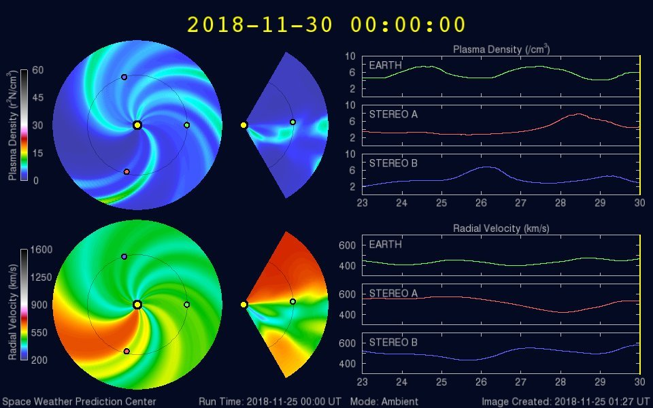
WSA-ENLIL Solar Wind Prediction Model (MHD) http://www.swpc.noaa.gov/products/wsa-enlil-solar-wind-prediction

Slide 4
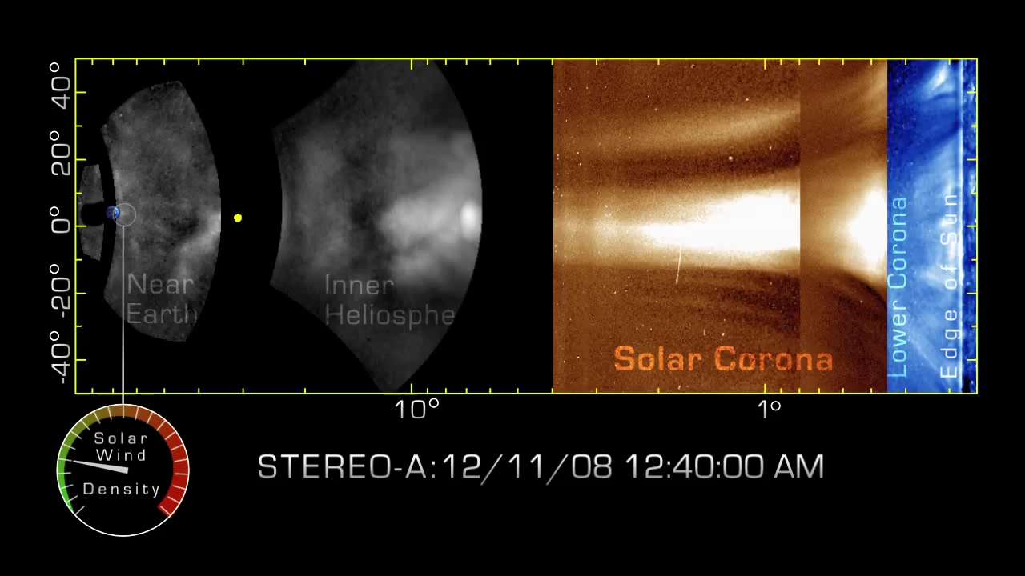
STEREO-A tracks a Coronal Mass Ejection from the Sun to Earth.
When the CME first left the sun, it was cavernous, with walls of magnetism encircling a cloud of low-density gas. As the CME crossed the Sun-Earth divide, however, its shape changed. The CME "snow-plowed" through the solar wind, scooping up material to form a towering wall of plasma. (DeForest, 2011)

Slide 5
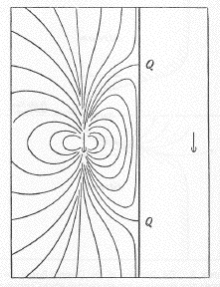
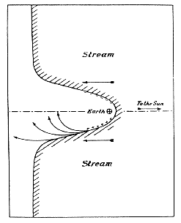
Chapman and Ferraro model
Back in 1930 Chapman and Ferraro foresaw that a planetary magnetic field could provide an effective obstacle to the solar-wind plasma.
The solar-wind dynamic pressure presses on the outer reaches of the magnetic field confining it to a magnetospheric cavity that has a long tail consisting of two antiparallel bundles of magnetic flux that stretch in the antisolar direction.
The pressure of the magnetic field and plasma it contains establishes an equilibrium with the solar wind.
Perfect conductor
The formation of the Chapman-Ferraro cavity. Arrows trace the paths of ions and electrons by which Chapman and Ferraro proposed to account for ring current effects.
The Earth's dipole field (left), flattened by the addition of the field of an image dipole (right), as proposed by Chapman and Ferraro.

Slide 6
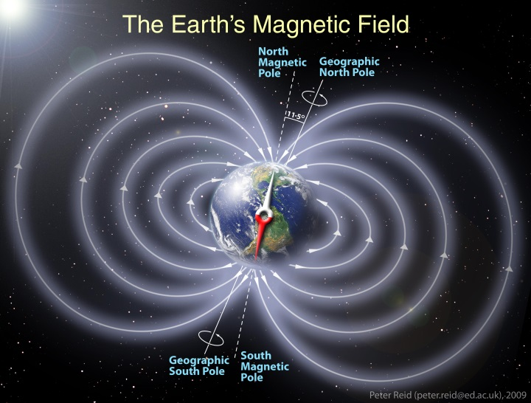
The Earth’s Magnetic Field (Spherical Coordinates)
To a first approximation the magnetic field of the Earth can be expressed as that of a dipole. The dipole moment of the Earth is tilted ~11⁰ to the rotation axis with a present day value of 8x10¹⁵Tm³ or 30.4x10⁻⁶TR_{E}³ where R_{E}=6371 km (one Earth radius).
In a coordinate system fixed to this dipole moment
where is the magnetic colatitude,
and M_{E} is the dipole magnetic moment.
Z
(X,Y,Z)
Θ
θ
r
Y
φ
X

Slide 7
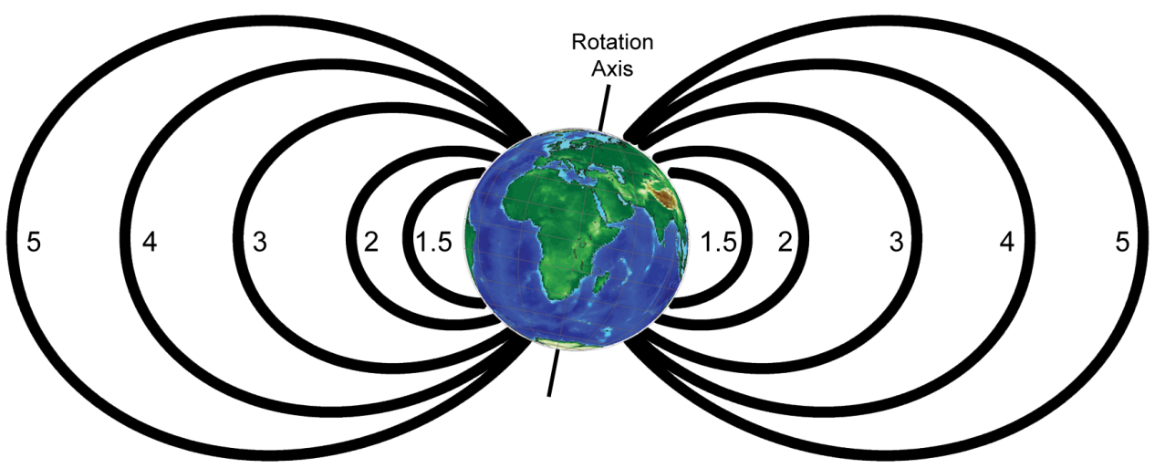
Dipole Magnetic Field Lines and the L-shell Parameter
The magnetic field line for a dipole.
Magnetic field lines are everywhere tangent to the magnetic field vector.
where r₀ is the distance to equatorial crossing of the field line. It is most common to use the magnetic latitude instead of the colatitude
where L is measured in R_{E.}

Slide 8
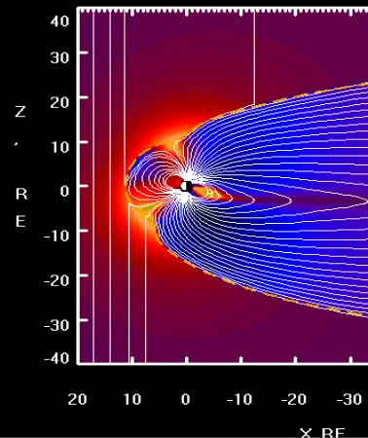
Properties of the Earth’s Magnetic Field
The dipole moment of the Earth presently is ~8x10¹⁵T m³ (3x10⁻⁵T R_{E}³).
The dipole moment is tilted ~11⁰ with respect to the rotation axis.
The dipole moment is decreasing.
  It was 9.5x10¹⁵T m³ in 1550 and had decreased to 7.84x10¹⁵T m³ in 1990.
  The tilt also is changing. It was 3⁰ in 1550, rose to 11.5⁰ in 1850 and has subsequently decreased to 10.8⁰ in 1990.
In addition to the tilt angle the rotation axis of the Earth is inclined by 23.5⁰ with respect to the ecliptic pole.
  Thus the Earth’s dipole axis can be inclined by ~35⁰ to the ecliptic pole.
  The angle between the direction of the dipole and the solar wind varies between 56⁰ and 90^{0.}

Slide 9
Three Kinds of Pressure
Dynamic pressure is like pressure of a flowing fluid
where ρ is the mass density (g/cm³) and V is the velocity (cm/s).
Thermal pressure of a fluid even if it is stationary.
where n is the number density (cm⁻³), k is the Boltzman constant (1.38x10⁻¹⁶ erg K⁻¹) and T is the temperature.
The magnetic field can also exert pressure
where B is the magnetic field intensity (Gauss).

Slide 10
Solar Wind Pressure at the Earth
Assume that the solar wind has a velocity of 400km/s, density of 5cm⁻³, temperature of 2x10⁵K, and magnetic field strength of 5nT=5x10⁻⁵ G.

Slide 11
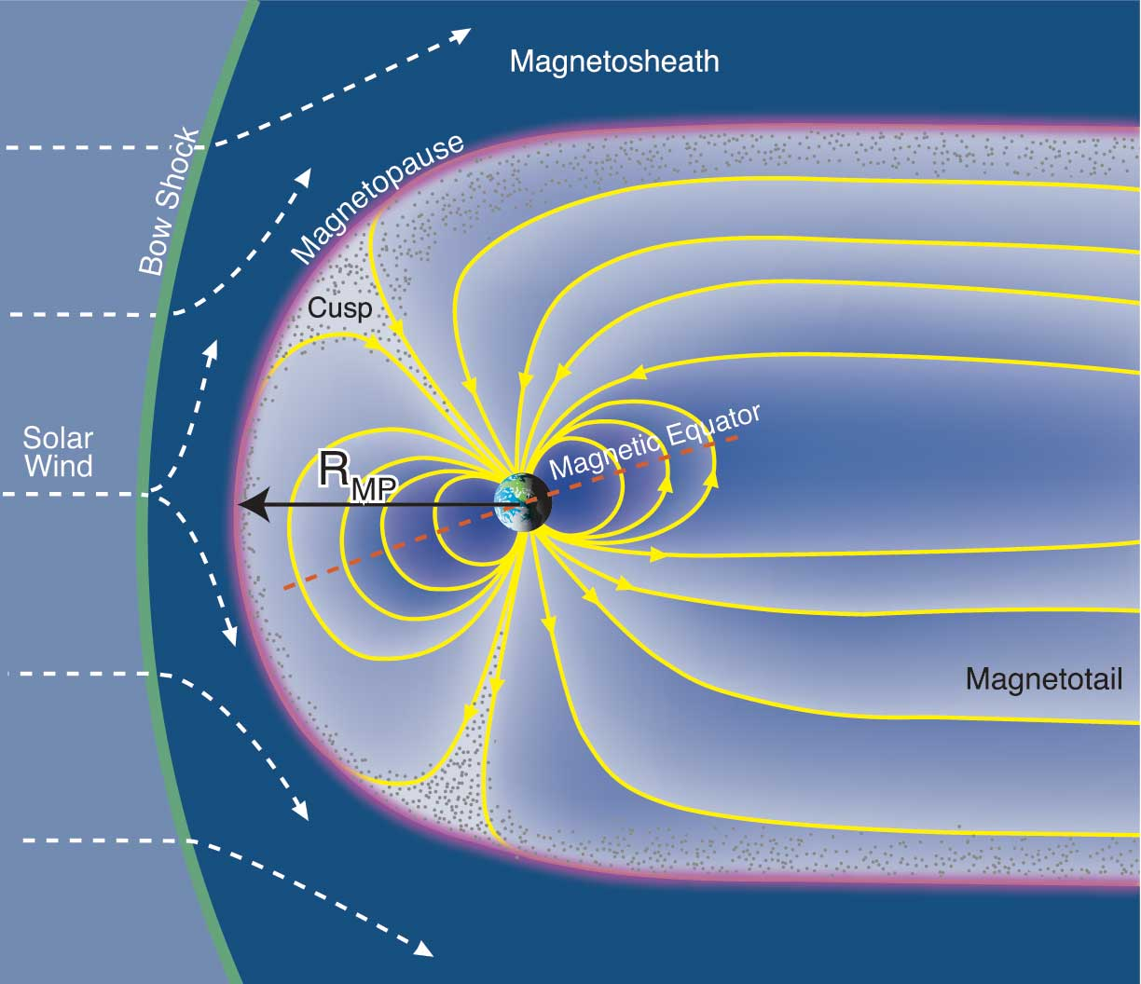
Forming the Magnetopause
The solar wind is supersonic and passes through a bow shock where the direction of flow is changed so that most of the solar wind plasma is deflected to either side of the magnetopause.
The zone of shocked solar wind plasma is the magnetosheath.
The dynamic pressure is much larger than the thermal pressure or magnetic pressure in the solar wind.
Within the magnetosphere the magnetic pressure of the Earth’s internal field dominates.
To a good approximation the boundary (the magnetopause) between the region dominated by the solar wind and the region dominated by the Earth (the magnetosphere) can be found by balancing the solar wind dynamic pressure with the magnetic pressure of the Earth.
R_{S}

Slide 12
Shielding the Earth from the Solar Wind
Ideally when the pressures are in balance the Earth’s field will be shielded from the solar wind in a cavity called the magnetosphere.
The interaction sets up Chapman-Ferraro currents on the boundary which cancel the Earth’s magnetic field outside.
Near the pole there is a singular point in the field where |B| = 0. This is called the neutral point.
The C-F current circulates in a sheet around the neutral point
This current is symmetric about the equator with a corresponding circulation around the southern neutral point

Slide 13
The Location of the Magnetopause
The magnetic field inside the boundary is the total field from dipole and boundary current. For an infinite planar sheet current the field would be exactly doubled. Inside a spherical boundary the multiplication factor is 3. The factor f must lie in this range .
Equate and substitute for the dipole strength variation with distance.
Solve for the dimensionless standoff distance L_{s}.
Where k~0.9 is the elasticity of particle collisions and f is the factor by which the magnetospheric magnetic field is enhanced by the boundary current. R_{s} is the subsolar standoff distance. B₀ is the field at the surface of the Earth.

Slide 14
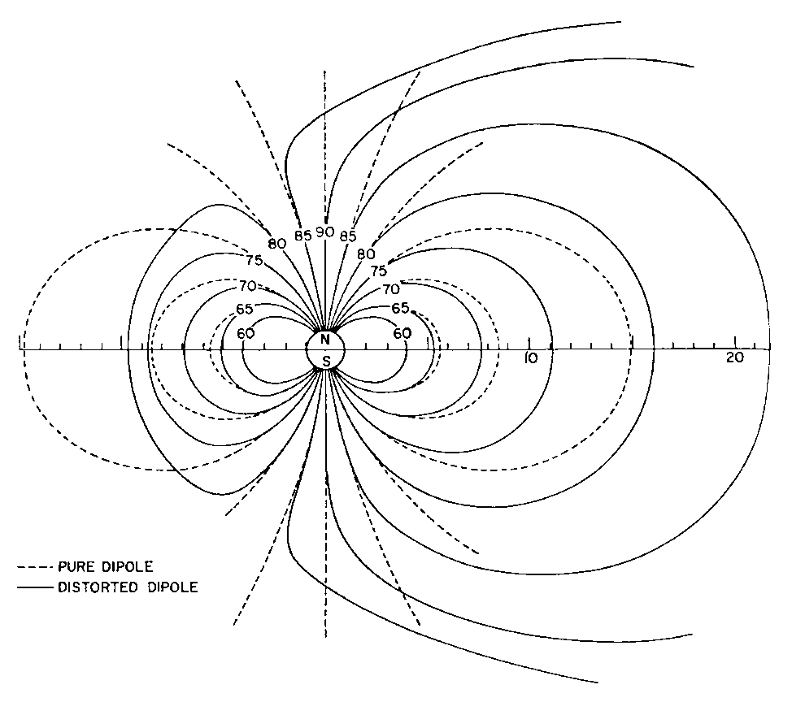
The Effect of Magnetopause Currents
Close to the Earth the dipole field dominates and there is little distortion
Further away there is a significant change in the shape of the field lines with all field lines passing through the equator closer to the Earth than dipole field lines from the same latitude.
All dipole field lines that originally passed through the equator more than 10 R_{E} sunward of the Earth are bent back and close on the night side
The neutral point separates the two types of field lines
L_{S}~10

Slide 15
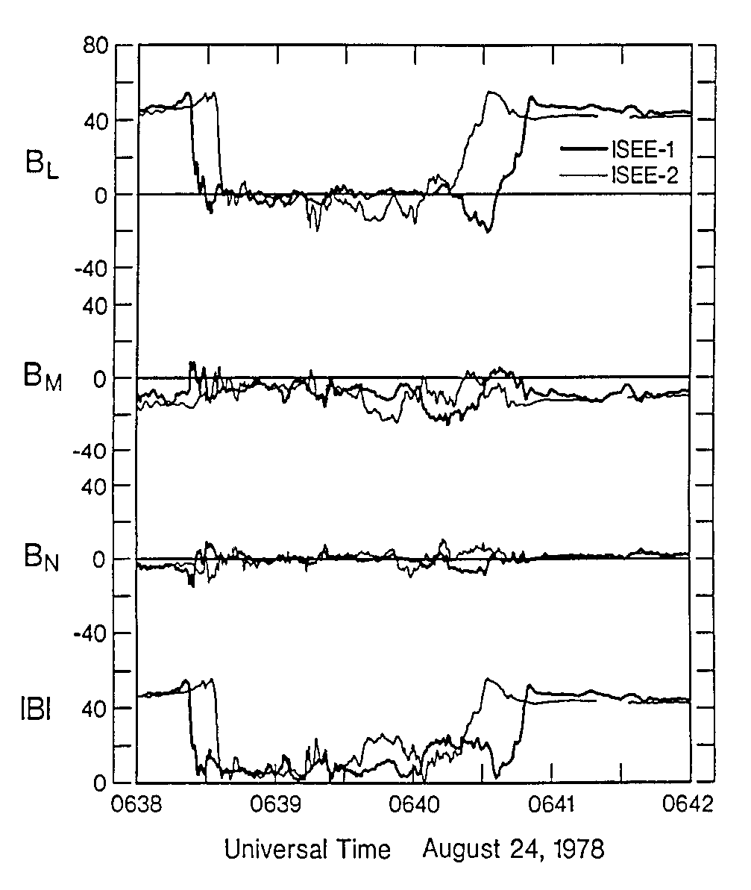
Observing the Magnetopause
Data from two spacecraft show two crossings of the boundary.
Initially both spacecraft are inside the magnetosphere (strong field).
The boundary moves inward and crosses first the ISEE-1 spacecraft (thick line) and later the ISEE-1 spacecraft (thin line).
Some time later the boundary reverses and moves outward appearing first at ISEE-2 and later at ISEE-1.
The spacecraft separation along the average normal divided by the time delay gives the boundary velocity.
The time profile scaled by the velocity gives the spatial profile of the boundary
The thickness of the magnetopause varies from 200 to 18000 km with a most probably thickness of 700 km.

Slide 16
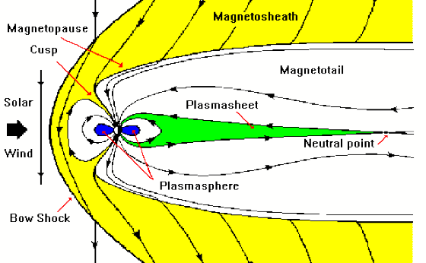
The Magnetotail
Behind the Earth the solar wind extends the magnetosphere a long distance(>3000R_{E}) away from the Earth on the night side forming the magnetotail.

Slide 17
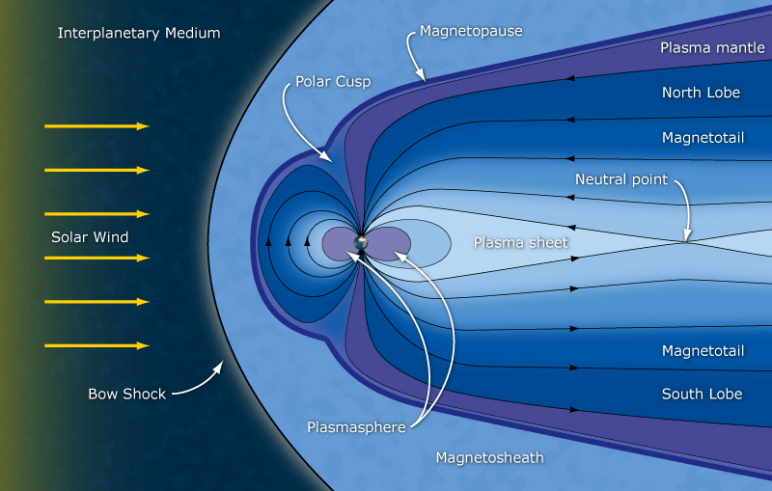
The Magnetotail
A current sheet lies in the middle of the tail and separates it into two regions called the lobes.
  The magnetic field in the north (south) lobe is directed away from (toward) the Earth.
  The magnetic field strength is typically ~20 nT.
  Plasma densities are low (<0.1 cm⁻³). Very few particles in the 5-50keV ( 1eV = 1.6x10⁻¹⁹J it is the energy an electron gains by being accelerated through one volt) range. Cool ions observed flowing away from the Earth with ionospheric composition. The tail lobes normally lie on “open” magnetic field lines.
The magnetotail acts as a reservoir for plasma and energy. Energy and plasma from the tail are released into the inner magnetosphere aperiodically during magnetospheric substorms.

Slide 18
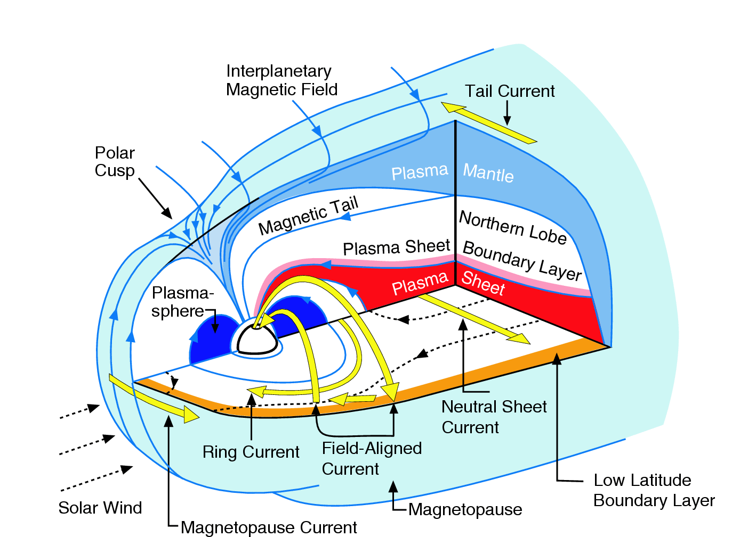
The Equatorial Current Sheet
The tail lobes are separated by an equatorial current sheet extend across the tail from dawn to dusk.
Magnetically induced currents must close – these close on the tail magnetopause.
A current creates a magnetic field.

Slide 19
The Cross Section of the Tail
The plasma sheet is found between the lobes in the tail.
It contains hot (3keV ions and 1keV electrons).
Observers have identified small regions within the plasma sheet (red, yellow and blue). The boundary layers are less than 1R_{E} thick.
The plasma (polar) mantle is found near the magnetopause (green).

Slide 20
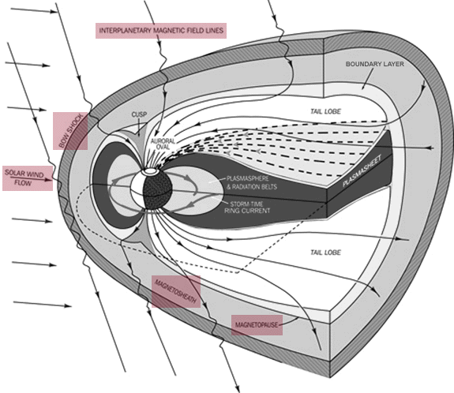
3D Diagram of Magnetosphere

Slide 21
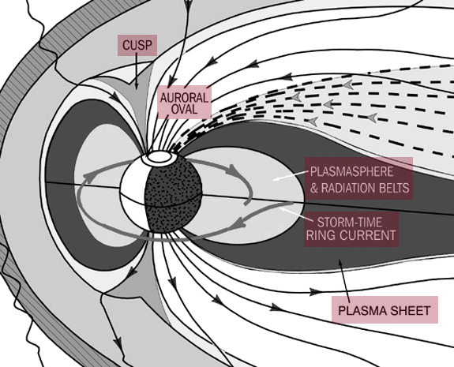
Inner Magnetosphere contains Plasmasphere and Radiation Belts

Slide 22
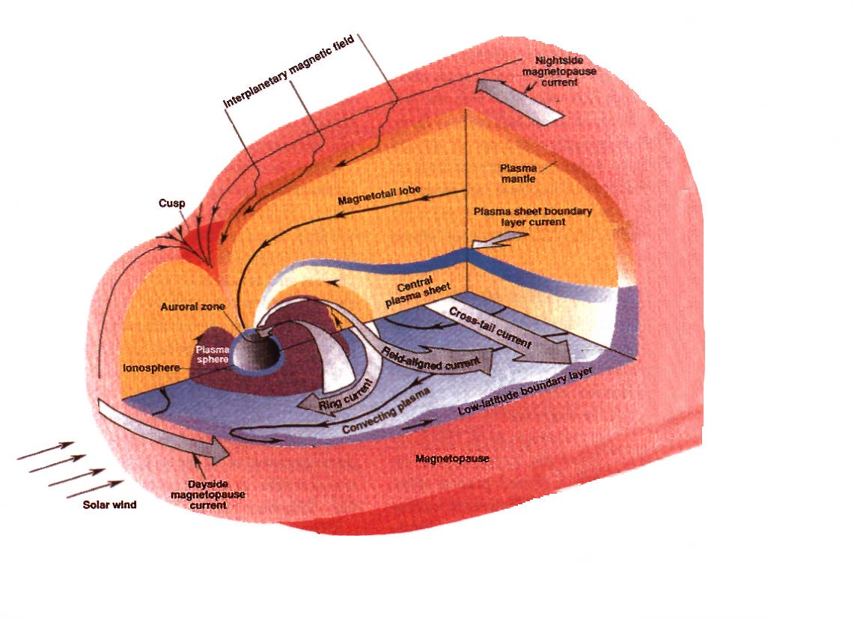
3D View of the Magnetosphere
Plasma mantle
Plasma sheet boundary layer
Central plasma sheet

Slide 23
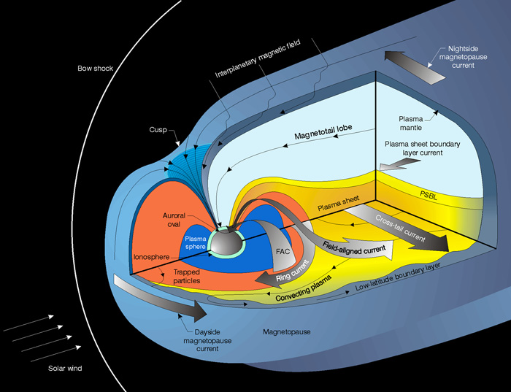
Magnetotail Structure – Plasma Mantle, Plasma Sheet Boundary Layer and Central Plasma Sheet
The plasma mantle has a gradual
transition from magnetosheath
to lobe plasma values.
  Flow is always tailward
  Flow speed, density and temperature
  all decrease away from the magnetopause.
Plasma sheet is separated from the tail
lobes by the plasma sheet boundary layer (PSBL).
Ions in the PSBL typically flow at hundreds of km/s parallel or antiparallel to the magnetic field.
  Frequently counterstreaming beams are observed: one flowing earthward and one flowing tailward.
  The PSBL is thought to be on “closed” magnetic field lines.
The central plasma sheet (CPS) consists of hot (kilovolt) particles.
  The CPS is usually on “closed” field lines.

Slide 24
Magnetotail Strucrture – the Low Latitude Boundary Layer
The low latitude boundary layer (LLBL) contains a mix of magnetosheath and magnetospheric plasma.
  Plasma flows can be found in almost any direction but are generally intermediate between the magnetosheath flow and magnetospheric flows.
  The LLBL extends from the dayside just within the magnetopause along the flanks of the magnetosphere forming a boundary between the plasma sheet and the magnetosheath.

Slide 25
Typical Magnetotail Plasma and Field Parameters
Beta is the ratio of the plasma thermal pressure to the magnetic pressure

Slide 27
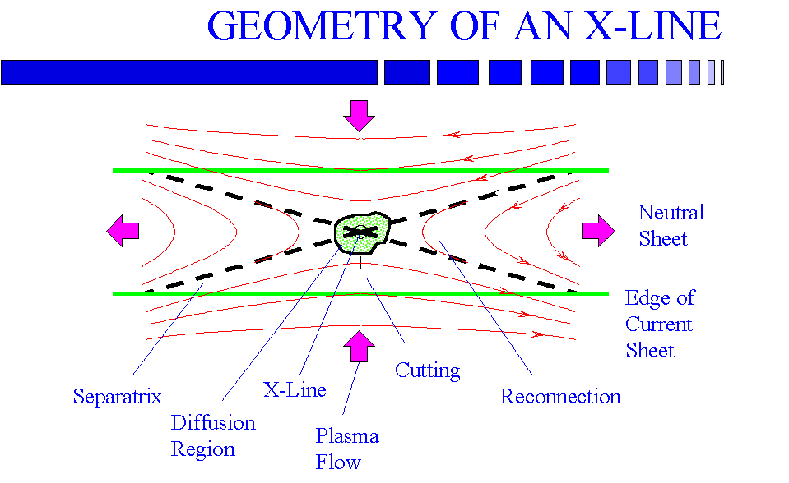
Magnetic Reconnection
The magnetotail is formed by the process of reconnection
Reconnection is thought to drive magnetospheric dynamics and the dynamics of the solar corona.
Z
X

Slide 28
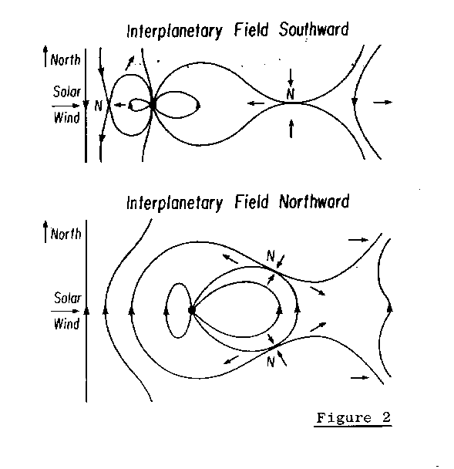
Reconnection Driven Convection
By the 1950’s it was realized that plasma flows observed in the polar and auroral ionospheres must be driven by magnetospheric flows.
  Flow in the polar regions was from noon toward midnight.
  Return flow toward the Sun was at somewhat lower latitudes.
  This flow pattern is called magnetospheric convection.
Dungey in 1961 showed that if magnetic field lines reconnected in front of the magnetosphere the required pattern would result.
This allows solar wind energy to be directly coupled into the magnetosphere.
The reconnection processes critically depend on the orientation of the solar wind magnetic field, “Bz component”.

Slide 30
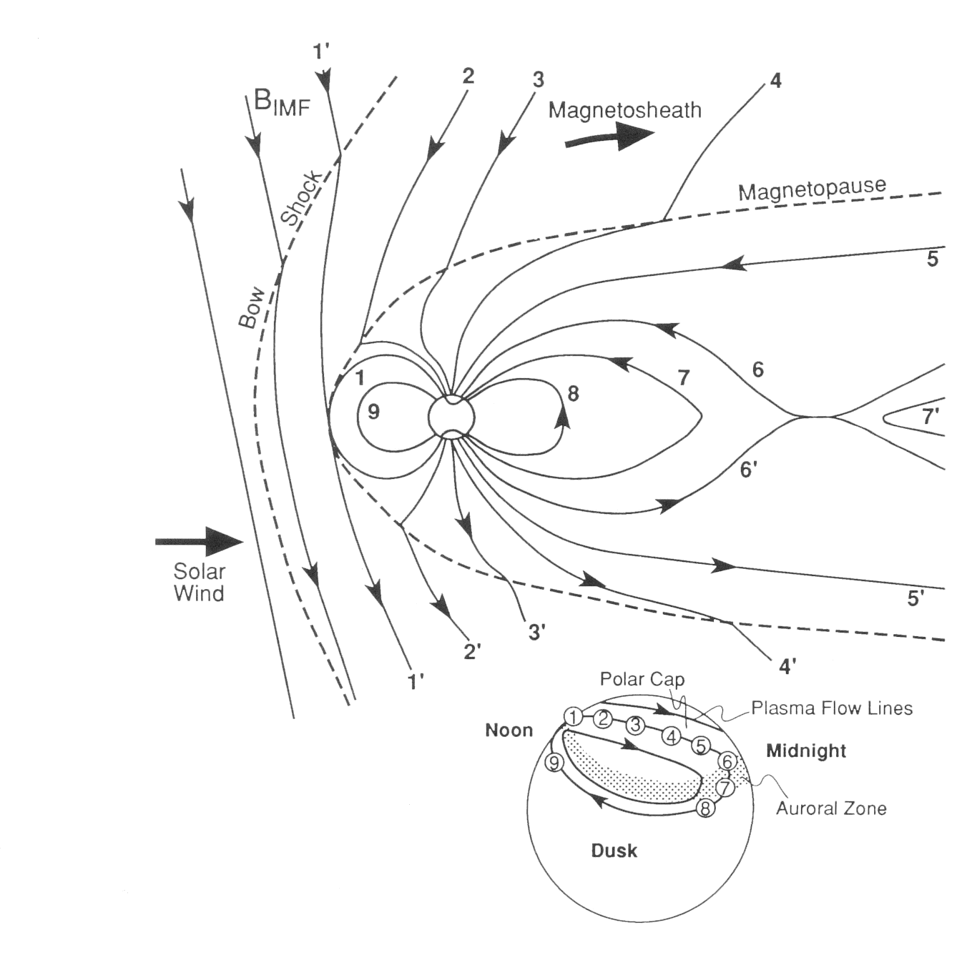
The Formation of the Magnetotail and Flows in the Magnetosphere
When IMF driven by the solar -wind has a southward B_{Z} reconnection occurs between field lines 1 (closed with both ends at the Earth) and the IMF field line 1’
  This forms two new field lines with one end at the Earth and one end in the solar wind (called open).
  The solar wind will pull its end tailward
The lower panel shows the motion of the flux tubes in the ionosphere.
In the ionosphere tailward flow in the solar wind will drive flow tailward as well.

Slide 31
Magnetospheric Convection – Steps 2, 3,4 and 5
The newly reconnected flux tube will move be dragged tailward by the solar wind (steps 2, 3, 4 and 5).
The part of the flux tube above the ionosphere but inside the magnetopause forms the tail lobes.
If the process of removing flux from the dayside continued indefinitely without returning some flux the Earth’s field would be lost.

Slide 32
Returning Flux to the Dayside – Steps 6, 7, 8 and 9
At a tail reconnection site (called an x-line) the lobe field lines (5 and 5’) reconnect at position (66’) to form new closed field lines 7 and new IMF field lines (7’).
The new IMF field line 7’ is distorted and stressed and moves tailward.
The new closed field line 7 is stressed and moves earthward.
The flow circuit is finally closed when the newly closed field lines flow around either the dawn or dusk flanks of the magnetosphere to the dayside (8 and 9)
The insert shows the flow pattern in the ionosphere that results. The return flow in the ionosphere is a lower latitudes than the tailward flow.

Slide 33
The Electric Field Across the Magnetosphere
The process of reconnection causes plasma to flow in the magnetosphere and therefore creates an electric field
where R_{PC} is the radius of the polar cap, v_{PC} is the plasma flow speed and B_{PC} is magnetic field strength in the polar cap. For typical ionospheric parameters
and the electric field is directed from dawn to dusk. .
The solar wind electric field across a distance equal to one diameter of the tail (50R_{E}) is about 640 kV. Thus about 10% of the flux that impacts the magnetosphere interacts with it. The rest goes around the sides of the magnetosphere.

Slide 34
The Convection in the Inner Magnetosphere
The cross magnetosphere electric field drives flows toward the Sun in the equator. There is another electric field. It causes plasma close to the Earth to go around the planet once every 24 hours – corotation.
When we include corotation the electric potential becomes
where E₀ is the cross tail electric field, φ is the azimuthal angle, r is the radial distance, ω_{E} is the angular frequency of the Earth,
and B₀ is the magnetic field magnitude at the equator at 1R_{E}.
Contours of constant potential give the motion of the flux tube.
E

Slide 35
The Plasmasphere
Near the Earth the corotation term dominates the effective potential while far out in the tail the convection potential dominates.
On the dusk side the two terms fight each other and at one point the velocity is zero.
The solid line shows a separatrix inside of which plasma from the tail can’t enter.
Cold particles that lie inside the separatrix go continuously around the Earth. They form the plasmasphere. It is filled with dense cold plasma from the ionosphere.
E

Slide 36
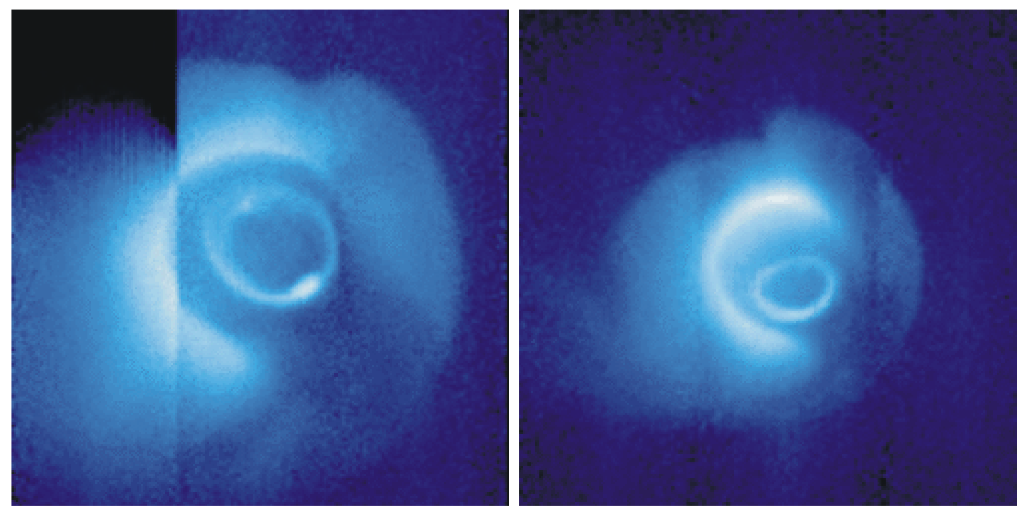
Imaging the Plasmasphere
Images in the EUV from the IMAGE spacecraft on May 24, 2000.
The 30.4nm emission from helium ions appears as a pale blue cloud.
The “bite out” in the lower right is caused by the Earth’s shadow. The helium is excited by sunlight.
The emission at high latitudes is from aurora and is thought to be caused by 53.9nm emission from atomic oxygen.

Slide 37
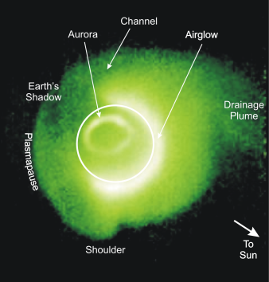
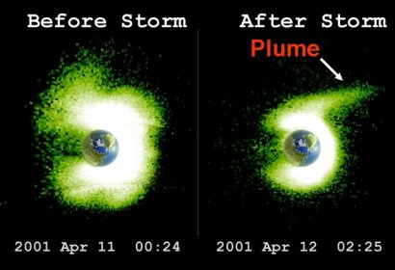
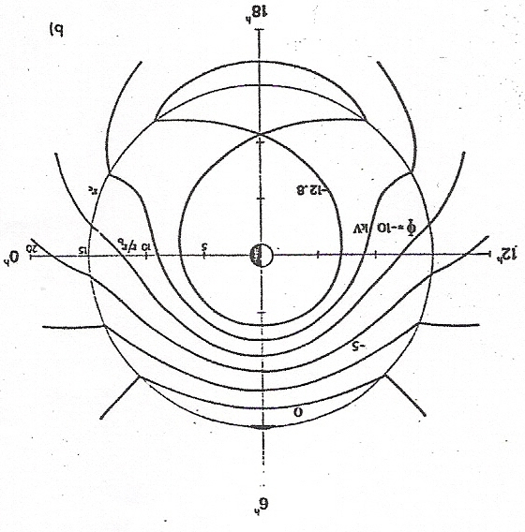
The Plasmasphere
Region of cold (~1-2 eV), dense (~100-1000 cm⁻³) plasma, ions and electrons of ionospheric origin, in the inner magnetosphere
Plasma co-rotates with Earth; plasmapause varies with changes in the convection electric field, and system has a “memory” of sorts…
Variability and storm-time dynamics
Difficult to observe in situ due to s/c potential, but plays an important role for waves affecting the ring current and radiation belts
Some good references:
  Lemaire and Gringauz [Cambridge Univ. Press, 1998]
  Kotova [Geomag. Aero., 2007]
  Darouzet et al. [SSR, 2009]
Extreme Ultraviolet Imager data from IMAGE
Source: vlf.stanford.edu
Dusk
Midn.
Noon
Source: Jerry Goldstein, SwRI
Equipotential in the
Vollund-Stern Model
Dawn
Notes:
Vollund-Stern model: superposition of the convection (solar wind driven) and co-rotational E-fields: yields equipotential lines that explain the plasmasphere (inside the Alfven layer) and plasmapause (separatrix)
Sources: ionosphere
Sinks: loss due to convection to the dayside magnetopause… erosion

Slide 38
Magnetic Storms Versus Substorms
An isolated substorm is caused by a brief (30-60 min) pulse of southward IMF.
Magnetospheric storms are large, prolonged disturbances of the magnetosphere caused by variations in the solar wind.
  Many storms follow coronal mass ejections.
  Storms also can be caused by high speed streams (interplanetary shocks).
Storms are global disturbances of the magnetosphere while substorms tend to be localized in the magnetotail.
During storms large amounts of energy are placed in the ring current – this does not happen in substorms.
Substorms occur during storms but also at other times.

Slide 39
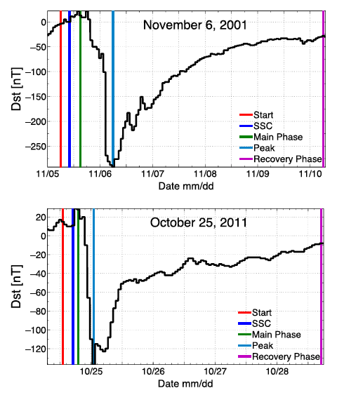
Geomagnetic Storms
Geomagnetic storms are periods of very strong activity in the inner magnetosphere; storms affect all populations.
Storm intensity is characterized by the “Disturbance storm-time” (Dst) index, which is a measure of perturbations to the symmetric near-equatorial magnetic field that result from enhancements of the ring current
Different drivers: CME shocks, sheaths, and magnetic clouds, SIs/CIRs, HSSs; prolonged periods of Bz south accompanied by high Vsw
Slow decay during recovery: Charge exchange with exospheric neutrals [Keika et al., JGR, 2006]
Rapid decay: ??? …unanswered question
Some good references:
  Tsurutani et al., [Geo. Mono., 1997]
  Katus et al. [JGR, 2013]
From Katus et al. [JGR, 2013]
Notes:
Dst : Disturbance storm-time index; put together of fixed stations using the local horizontal (H) components; sym-H is a good proxy
Also mention SuperMag indices: local time dependent

Slide 40
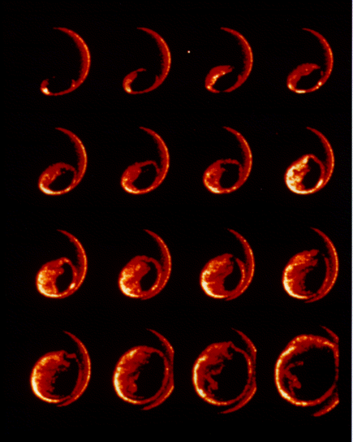
Time Series of Images of the Auroral Substorm
This set of images in the ultra-violet from the Polar satellite shows changes that occur during an auroral substorm.
In aurora substorms go through a series of stages.
They start with a brightening of an auroral arc nearest the equator.
Moments later the aurora brightens more, and expands poleward and to the west.

Slide 41
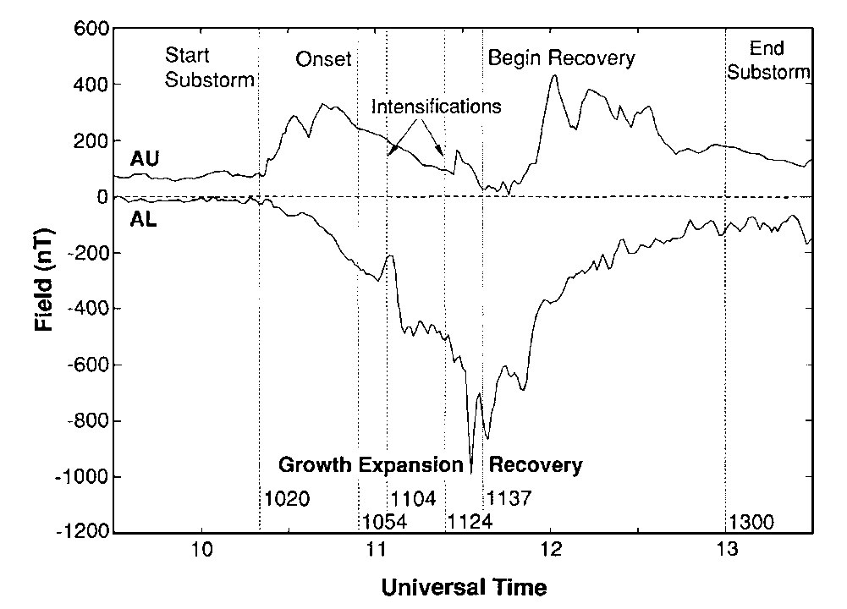
Magnetospheric Substorms
The phenomena associated with substorms in the magnetosphere start before the auroral signatures.
McPherron interpreted these phenomena as the growth phase of the substorm.
  Energy extracted from the solar wind is stored in the magnetosphere.
  The initial interval of slowly growing AU and AL.
  The growth phase usually lasts 30 minutes to one hour.
  The magnetic perturbations during the growth phase results from increased ionospheric currents.
The expansion phase corresponds to the release and unloading of the stored energy.
The recovery phase is the return of the system to its ground state.

Slide 42
Auroral Electrojet Indices
Positive perturbations are produced by a concentrated current (called an auroral elecrojet) flowing eastward. They are observed by stations in the afternoon or evening.
Negative perturbations are produced by a westward electrojet. They are observed near and past midnight.
These currents flow at ~120km altitude and are carried by auroral particles.
The positive and negative envelopes give the AU and AL indices.

Slide 43
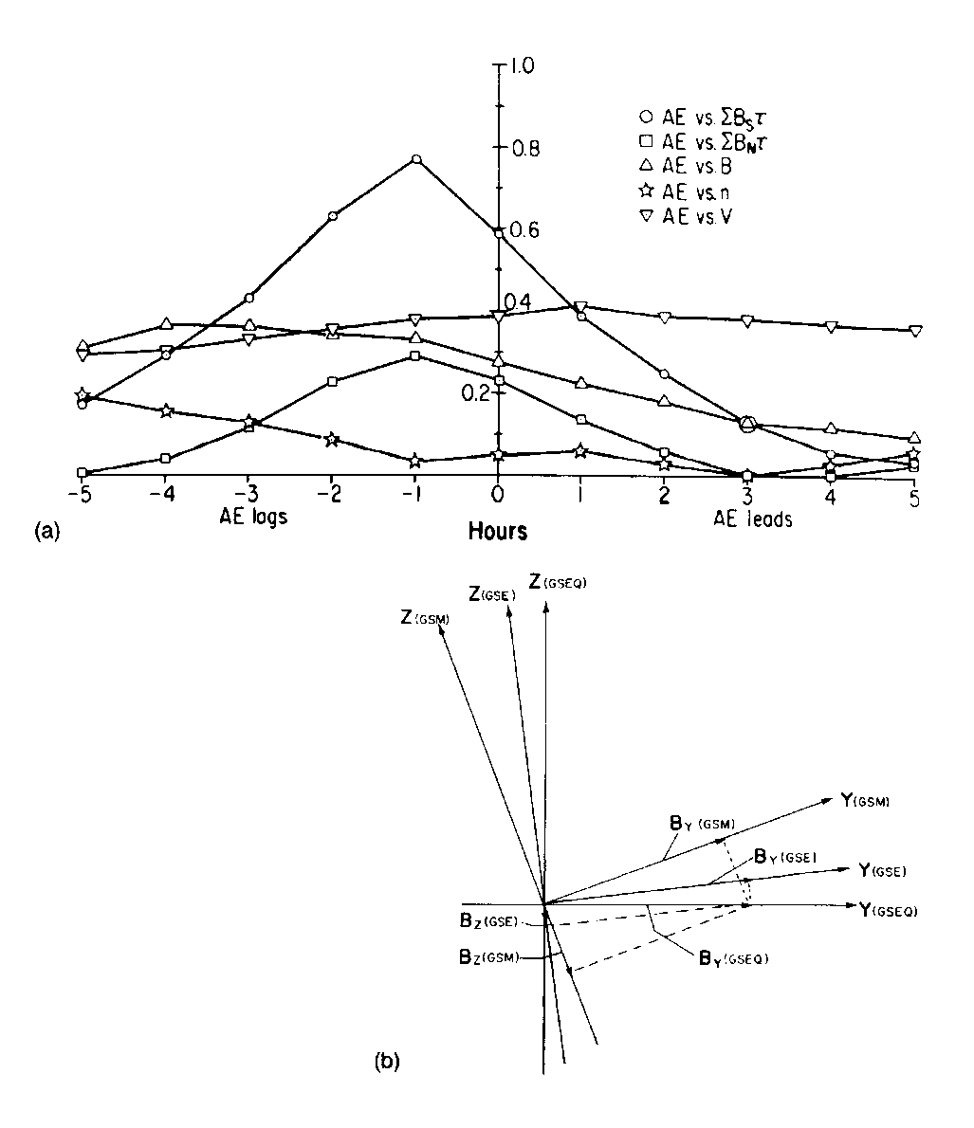
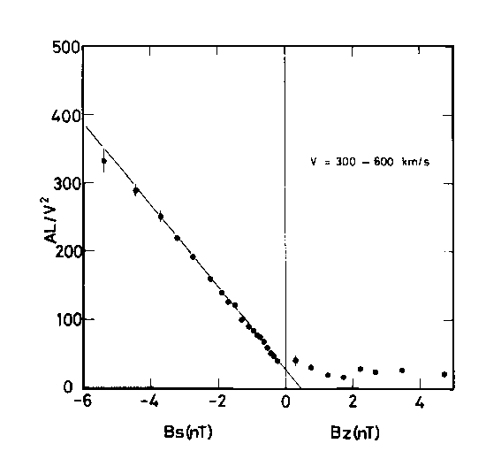
Substorms Occur when the Interplanetary Magnetic is Southward
Correlation analysis between the auroral-electrojet index AE (difference between the envelope of positive -AU- and negative -AL- magnetic perturbations at auroral latitudes) and five solar wind parameters (u, n, B, B_{n}, B_{s})
  B_{n} is hourly average of the B_{zGSM} magnetic field when B_{zGSM}>0.
  B_{s} is hourly average of the B_{zGSM} magnetic field when B_{zGSM}<0.
Activity peaks in B_{s} for the hour prior to the hour when the activity was measured.
AL/v² as a function of B_{s} (B_{z}<0) and B_{n} (B_{z}>0). No dependence on B_{n} but strong dependence on B_{s}

Slide 44
Magnetospheric Substorms
The phenomena associated with substorms in the magnetosphere start before the auroral signatures.
McPherron interpreted these phenomena as the growth phase of the substorm.
  Energy extracted from the solar wind is stored in the magnetosphere.
  The initial interval of slowly growing AU and AL.
  The growth phase usually lasts 30 minutes to one hour.
  The magnetic perturbations during the growth phase results from increased ionospheric currents.
The expansion phase corresponds to the release and unloading of the stored energy.
The recovery phase is the return of the system to its ground state.

Slide 45
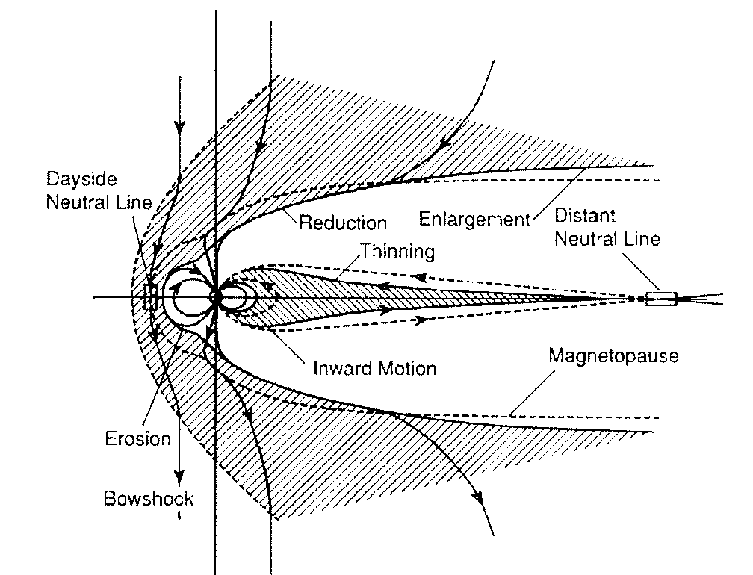
The Events in the Magnetosphere During a Substorm – Growth Phase
A southward turning of the IMF initiates or increases dayside reconnection.
  Magnetic flux from the Earth connects to the IMF and is transported over the polar caps into the lobes.
  The return flow in the magnetosphere is unable to return flux to the dayside as fast as it is removed. The dayside magnetopause is eroded.
The magnetic field in the tail lobes increases storing energy for later release.
The plasma sheet thins.

Slide 46
Events in the Magnetosphere During a Substorm – The Late Growth Phase
Some time during the late growth phase reconnection begins on closed field lines in the near-Earth plasma sheet.
  The reconnection is slow at first.
  As closed field lines are cut they reconnect to form a magnetic O region called a plasmoid (technically a magnetic flux rope).
  This stage of the substorm continues until the last closed field line is severed by the reconnection process.
  The reconnection rate increases during the late growth phase.

Slide 47
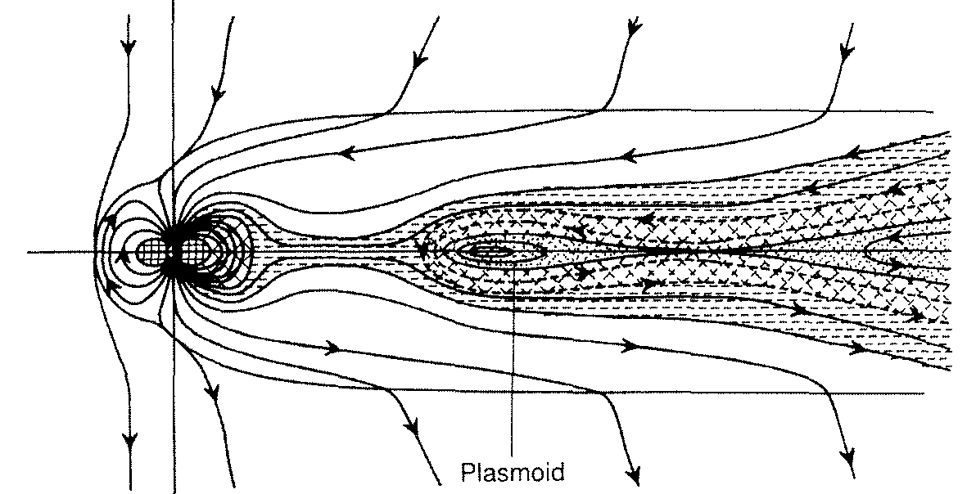
Events in the Magnetosphere During Substorms – The Expansion Phase
When the last closed field line is severed the reconnection rate becomes explosive. This is the onset of the expansion phase of the substorm.
  The current “wedge” may occur at this time.
  20%-30% of the open magnetic flux stored in the tail lobes is rapidly reconnected.
  This is the principal energy conversion process during substorms.
The severed plasmoid leaves the magnetotail.
If the reconnection fails to reach the lobe field lines the disturbance is quenched. This is called a pseudo-breakup.

Slide 48
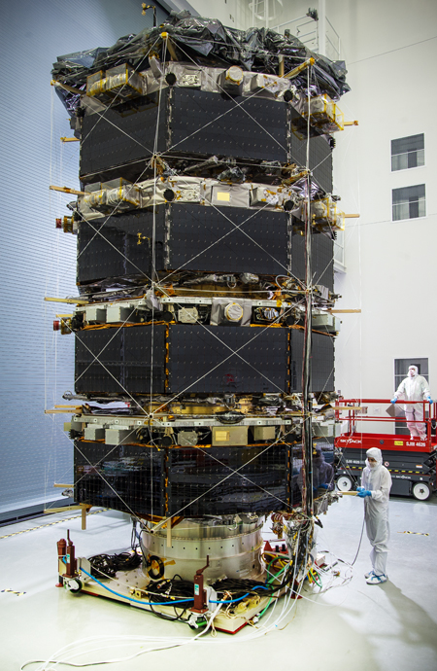
Magnetospheric Multiscale Mission
Understand the microphysics of magnetic reconnection by determining the kinetic processes occurring in the electron diffusion region that are responsible for collisionless magnetic reconnection, especially how reconnection is initiated.
Determine the role played by electron inertia and turbulence in regulating magnetic reconnection.
Determine the rate of magnetic reconnection and the parameters that control it.
Determine the role played by ion inertia and turbulence in magnetic reconnection.
Notes:
Let me remind you of the specific science objectives that the core team members are committed to addressing.
These goals are what the team have been given the resources to address. Their highest priority in managing those resources must be committed to advancing these goals.
These are actually quite narrow goals aren’t they? This is especially so when one considers the scope and sophistication of the hardware.

Slide 49
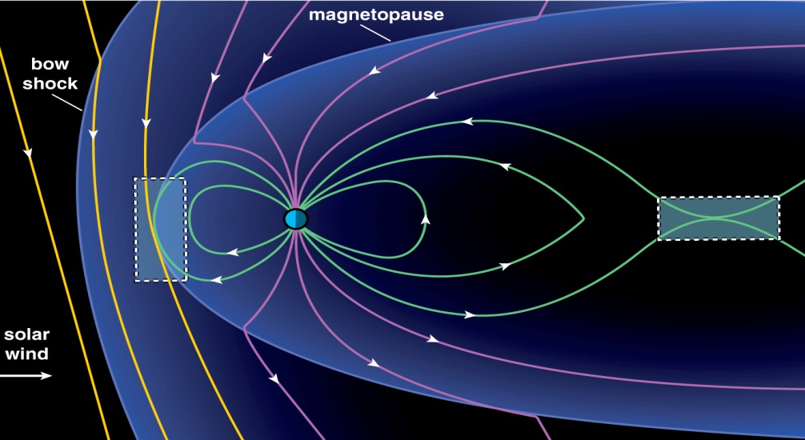
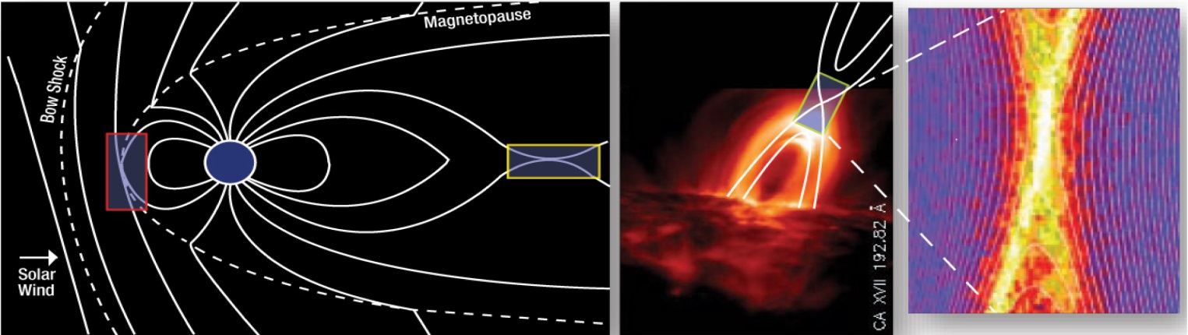
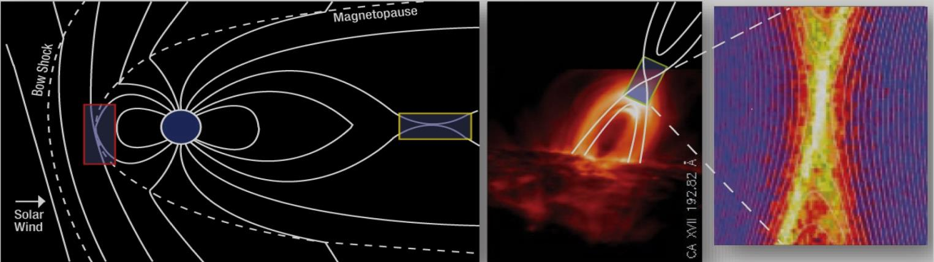
Magnetic Reconnection is a Fundamental Universal Process
Notes:
The core MMS team will be laser focused on two regions of geospace: the dayside magnetopause boundary and the nightside neutral sheet. Their interests are on the extremely small electron and ion diffusion regions.

Slide 50
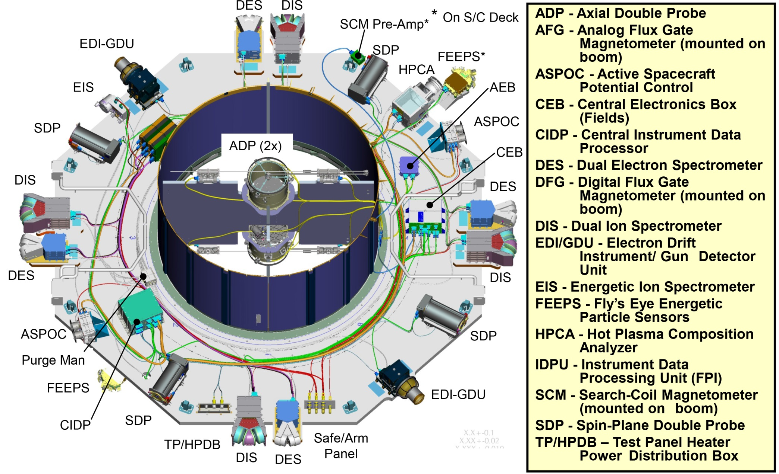
MMS Instrument Suite

Slide 51
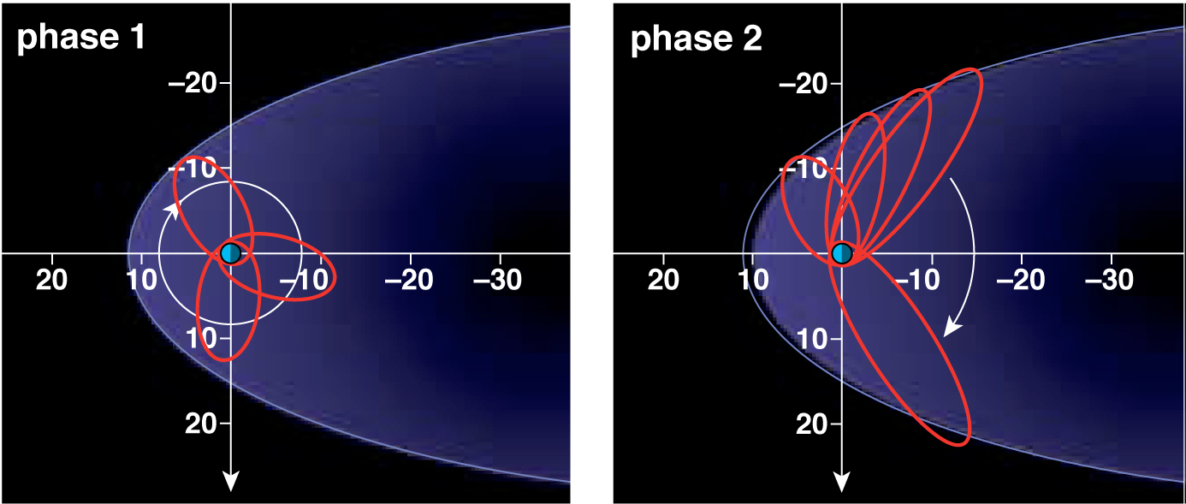
Orbital Phases
  MMS employs two mission phases with inclination of 28 deg. to optimize encounters with both dayside and nightside reconnection regions.
Notes:
The mission orbit has two phases to accomplish this. First is an approximately 12 RE apogee orbit to skim the dayside magnetopause twice, this fall of 2015 and then again next fall in 2016. MMS will then raise its apogee gradually to approximately 25 RE as it approaches the nightside neutral sheet region in 2016. When that exploration of the nightside is completed, the prime mission officially ends.
If MMS is fortunate, we will be able to hold this configuration for a few years of an extended mission operations.

Slide 52
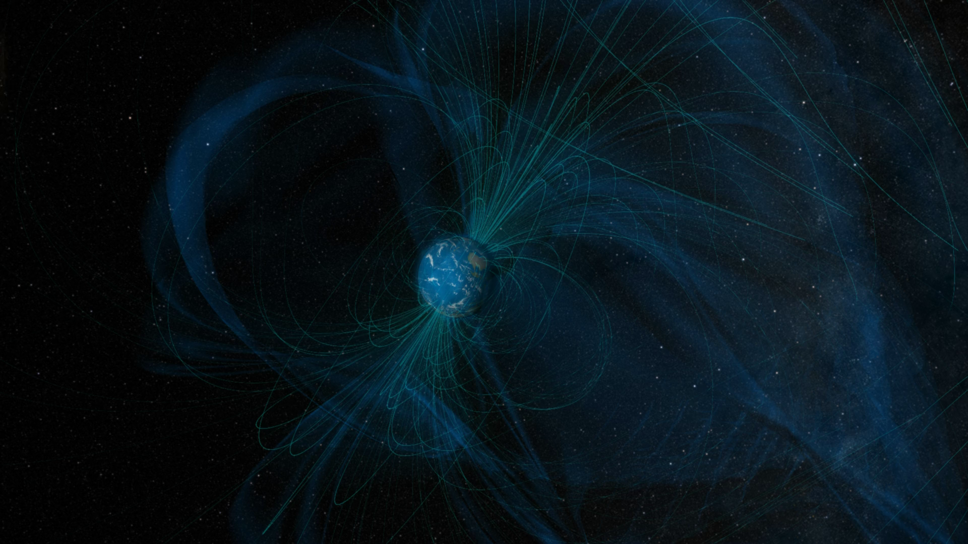
Animation of reconnection and MMS orbit

