Slide 1
3. Tools for Solar Observations-I
Solar telescopes. Resolution, MTF, seeing. High resolution telescopes. Spectrographs.

Slide 2
Types of Solar Observations
Electro-magnetic observations (optical, UV, X-rays, -rays).
  Filtergrams
  Spectrograms
  Dopplergrams
  Magnetograms
Special Observations
  Neutrino Experiments
  Sound Waves (Helioseismology)
  Particles (in situ measurements)
  Gravitational Waves

Slide 3
Limitations
Photon noise.
Seeing.
Diffraction limit

Slide 7
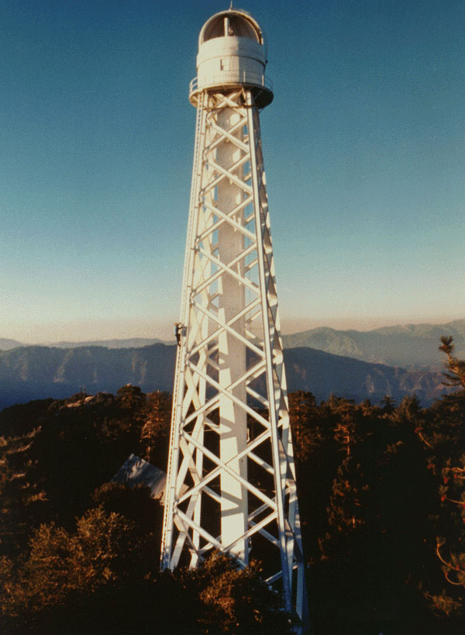
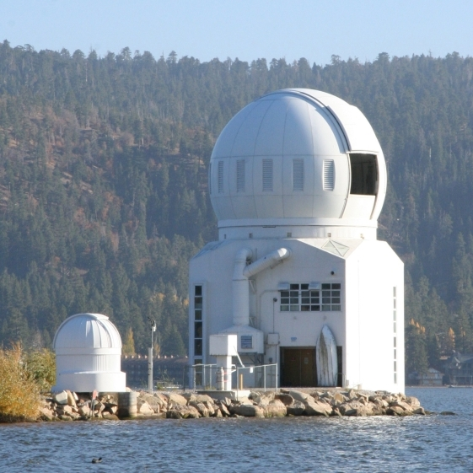
Big Bear Solar Observatory
Mount Wilson Observatory 150-foot tower

Slide 9
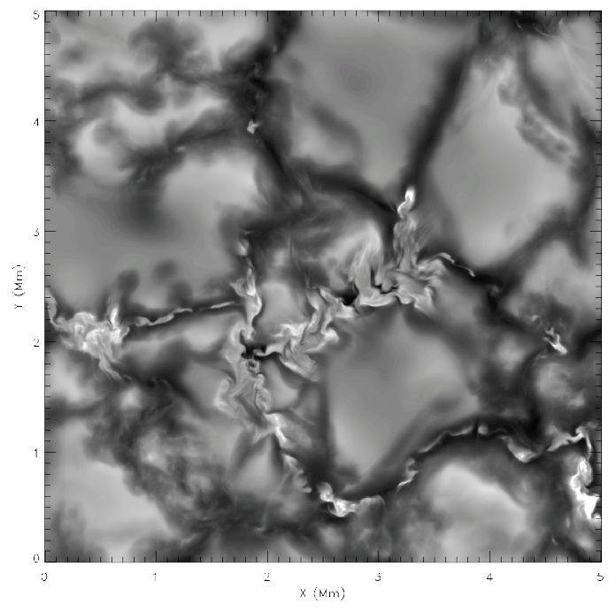
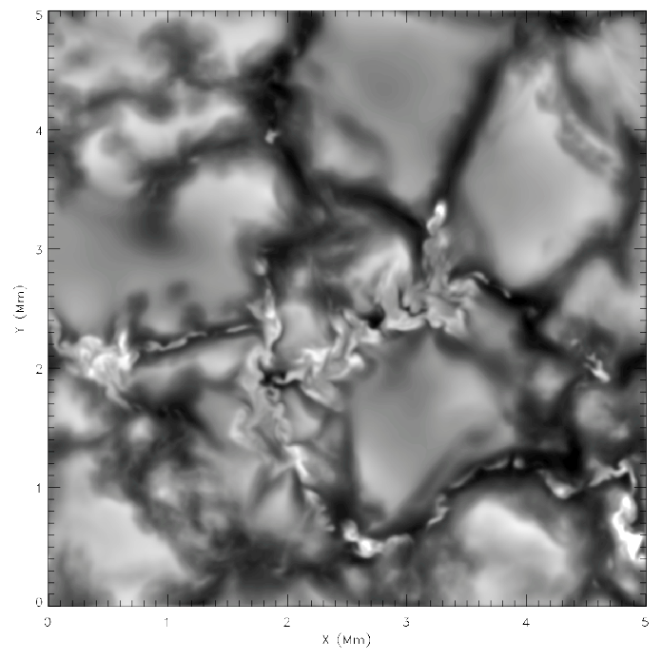
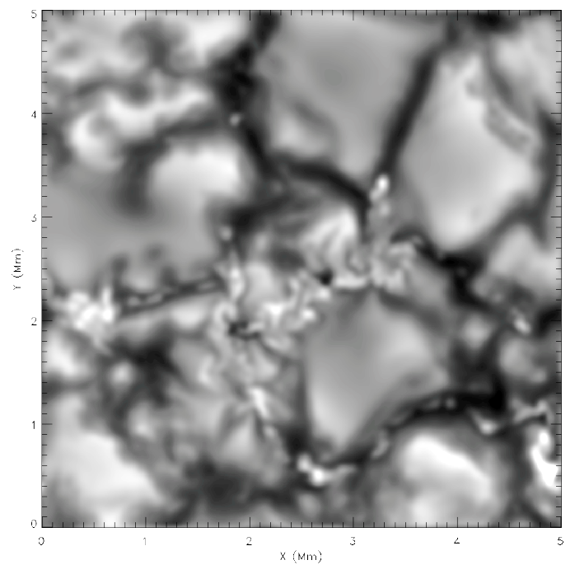
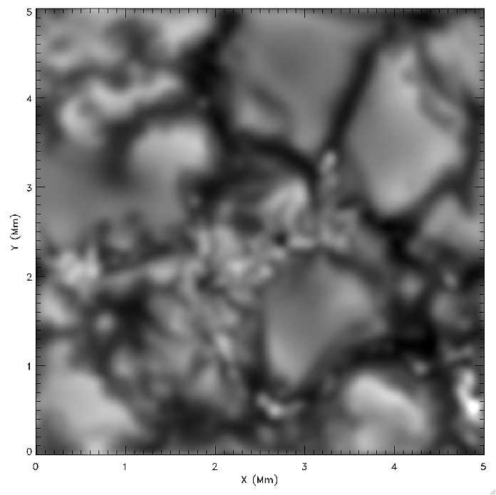
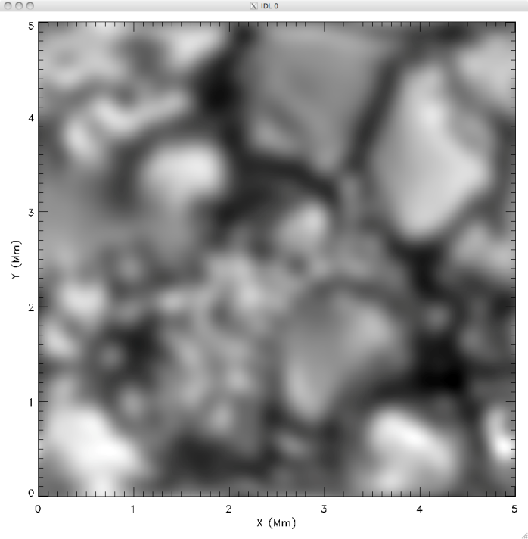
Effect of Telescope Point-Spread Function
Simulations
DKIST 4m
GST 1.6m
SST 1m
Hinode SOT 0.5m
Simulations, DKIST, GST
SST, Hinode

Slide 11
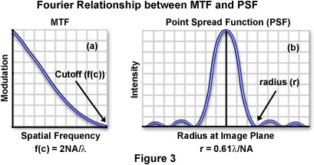
Numerical Aperture: NA=D/2f (or N=f/D: f-number”)
D is the telescope aperture
f is the focal length

Slide 13
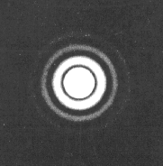
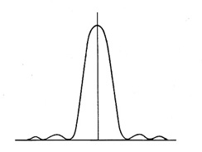
Light transmission curve for an Airy disk
Airy disk

Slide 14
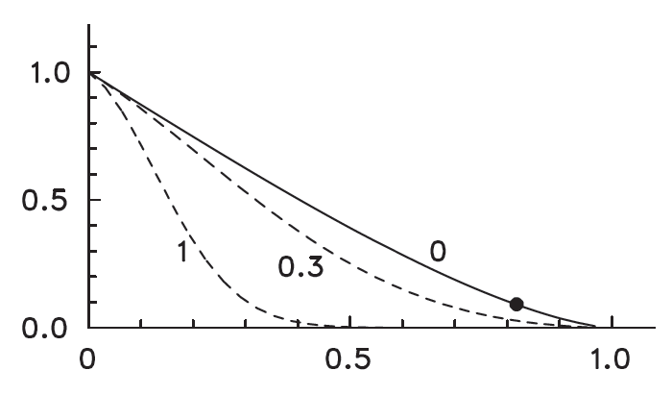
Modulation Transfer Function (MTF) vs spatial frequency k
Telescope MTF_{D}
Ideal seeing conditions (MTF_{S}=1) –
diffraction-limited telescope
MTF(k)
MTF_{D}*MTF_{S}
Two different
seeing conditions
k/k_{m}
The solid curve of shows MTF. According to its definition, the modulation transfer function is the factor by which a signal is reduced at each spatial frequency k. The spatial frequency corresponding to the “spatial resolution” r₁ is k = 1/r₁ = k_{m}/1.22, and MTF_{D} = 0.0894 for this k (the black dot in). This means that of the original, say, 15% intensity contrast of the solar granulation, little more than 1% is left in the image if a telescope is used which according to the criterion just “resolves” the granular structure.

Slide 15
Exercise: What aperture needs a diffraction-limited solar telescope in order to transmit, at λ = 500 nm, 60% of the contrast of a 1 arcsec sharp feature?
Solution:
From the MTF plot: MTF=0.6 at k/k_{m}=0.32

Slide 17
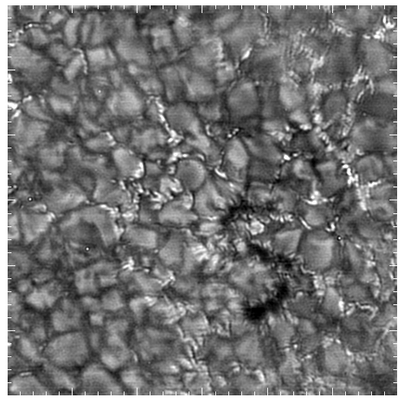

Slide 19
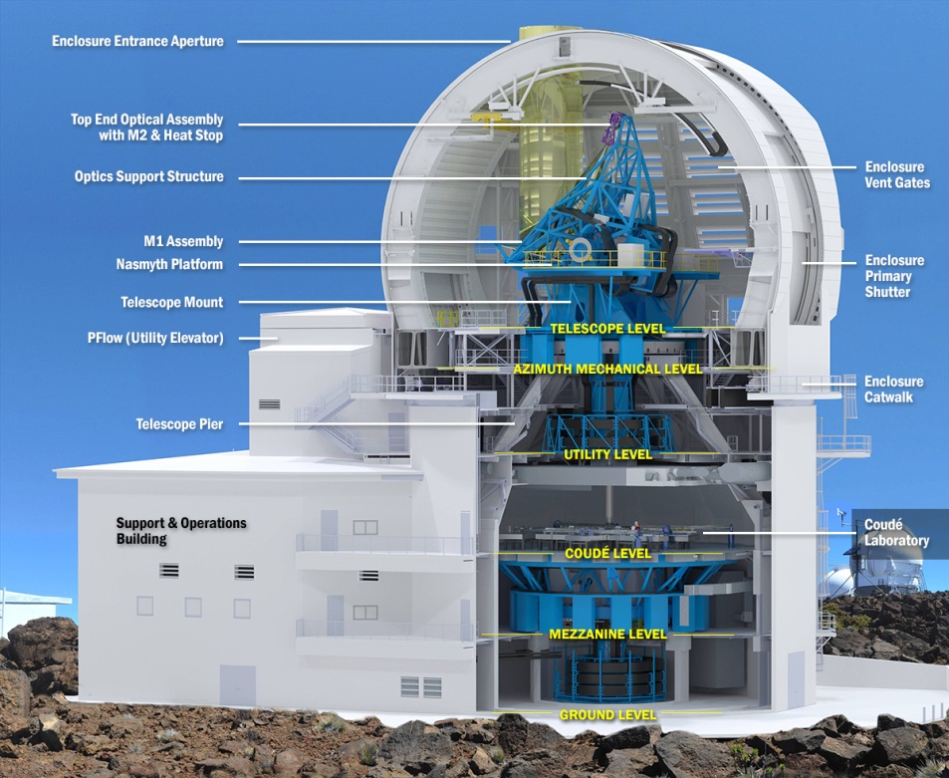
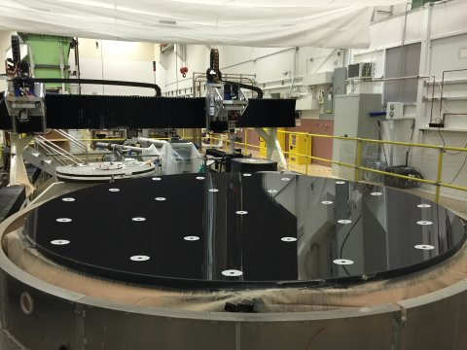
http://dkist.nso.edu/

Slide 20


Slide 22
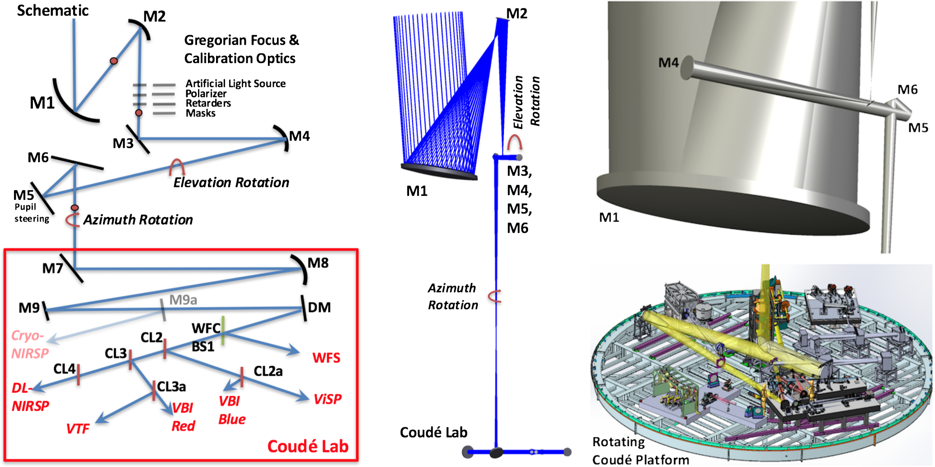
DKIST optics

Slide 23
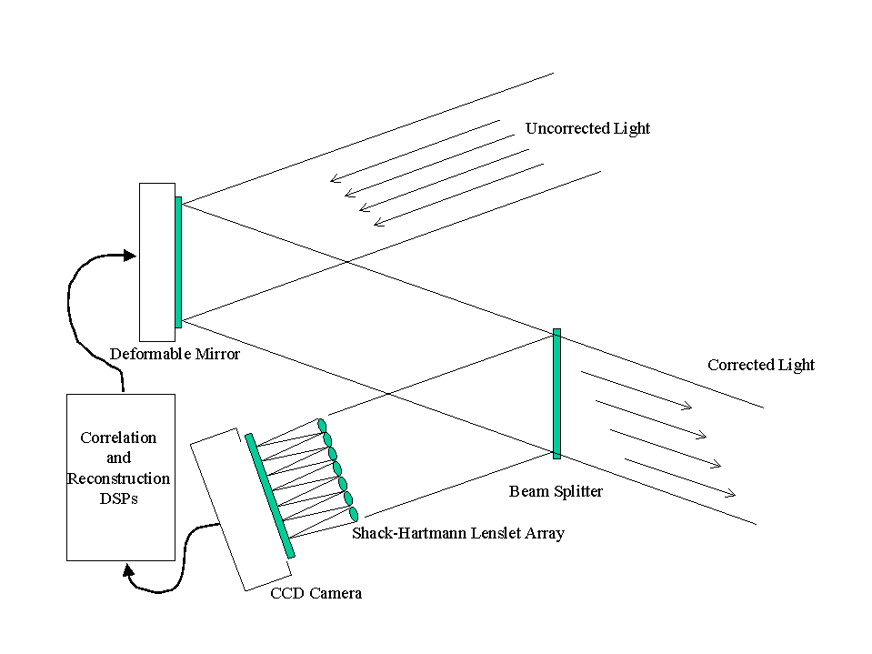

Slide 26
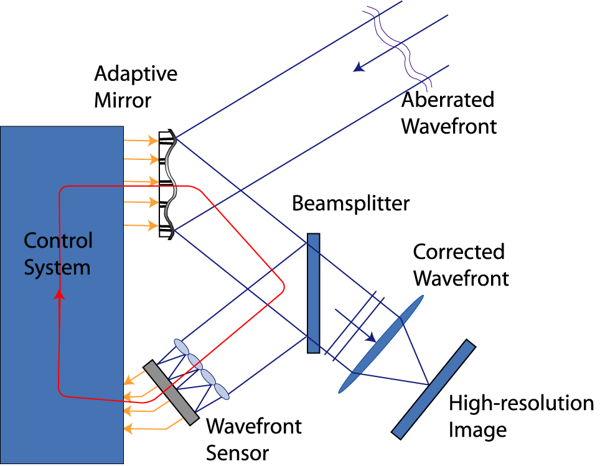
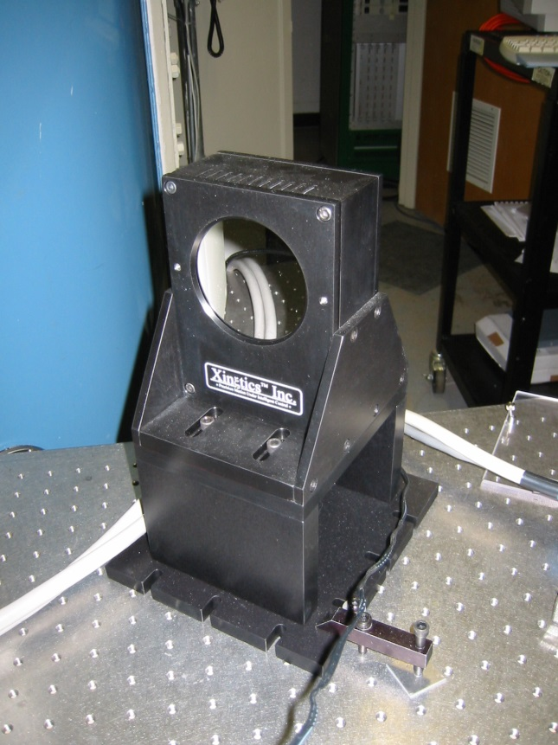
Adaptive Optics at 1.6m Telescope BBSO

Slide 27
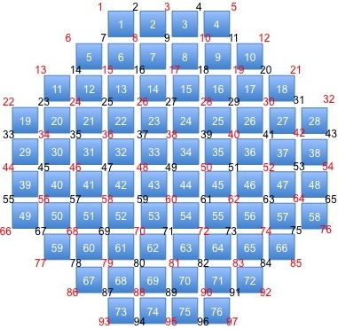
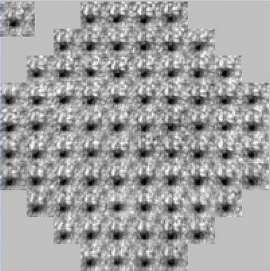
1st Generation AO: AO-76
Shack Hartmann WFS with 76 sub-apertures (AO-76): 10 sub-apertures across the NST PM
Xinetics Deformable Mirror with 97 actuators and 7 mm spacing
Baja camera with a frame rate of 2500 Hz for 200 by 200 sub-array
Bitware Hammerhead Boards with 40 digital signal processors (DSPs)
Closed-loop Bandwidth: 120 Hz
Strehl ratio: 0.7 in the NIR under median BBSO seeing
BBSO r₀ = 6 ~ 8 cm @ 500 nm, NST requires 20 sub-apertures across pupil
AO-76
Notes:
The first generation NST AO is “AO-76”.
The reason that we call it AO-76 is that the Shack-Hartmann WFS has a total of 76 sub-apertures. In other words, there are only 10 WFS sub-apertures across the telescope pupil.
AO-76 works fine for the IR observation, but it is unable to correct the seeing very well in the visible.
That is because the Fried parameter at Big Bear is about 6-8 cm in the visible. To acquire enough spatial sampling of wavefront distortion, we need a comparable number of wfs sub-apertures over the telescope pupil.
That is one of the main reason to push us to develop the 2nd generation AO system: AO-308.
AO-76 was appropriate for 0.5 m class telescopes, but only useful on the red end of the spectrum for NST. Second generation has subapertures of comparable size as seeing (Fried parameter)
20 subapertures across 1.6 m implies 8 cm resolution. Fried parameter is a measure of telescope aperture that would be diffraction limited
Diffraction limited observation in the visible need aid of speckle reconstruction and good seeing condition

Slide 28
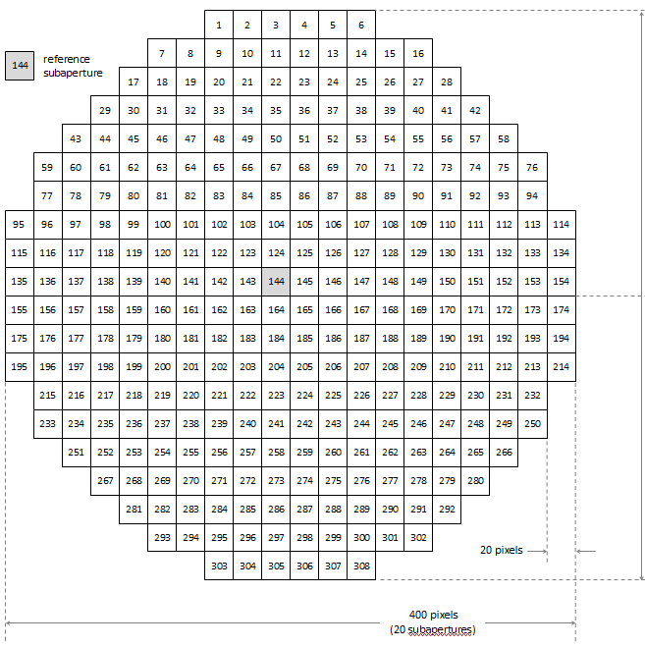
2nd Generation AO: AO-308
AO-308 is operational, AO-308 is a collaboration between BBSO and NSO
Shack Hartmann WFS with 308 sub-apertures (AO-308): 20 sub-apertures across the NST primary mirror
Xinetics Deformable Mirror with 357 actuators and 5 mm spacing
Phantom V.7.3 camera with a frame rate of 2000 Hz for 400 by 400 pixel sub-array
Bitware TigerSHARC Boards with 16 digital signal processors (DSPs)
Closed-loop Bandwidth: 120 Hz
Acquire diffraction limited imaging over the telescope’s full range of operation
Notes:
AO-308 integrates a Shack-Hartmann WFS with 308 sub-apertures: 20 sub-aperture across the telescope PM, providing enough spatial sampling of wavefront over the 1.6 m NST pupil.
Deformable mirror has a total of 357 actuators.
Under median BBSO seeing condition, AO-308 is able to help acquire diffraction limited imaging over the telescope’s full wavelength range of operation from the bluest visible to the IR.

Slide 29
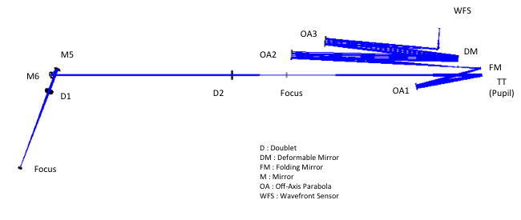
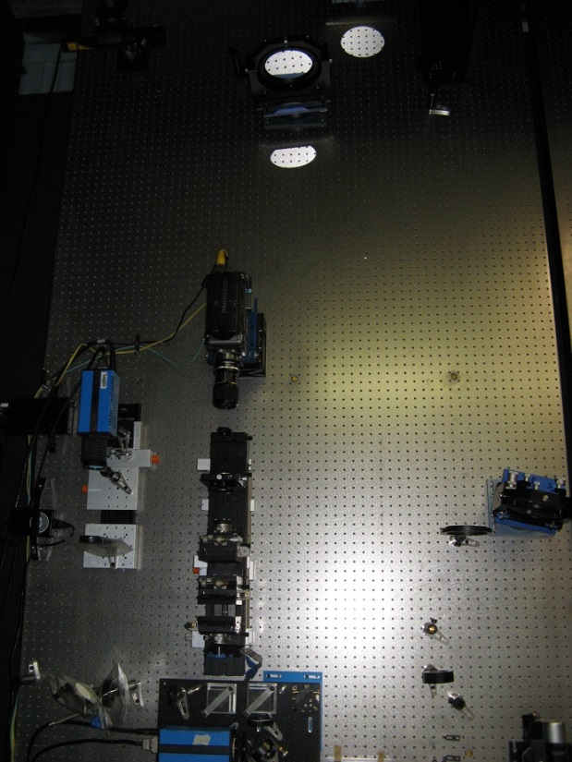
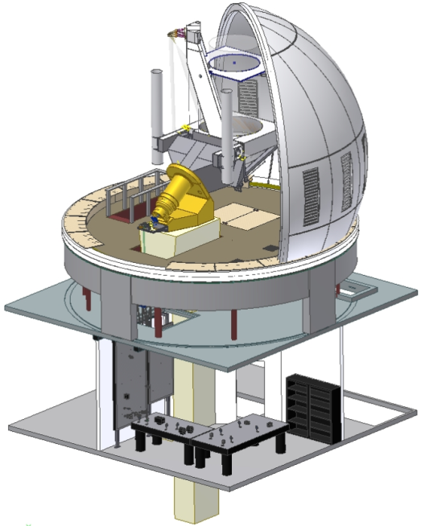
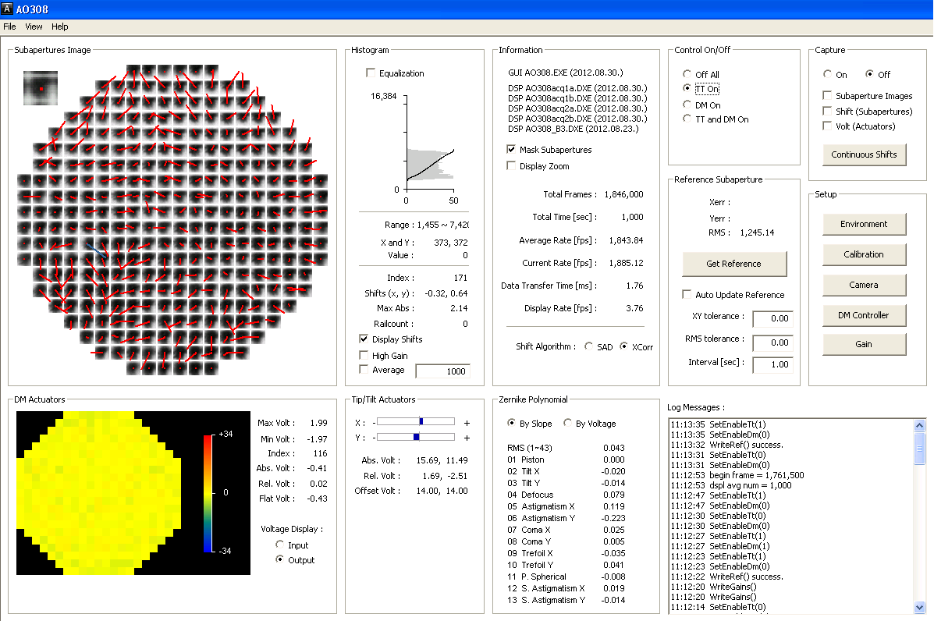
AO-308 Layout and GUI
Notes:
29
AO-308 has been installed on the vertical bench in the Coude Lab and put into NST routine observations.
We note that AO-308 is fully operational with in the in-house control system as well as the system (KAOS) developed by our German partners at KIS.

Slide 30
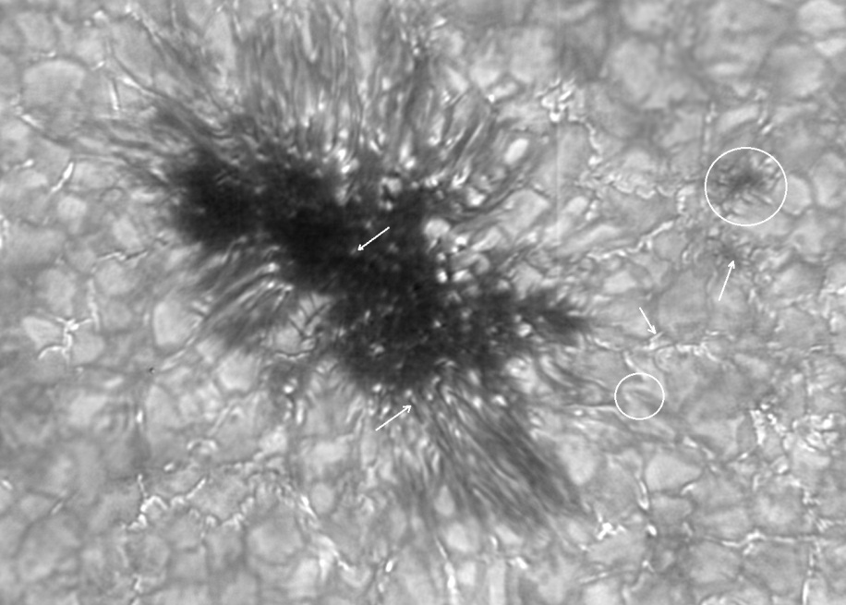
G-band with AO-308 (9/04/12)
Notes:
First engineering light images with the new NST BBSO adaptive optics system. The old system has a 97 actuator deformable mirror (DM), while the new system has a 357 actuator DM. With the old system we were never able to obtain a good image in G-band (~430 nm) even under very good seeing conditions. I have attached two G-band images from the new AO under mediocre seeing. In the first attached image, some points of interest are denoted by arrows and circles (from left to right)
1) arrow: fine structure of umbral dots: some umbral dots display a coffee bean-like
pattern: two elongated bright kernels separated by a thin dark line
2) arrow: dark channels of penumbral filaments
3) circle: bright bow shaped ridge (pointed to the top left corner of the
image) surrounds a somewhat darker area with a bright straight lane. This is
signature of a small-scale flux emergence
4) arrow: elongated bright point: highly inclined magnetic flux tube
5) arrow: points toward the center of a small micro-pore
6) circle: a daisy shaped micro-pore: a darker center surrounded by elongated,
highly inclined magnetic flux tubes (i.e., elongated bright points and modified
granules). Under slightly better seeing conditions, the second image is of the same sunspot, but was taken two days after the first. The spot had developed its penumbra.
We call this “engineering first light” because the higher order system is fed light from the passive lower order system. This complicated optical setup makes it easy to switch between observations using the lower order system and testing of the higher order system. Of course, the price for the new AO in the “engineering” setup is many more, and unnecessary, optical elements in the light path, which will be gone when the lower order system will be fully replaced by the higher order system in October.
The NST has successfully obtained diffraction limited imaging at 0”.1 with the old system. With the new AO system, resolution will reach down to 0”.05.

Slide 31
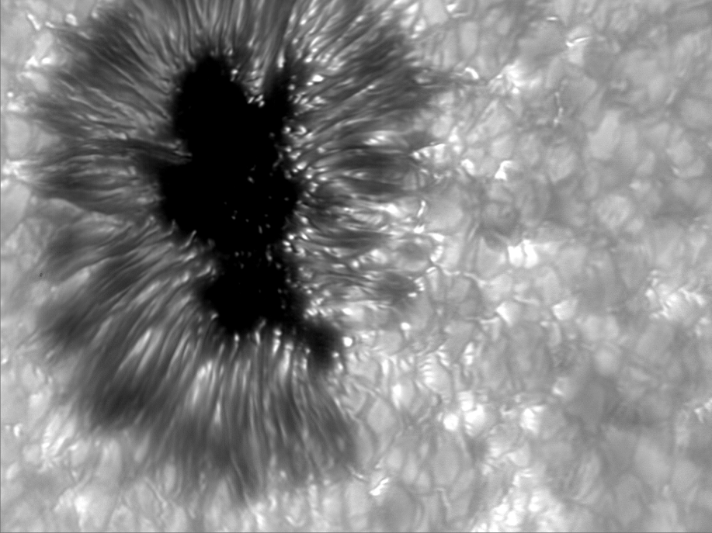
G-band with AO-308 (9/06/12)
Notes:
Same spot two days later under worse seeing conditions. Spot has acquired a penumbra.

Slide 32
Third Generation AO: Multi-Conjugate AO in Collaboration with NSO/SP & KIS
Notes:
Two projects that are starting. MCAO: no one has done it to correct the full field of view. Our AO partly corrects.

Slide 33
a(sinα+sinβ)

Slide 36
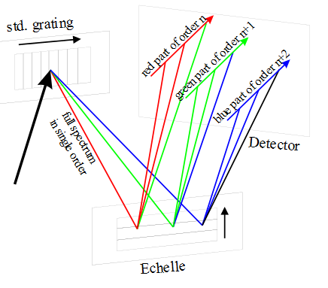
Echelle grating
Echelle spectrometer
The first standard grating is optimized for a single lower order. The echelle is mounted orthogonally in such a way that the highly illuminated orders of the echelle are transversally separated. Different parts of the spectrum are recorded simultaneously.

Slide 37
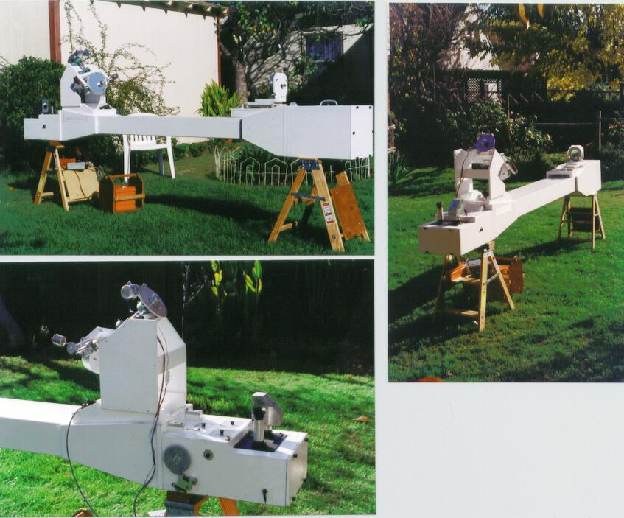
Spectrohelioscope.org

Slide 38
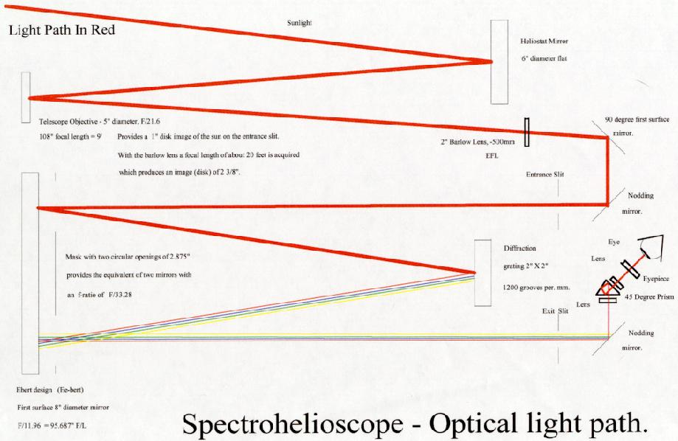

Slide 39
