Slide 1
4. Tools for Solar Observations-II
Spectrographs. Measurements of the line shift.

Slide 2
a(sinα+sinβ)
grating constant

Slide 3
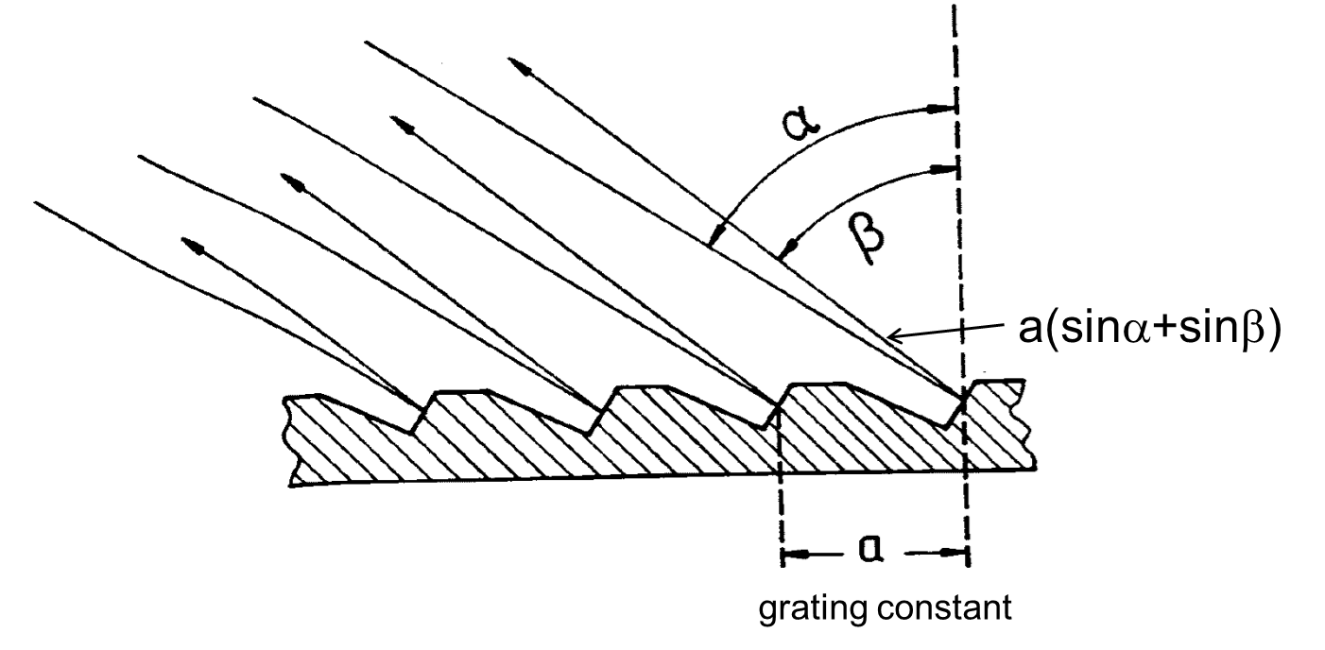

Slide 4
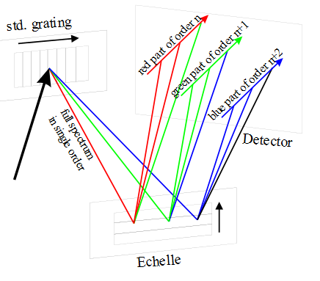
Echelle grating
Echelle spectrometer
The first standard grating is optimized for a single lower order. The echelle is mounted orthogonally in such a way that the highly illuminated orders of the echelle are transversally separated. Different parts of the spectrum are recorded simultaneously.

Slide 5
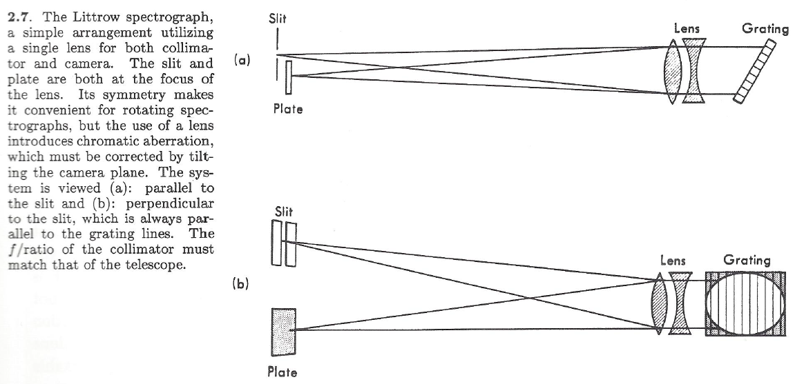
Littrow spectrograph
In the Littrow system, a single lens perform functions of both collimator and camera

Slide 6
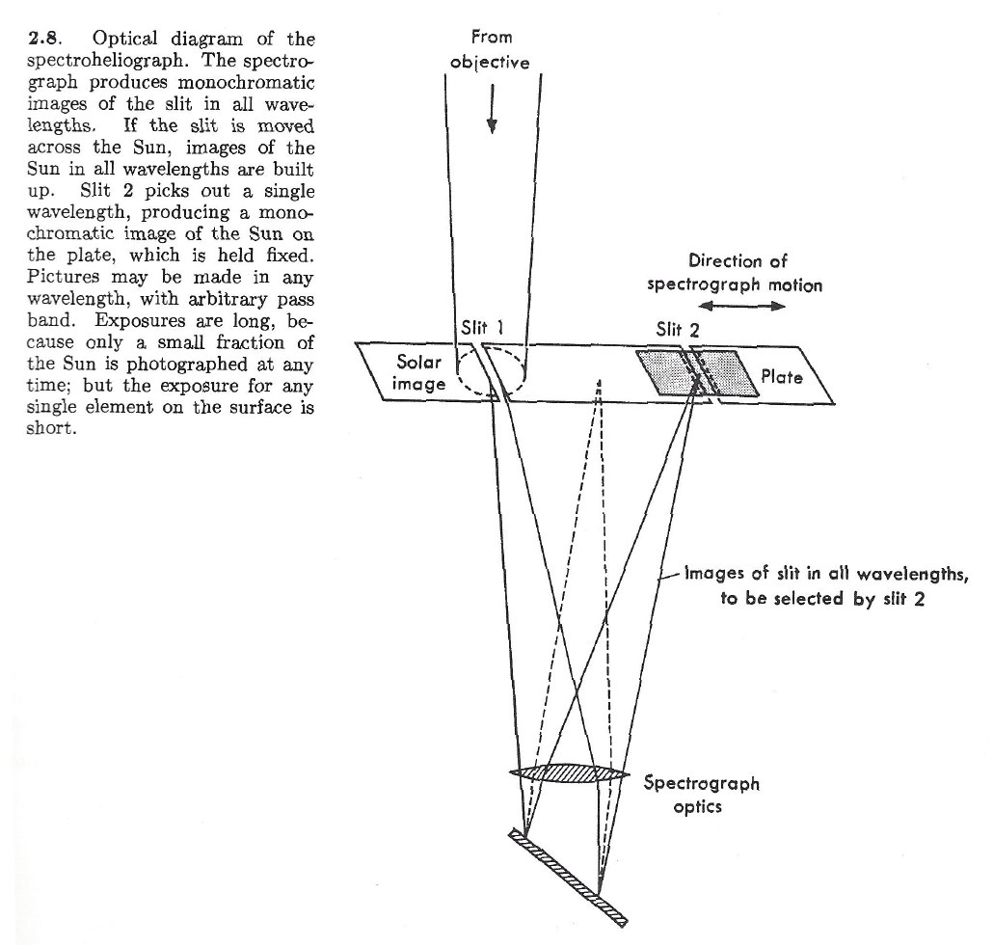
Spectroheliograph

Slide 7
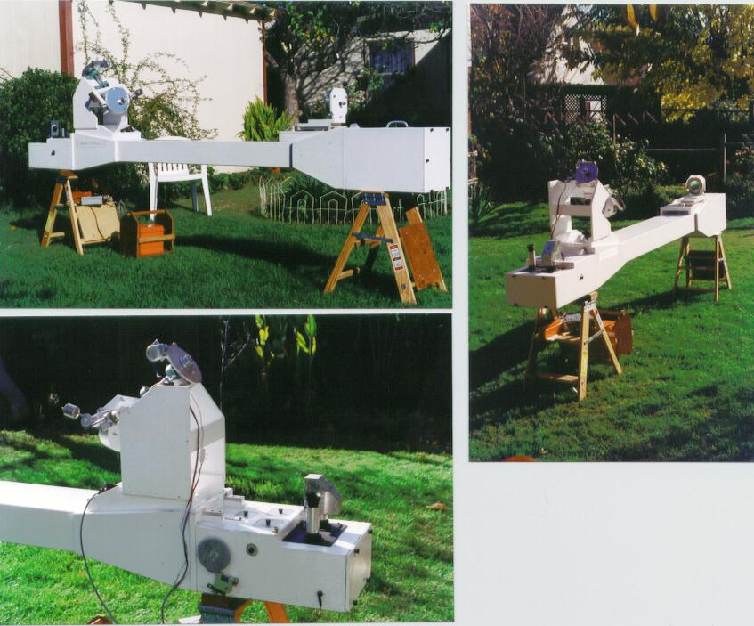
Spectrohelioscope.org

Slide 8
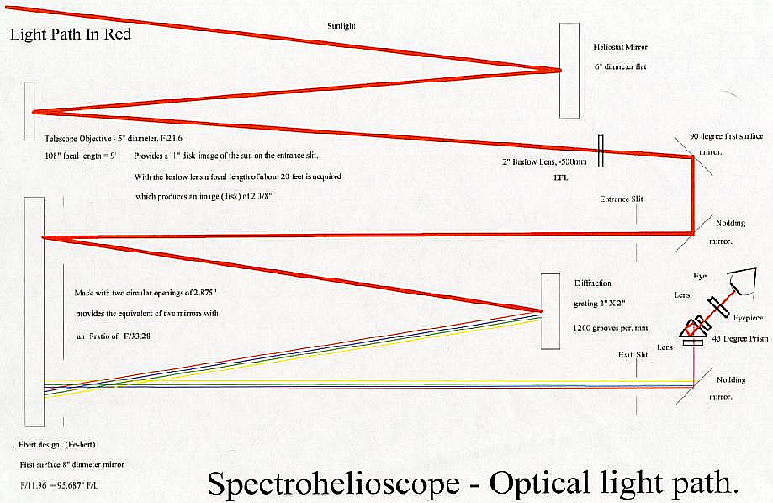
Heliostat mirror
5” telescope mirror provides 1” disk image
on the entrance slit
Entrance slit
Diffraction grating

Slide 9
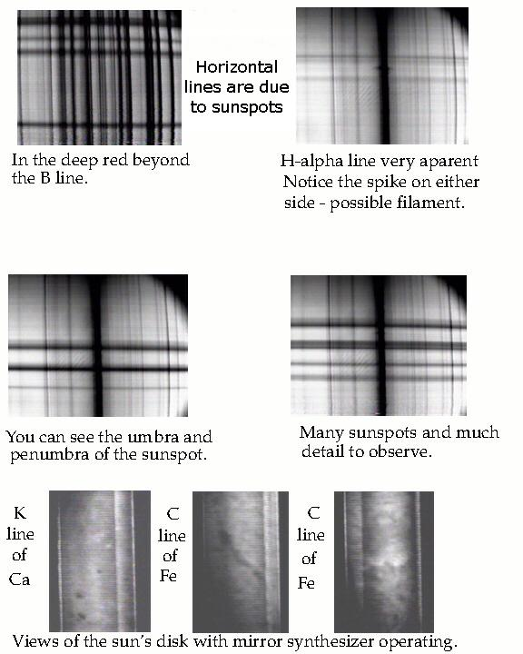
Examples of Spectrohelioscope observations
x
λ

Slide 10
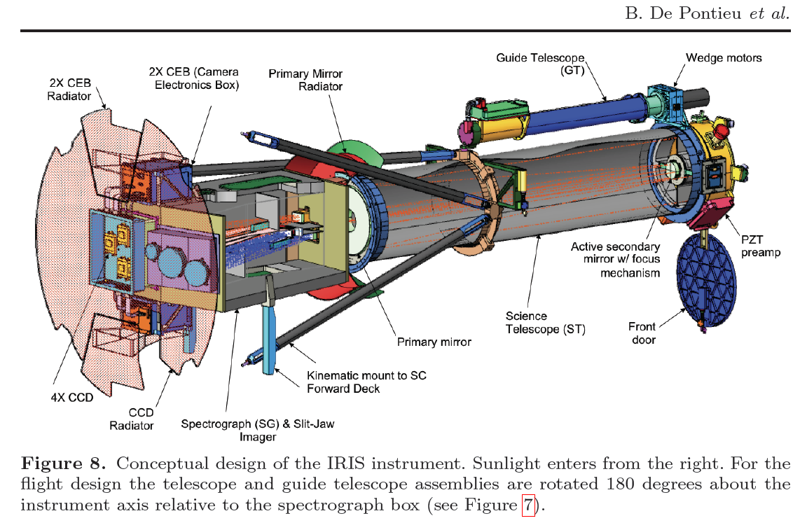
The Interface Region Imaging Spectrograph (IRIS)
IRIS observes UV spectra of the chromosphere-corona transition region: 19 cm telescope, spatial resolution 0.33 arcsec, field of view 175x175 acrsec²

Slide 11
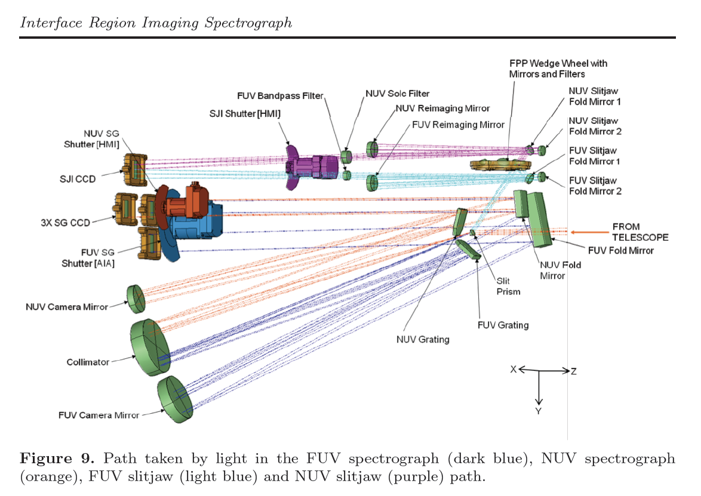
IRIS spectrograph
The instrument simultaneously obtains spectra and slit-jaw images (images reflected from the spectrograph slit) in the Near-UV and Far-UV spectral intervals.
The Czerny-Turner design separates collimator and camera mirrors.

Slide 12
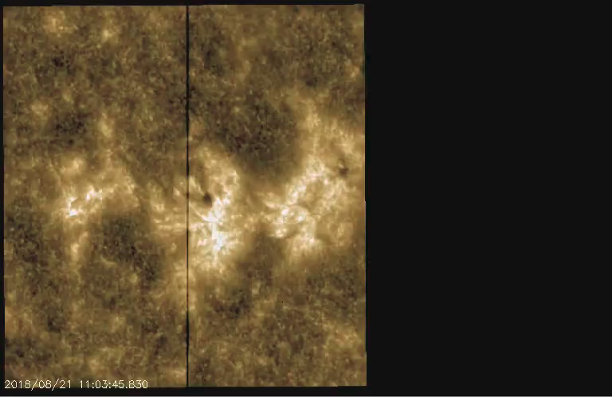
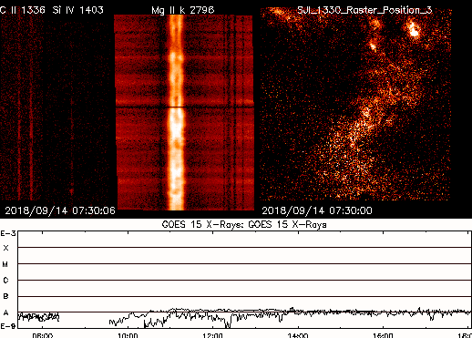
IRIS observations on 08/21/18-09/14/18
This Mg II k (279.6 nm) slit-jaw movie shows NOAA AR 12719 making its way across the disk, starting three days after the region had emerged. While active at first, the active region seems to be decaying in the first half of the movie, but then magnetic fields suddenly start emerging bringing new life to the scene. The heating that is released while the magnetic fields reconfigure leads to short-lived brightenings, both compact and in more elongated filamentary structures, as the two opposite polarity pores (dark, roundish spots) move apart. Eventually the build up of magnetic potential energy is sufficient to be released in a minor flare visible towards the end of the movie.

Slide 13
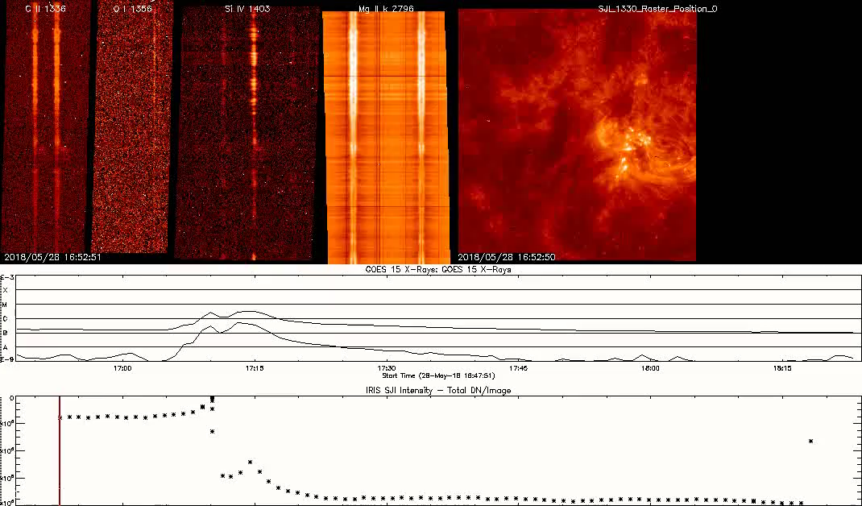
C2.7 flare of 05/28/18 observed by IRIS
The C2.7 flare is prominently visible in the C II slit-jaw movie in the top right, shooting out material that later falls back to the surface again along arched trajectories, both towards the leading part of the active region on the right and the trailing part on the left, where the flare occurred. The IRIS slit crosses the flare exactly as it goes off, catching the strong broadening and enhancement of all the major lines (C II, Si IV and Mg II h & k), as well as the usually weaker lines (like O I and C I) that IRIS routinely observes.

Slide 15
Fourier Transform Spectrometer
x₁
x₂

Slide 16
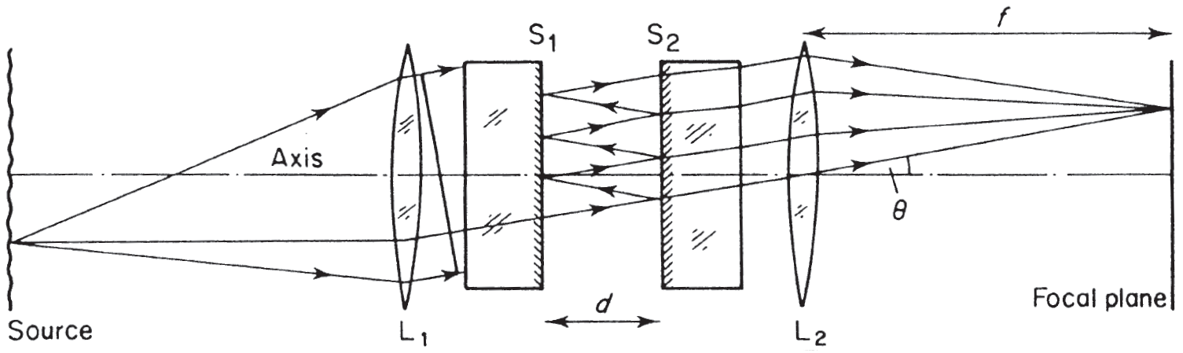

Fabry-Perot interferometer (etalon)
An incident beam is multiply reflected between the two parallel surfaces, but with each reflection a fraction R of the intensity is reflected and a fraction T is transmitted, and all these transmitted fractions interfere in the outgoing beam.
If the angle of incidence is θ, the layer thickness is d, the refraction index is n, then the path difference between two successive beam fractions is Δ = 2nd cosθ, and the phase difference is δ = 2πΔ/λ = 4πnd (cosθ)/λ .
For an incoming wave of form exp(iωt) the transmitted and reflected (absolute) wave amplitudes are T^{1/2} and R^{1/2}, respectively; thus, counting all the reflections and the phase differences, the outgoing wave is a geometric series:
Ae^{iωt} = Te^{iωt} + TRe^{i(ωt+δ)} + TR²e^{i(ωt+2δ)} + . . .
A= T(1 + Re^{iδ} + R²e^{2iδ} + . . . ) = T/(1 − Re^{iδ})

Slide 17
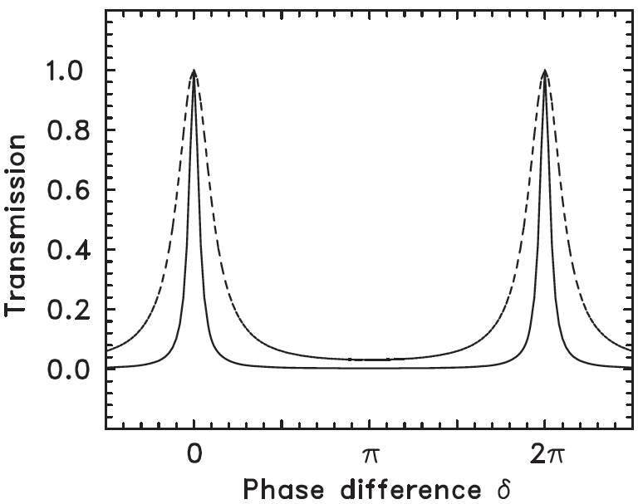
Fabry-Perot interferometer (etalon)
The transmission is periodic; the mth maximum is at δ = 2mπ or λ = 2nd cosθ/m.
FRS (free spectral range)
The distance between the peaks (Free Spectral Range) is FRS=λ/m =λ²/2ndcosθ
Full-width at half maximum (FWHM), Δλ, depends on the reflectance R:
The ratio, FRS/Δλ is called finesse.
For λ=500nm, d=1mm, FRS=0.13nm small.
Thus, Fabry-Perot etalons are used in combination with other filters.
R=0.9
Δλ
R=0.7

Slide 18
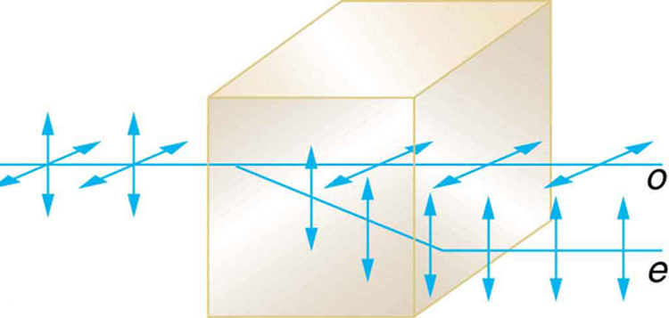
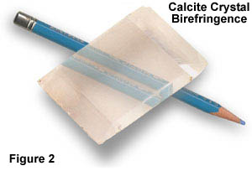
Ordinary ray
CaCO₃
Extraordinary ray
does not obey Snell’s law,
can be faster or slower than the o-ray.
Optical axis

Slide 19
Calculate the phase difference between
ordinary and extraordinary rays:
e
n_{o}=1.6584
n_{e}=1.4864

Slide 20
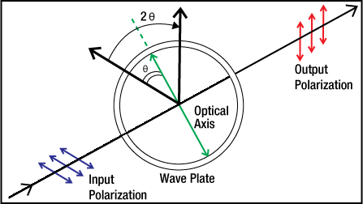
Half-wave plate
Optical axis
Input
polarization
Output
polarization
θ
θ
π

Slide 21
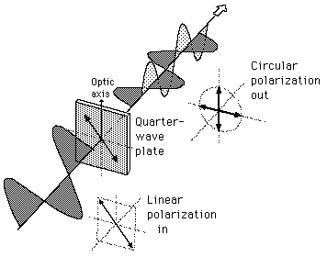
Quarter-wave plate
If linearly polarized light is incident on a quarter-wave plate at 45° to the optical axis, then the light is divided into two equal electric field components.
One of these is retarded by a quarter wavelength by the plate. This produces circularly polarized light. Incident circularly polarized light will be changed to linearly polarized light.

Slide 23
Lyot filter.
Passing intensity of a single filter of thickness e:

Slide 25
Rotating half-wave plate

Slide 27
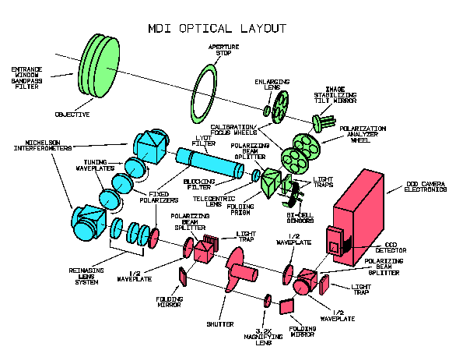

Slide 28
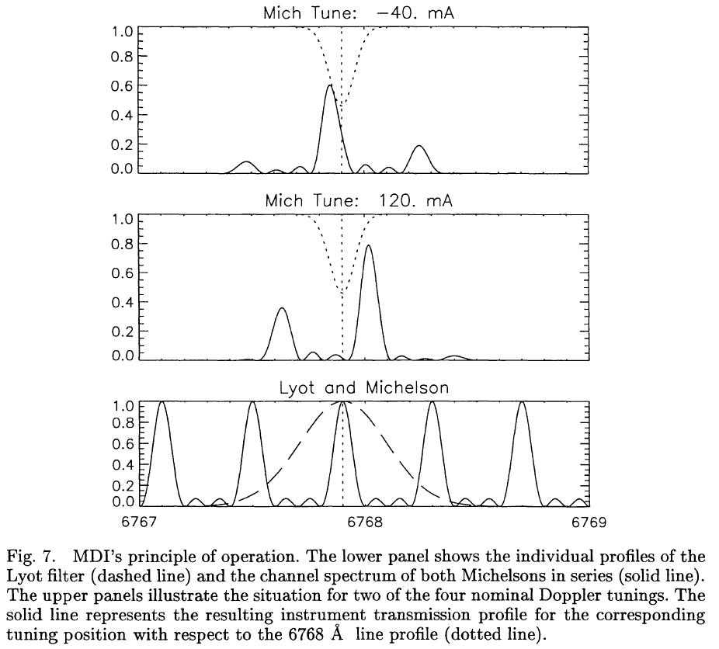

Slide 29
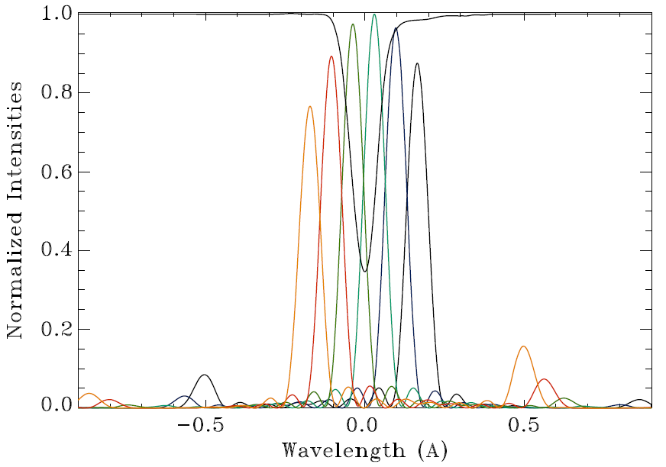
Six tuning positions of the HMI instrument on Solar Dynamics Observatory (SDO) are shown here with respect to the Fe I 6173A solar line at disk center and at rest.
During observations the line profile is shifted due to the surface motions and spacecraft orbital velocity (Doppler effect), and also the line split in magnetic field (Zeeman effect). These line changes are used to measure the Doppler velocity and magnetic field strength.

Slide 30
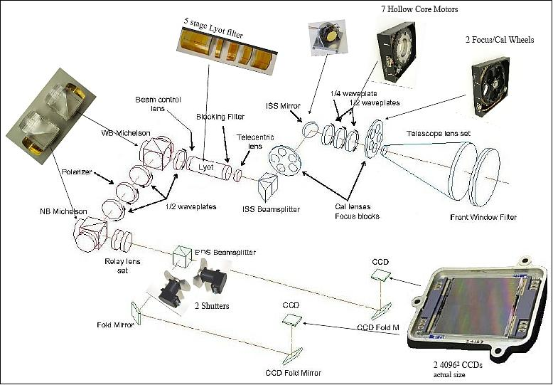
Helioseismic and Magnetic Imager

Slide 31
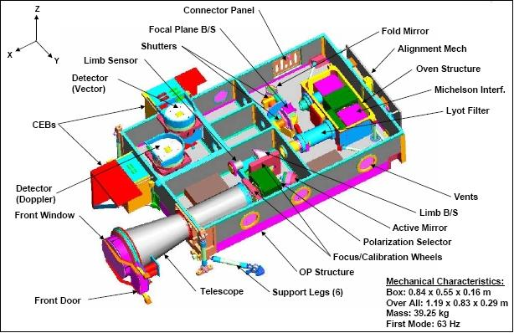
Helioseismic and Magnetic Imager

Slide 32
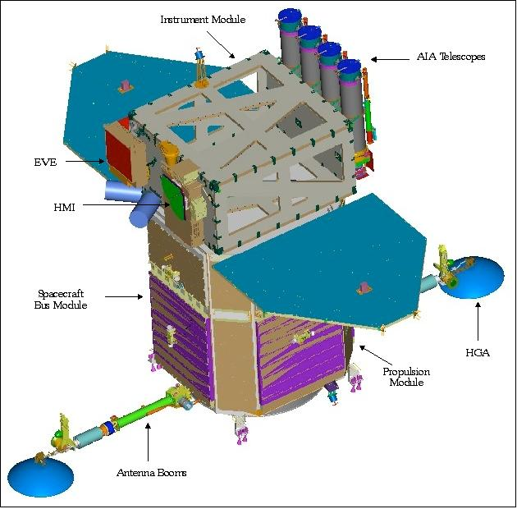
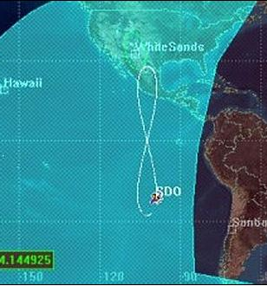
Solar Dynamics Observatory
Geostationary orbit for uninterrupted observations of the Sun.
Helioseismic and Magnetic Imager (HMI)
- Full-disk Dopplergrams and magnetograms
Atmospheric Imaging Assembly (AIA)
– Full-disk images of the chromosphere and corona
Extreme Ultraviolet Variability Experiment (EVE)
– EUV solar irradiance

Slide 33
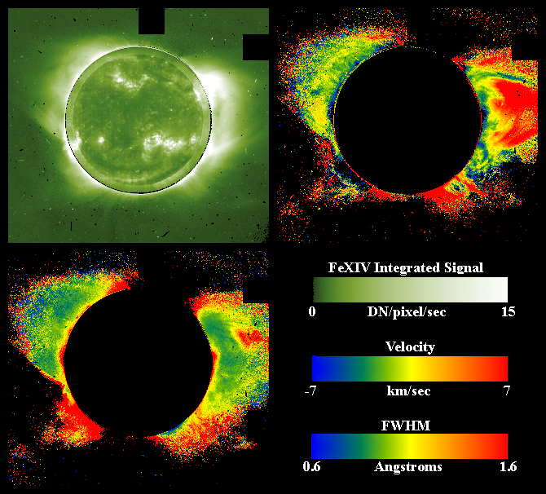
LASCO C1 coronagraph on SOHO used Fabry-Perot etalon to image the Doppler shift of coronal Fe XVI line

Slide 34
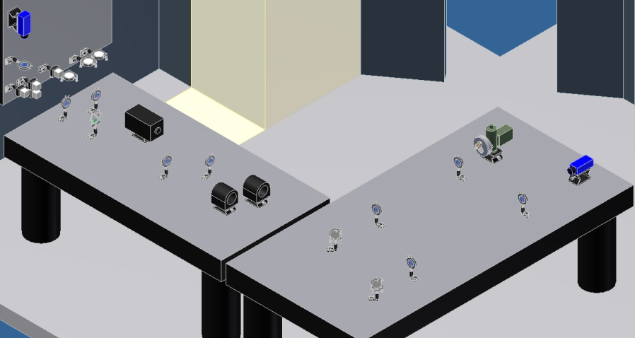
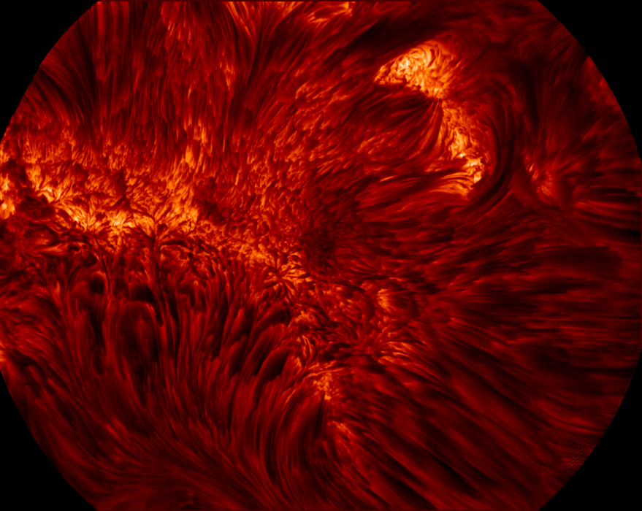
Visible Imaging Spectrometer
Single Fabry-Pérot etalon (D = 70 mm) plus narrow band interference filterjjjjjj
Wavelength coverage: 550 – 700 nmjjjj
Band pass: 5.8 pmjjjjjjjjjjjjjjjjjjjjjjjjjjjjjjjj
Telecentric optical configurationjjjjjjjjjjjj
Field of view: 70” by 64”jjjjjjjjjjjjjjjjjjjjjjj
Available spectral lines:jjjjjjjjjjjjjjjjjjjjjjjjj
  Hα (656.3 ± 0.15 nm)jjjjjjjjjjjjj
  Fe I (630.2 ± 0.15 nm)jjjjjjjjjjjjjj
  NaD₂ (588.9 ± 0.15 nm)jjjjjjjjjjjj
  more lines coming as needed …
High speed computer with SSD HDsjjjjjjj
Spectroscopy cadence: a 11 points scan with multi-frames selection: < 15 sjjjjjjjj
Notes:
34
VIS replaced VIM

Slide 35
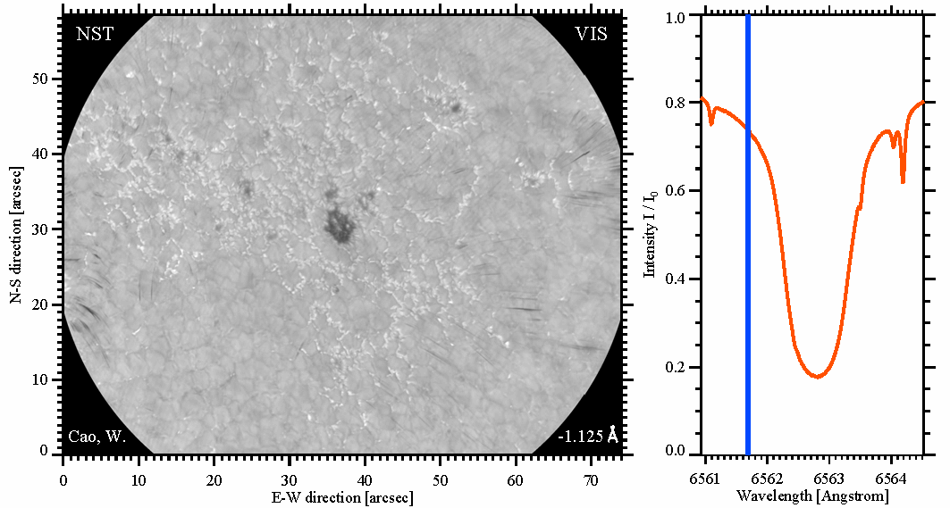
VIS: H-alpha Observations
Notes:
35
The 1st light observations of VIS on 22May2013 have revealed quite good image quality.
This image was taken in the line center of Ha line.
And this movie illustrates a spectroscopic scan over the Ha line.

Slide 38
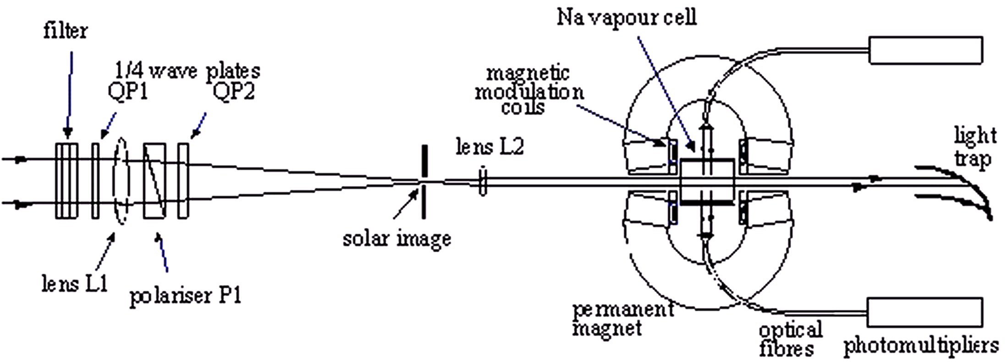
Resonance-scattering spectrometer- GOLF
instrument on SOHO (Global Oscillations at Low Frequencies)
5000 G magnetic field

