Slide 1
5. Tools for Solar Observations-III
Zeeman effect. Magnetic fields and polarimetry.

Slide 2
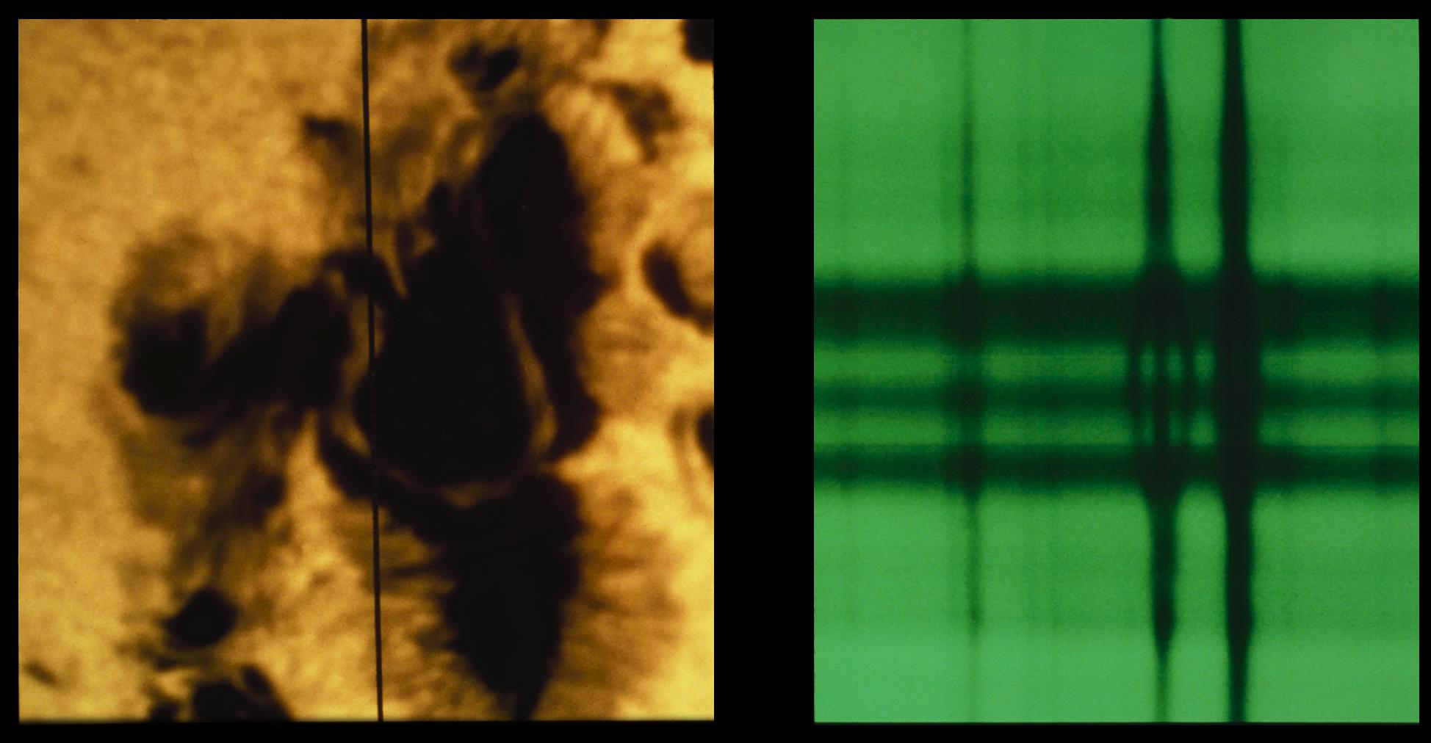
Fe 5250.2A (525nm)
A complex sunspot picture, taken at 15:30 hours UT on 4th July 1974. The vertical black line on the white light image (left) indicates the location of the slit for the spectrograph which took the spectrum, shown on the right. The division of one spectral line into three parts is a clear demonstration of the Zeeman effect. In fact, the Zeeman splitting of this line Fe I at 5250.2A indicates a record field strength of 4130 Gauss. The white light photo shows a sinuous light bridge which divides the spot's umbra into different magnetic polarities. Twenty minutes before this picture was taken, a major white light flare occurred. This picture was taken at the McMath-Pierce Solar Facility on Kitt Peak.

Slide 3
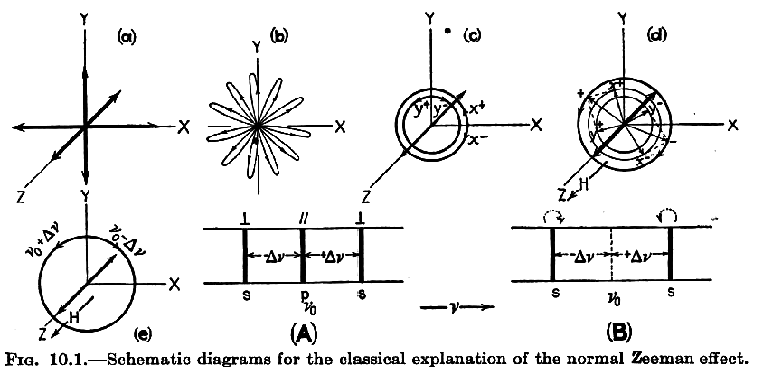
Magnetic field causes perpendicular circular motion
(From H.White, Introduction
to Atomic Spectra, 1934)
Electron oscillates in atom
Frequency change is due the Lorentz
force ~VxB
gyrofrequency
Two circular polarized component are observed if B is along the line of sight (z-axis).
Three linear polarized component are
observed if B is perpendicular to the line of sight.
B
Electrons moving in a counterclockwise direction in the plane of the screen are speeded up by an amount Δν and those moving in a clockwise direction are slowed down by the same amount. In the absence of a field, the electrons are emitting light. If we observe the radiation in the x direction, only the light from the y and z motions will be observed. Since these motions are projections from all orientations, this light will be unpolarized.
In magnetic field, moving transversely to the field, the x and y motions will take the form of rosettes. This motion is equivalent to the resultant of two equal but opposite circular motions as shown in panel c).
When viewed in the direction of the field, only the circular motions are observed, and these produce right- and left-handed circularly polarized light; the z motions will not emit light in the field direction.
When viewed perpendicular to the field, the z motions are observed as plane-polarized light with the electric vector vibrating parallel to the field, and the circular motions, seen edge on, are observed as plane-polarized light with the electric vector at right angles to the field.

Slide 4
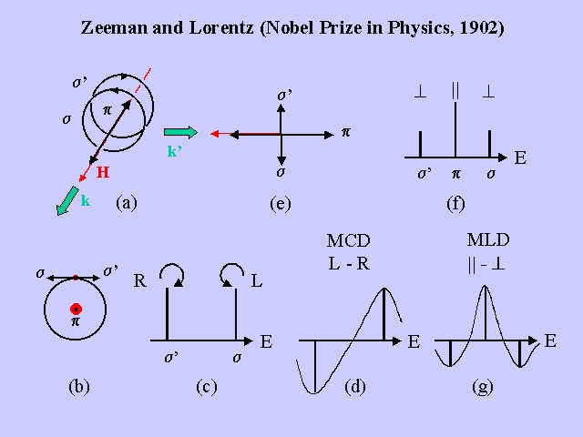
When viewed in the direction of the field, only the circular motions are observed, and these produce right- and left-handed circularly polarized light; the z motions will not emit light in the field direction.
When viewed perpendicular to the field, the z motions are observed as plane-polarized light with the electric vector vibrating parallel to the field, and the circular motions, seen edge on, are observed as plane-polarized light with the electric vector at right angles to the field.

Slide 5
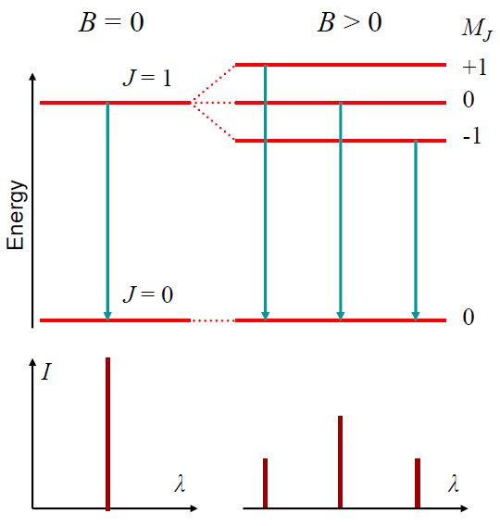



π
σ
σ
g-factor of the transition
L is the total orbital moment of the electrons
S is the spin quantum number
J is the total angular momentum
M_{J} is the magnetic quantum number: -J,…,J
Lande factor

Slide 6
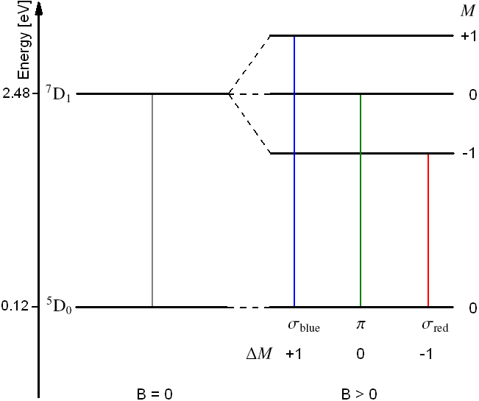
Normal Zeeman splitting for iron line Fe I 525.02 nm
Standard notation ^{2S+1}L_{J} provides information about quantum numbers L, S and J.
The letters S,P,D,F, ... mean an orbital angular momentum corresponding to
L=0,1,2,3…
⁷D₁ means L=2,S=3,J=1.
Zeeman splitting for the iron line at 525.02 nm formed by transition between the energy levels ⁵D₀ ↔ ⁷D₁. Because of J = 0, the lower energy level ⁵D₀ is not degenerate, i.e. it does not split in the presence of a magnetic field. The upper J = 1 level splits into three different sublevels with the magnetic quantum numbers M = −1, 0, +1.
A Lorentz triplet is formed, which is named the normal Zeeman effect. The formation of exactly three split lines is a particular case that only occurs when one of the two energy levels has J = 0.
Riethmuller, PhD thesis, 2013

Slide 7
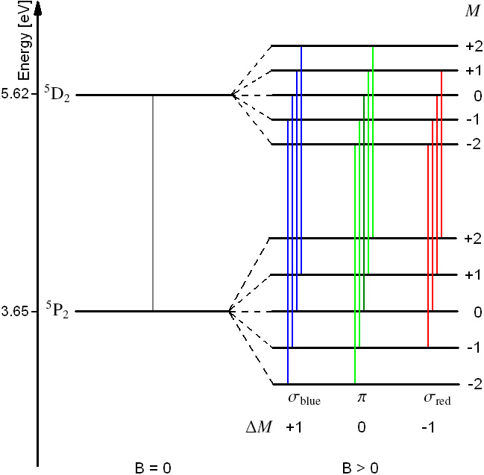
Anomalous Zeeman splitting for iron line Fe I 630.15nm
Not all transitions are allowed. The magnetic quantum number m of the two energy levels must not differ by more than one.
In a general (more common) case more than three components are observed (anomalous Zeeman effect). The anomalous Zeeman effect is illustrated for the ⁵P₂ ↔ ⁵D₂ transition of the iron line at 630.15 nm.
Both energy levels have J = 2 but the different Landé factors, 1.8333 and 1.5, so that the line splits into 13 components. Effective g-factor (g*) is prescribed in this case.
Riethmuller, PhD thesis, 2013

Slide 8

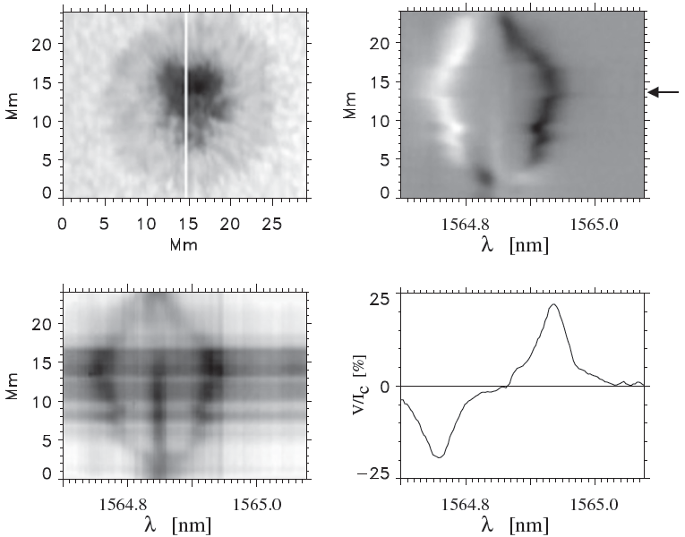
Numerical formula for the line displacement in cm, B is in Gauss. The Zeeman splitting is higher for longer wavelength and larger g-factor.
Zeeman splitting and circular polarization of the infrared
Fe I line at 1564.8 nm (g=3).
The white line is the slit position for the spectrum
shown in the lower left. T
The upper right panel shows the circular polarization, with
an arrow marking the position of the Stokes V (λ) profile in the lower right.
Observation was performed on 9 Nov 1999 at the German Vacuum Tower Telescope

Slide 10
B
E_{x}
E_{y}
Polarization degree

Slide 11
Description of the state of polarization: the Stokes vector {I,Q,U,V}
Denote the phase difference between the electric vectors along the x- and y-axes as
The operational definition of the Stokes parameters are then as follows:
I = I + I = I + I = <E_{x}²> + <E_{y}²>
Q = I - I = <E_{x}²> - <E_{y}²>
U = I - I = 2<E_{x} E_{y} cos δ>
V = I - I = 2<E_{x} E_{y} sin δ>

Slide 12
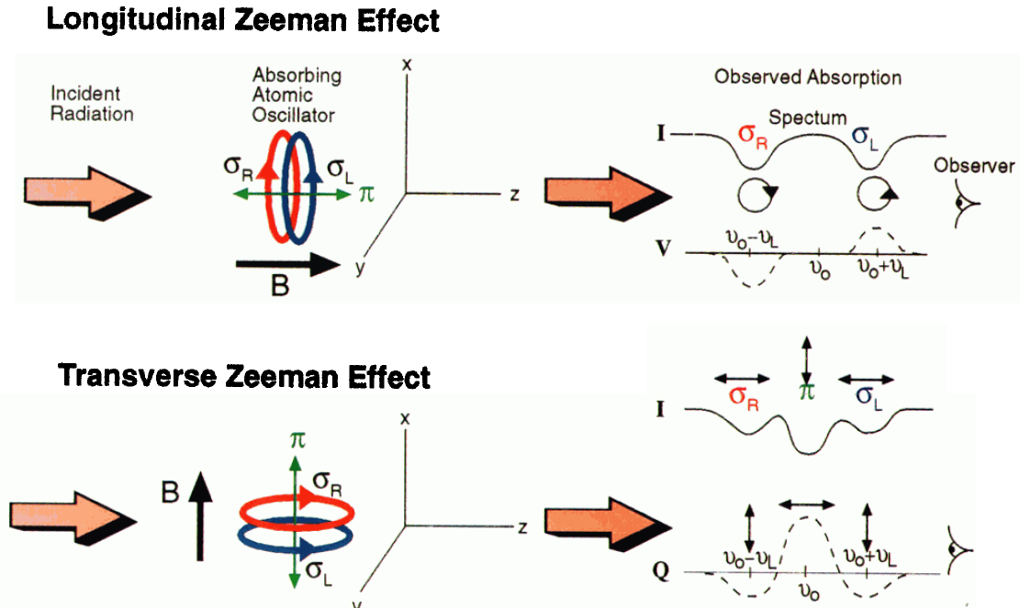
Formation of absorption Stokes profiles
I = I + I
Q = I - I
U = I - I
V = I - I
(from B.Lites, 2000)
The longitudinal Zeeman effect occurs when a plane wave propagating in the direction of B excites both circular modes, σ_{R} and σ_{L}, corresponding to right- and left circular polarization, respectively, leading to the absorption of circularly polarized light at the shifted frequencies. These circular modes correspond to the σ components of the Zeeman pattern. In this case the light propagates along B, and the incident electromagnetic wave has no oscillatory component along the linear oscillator parallel to B (the π component), so absorption of that component cannot occur. Because the background continuum is unpolarized, the absorption of right- (left) circular polarization results in an excess of left- (right)-circular polarization in the residual intensity as evidenced by negative (positive) Stokes V.
In the transverse Zeeman effect the propagating wave excites both σ and π components. π is unshifted, and σ only influences the state of linear polarization of the incident beam that is perpendicular to B, or along y. The three components of the Stokes Q profile (up-down minus left-right linear polarization) are identified with the linear polarizations resulting from the absorption process. The Stokes U is zero in this case because B is oriented along x.

Slide 13



Longitudinal Zeeman effect
Consider Stokes profiles for an absorption line formed in a layer of optical thickness τ illuminated by continuum intensity I_{C}
uniform attenuation
shifted absorption
line profiles.

Slide 14
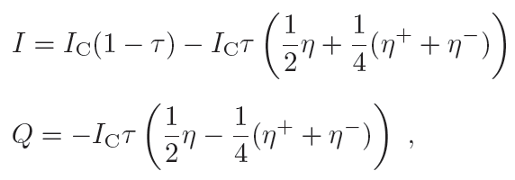
Transverse Zeeman effect
Consider magnetic field is parallel to axis x. The line of sight is along z axis.

Slide 15
The transverse effect is quadratic in B, and is much smaller than the longitudinal effect.

Slide 16
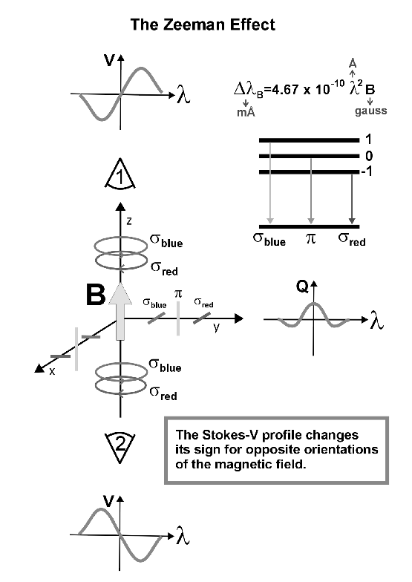

Slide 17
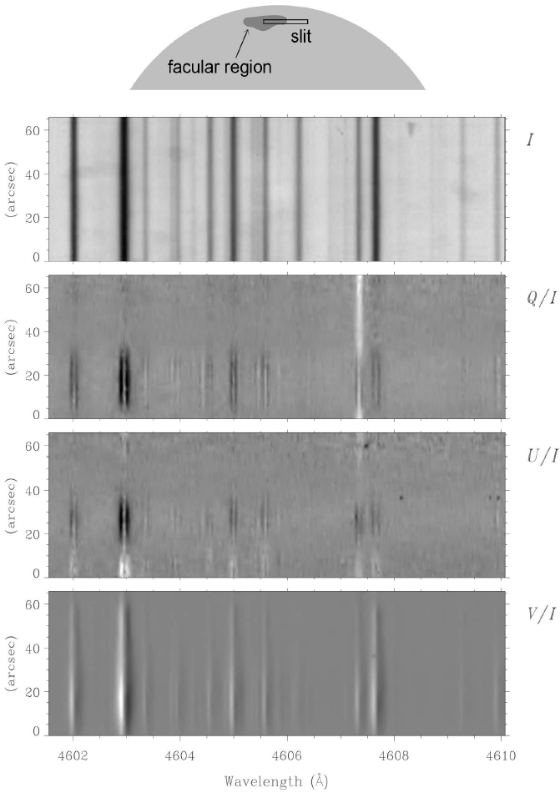
(Stenflo, 2002)

Slide 18
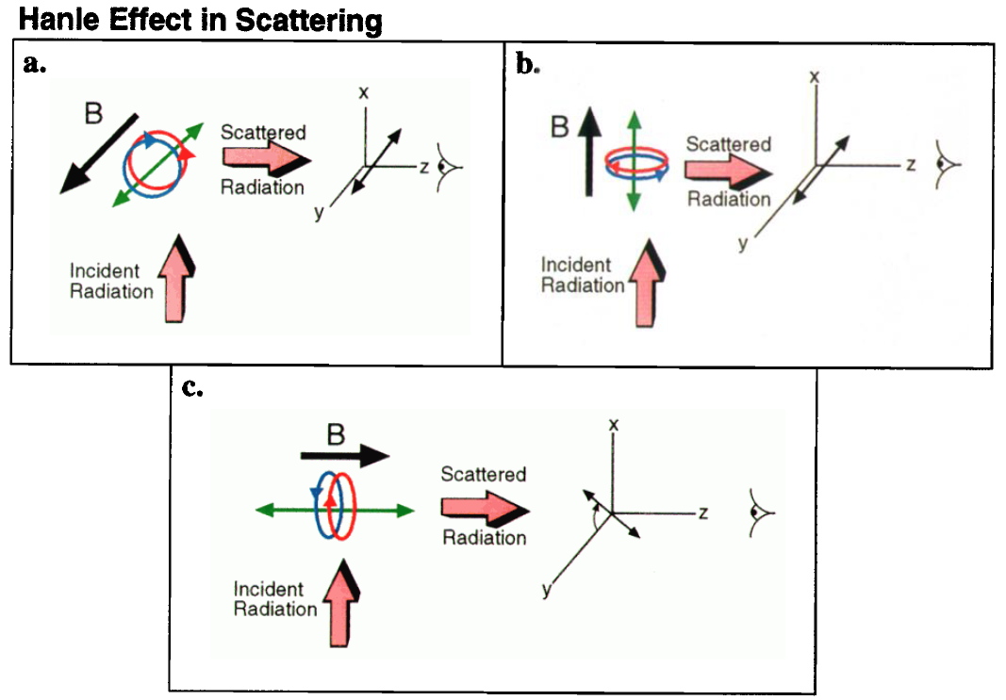
(from Lites, 2002)
A scattering system illuminated anisotropically by a plane wave propagating along the x axis. Assume the magnetic field is directed along the y axis and the observer is positioned along the z axis (panel a). For pure scattering in the absence of a magnetic field the observer would measure pure linear polarization oriented parallel to the y axis: No excitation and reemission of polarization occurs along x because the incident wave has no corresponding component of the electric field. As with the Zeeman effect, we represent the oscillator by a linear oscillator along y and two oppositely rotating circular oscillators in the x-z plane. The magnetic field causes a mixing of the field-aligned state with the circular states, causing some reemission polarized along x. Therefore, in this geometry, the Hanle effect reduces the net polarization of the scattered radiation but does not alter its orientation along the y axis.
Depolarization alone also occurs if the magnetic field is oriented along the x axis (panel b): In this case the magnetic field mixes the radiatively excited circular os­cillator states into the linear state aligned with the mag­netic field. The more interesting special case is where the field is aligned along the LOS, i.e., along z (panel c). The observed light results from the circular states only.

Slide 19
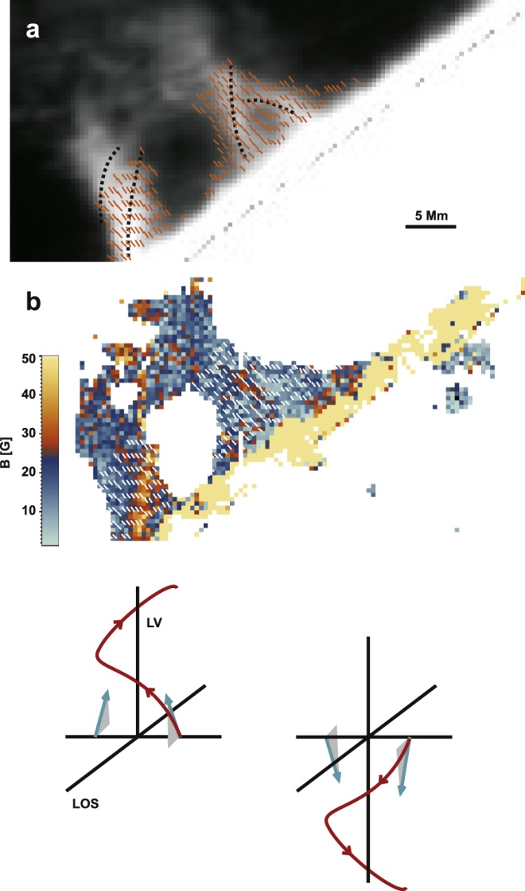
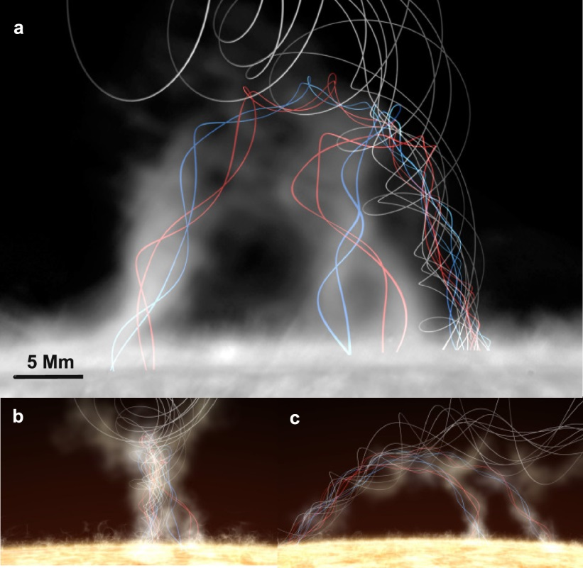
SPECTRO-POLARIMETRIC IMAGING REVEALS HELICAL MAGNETIC FIELDS IN SOLAR PROMINENCE FEET
M. J. Martínez González et al, 2015, Astrophys.J., 802:3.
Left images: (a) Inferred magnetic field topology of the prominence feet. Direction of the field projected onto the plane of the sky (short lines) overplotted to the intensity of the He I 1083.0 nm line and magnetic field strength (b). Short-dashed black lines in panel (a) trace the axes of the fibrils in the two feet. In the sketches below, blue arrows represent the actual inferred field vector in the f2a fibril. Note the opposite polarities of the magnetic field in both sides of the local vertical. This, and the relative inclination of the projected field with respect to the fibrils imply a helical field (red lines).

Slide 20
Magnetograph
This figure illustrates the principle of a photoelectric V -polarimeter. Behind the entrance slit is an electro-optic light modulator (EOLM): the orientation of the crystal and the applied AC voltage are chosen in such a way that the circularly polarized part of the light becomes linearly polarized.
Thus, an intensity signal which alternately originates from the right and left circular polarization passes the polarizer and enters the spectrograph. A servo mechanism, e.g., the Doppler compensator, centers a magnetically sensitive line between two exit windows in the spectral plane.
An electronic device measures the diﬀerence between the two signals and, because of the modulation, recognizes the part which originally was circularly polarized. This part yields the desired V signal.
In solar physics a polarimeter is often called a magnetograph - the output signal is directly converted
to a magnetic field strength by using the weak-field approximation.

Slide 21
X-ray imaging system.

Slide 23
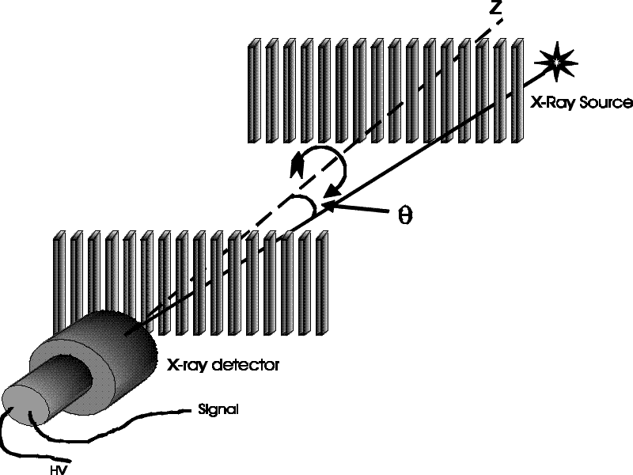

Slide 25
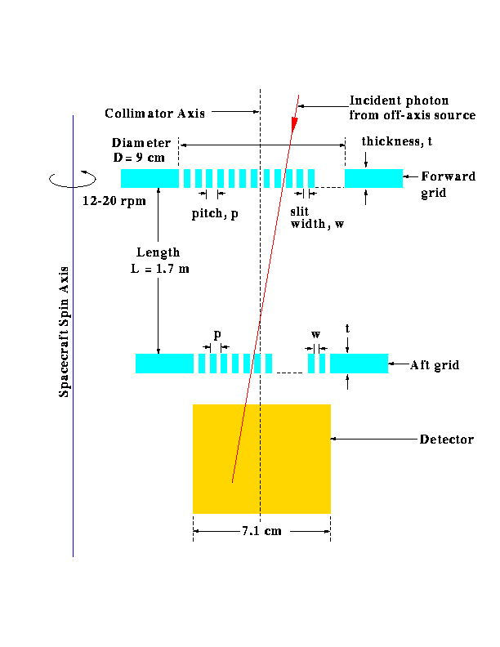
RHESSI grid parameters.

Slide 26
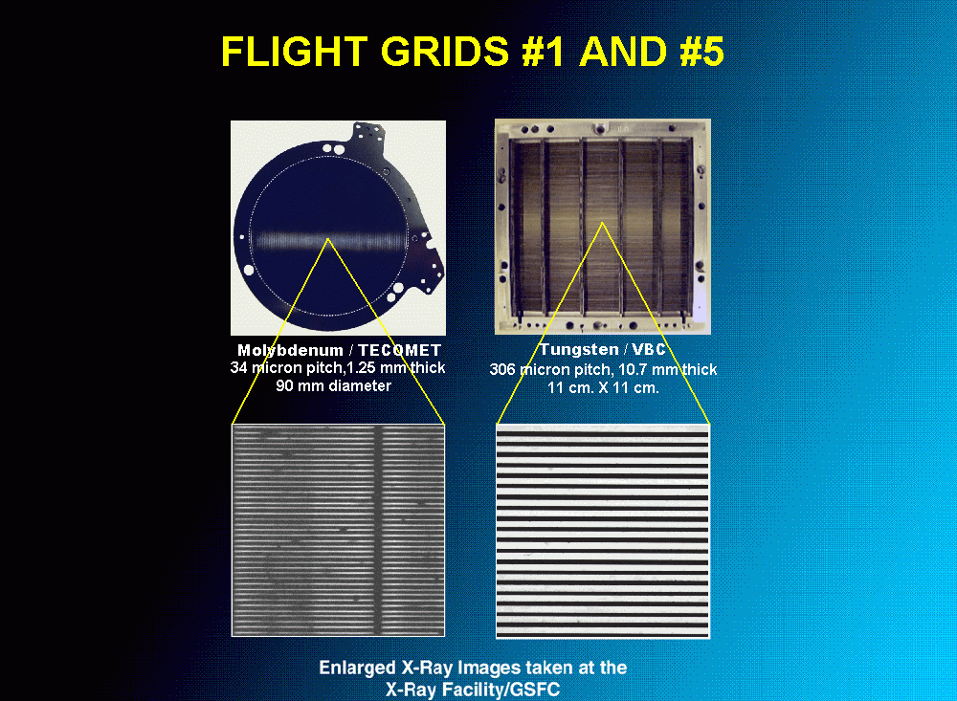

Slide 27
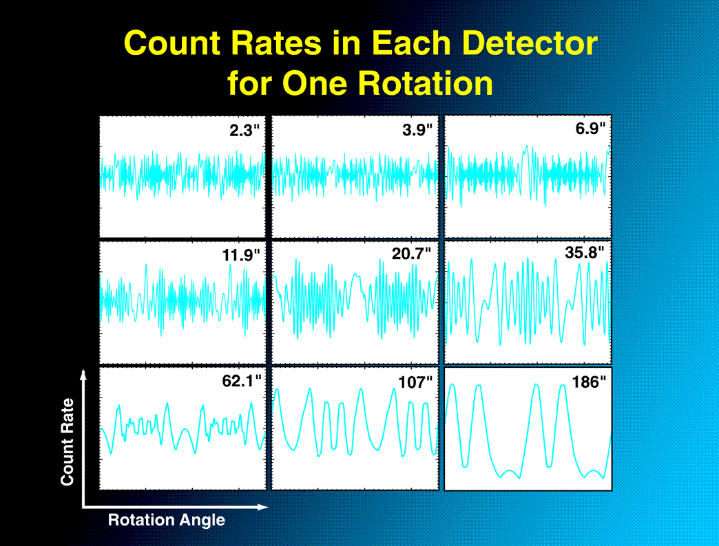

Slide 28
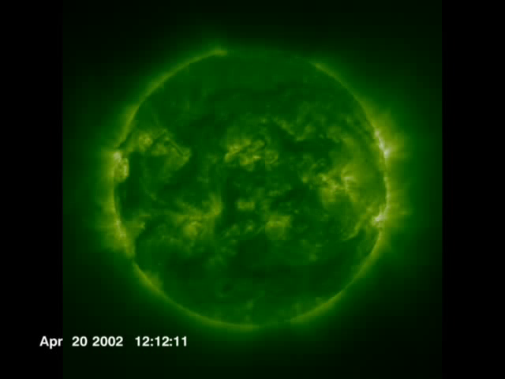
RHESSI observations of X-rays sources of a solar flare
Zoom in (with rotation) to solar active region AR9906 on April 21, 2002 with SOHO/EIT,TRACE and RHESSI data. RHESSI observes x-rays from this flare. The red contours represent the 12-25 keV photon energy range and the blue contours represent 50-100 keV.

Slide 29
