Slide 1
6. Evolution and internal structure of the Sun. I.

Slide 2
Formation and Evolution of the Sun
Determination of the Sun’s age
Pre-main sequence evolution
Jeans instability
Kelvin-Helmholtz stage
Evolution of the Sun on the HR diagram
Equations of stellar structure
Hydrostatic equations
Radiative energy transfer
Equation of state
Nuclear reactions

Slide 3
Sun’s age
Radioactive
decay
Does not change
over time
Measured by mass spectrometer

Slide 4
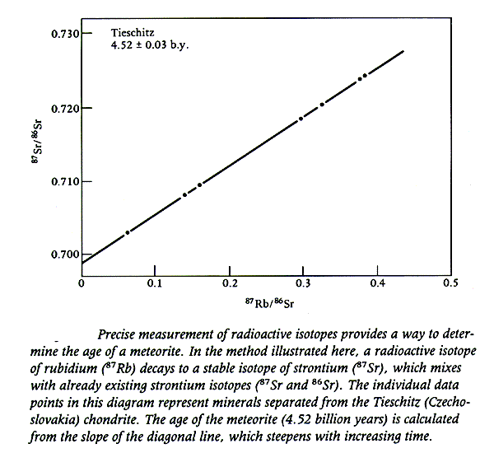
The age is
determined from
the slope

Slide 5
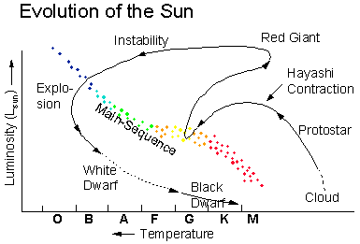
Post-main sequence
Kelvin-Helmholtz stage
Pre-main sequence
Jeans instability
HR diagram

Slide 6
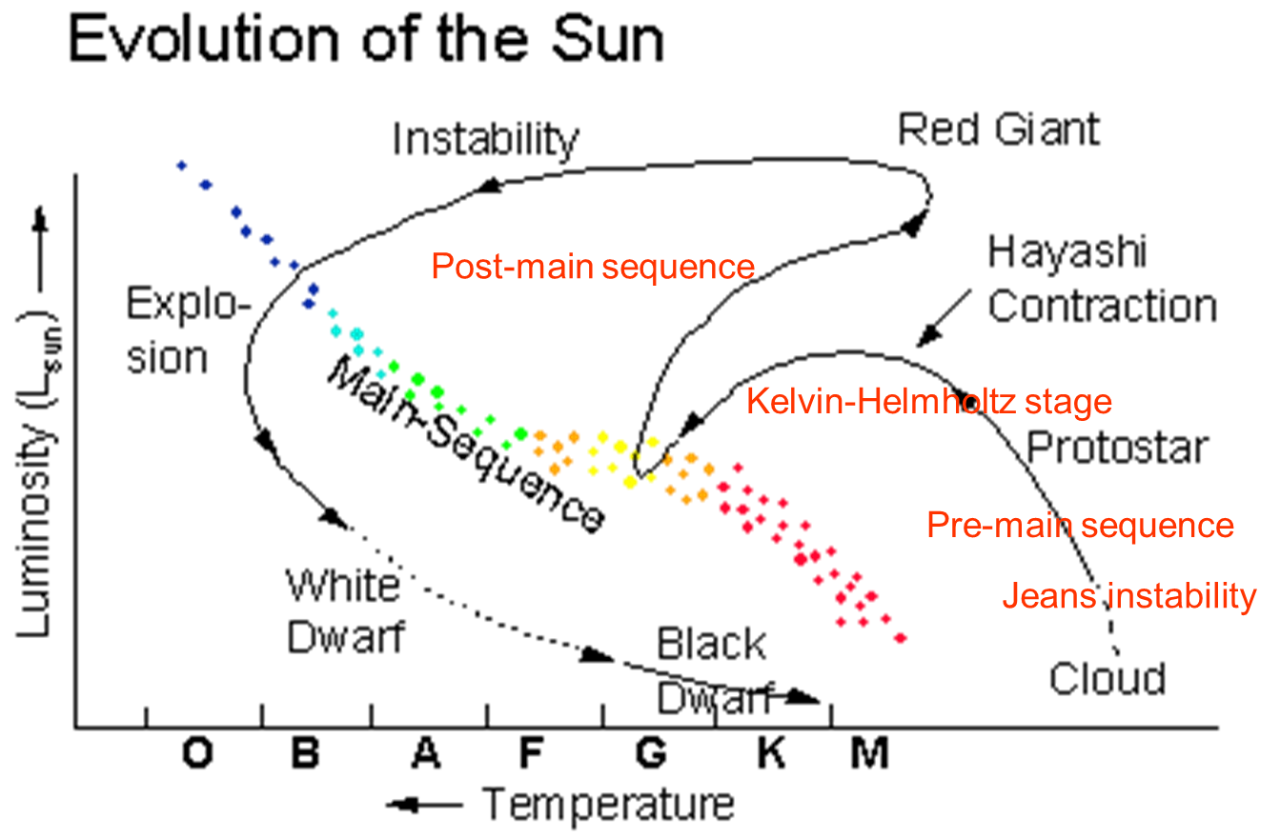
Stages of the solar evolution
Pre-main sequence evolution
  Jeans instability
  Kelvin-Helmholtz stage
  Zero-age main sequence (ZAMS)
Main sequence evolution
Post-main sequence evolution
  Red giant
  Helium flash
  White dwarf
  Black dwarf
Main sequence
ZAMS

Slide 7
Jeans instability
δF_{out}
Excess of gravity force:
δF_{in}
Excess of pressure force:
Density
perturbation
Gas constant

Slide 8
Jeans instability
Jeans radius

Slide 12
Kelvin-Helmholtz stage

Slide 13
Kelvin-Helmholtz stage

Slide 14
Li

Slide 15
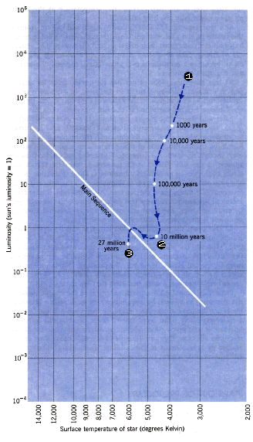

Slide 16
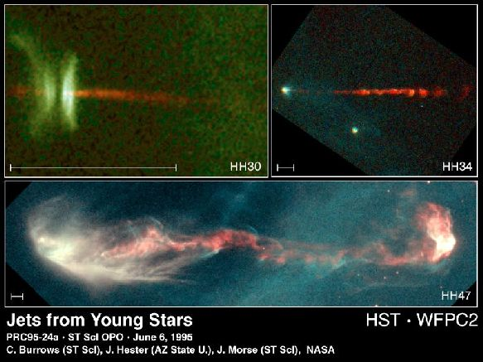

Slide 17
Main-sequence evolution
ZAMS

Slide 18
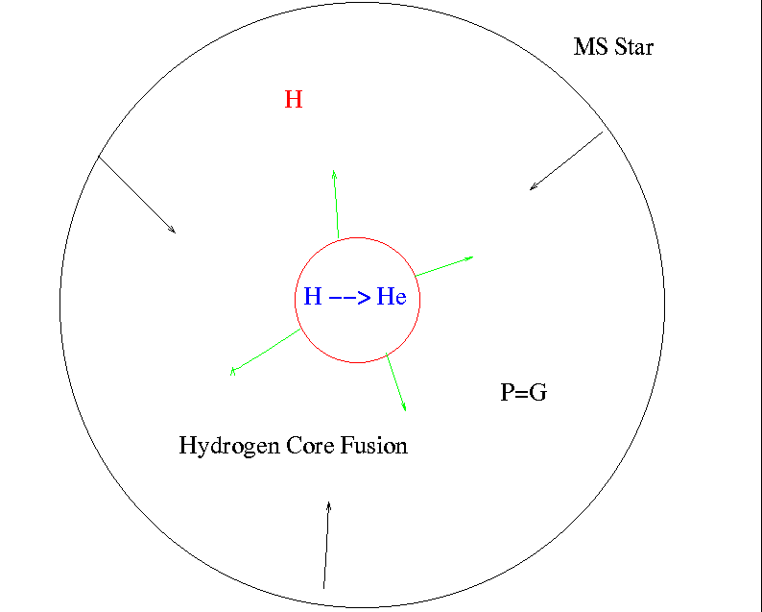
Post-Main Sequence Evolution

Slide 19
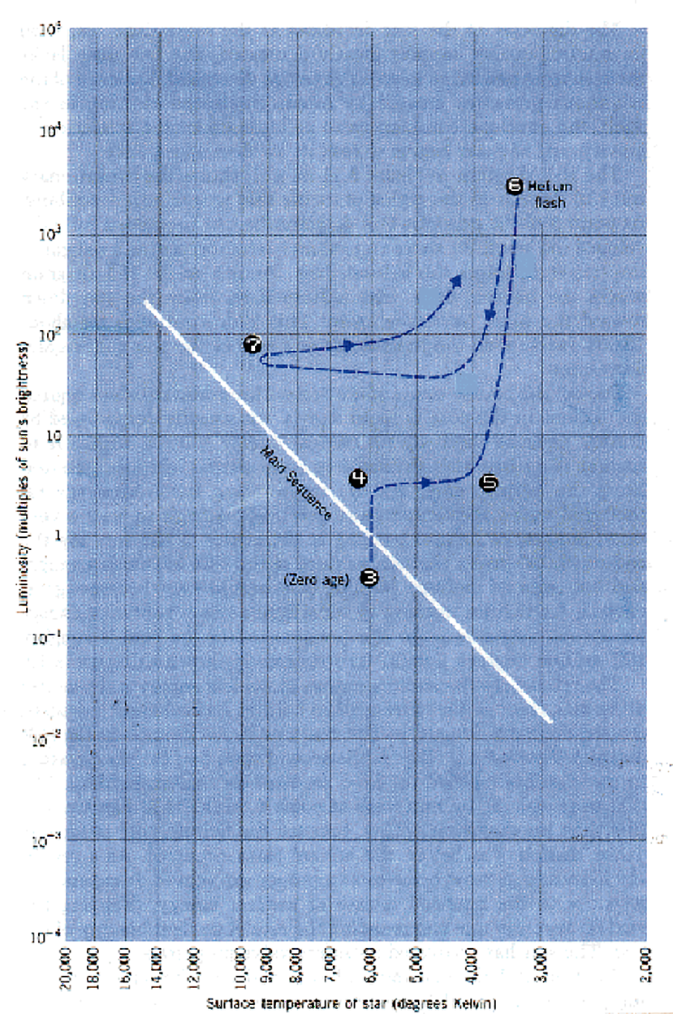

Slide 20
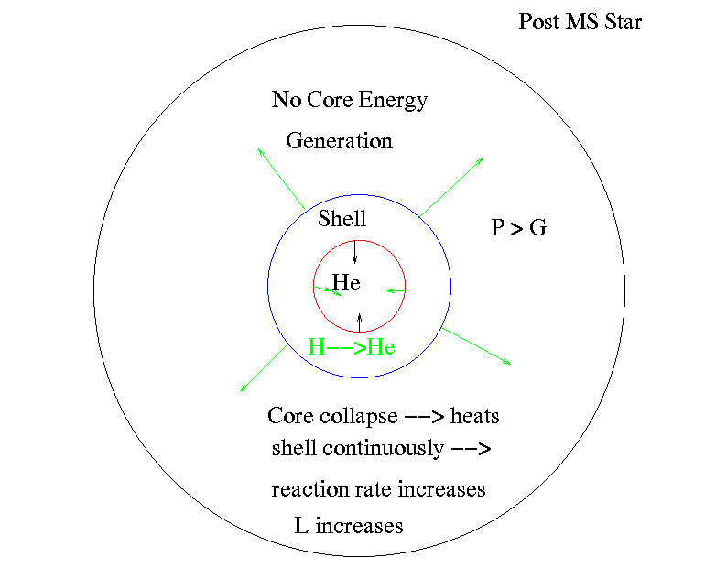
Post Main-Sequence Evolution

Slide 21
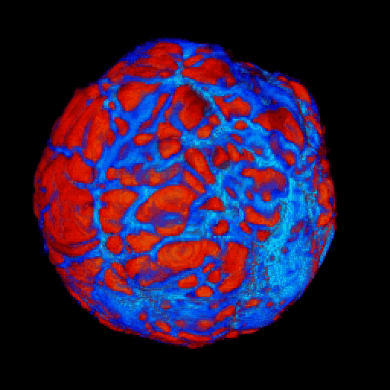
Simulating a Pulsating Red Giant Star, Porter, et al

Slide 22
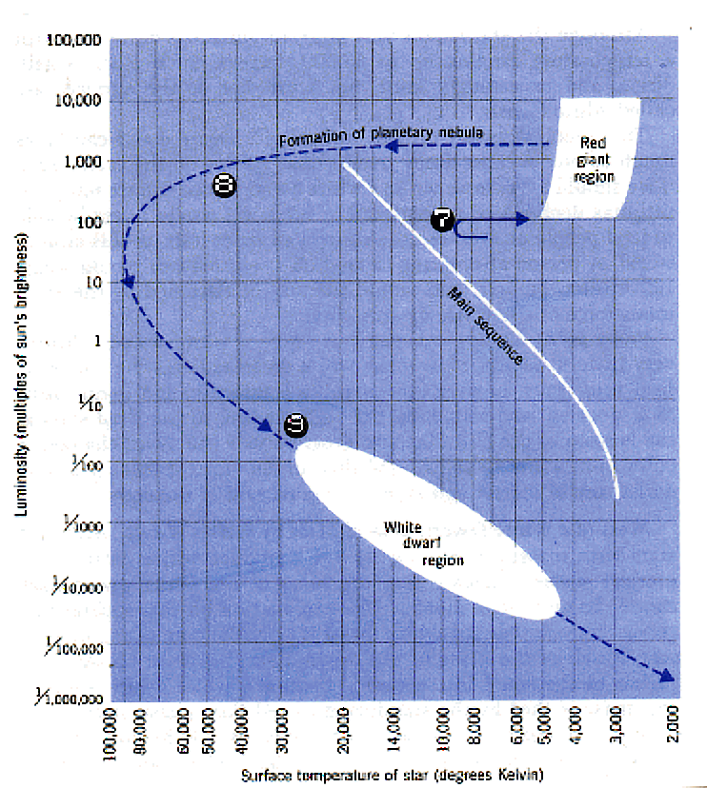

Slide 23


Slide 24
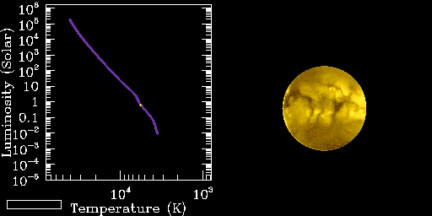
Sun’s Evolution on HR Diagram

Slide 25
ρ
dm
dr
dP

Slide 26
dI_{ν}
ds
dr
θ

Slide 28
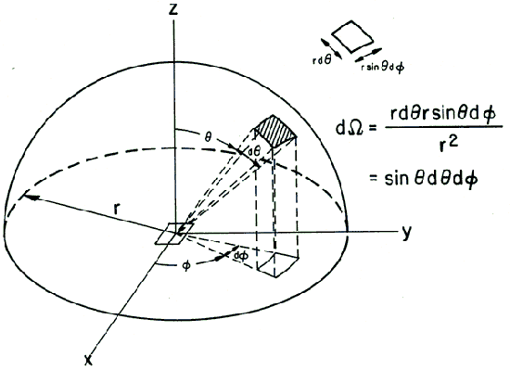

Slide 30
Energy transfer and balance equations
L+dL
If ε is the energy release per unit mass then
the energy flux change in a shell dr is:
ε
L
This is the equation for conservation
of energy (energy balance).

