Slide 1
7. Internal structure. II

Slide 2
Internal Structure II.
Equations of solar evolution
Scaling laws
Nuclear reactions: p-p chain
Convective energy transport
Solar neutrino problem

Slide 3
Energy transfer and balance equations
L+dL
If ε is the energy release per unit mass then
the energy flux change in a shell dr is:
ε
L
This is the equation for conservation
of energy (energy balance).

Slide 4
Equations of the stellar structure
Kramer’s opacity law

Slide 5
Scaling Laws

Slide 9
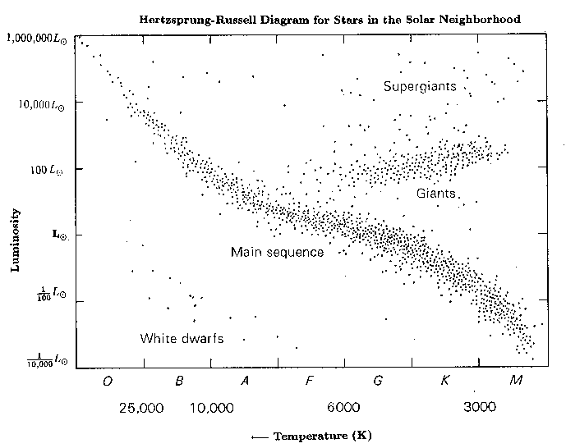

Slide 13
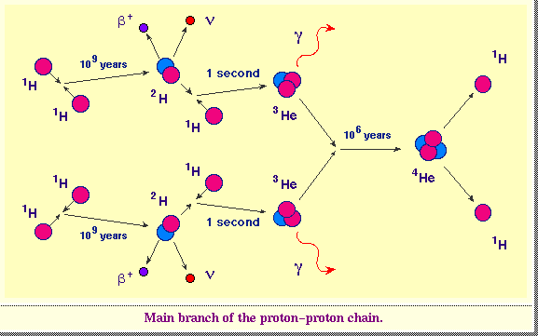

Slide 14
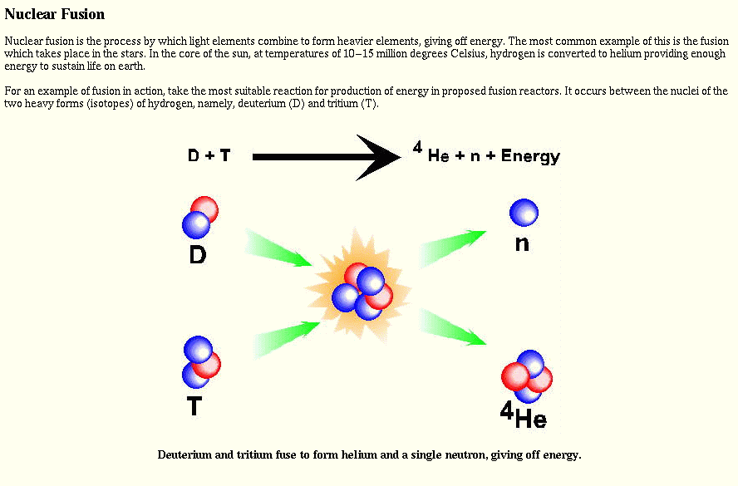

Slide 15
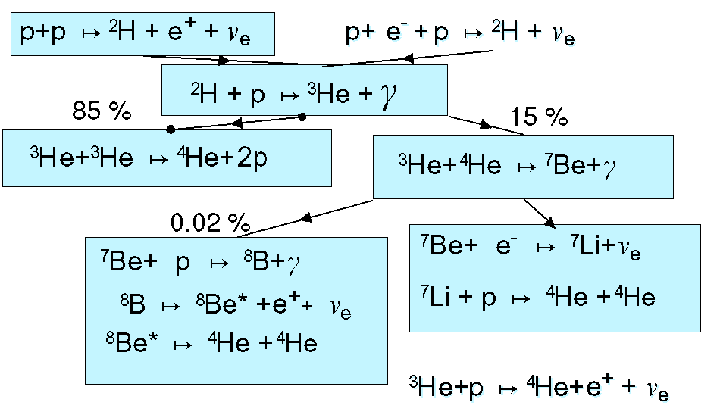
The p-p chain

Slide 16
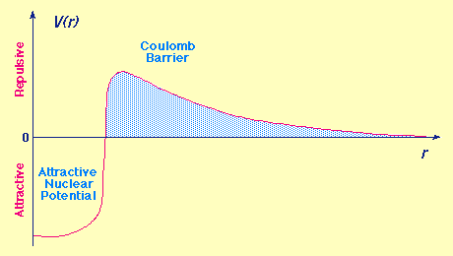
Nuclear potential

Slide 17
Particle flux: n_{α}v
Reaction cross-section: σ
1 keV
Reaction rate:
r_{αβ}=n_{α}v σ n_{β}
Coulomb barrier
Attractive nuclear
potential
density of particles β

Slide 22
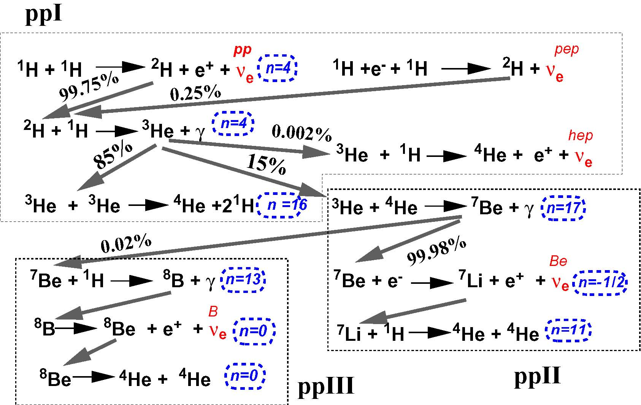

Slide 23
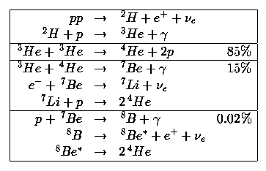

Slide 28
Another form of
Brunt-Vaisala frequency:

Slide 31
Online stellar modeling:
http://mesa-web.asu.edu/index.html

Slide 32
Standard solar model

Slide 33
Standard solar model

Slide 36
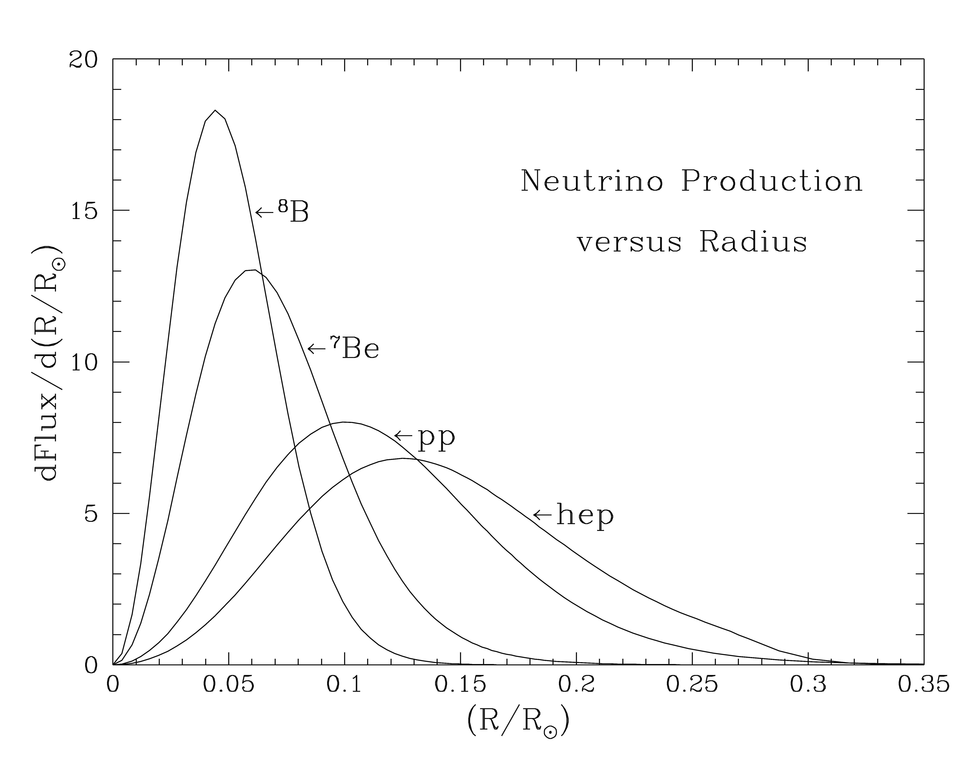

Slide 37
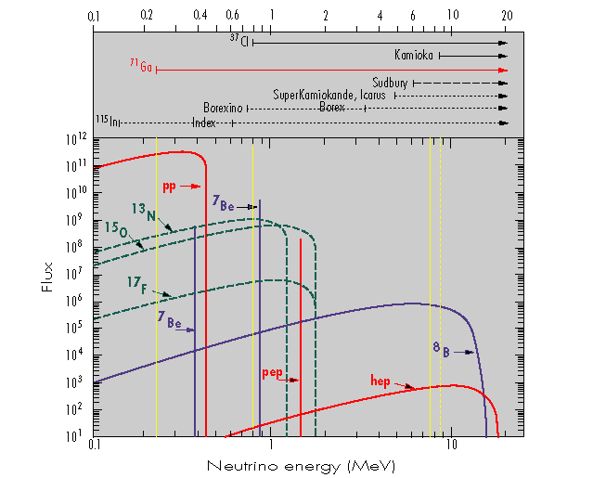
Sensitivity of various neutrino experiments

Slide 38
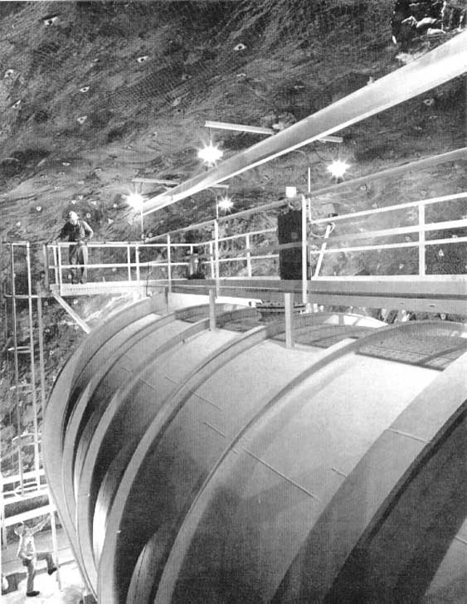
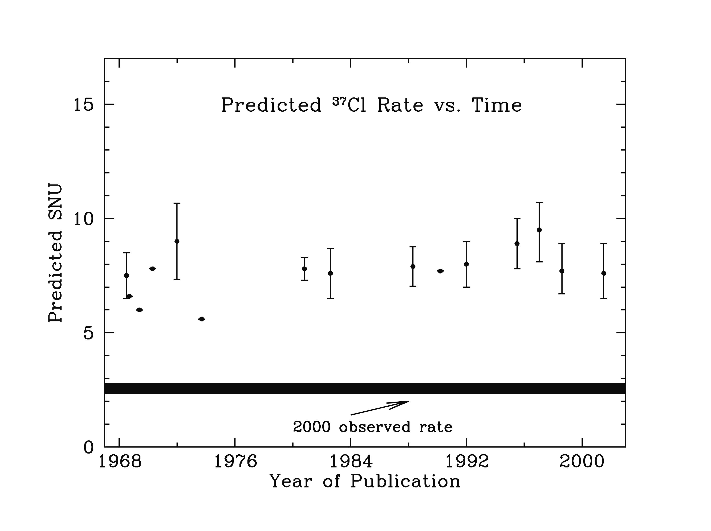
³⁷Cl detector

Slide 39
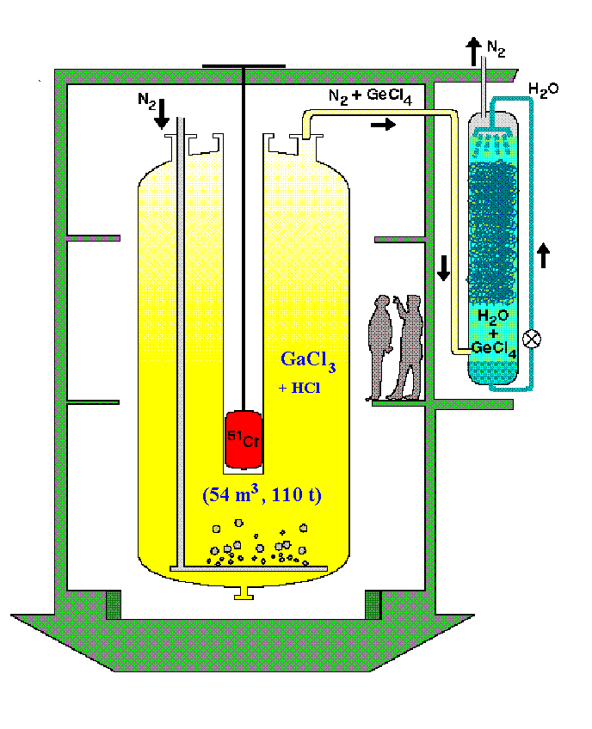
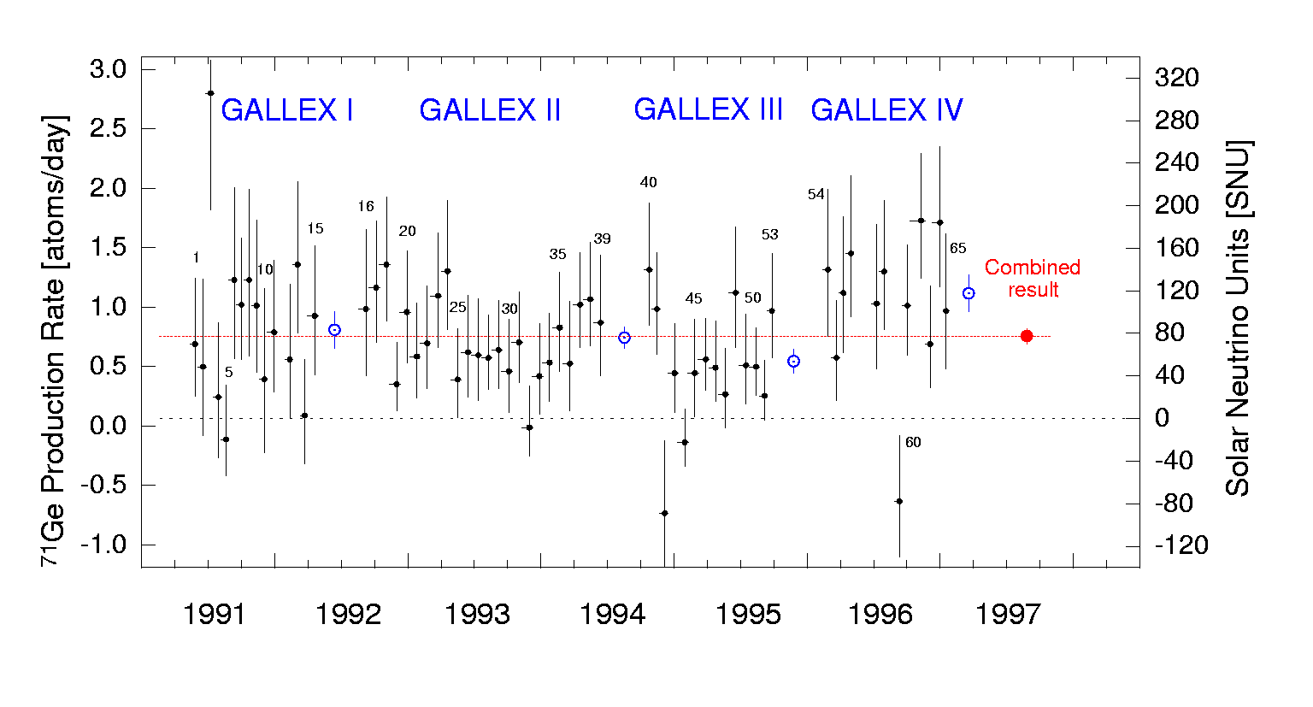
GALLEX experiment
  Result: 77.5 8 SNU
  Standard Solar Model prediction: 129.6 SNU
ν_{e} + ⁷¹Ga → ⁷¹Ge + e–

Slide 40
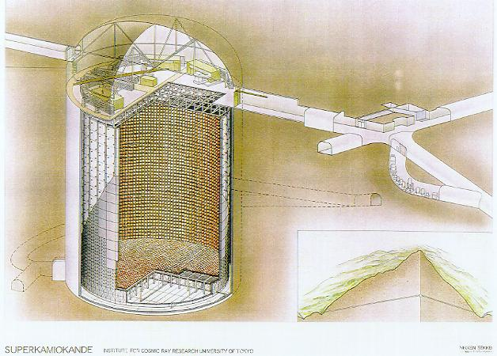
Superkamiokande (Japan)

Slide 41
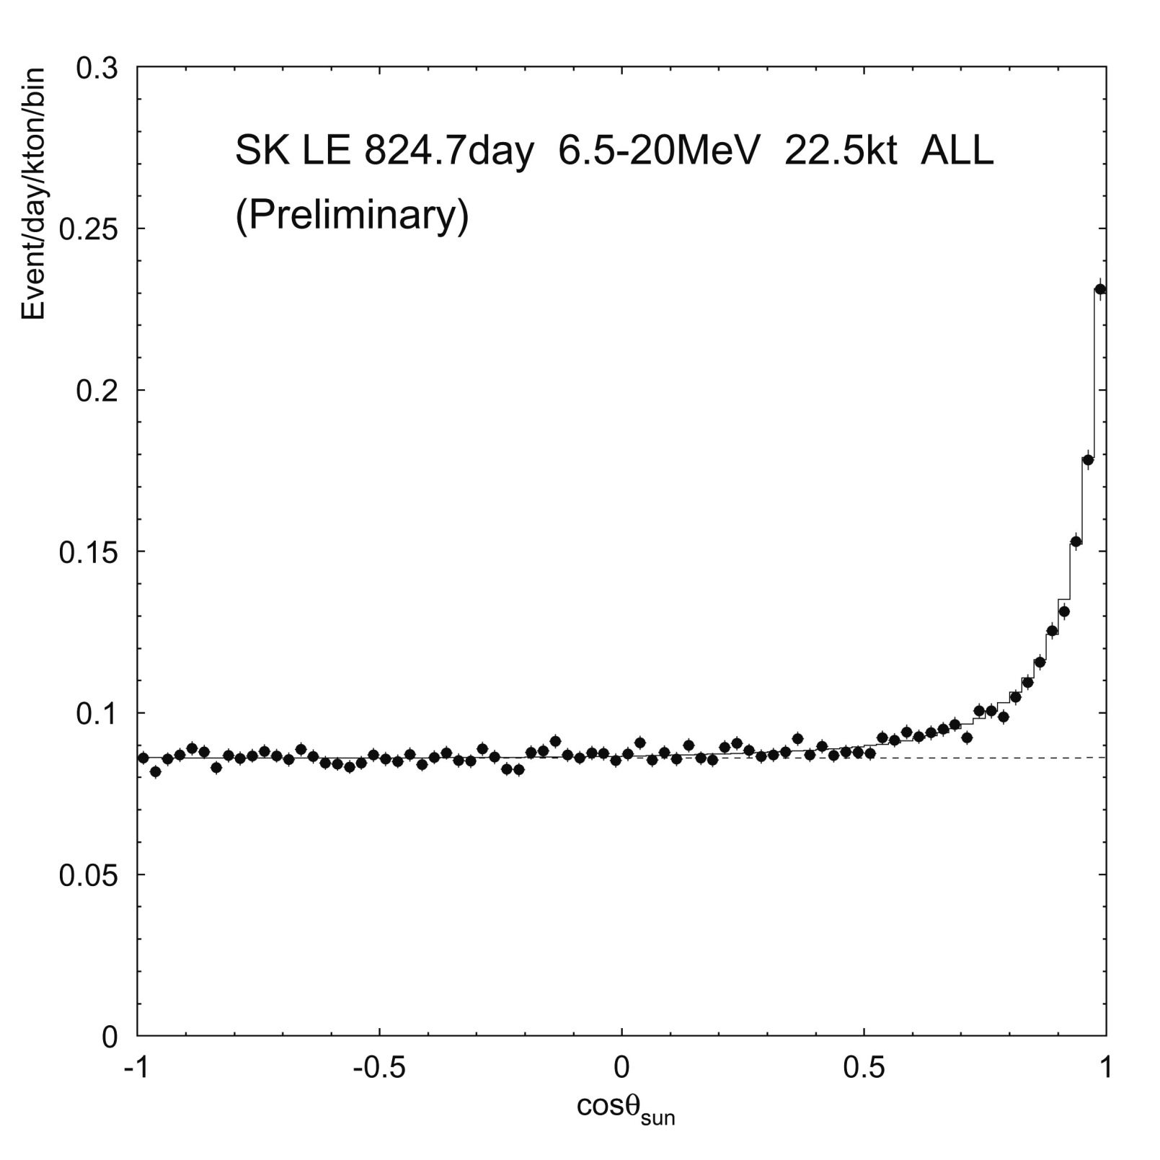

Slide 42
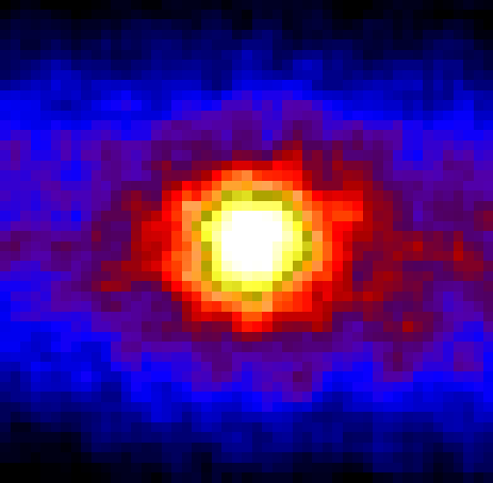
Neutrino image of the Sun

Slide 43
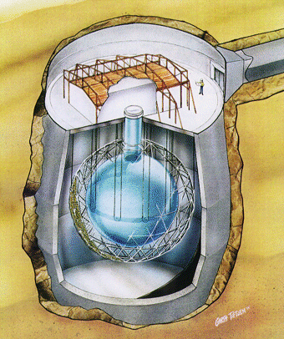
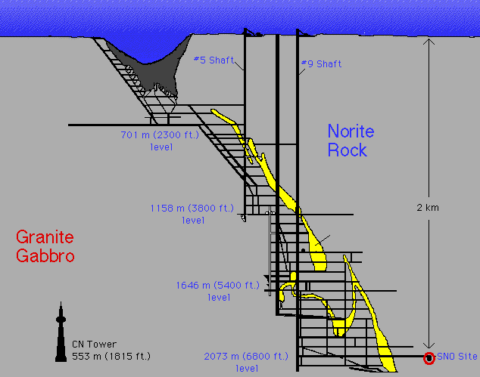
Sudbury Neutrino Observatory (SNO) measured the total flux of electron, muon and tau neutrinos and confirmed the neutrino transition from one type to another on their way from the Sun to Earth

Slide 44
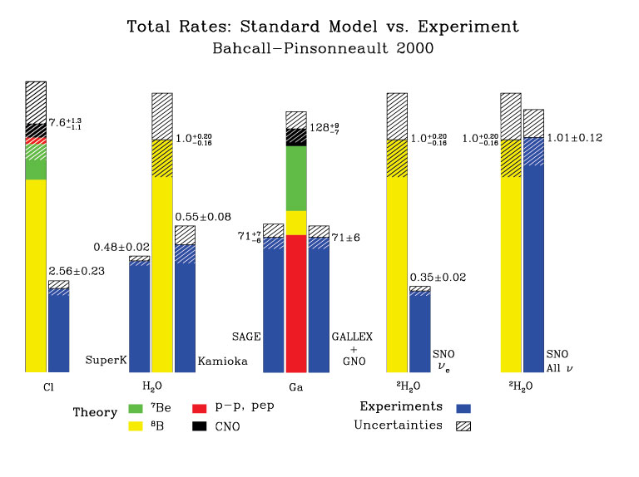
ν_{e} + ³⁷Cl → ³⁷Ar + e–.
ν_{e} + ⁷¹Ga → ⁷¹Ge + e–

Slide 45
