Slide 1
Leakage Matrices:
Then and Now
  Tim Larson
  tplarson@sun.stanford.edu
  with figures and equations shamelessly lifted from others

Slide 2
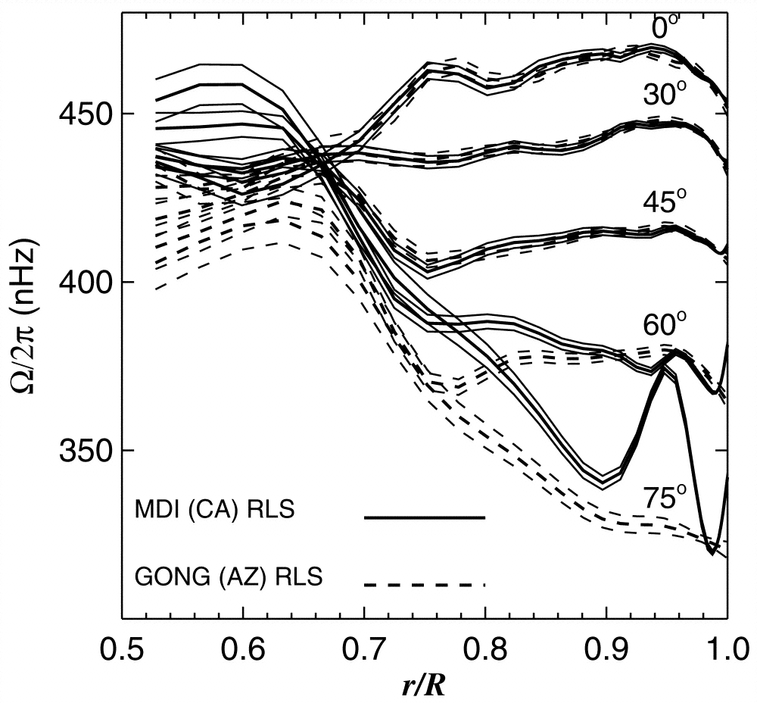

Slide 3
How I Got Started in Global Helioseismology
Discrepancies with GONG
  what doesn’t fix them in the remapping:
    using the correct MDI plate scale, correcting for cubic distortion from the optics, P angle error, Carrington inclination error, and alleged tilt of the CCD
  what doesn’t fix them in the fitting:
    improved gapfilling, asymmetric line profiles, accounting for distortion of eigenfunctions by differential rotation and horizontal displacement at the solar surface

Slide 4
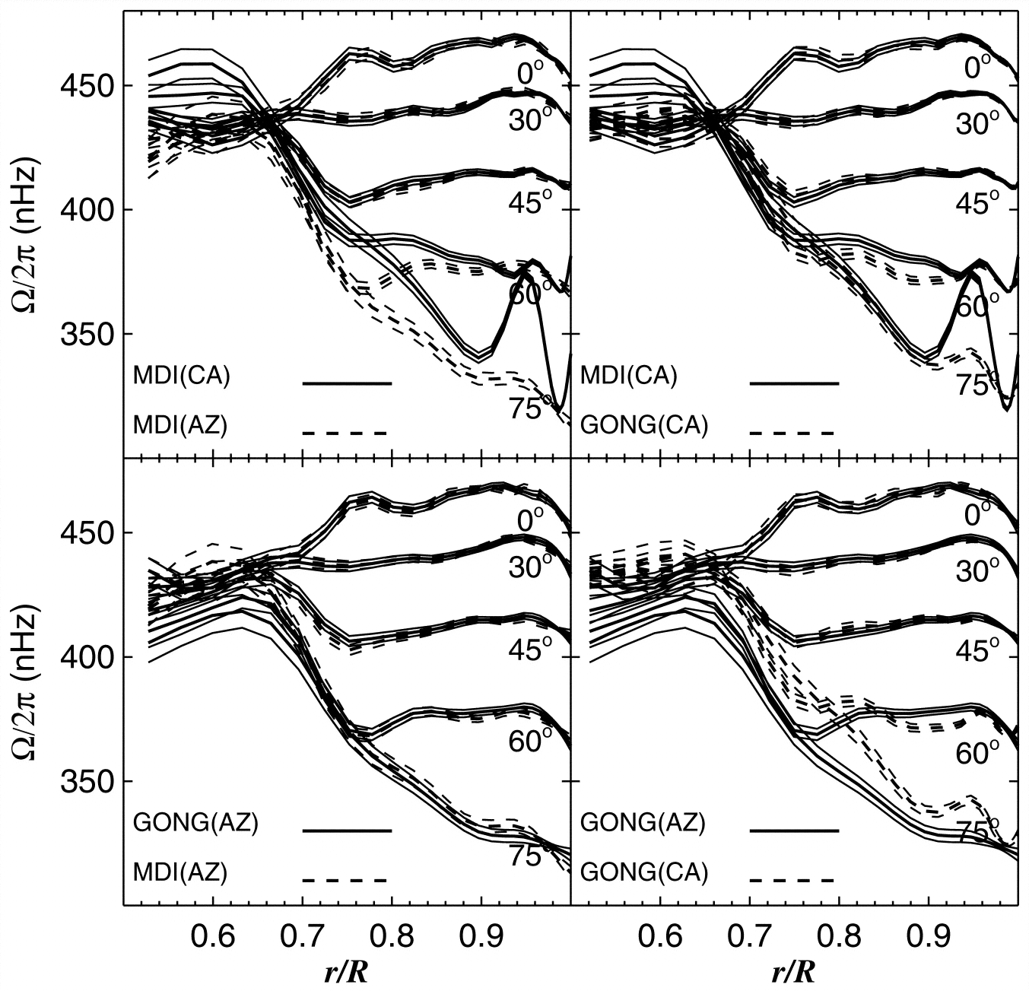

Slide 5
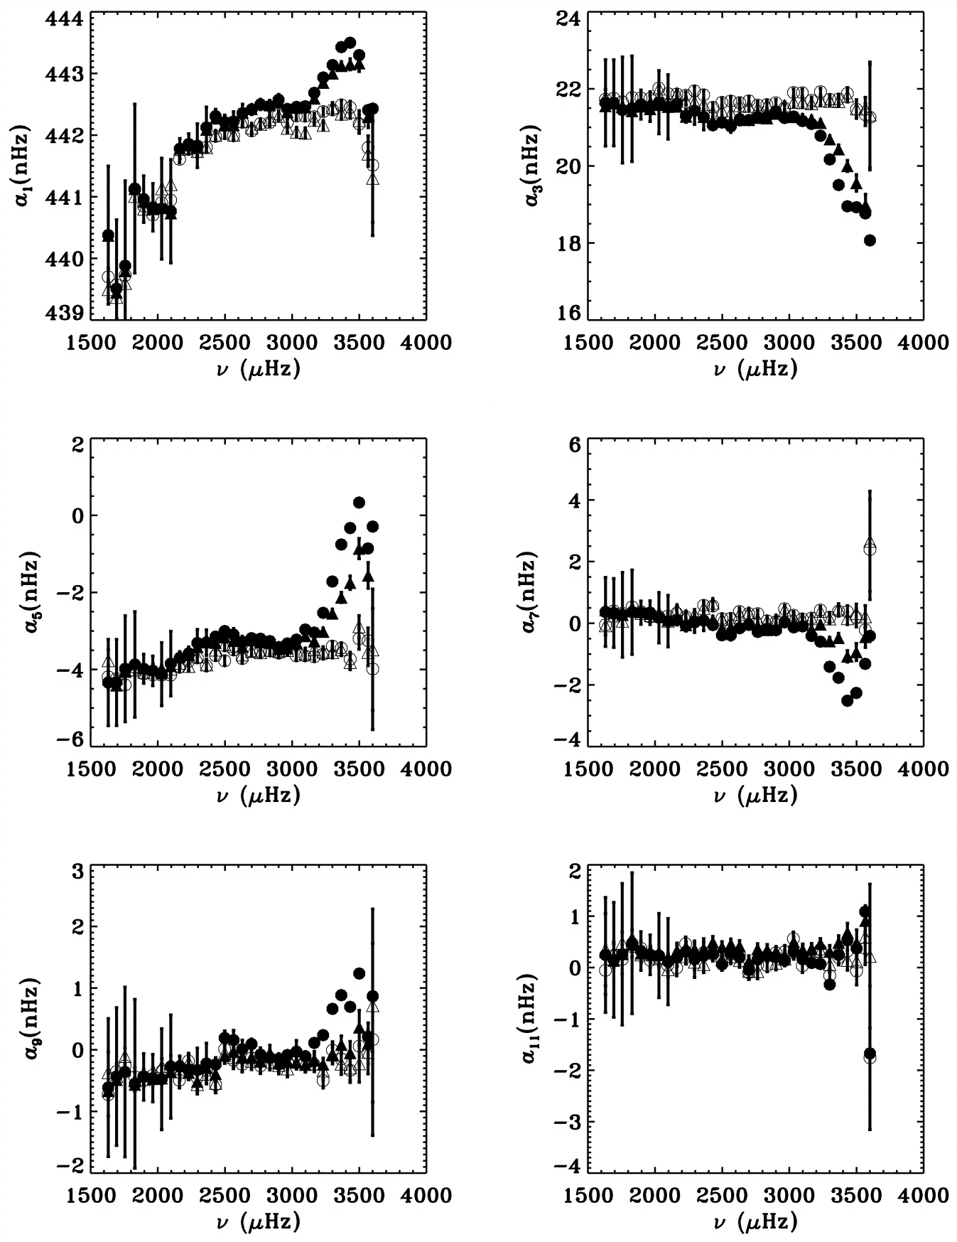

Slide 6
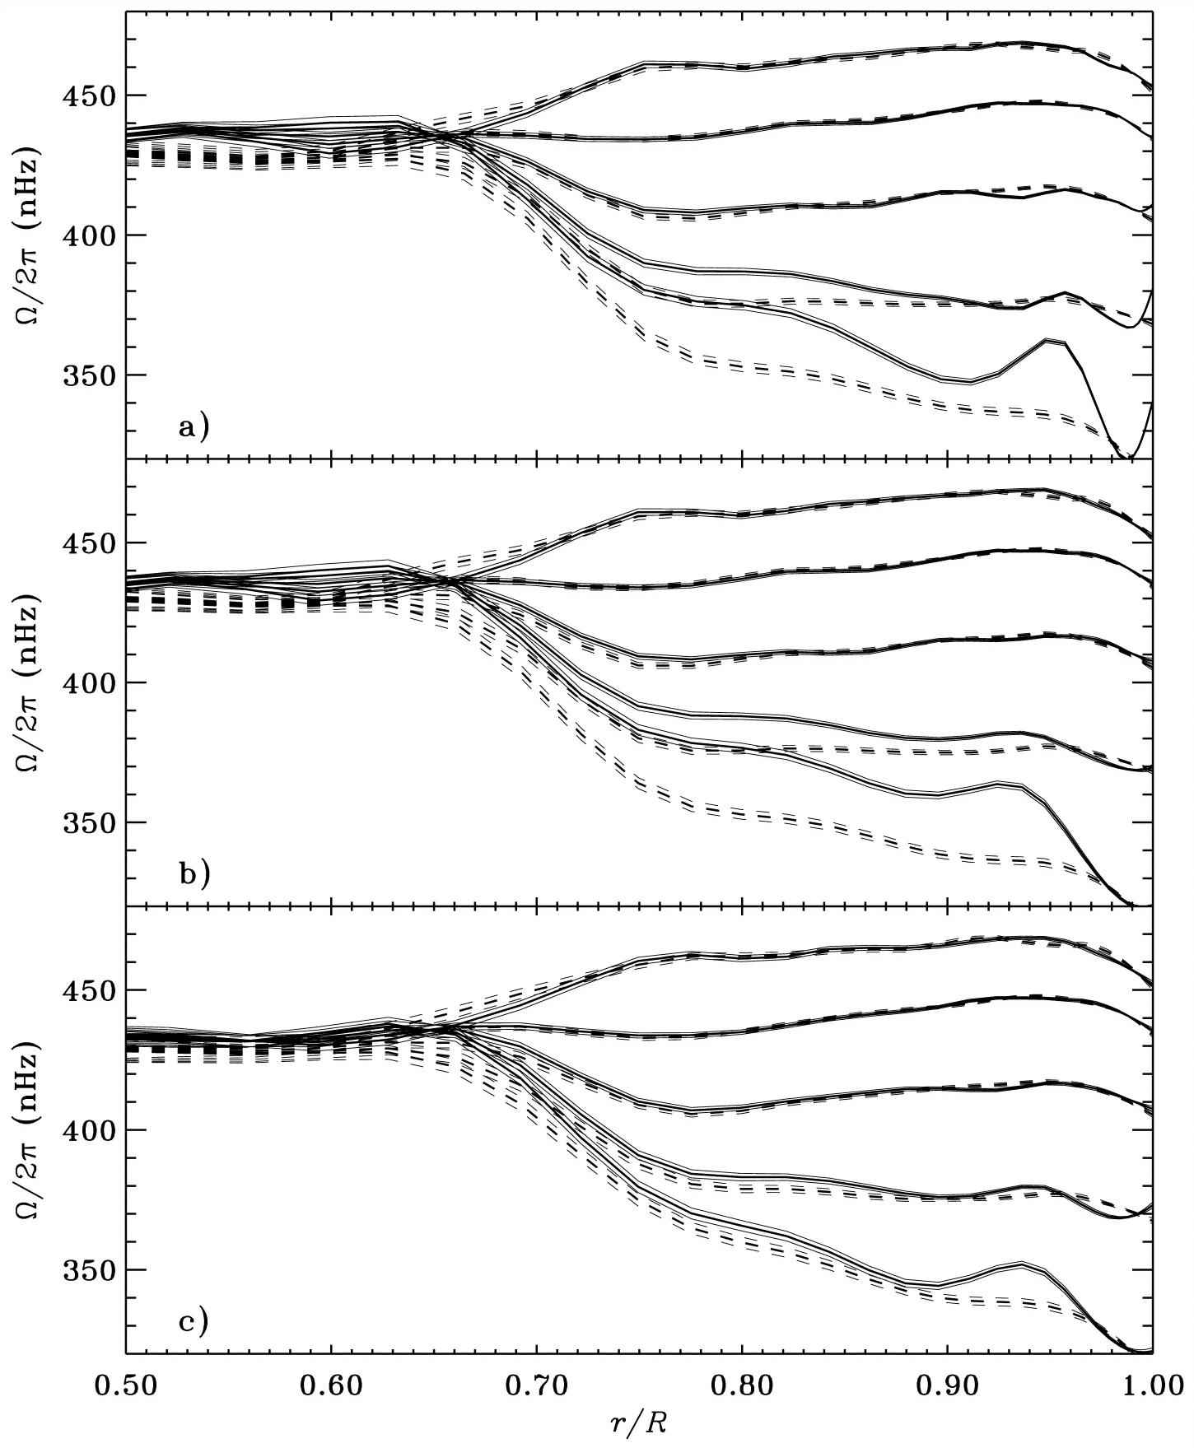

Slide 7
What is a Leakage Matrix Anyhow?
Global helioseismology pipeline
  apodize dopplergrams in image radius
  remap to uniform grid in longitude and sin(latitude)
  fourier transform in longitude, take inner product in latitude with associated legendre functions
  form timeseries of resulting spherical harmonic coefficients, detrend and fill gaps
  fit peaks in the fourier transform of these, taking leaks into account

Slide 8
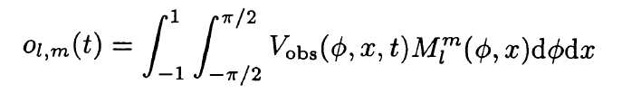
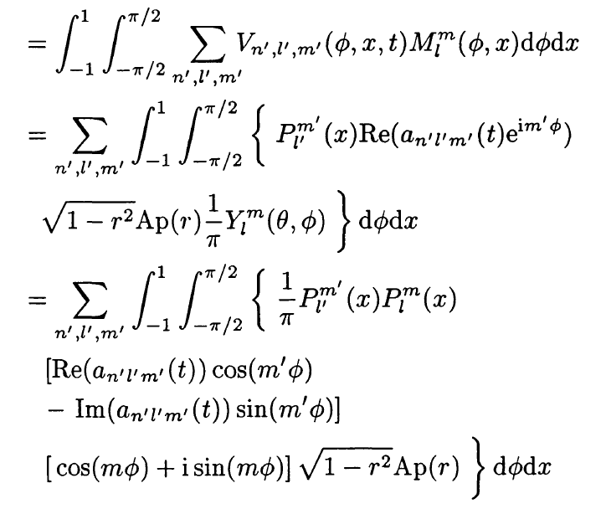

Slide 9
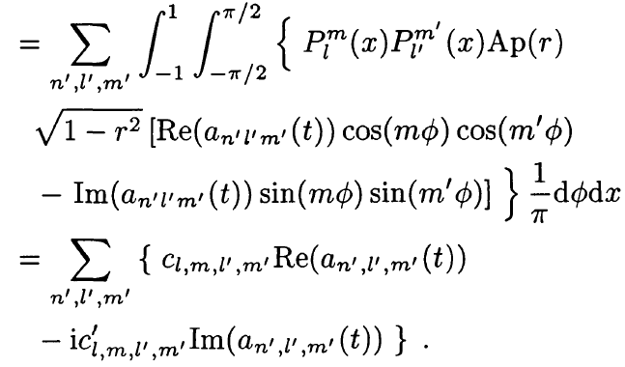

Slide 10
original leakage matrix, m=l

Slide 11
x offsets, m=l

Slide 12
real to imaginary component, m=l

Slide 13
max (bottom) and min (top) observer distance, m=l

Slide 14
b angle = 0 (solid) and b angle = 7 (dashed), m=0

Slide 15
effect of b angle

Slide 16
rotation at 75 deg

Slide 17
What’s Next?
Combine leaks from different pixel offsets
Account for cross terms
Convolve with point spread functions
Try different apodizations to get more clues
  different apodization radii and width
  elliptical apodization
  apodize in latitude/longitude rather than image radius

